Slide 1
Bias Evaluation for Web Health Surveys, A Sensitivity Analysis Approach
CDC's National Center for Health Statistics
Yulei He¹, Katherine Irimata¹, Guangyu Zhang¹, Yan Li²
¹National Center for Health Statistics
²University of Maryland
2024 Joint Statistical Meetings

Slide 2
Motivation: Web-based panel health surveys
Web-based panel surveys can be used for more timely and cost-effective health data collections
However, these surveys may be subject to lower coverage and response rates than large nationally representative surveys, leading to possibly biased estimates
Weighting can be used to correct for selection bias and improve population mean estimation
Sensitivity analysis can be further conducted to evaluate the bias from the weighting adjustment
Approach can also be used for other applications such as nonresponse weighting
2

Slide 3
Outline
Propensity score-based weighting adjustments using the causal inference framework
Possible bias of the population mean estimate due to unmeasured confounders
Numerical illustration
3

Slide 4
PS-based weighting adjustments using the causal inference framework

Slide 5
Overview: Propensity score-adjustment methods
Propensity score (PS) methods were developed by Rosenbaum and Rubin (1983) to control for confounding in treatment estimation in observational studies
Propensity score (PS)-based adjustment methods have been used in survey research as a reweighting method
PS methods use an existing high quality probability sample as a reference to align the distribution of specified variables between the target (web) survey and the reference survey
Estimated propensity scores are incorporated into the weights using various approaches such as PS weighting or PS matching
5

Slide 6
Causal inference framework
Used to understand and establish cause and effect relationships between variables
Useful for survey weighting to identify and understand variables that account for differences between the survey respondents and the population of interest (ex: due to nonresponse or coverage error)
Li et al (2022) provided guidance for variable selection in survey weighting using directed acyclic graphs (DAGs) to examine how different types of variables in the causal pathways impact the performance of PS-adjustment
6

Slide 7
DAG: Covariate types in PS adjustment
Confounder
Selection Variable
Outcome Predictor
Selection Indicator
Outcome
7

Slide 8

Key assumptions in survey weighting adjustment
Based on this DAG, Li et al (2022) assessed the impact of the covariates on the bias and variance of the population mean to guide covariate selection
Numerically and through simulation, they demonstrated
Confounders (X₁) induce bias in the estimate of the population mean (bias ≠ 0)
Now use X to generally denote confounder variables
The key assumption is
Conditional on confounder variables, the sample selection and outcome variable are independent
$$A⊥Y\left|X\right.$$
8

Slide 9
Unmeasured confounders
In practical data analysis, the included confounding variables might not be fully exhaustive
When unmeasured confounders exist, the weighting adjustment using existing confounders might not remove all selection bias
This research aims to propose a sensitivity analysis to explore possible bias of the population mean estimate of the web health survey when unmeasured confounders exist in the weighting adjustment
9

Slide 10
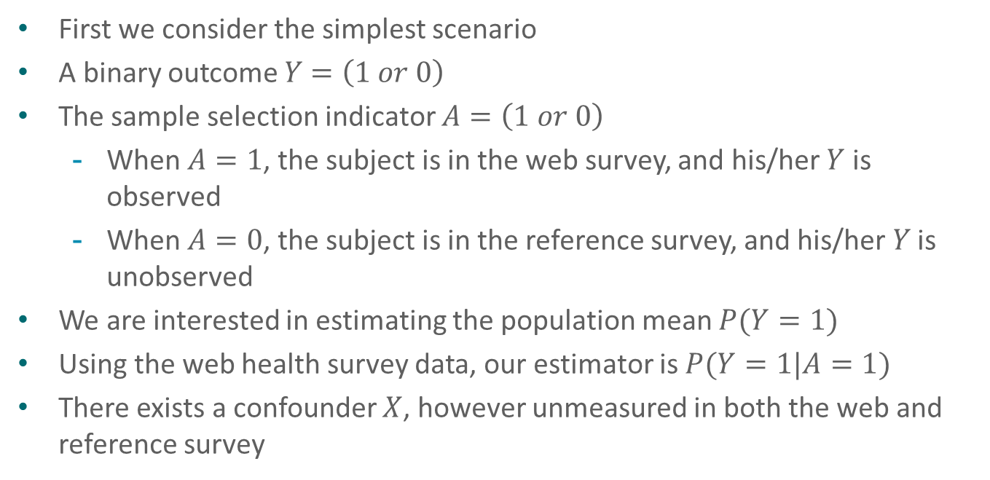
Research Strategy
First we consider the simplest scenario
A binary outcome $Y$ $=\left(1 or 0\right)$
The sample selection indicator $A=\left(1 or 0\right)$
When $A=1$, the subject is in the web survey, and his/her $Y$ is observed
When $A=0$, the subject is in the reference survey, and his/her 𝑌 is unobserved
We are interested in estimating the population mean $P(Y=1)$
Using the web health survey data, our estimator is $P(Y=1|A=1)$
There exists a confounder $X$, however unmeasured in both the web and reference survey
10

Slide 11
A Schematic Table
A | Y | X
1 | 1 | 1
1 | 1 | 0
1 | 0 | 1
1 | 1 | 0
….. | …. | ….
0 | ? | 1
0 | ? | 1
0 | ? | 0
0 | ? | 1
A=1: Web survey
A=0: Reference survey
Y: the outcome of interest (collected in the web survey and typically not in the reference survey)
X: the binary unmeasured confounder
Note: in real scenarios, the weighting adjustment would likely include multiple confounders (calibration variables) that are available in both the web and reference survey

Slide 12
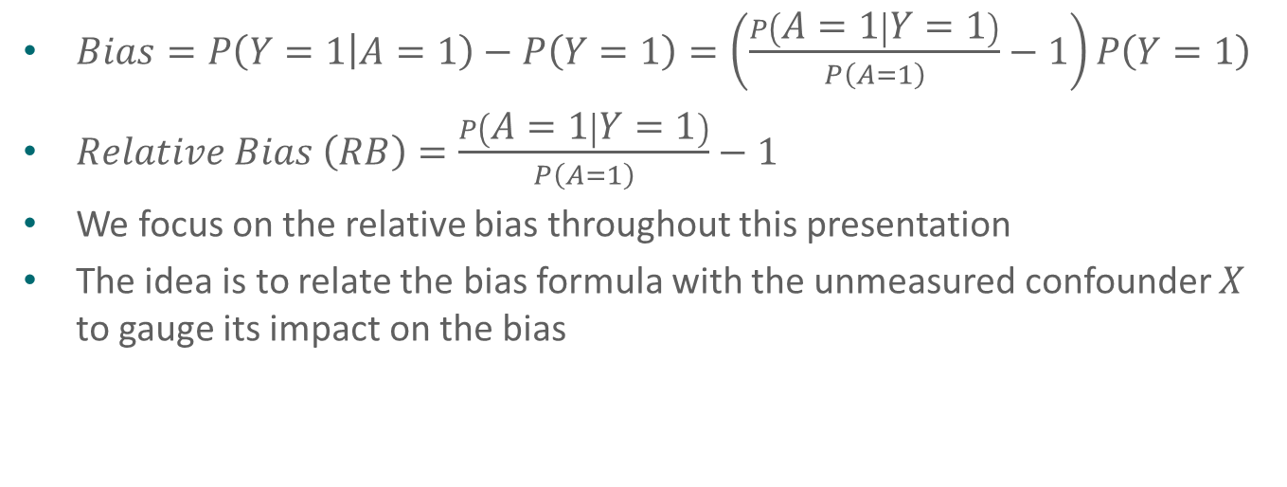
Bias Formula
$Bias=P\left(Y=1 | A=1\right)−P\left(Y=1\right)=\left(\frac{P\left(A=1 | Y=1\right)}{P\left(A=1\right)}−1\right)P\left(Y=1\right)$
$Relative Bias \left(RB\right)=\frac{P\left(A=1 | Y=1\right)}{P\left(A=1\right)}−1$
We focus on the relative bias throughout this presentation
The idea is to relate the bias formula with the unmeasured confounder $X$ to gauge its impact on the bias
12

Slide 13
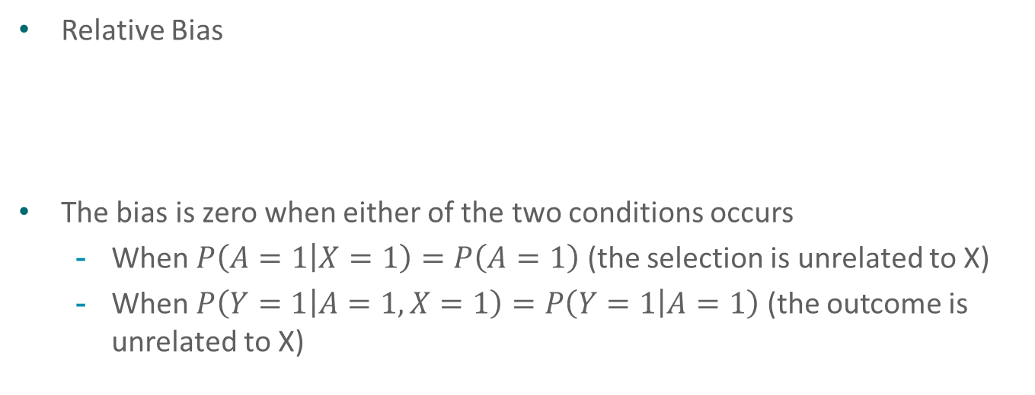
Bias Formula Using Proportions
Relative Bias
The bias is zero when either of the two conditions occurs
When $P\left(A=1 | X=1\right)=P\left(A=1\right)$ (the selection is unrelated to X)
When $P\left(Y=1 | A=1,X=1\right)=P\left(Y=1 | A=1\right)$ (the outcome is unrelated to X)
13

Slide 14
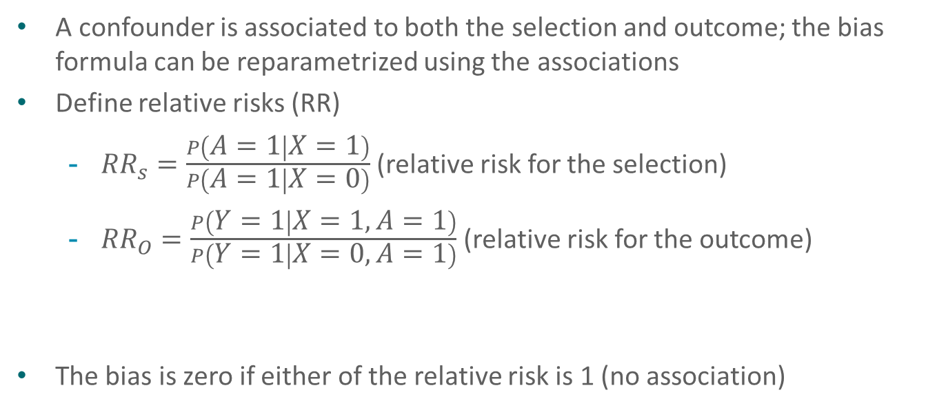
Bias Formula Using Relative Risks
A confounder is associated to both the selection and outcome; the bias formula can be reparametrized using the associations
Define relative risks (RR)
${RR}_{s}=\frac{P\left(A=1 | X=1\right)}{P\left(A=1 | X=0\right)}$ (relative risk for the selection)
${RR}_{O}=\frac{P\left(Y=1 | X=1,A=1\right)}{P\left(Y=1 | X=0,A=1\right)}$ (relative risk for the outcome)
The bias is zero if either of the relative risk is 1 (no association)
14

Slide 15
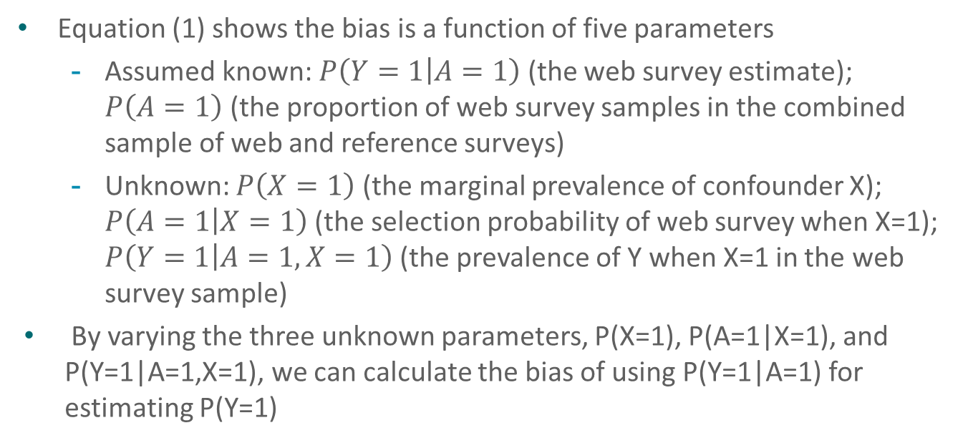
Sensitivity Analysis for Bias Evaluation
Equation (1) shows the bias is a function of five parameters
Assumed known: $P\left(Y=1 | A=1\right)$ (the web survey estimate); $P\left(A=1\right)$ (the proportion of web survey samples in the combined sample of web and reference surveys)
Unknown: $P\left(X=1\right)$ (the marginal prevalence of confounder X); $P\left(A=1 | X=1\right)$(the selection probability of web survey when X=1); $P\left(Y=1 | A=1,X=1\right)$ (the prevalence of Y when X=1 in the web survey sample)
By varying the three unknown parameters, P(X=1), P(A=1|X=1), and P(Y=1|A=1,X=1), we can calculate the bias of using P(Y=1|A=1) for estimating P(Y=1)
15

Slide 16
Bias Evaluation: Three Body (Parameter) Problem
However, the three parameters, P(X=1), P(A=1|X=1), and P(Y=1|A=1,X=1), cannot vary freely; their values are impacted by observed P(Y=1|A=1) and P(A=1)
Constraints for the three parameters
0 < P(X=1) < 1
max[0, (P(A=1)+P(X=1)−1)/P(X=1) ] < P(A = 1|X = 1) < min[1, P(A=1)/P(X=1)]
max[0, (P(A=1)P(Y =1|A=1)−P(A=1|X=0)(1−P(X=1)))/(P(A=1|X=1)P(X=1))] <
P(Y = 1|A = 1,X = 1) < min[1, (P(A=1)P(Y =1|A=1))/(P(A=1|X=1)P(X=1))]
If we reparametrize the bias using P(X=1), RR_{S} and RR_{O}, although Eq (2) does not contain P(Y=1|A=1) and P(A=1), the relative risks are still constrained by them (formulas not shown)
16

Slide 17
Bias Evaluation Strategy
What is the likely distributional characteristic of the unmeasured confounder X (i.e., its association with A and Y) to induce a given bias value?
Given P(Y=1|A=1) and P(A=1), change possible values of P(X=1), P(A=1|X=1), and P(Y=1|A=1, X=1) (or P(X=1), RR_{S} and RR_{O}) to calculate the possible bias
17

Slide 18
What is the likely association of the unmeasured confounder to induce the bias
From Eq. (2), the bias is
Positive if both relative risks are in the same direction (i.e., both > 1 or both < 1)
Negative if the relative risks are in the opposite directions (i.e., one of them is > 1 and the other is < 1)
For simplicity, suppose RR_{S} = RR_{O} (for a positive bias), we can solve for RR given the bias (RB) and P(X=1)
E.g., to induce a 10% relative bias, the unmeasured confounder X with 10% marginal prevalence must have RR=2.17 (or 0.046) with A and Y; then the question is, is this possible?
18

Slide 19
Calculate the possible bias in real scenarios
In real scenarios, the weighting adjustment for the web survey likely has already included (adjusted) multiple observed confounders
The goal of the sensitivity analysis is to demonstrate possible bias of excluding an unmeasured binary confounder
The bias formula considering observed confounders seems to be complex
However, going back to the simplest scenario, we can treat P(Y=1|A=1) as the adjusted estimate after controlling the observed confounders
P(A=1)=1/2: the weighting adjustment has likely balanced all the observed confounders
RR_{S} and RR_{O} can be understood as the residual association of the unmeasured confounder with A and Y after controlling for observed confounders
19

Slide 20
How to determine reasonable sensitivity parameters
In the PS-adjustment process, we have run logistic models
One for predicting A (the selection model)
One for predicting Y (the outcome model)
In both models, we get odds ratios (OR) from the observed confounders
Assuming OR approximately equals to RR, we might hypothesize that for the unmeasured confounder X, its residual association (after controlling for observed confounders) wouldn’t be too much deviated from the association estimates from the observed confounders; this would help set reasonable values and ranges for RR_{S} and RR_{O}
We then vary P(X) (from 0 to 1) and calculate the possible ranges of the bias
20

Slide 21
Application: Research and Development Survey

Slide 22
National Center for Health Statistics’ Research and Development Survey (RANDS)
Ongoing series of surveys conducted by the NCHS Division of Research and Methodology (https://www.cdc.gov/nchs/rands/)
Primarily recruited, web-based commercial survey panels
Designed to expand NCHS’ methodological research:
To supplement NCHS’ survey and questionnaire evaluation efforts, including the detection of measurement error
To explore ways to integrate data from commercial survey panels with high-quality data collections to produce reliable national estimates
Adapted to provide early experimental estimates on the COVID-19 pandemic (https://www.cdc.gov/nchs/covid19/rands.htm)
22

Slide 23
RANDS 3
Conducted by NORC using the AmeriSpeak Panel
Data collection: April 11-24, 2019
Mode: Web
Respondents: 2,646 (4,255 panelists invited)
Completion rate: 62.2%
Weighted cumulative response rate: 18.1%
Content: general health, opioid use, pain, probes, split sample experiment
References:
Technical Documentation
RANDS 3 Overview Report
23

Slide 24
National prevalence of ever diagnosed asthma
RANDS 3 included a question on asthma:
“Have you ever been told by a doctor or other health professional that you had asthma?” (Yes/No)
Also collected by the NHIS, a cross-sectional household survey that collects information on a broad range of health topics, used as the gold standard for evaluation
 |  | RANDS 3 | 2019 NHIS
Sample Size |  | 2,646 | 31,997
Response Rate |  | 18.1% | 59.1%
Asthma prevalence | Mean | 16.86% | 13.46%
 | Standard Error | 0.98% | 0.25%
24

Slide 25
Common covariates in RANDS 3 and 2019 NHIS
Common sociodemographic and health variables (observed confounders) can be identified for PS-weighting adjustment
Outcome: ever diagnosed asthma
Potential observed confounders: age group, sex, race and Hispanic origin, marital status, education, smoking status, ever diagnosed high cholesterol, ever diagnosed diabetes, ever diagnosed chronic obstructive pulmonary disease/emphysema/chronic bronchitis, ever diagnosed hypertension, employment status
Prior to adjustment, the RANDS 3 estimate for ever diagnosed asthma is 16.86%; after the adjustment the estimate is 14.95%
Using 2019 NHIS estimate (13.46%) as the gold standard, the adjustment achieves considerable bias reduction
25

Slide 26
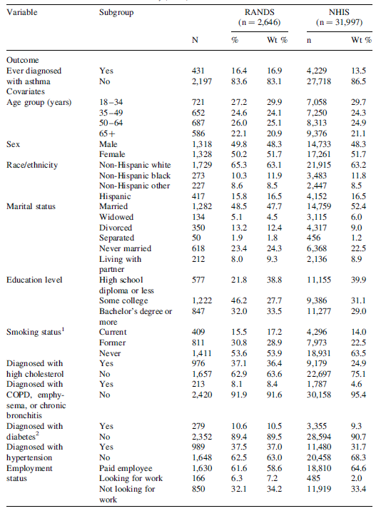
Calibration variable frequencies in RANDS 3 and 2019 NHIS
Comparisons of the potential calibration variables reveal differences in the distributions
Age, sex, and race/ethnicity had similar weighted distributions as these were used in poststratification weighting to construct the panel weights
Persons with higher levels of education, current or former smokers, and those with the selected health conditions participated in RANDS at a higher rate compared to the NHIS
26

Slide 27
Possible Association Values for the Unmeasured Confounder
Suppose there exits a binary unmeasured confounder
The outcome logistic model OR ranges from exp(-0.8)=0.45 (Younger age) to exp(1.5)=4.5 (COPD Yes)
The selection logistic model OR ranges from exp(-0.4)=0.67 (Younger age) to exp(1.3)=3.7 (Looking for work)
For simplicity, we can hypothesize for the unmeasured confounder, its RR_{O} ranges from 0.45 to 4.5, and its RR_{s} ranges from 0.67 to 3.7
We plug RR_{O}, RRs, and P(X=1) in Eq (2) to calculate the possible bias
27

Slide 28
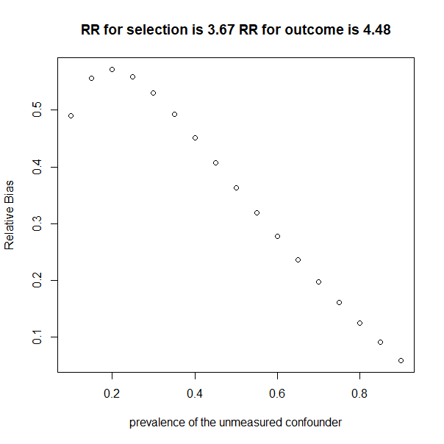
28

Slide 29
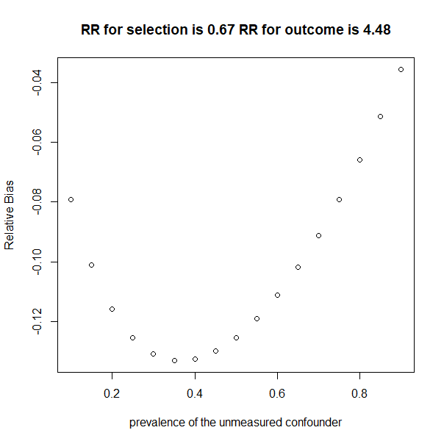

Slide 30
Discussion

Slide 31
Discussion
We propose to conduct sensitivity analysis to explore the possible bias from the weighting adjustment of the web survey estimate
We hypothesize there exists a binary unmeasured confounder
Research in progress
For association analysis using observational studies, sensitivity analysis with unmeasured confounders is very popular (e.g., E-value)
Similar sensitivity analysis might also be applied to nonresponse analysis (e.g., fundamental work laid down by Dr. Ralph Folsom Jr., who we are memorizing and celebrating his important work in today’s session)
31

Slide 32
References
Hu LYR, Scanlon P, Miller K, He Y, Irimata KE, Zhang G, Hibben KC. National Center for Health Statistics’ 2019 Research and Development Survey, RANDS 3. National Center for Health Statistics. Vital Health Stat 1(65). 2023. DOI: https://dx.doi.org/10.15620/cdc:130273.
Li Y, Irimata KE, He Y, Parker J. 2022. Variable inclusion strategies through directed acylic graphs to adjust health surveys subject to selection bias for producing national estimates. Journal of Official Statistics 38(3): 875-900.
National Center for Health Statistics. RANDS 3 Technical Documentation. Hyattsville, Maryland. 2020. https://www.cdc.gov/nchs/rands/files/RANDS3_technical_documentation.pdf
32

Slide 33
References
Pearl, J. 2009. Causality: Models, Reasoning, and Inference. Cambridge, England: Cambridge University Press, 2nd edn.
Rosenbaum, P.R. and Rubin, D.B. 1983. “The central role of the propensity score in observational studies for causal effects.” Biometrika, 70, 41–55. https://doi.org/10.1093/biomet/70.1.41.
33

Slide 34
Contact Information:
Yulei He
wdq7@cdc.gov

