Slide 1

Nonresponse weighting: a Bayesian perspective
Rod Little

Slide 2
Ralph Folsom
Honored to talk at this memorial session for Ralph Folsom
A prolific career at RTI and engaging speaker at many JSM’s over the years
Shared interests on sample survey inference, survey nonresponse
Ralph’s perspective was design-based, whereas I view (calibrated) Bayes as the best overarching paradigm for survey inference (e.g. Little (2022)
Discuss here:
The appropriate definition of response propensity (Little 2021)
The Bayesian perspective on nonresponse weighting and the use of poststratification information in survey estimates (Zangeneh & Little 2022)

Slide 3
Setting: unit nonresponse
Z: Design variables observed for whole population
X: Fully observed survey variables X, measured for respondents and nonrespondents (can include paradata)
Y: Survey variables measured only for respondents, R = response indicator
Goal of nonresponse weighting is to use information in X and Z to weight the respondents, improve estimates
Goal of a prediction model is to predict the values of Y for nonrespondents (and nonsampled units)
Sample Pop
1
0

Slide 4
Unit Nonresponse Weights
“With nonresponse, each unit i is typically assigned a probability of response given that it is selected, say θ_{i} ” (Platek and Gray, 1983, Ch. 17 in “Incomplete Data in Sample Surveys, Vol 2)
If probability of response was known, we could obtain weight for units that are selected and respond:
Response probability is unknown, so it needs to be estimated… but how is it defined? A lot of factors potentially affect an individual’s probability of responding…

Slide 5
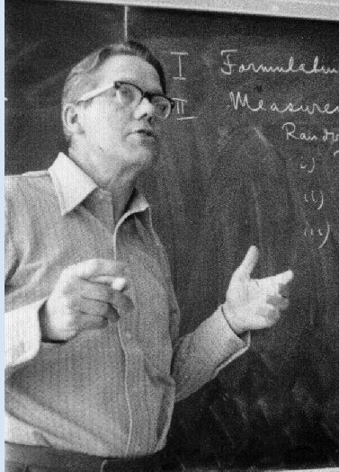
Torre Dalenius (1983, Incomplete Data in Sample Surveys Vol 3)
“it appears utterly unrealistic to postulate fixed “response probabilities” which are independent of the varying circumstances under which an effort is made to elicit a response. Whether an individual selected for a survey will respond or not may in many instances be determined by factors external to the individual.
In an interview survey, for example, a black individual may respond if the interviewer is also black, but may not respond if the interviewer is white. In other words, for this individual there is no unique [θ_{i}] value, but possibly a wide spectrum of [θ_{i}]-values… … In summary, I am inclined to reject approaches to the nonresponse problem which involve ‘response probabilities’.”

Slide 6

Dan Hedlin (2020 Int. Statist. Rev.)
a population unit is assumed to have propensity (probability)
“a population unit is assumed to have propensity (probability) θ_{i} to respond to a particular survey at a particular a probability point in time, using the survey protocol. While this probability may be philosophically baffling to interpret, it seems to be a very useful construct” (italics are mine)
Need to clarify what variables response is conditioned on…

Slide 7
What should response propensity condition on?

Slide 8
Conditioning on d_{i} is sufficient

Slide 9
Example: MAR

Slide 10
A missing not at random model: the Heckman selection model

Slide 11
Monotone longitudinal data

Slide 12
Summary
For a cross-sectional survey, the propensity should condition only on variables D = (Z, X, Y), where Y are the survey variables subject to nonresponse, Z are survey design variables, and X are variables measured for respondents and nonrespondents in the sample.
The propensity should not condition on latent variables or variables other than Y observed for respondents but not nonrespondents, whether or not such variables are related to nonresponse.
These definitions allow for MNAR missing data when missingness depends on Y, but the MAR assumption remains important in practice because it facilitates estimation from the available data.
I also outlined a modification for a longitudinal survey with a monotone pattern of nonresponse.

Slide 13
Weights as covariates
In the modeling perspective, sampling and nonresponse weights are predictors:
Regression (unlike weighting) reflects the strength of the relationship between the weight and the survey outcome
Regressing on the spline of the propensity provides model robustness
See Penalized Spline of Propensity Prediction (Zheng & Little 2003, 2005; Zhang & Little (2009)

Slide 14
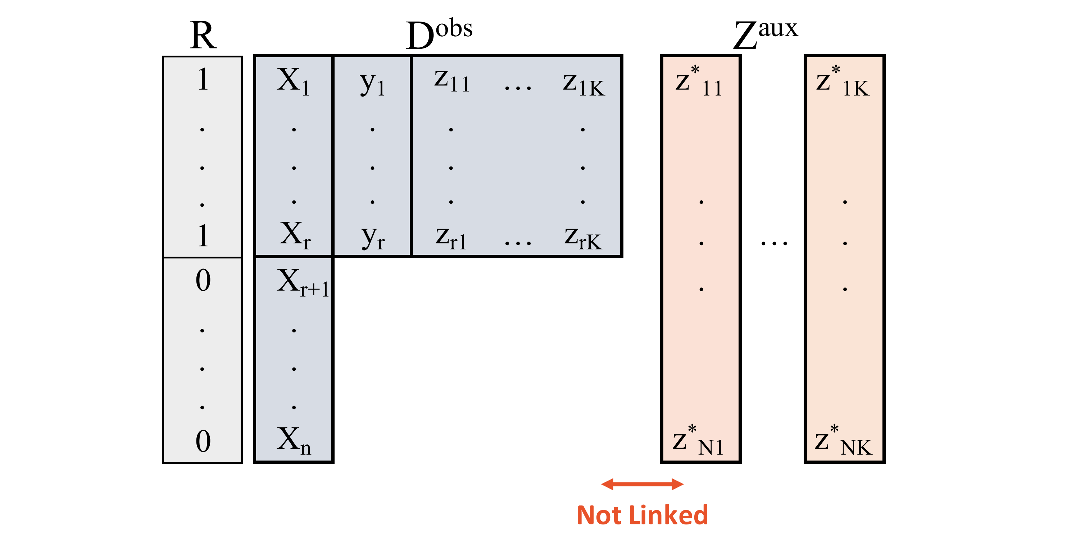
Survey nonresponse with post-strata

Slide 15
Basic model factorization

Slide 16
Case 1: No X, One categorical Z
Conditional distribution of Y given Z estimated from survey respondents
Marginal distribution of Z from auxiliary margin
Note: response mechanism is MNAR but ignorable!

Slide 17
Case 2: One categorical X, One categorical Z
Distribution of Y given X and Z from survey respondents
Distribution of (X, Z, R) from auxiliary margin from available data: now not identified without assumptions
“Rake Model:” assume marginal distributions of X and Z are differ for R =1 and R = 0, but odds ratios are same. Resulting model is just identified, and ML estimate of mean of Y is
Of theoretical interest: response mechanism is missing not at random but ignorable!

Slide 18
Comments on Case 2
This is an MNAR model: MAR assumes that response depends on X but not on Z. The method tends to be better than alternative methods that assume MAR for consistent estimates
ML approach does not modify the implied weights applied to the data in cell X = j, Z = k using arbitrary distance functions (e.g. Deville and Särndal 1992) – ML estimates are fully efficient under the assumed model
Sparse data in the cells can be addressed by adding proper prior distributions for the parameters and applying Bayesian methods
Raking to X and Z margins is familiar, but note that if X is a stratifier and Z is a post-stratifier, one standard approach is not to iterate

Slide 19
Conclusion: I have…
Discussed appropriate definition of response propensity for survey nonresponse
Described the likelihood-based approach to nonresponse with post-stratification, allowing certain MNAR models to be identified
Thanks for listening!

Slide 20
References
Deville, J. -C. and Särndal, C. E. (1992). Calibration estimation in survey sampling, JASA, 87, 376-382.
Little, R.J. (2021). A Note About the Definition of Propensity Weights. Journal of Survey Statistics and Methodology. 10 (4), 1098-1106.
Little, R.J. (2022). Bayes, buttressed by design-based ideas, is the best overarching paradigm for sample survey inference. Survey Methodology, 48, 2, 257-281.
Little, R.J. (2022). Some reflections on Rosenbaum and Rubin’s propensity score paper. Observational Studies, 9, 1, 69-75.
Little, R.J.A. & Vartivarian, S. (2005). Does weighting for nonresponse increase the variance of survey means? Survey Methodology, 31, 161-168. {330}
Zangeneh, S.Z. and Little, R.J. (2022). Likelihood based estimation of the finite population mean with post-stratification information under nonignorable nonresponse. International Statistical Review, 90. S17-36.
Zhang, G. & Little, R. J. (2009). Extensions of the penalized spline of propensity prediction method of imputation. Biometrics, 65, 3, 911-918.
Zheng, H. & Little, R.J. (2003). Penalized spline model-based estimation of the finite population total from probability-proportional-to-size samples. Journal of Official Statistics, 19, 2, 99-117.
Zheng, H. & Little, R.J. (2005). Inference for the population total from probability-proportional-to-size samples based on predictions from a penalized spline nonparametric model. Journal of Official Statistics, 21, 1-20

