Slide 1
Testing Monotone Bias via a
Semi-parametric approach
Zixiang Xu^{[1]}, Jiayang Sun^{[1]}, Mary Meyer^{[2]}, Michael Woodroofe^{[3]}
[1]George Mason University, [2]Colorado State University, [3]University of Michigan - Ann Arbor
Notes:
Hello everyone,
My topic today is …
I won’t go into theoretical detail, and I’ll make sure you can get the idea behind the tests.
Names: me, advisor, based on a previous paper by … , And one of our test is extending that previous paper.
Meanwhile, Dr. Meyer also suggests an alternative test using spline method with similar idea, which she has proofed to have nice properties.
I’ll focus on the extended test from previous paper by ,,, today, since we only have 15mins here.

Slide 2
Outline
What & Why?
Estimation → Test
Performance (power curves)
More
Notes:
Here is the outline,
First im gonna introduce the motivation, what is monotone bias and why are we interested in monotone bias.
Second, I’ll briefly go through the estimation procedure and how do we form the test based on the estimation.
After that, I’ll show our simulation result, and if time permits, I can extend some details.

Slide 3
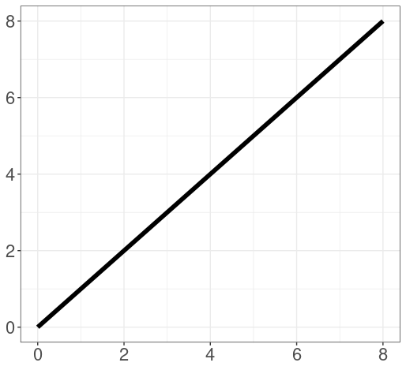
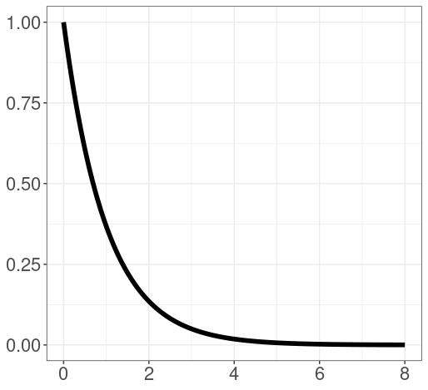
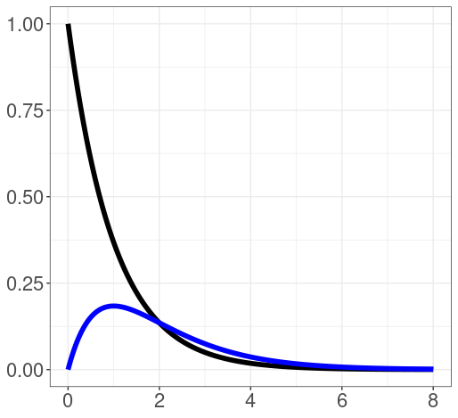


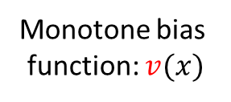
What & Why?
Monotone bias
function: $v(x)$
Ideally: $f_{θ}\left(x\right)$
Observed: ${v\left(x\right) f}_{θ}\left(x\right)/κ(v,θ)$
Notes:
So we’ll begin with the motivation of the test.
Consider the case that we have a bunch of samples.
We know that, ideally, they have density f, e.g., we know they are from an exp dist, although we don not know the exact value of parameter theta.
However, in reality, the samples we observed are subject to a monotone bias function.
i.e., for larger sample x, we have a higher chance to observe it.
So combing with the monotone bias function v, the samples we truly observed should have a density of this form, where v & theta are unknown but we do know f (like exp/normal density).
And kappa here is the normalizing constant, which is the integral of vf, making “this” a valid density (integral to 1), and of course it’s affected by v and theta.
This is actually common in real application, e.g., when astronomers gather the luminosity information from stars, the stars with higher luminosity have a higher probability to be observed. So the observed data would possibly be biased. And that’s why we wanted to develop a way to identify the monotone bias and see if we can correct them.

Slide 4

What & Why?
Monotone bias
function: $v(x)$
Ideally: $f_{θ}\left(x\right)$
Observed: ${v\left(x\right) f}_{θ}\left(x\right)/κ(v,θ)$
Given: $x_{1},…,x_{n}∼{v\left(x\right) f}_{θ}\left(x\right)/κ(v,θ)$,
Test: $H_{0}:v≡d$ vs. $H_{A}:v$ is monotone increasing.
Notes:
And now our target is that given …, we want to test if there is a monotone selection bias, i.e., …

Slide 5
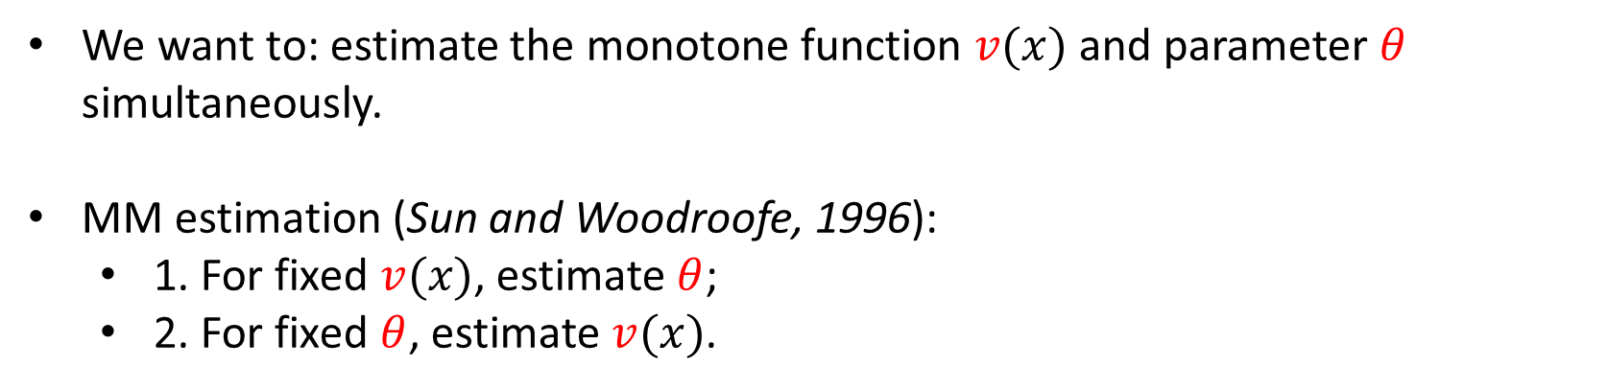

Estimation → Test
Given: $x_{1},…,x_{n}∼{v\left(x\right) f}_{θ}\left(x\right)/κ(v,θ)$,
Test: $H_{0}:v≡d$ vs. $H_{A}:v$ is monotone increasing.
We want to: estimate the monotone function $v(x)$ and parameter $θ$ simultaneously.
MM estimation (Sun and Woodroofe, 1996):
  1. For fixed $v(x)$, estimate $θ$;
  2. For fixed $θ$, estimate $v(x)$.
Notes:
Now, with this target, we shall certainly first estimate the unknown things here. Once the red-colored-unknown things are all estimated, forming the test would be easy. i.e., we need to …
And immediately, we would have the idea of MM estimation algorithm, which is a simple iterative approach.
We just fix v and estimate theta by maximizing the likelihood function. And then fix … …
Since we are maximizing the likelihood at each time, that’s why the algorithm is called MM estimation.
And it’s guaranteed to converge to the unique maxima under some minor conditions.
Okay, notice that for the first step, estimating theta when v is fixed, we only need to take the derivative of llh and set it to 0. Finding the solution would be easy since the likelihood is concave.
But the second step is more complicated,

Slide 6
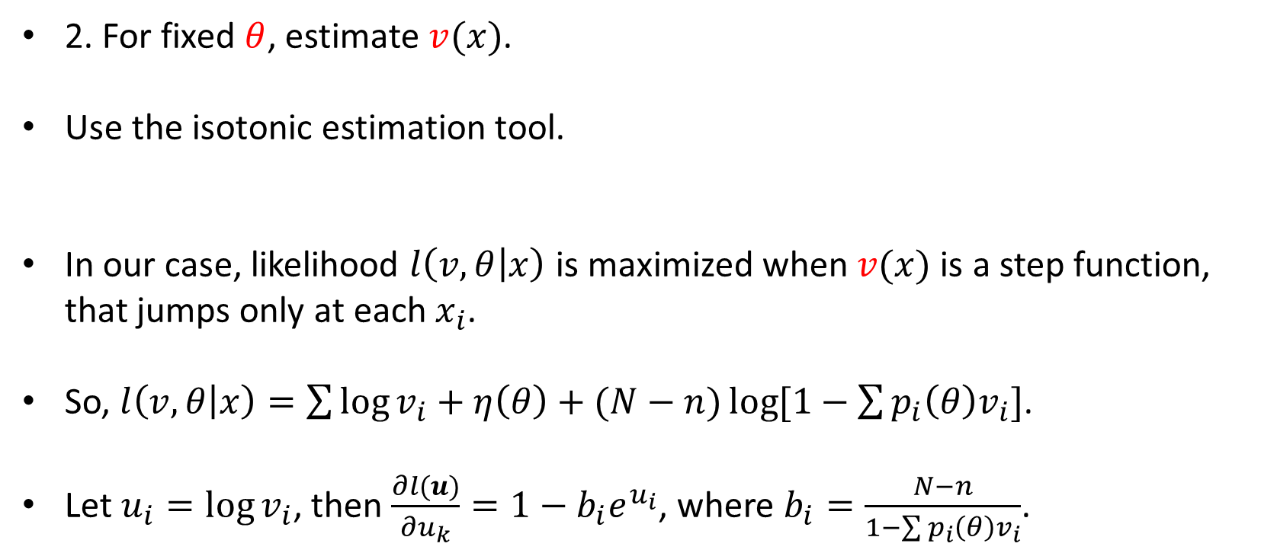
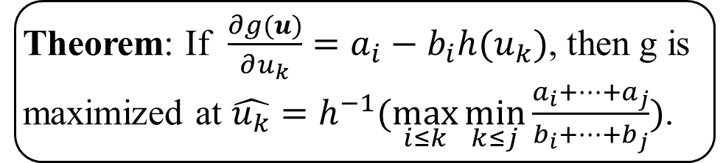
Estimation → Test
2. For fixed $θ$, estimate $v(x)$.
Use the isotonic estimation tool.
In our case, likelihood $l\left(v,θ | x\right)$ is maximized when $v(x)$ is a step function, that jumps only at each $x_{i}$.
So, $l\left(v,θ | x\right)=\sum{\log{v_{i}}}+η\left(θ\right)+(N−n)\log{[1−\sum{p_{i}\left(θ\right)v_{i}}]}$.
Let $u_{i}=\log{v_{i}}$, then $\frac{∂l(u)}{∂u_{k}}=1−b_{i}e^{u_{i}}$, where $b_{i}=\frac{N−n}{1−\sum{p_{i}\left(θ\right)v_{i}}}$.
Theorem: If $\frac{∂g(u)}{∂u_{k}}=a_{i}−b_{i}h(u_{k})$, then g is maximized at $\hat{u_{k}}=h^{−1}(\max_{i≤k}{\min_{k≤j}{\frac{a_{i}+…+a_{j}}{b_{i}+…+b_{j}}}})$.
Notes:
And that’s where we need the isotonic estimation tool.
It’s not possible to cover all the derivation steps in this short time today, so I’ll pick a few crucial points here and go through them quickly.
If you are not familiar with isotonic regression, you’ll just have to know that: we had a way to estimate v. And don’t be worried, it won’t affect the following pages, You’ll still be able to understand the ideas and results even if you skip this page.
Okay, the derivation was based on this theorem: …
Note that in our case, …
So, …, where v is , eta, N, pi.
And if we let …,
So, by applying this theorem, we can get an estimations of uk, logvi, vi, v.
If you are interested in this part, we can discuss later..

Slide 7
Estimation → Test
Test statistic
$$\hat{Λ}=l\left(\hat{v},\hat{θ};\vec{x}\right)−l({\hat{v}}_{0}≡1,{\hat{θ}}_{0};\vec{x})$$
Notes:
Now with v and theta estimated, forming the test is easy.
It’s basically a likelihood ratio test, the log-likelihood under alternative minus the llh under null,
Where under null, we assume v=1, which means there’s no bias. And theta_0 is estimated by simple MLE.

Slide 8
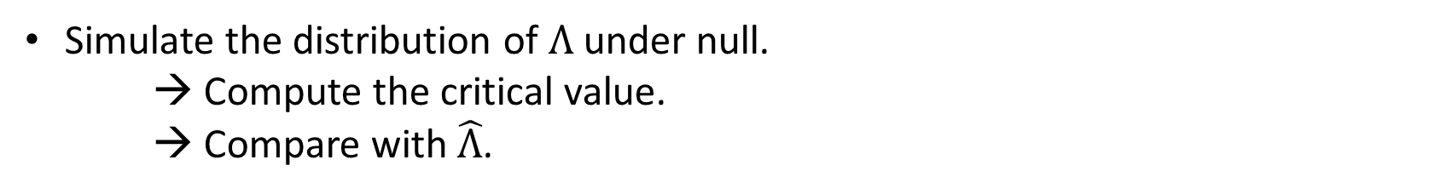
Estimation → Test
Test statistic
$$\hat{Λ}=l\left(\hat{v},\hat{θ};\vec{x}\right)−l({\hat{v}}_{0}≡1,{\hat{θ}}_{0};\vec{x})$$
Simulate the distribution of $Λ$under null.
→ Compute the critical value.
→ Compare with $\hat{Λ}$.
Notes:
And the way of performing the test is quite classic.
We just compare our estimated test statistic with the critical value.
And the critical value is obtained by easy simulation.

Slide 9
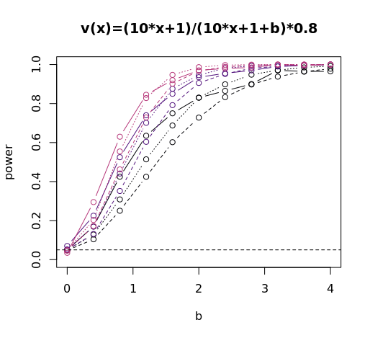

Performance (power curves)
Comparing to:
  1. K-S test (assuming $θ$ is known)
  2. A-D test (assuming $θ$ is known)
Setting:
  $f_{θ}\left(x\right)=θe^{−θx}$
  $v\left(x\right)=0.8∙\frac{10x+1}{10x+1+b}$
Notes:
Here is the performance part, where we want to show that the power of our test is better than other different tests, of course under the monotone bias case.
E.g. here, the plot shows the power of our test and the power of ks test as well as Anderson-darling test, they can all test if the sample is from the given dist.
The setting of this example is simple, the null dist is exp. And the bias … , where b is a constant that affects the biasness of the bias function – larger b means bigger bias, b=0 means no bias.
In the plot, b is the x axis, and we increase b from 0 to 4. And y axis is the power. Like here (0,.5), when b=0 … .
Notice that in this example of comparison, we even assume that we know the true theta in those benchmark tests – otherwise we won’t be able to implement those two tests at all.
And clearly, our test, the solid line ones are comparable with those two even when we have to also estimate theta (different colors stand for different sample sizes).
We’ve also tried different settings and sample size and bias functions, the results are all promising. So this is not a ‘best example’ that we picked intentionally. It’s just a random one that is representative for showing the results.

Slide 10
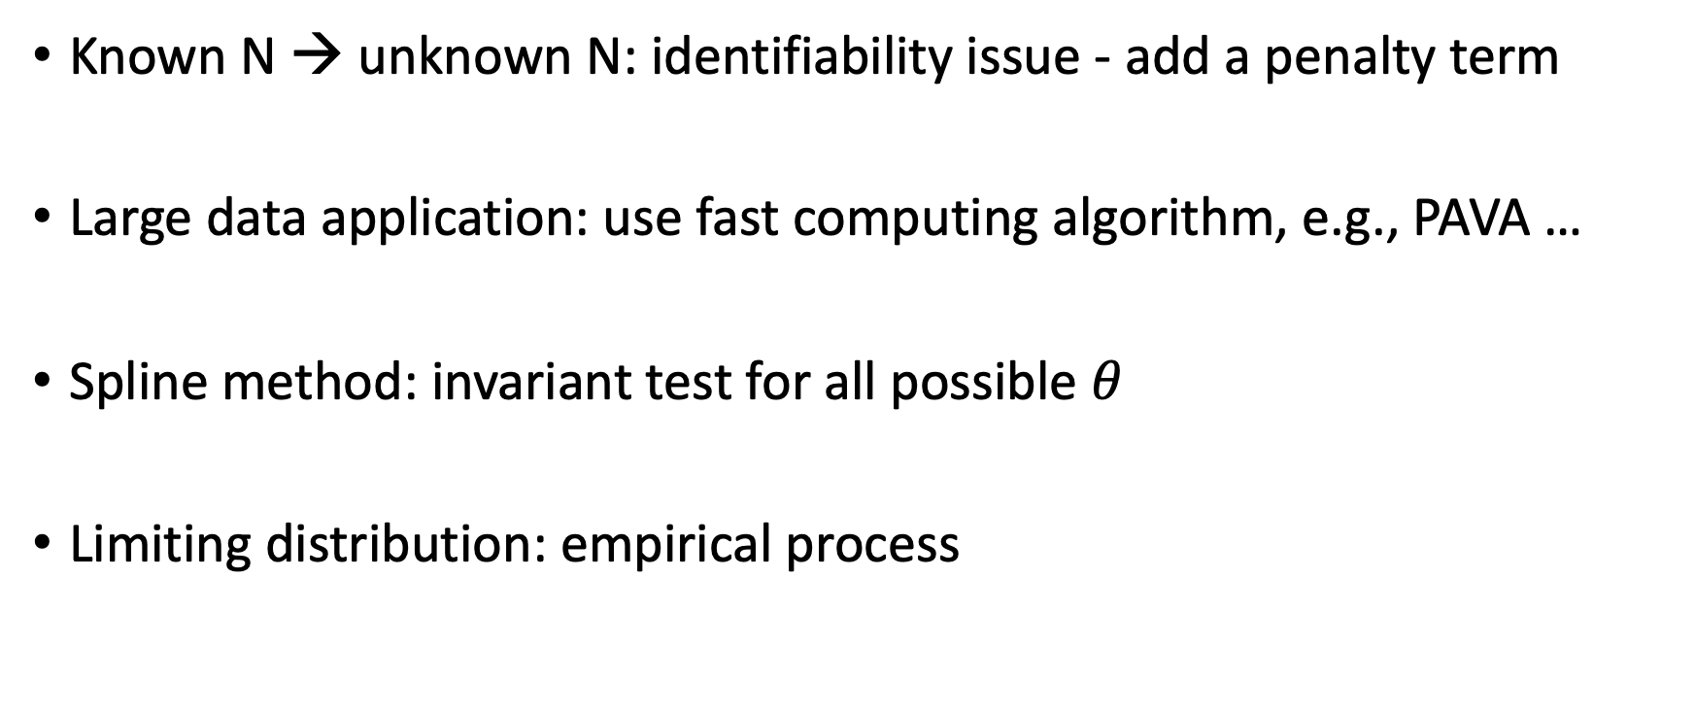
More
Known N → unknown N: identifiability issue - add a penalty term
Large data application: use fast computing algorithm, e.g., PAVA …
Spline method: invariant test for all possible $θ$
Limiting distribution: empirical process

Slide 11
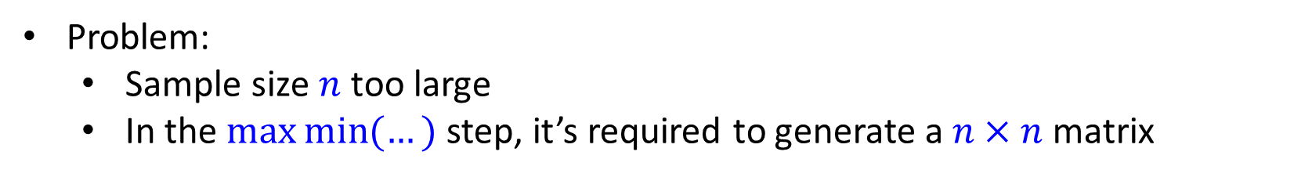
Astronomy application: large data
Data: Observed magnitudes -> Luminosity (from Dr. Nathan Secrest)
Problem:
  Sample size $n$ too large
  In the $\max{\min{(…)}}$ step, it’s required to generate a $n×$ $n$ matrix

Slide 12
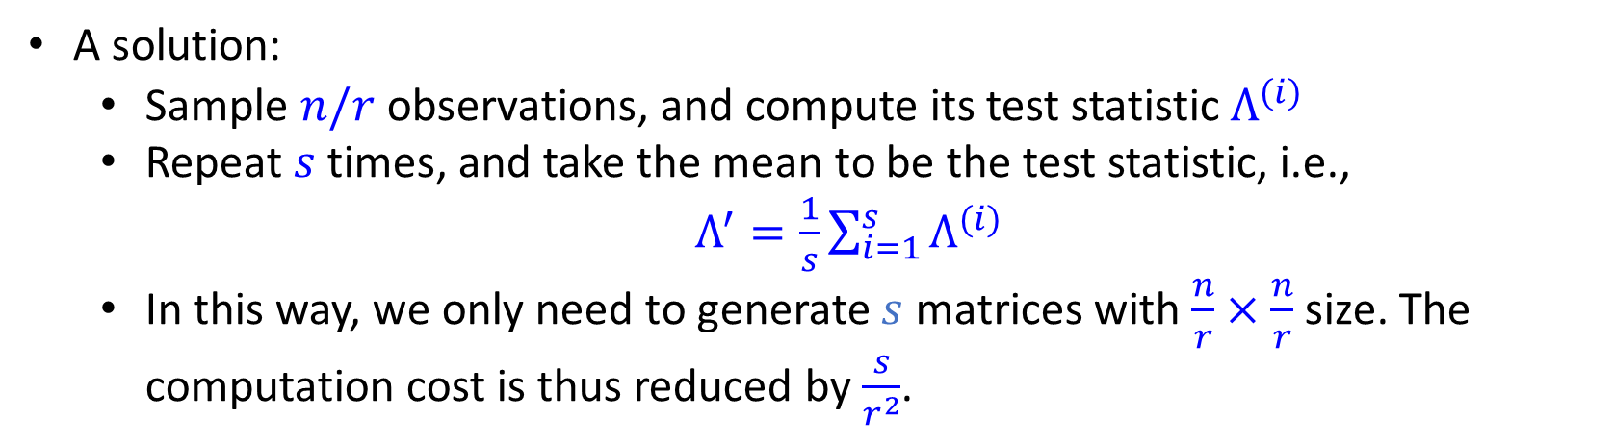
Astronomy application: large data
Data: Observed magnitudes -> Luminosity (from Dr. Nathan Secrest)
Problem:
  Sample size $n$ too large
  In the $\max{\min{(…)}}$ step, it’s required to generate a $n×$ $n$ matrix
A solution:
  Sample $n/r$ observations, and compute its test statistic $Λ^{(i)}$
  Repeat $s$ times, and take the mean to be the test statistic, i.e.,
  $Λ^{′}=\frac{1}{s}\sum_{i=1}^{s}{Λ^{(i)}}$
  In this way, we only need to generate $s$ matrices with $\frac{n}{r}×$ $\frac{n}{r}$ size. The computation cost is thus reduced by $\frac{s}{r^{2}}$.

Slide 13
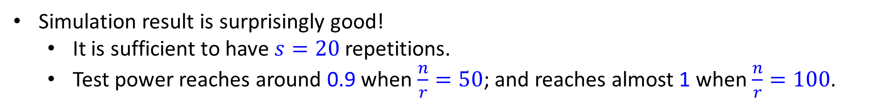
Astronomy application: large data
Simulation result is surprisingly good!
  It is sufficient to have $s=20$ repetitions.
  Test power reaches around 0.9 when $\frac{n}{r}=50$; and reaches almost 1 when $\frac{n}{r}=100$.
Power curve plot

Slide 14
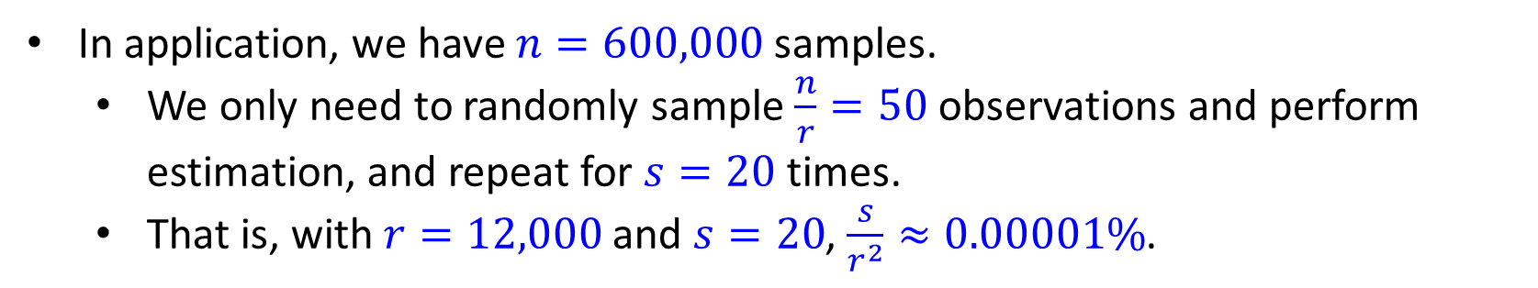
Astronomy application: large data
Simulation result is surprisingly good!
  It is sufficient to have $s=20$ repetitions.
  Test power reaches around 0.9 when $\frac{n}{r}=50$; and reaches almost 1 when $\frac{n}{r}=100$.
Power curve plot
In application, we have $n=600,000$samples.
  We only need to randomly sample $\frac{n}{r}=50$ observations and perform estimation, and repeat for $s=20$ times.
  That is, with $r=12,000$ and $s=20$, $\frac{s}{r^{2}}≈0.00001\%$.

Slide 15
Thanks!
Zixiang Xu, 08/07/2024
    [1] Robertson, T., F. Wright, and R. Dykstra (1988). Order Restricted Statistical Inference. Probability and Statistics Series. Wiley.
    [2] Sun, J. and M. Woodroofe (1996). Semi-parametric estimates under biased sampling. Statistica Sinica 7.
    [3] Sun, J. and M. Woodroofe (1999). Testing uniformity versus a monotone density. The Annals of Statistics 27 (1), 338–360

