Slide 1
Leveraging Administrative Records and Record Linkages to Enhance Health Data at the U.S. Census Bureau
Victoria Udalova, PhD
Director, Enhancing Health Data (EHealth) Program
August 7, 2024
JSM 2024
Any opinions and conclusions expressed herein are those of the presenter and do not reflect the views of the U.S. Census Bureau.

Slide 2
Why Enhance Health Data at Census?
Direct data collection via surveys of patients and health care providers continues to experience declining response rates and increased costs
Complex and rapidly evolving structure of the U.S. healthcare system
Greater availability of health and other administrative records
Greater understanding of the importance of non-health care factors
Social determinants of health – e.g., income, education, access to transportation, health insurance, housing quality, access and quality of food
But this information is limited in health records

Slide 3
Ongoing Paradigm Shift
Enhance health data using record linkages and existing survey and administrative records uniquely available at the Census Bureau
Link multiple data sources to create new statistical products and research
Conduct original research and collaborate with external partners for health records data and expertise
Lower cost, more granularity, more timely, higher quality than direct data collection
A way to complement direct data collection

Slide 4
Data Sources at the Census Bureau
Census Bureau collects information directly from individuals and businesses via multiple surveys and censuses
Decennial Census, American Community Survey (ACS), Economic Census
Frames that are used for survey/census operations and research
Master Address File (MAF), Business Register
Census Bureau acquires administrative records from state and federal agencies, third parties, and private sources
Social Security Administration (SSA), Internal Revenue Service (IRS), Supplemental Nutrition Assistance Program (SNAP), Special Supplemental Nutrition Program for Women, Infants, and Children (WIC), Temporary Assistance to Needy Families (TANF), Longitudinal Employer-Household Dynamics (LEHD)
Medicaid and Medicare enrollment records, Medicaid claims, and select electronic health records from our external partners

Slide 5
Record Linkages at the Census Bureau
Personally Identifiable Information (PII) is used to assign internal person-level anonymized Census Bureau linkage keys, Protected Identification Keys (PIKs)
PII is matched to the internal reference file, an agglomeration of multiple survey and administrative records data
Internal and approved external researchers do not have access to identified data
Restricted microdata must remain within the Bureau’s secure firewall
Microdata can only be used for statistical purposes
All aggregate statistical output is reviewed before it can be released publicly

Slide 6
Scope of Enhancing Health Data (EHealth) Program
Assess representativeness of patients captured by health records relative to all patients or all individuals living in a particular community
Assess representativeness of providers relative to communities they serve
Population
Patients
Visits
Providers
Institutions

Slide 7
Scope of Enhancing Health Data (EHealth) Program
Population
Patients
Demand for healthcare:
Social Determinants of Health
Visits
Providers
Institutions

Slide 8
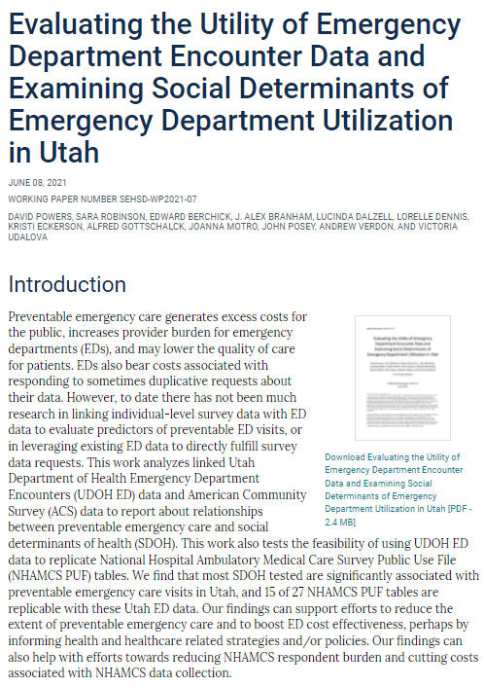
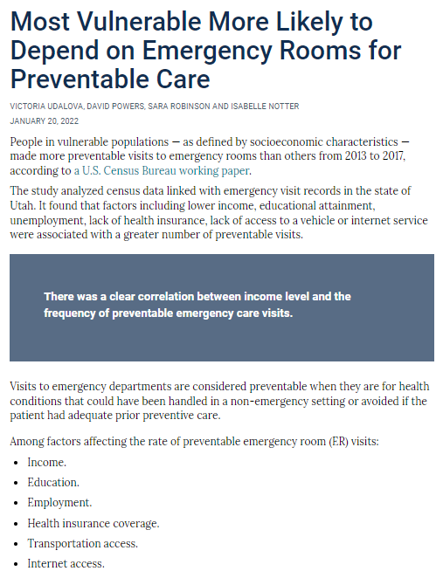
Scope of Enhancing Health Data (EHealth) Program
Partnership with Utah Department of Health:
New estimates of emergency department utilization by social determinants
Population
Patients
Visits
Providers
Institutions
census.gov/library/working-papers/2021/demo/SEHSD-WP2021-07.html
census.gov/library/stories/2022/01/
who-makes-more-preventable-visits-to-emergency-rooms.html

Slide 9
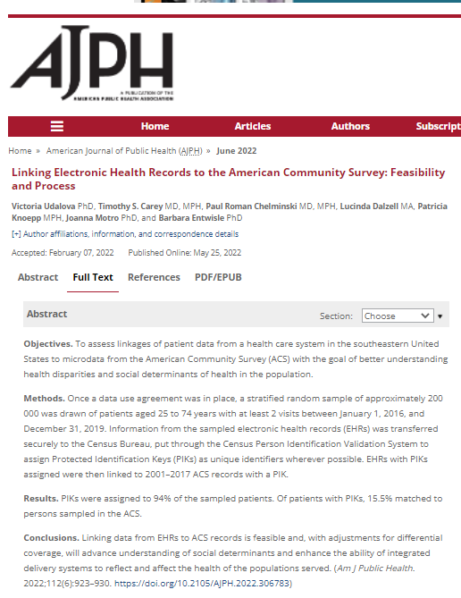
Scope of Enhancing Health Data (EHealth) Program
Partnership with University of North Carolina (UNC):
Analysis of patient-level EHR data linked to American Community Survey
Population
Patients
Visits
Providers
Institutions
ajph.aphapublications.org/doi/10.2105/AJPH.2022.306783

Slide 10
Scope of Enhancing Health Data (EHealth) Program
Partnership with American Board of Family Medicine (ABFM) and Stanford
Population
Patients
Near-real time electronic health records (EHRs) from family physicians across the country
800+ primary care practices, 3000+ clinicians, 7+ million patients, 70+ million visits across 50 states
Care quality and health outcome measures
High representation of small and rural areas
Studies of social determinants of health in primary care setting
Several ongoing research projects
Visits
Providers
Institutions

Slide 11
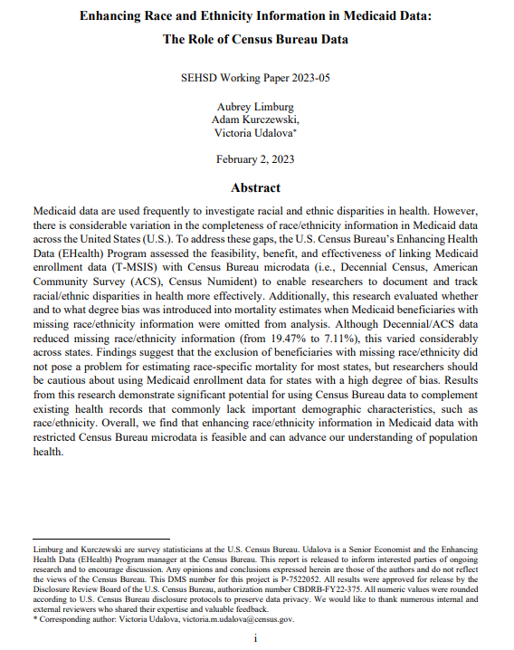
Scope of Enhancing Health Data (EHealth) Program
Race/Ethnicity Information in Medicaid Data
Population
Patients
A high rate of missing race/ethnicity information in Medicaid data
Linked national Medicaid administrative records with Census microdata
Evaluated the impact of missing race/ethnicity information on estimation of race-specific all-cause mortality
Visits
Providers
Institutions
https://www.census.gov/library/working-papers/2023/demo/SEHSD-WP2023-05.html

Slide 12
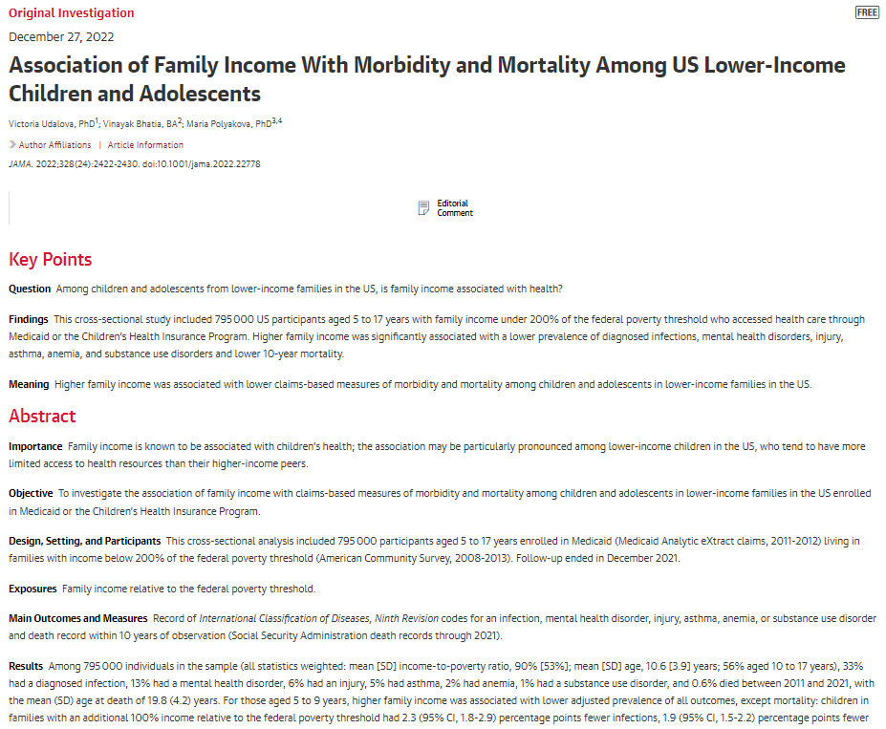
Scope of Enhancing Health Data (EHealth) Program
Health-Income Gradient Study
Population
Patients
Evaluated the relationship between income and health using Medicaid claims data linked to ACS and Numident administrative records
Focused on children and adolescents
Higher family income is significantly associated with a lower prevalence of diagnosed infections, mental health disorders, asthma, and lower mortality
Visits
Providers
Institutions
https://jamanetwork.com/journals/jama/fullarticle/2799910

Slide 13
Scope of Enhancing Health Data (EHealth) Program
Economic and Health Impacts of the COVID-19 Pandemic
Population
Patients
Linked survey and administrative records to document and decompose differences across demographic groups in economic and health impacts of the pandemic
Impacts of the pandemic on all-cause mortality and on employment were concentrated in the same racial, ethnic, and education groups
Visits
Providers
Institutions
https://www.pnas.org/doi/abs/10.1073/pnas.2014279117
https://www.healthaffairs.org/doi/full/10.1377/hlthaff.2020.02142
https://www.nber.org/papers/w30658

Slide 14
Scope of Enhancing Health Data (EHealth) Program
Population
Patients
Visits
Providers
Supply of healthcare:
Physician Component of the Health Frame
Institutions

Slide 15

Scope of Enhancing Health Data (EHealth) Program
Earnings and Labor Supply of U.S. Physicians
Population
Patients
Visits
Providers
Institutions
https://www.nber.org/papers/w31469

Slide 16
Health Frame - Physicians
No single authoritative data source on the supply of health care
Rapid reshaping of the U.S. health care system’s structure
Consolidation of physician practices
Private equity investments
Leverage Census unique data assets on workers, taxpayers, and employers to measure characteristics
physicians (race/ethnicity, employment status, earnings)
institutions where physicians work (geography, business structure, revenue, ownership)

Slide 17
Data Sources: Overview
Integrating 34+ datasets across 8+ years
Physician-level data
American Community Survey (race/ethnicity, hours of work), Decennial Census (race/ethnicity)
Numident (date of birth/death, place of birth)
Master Address File (residence location)
IRS Forms W2/1040/1099/K1 (ownership, self-employment, income, retirement)
CMS MPUPD (Medicare charges, service provision), CMS Care Compare (places of work, credentials, affiliations), CMS NPPES/NPI Registry (specialty, places of work)
Business-level data
Business Register (payroll, employment, business structure-establishments, location, industry)
Longitudinal Business Database (merger/acquisitions, entry/exit, revenue)
Service Annual Survey (care revenue, visits, expenses)
AHRQ Compendium of U.S. Health Systems (hospitals, health systems)

Slide 18
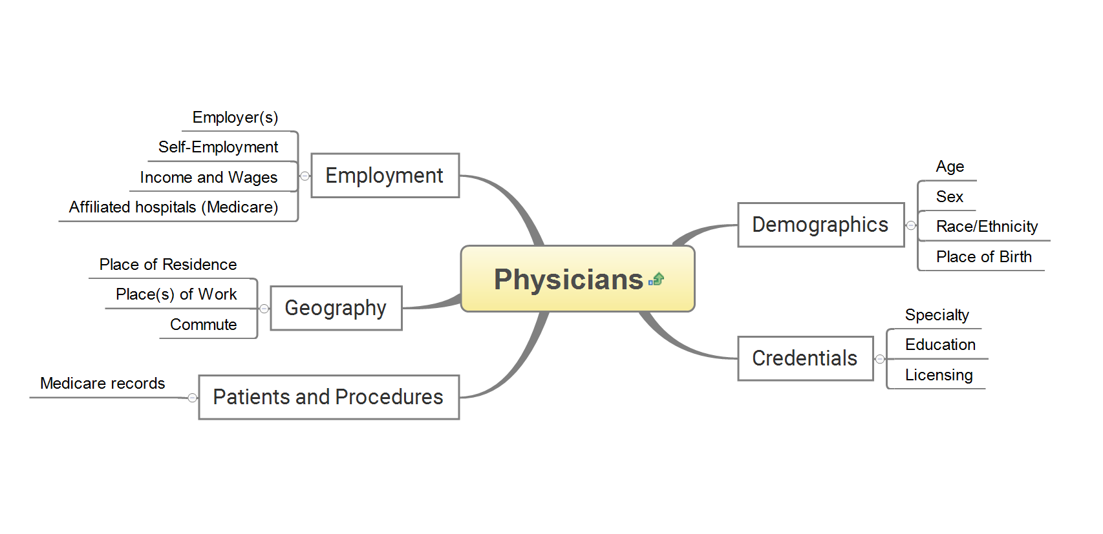
Health Frame - Physicians
physicians
(public data)

Slide 19
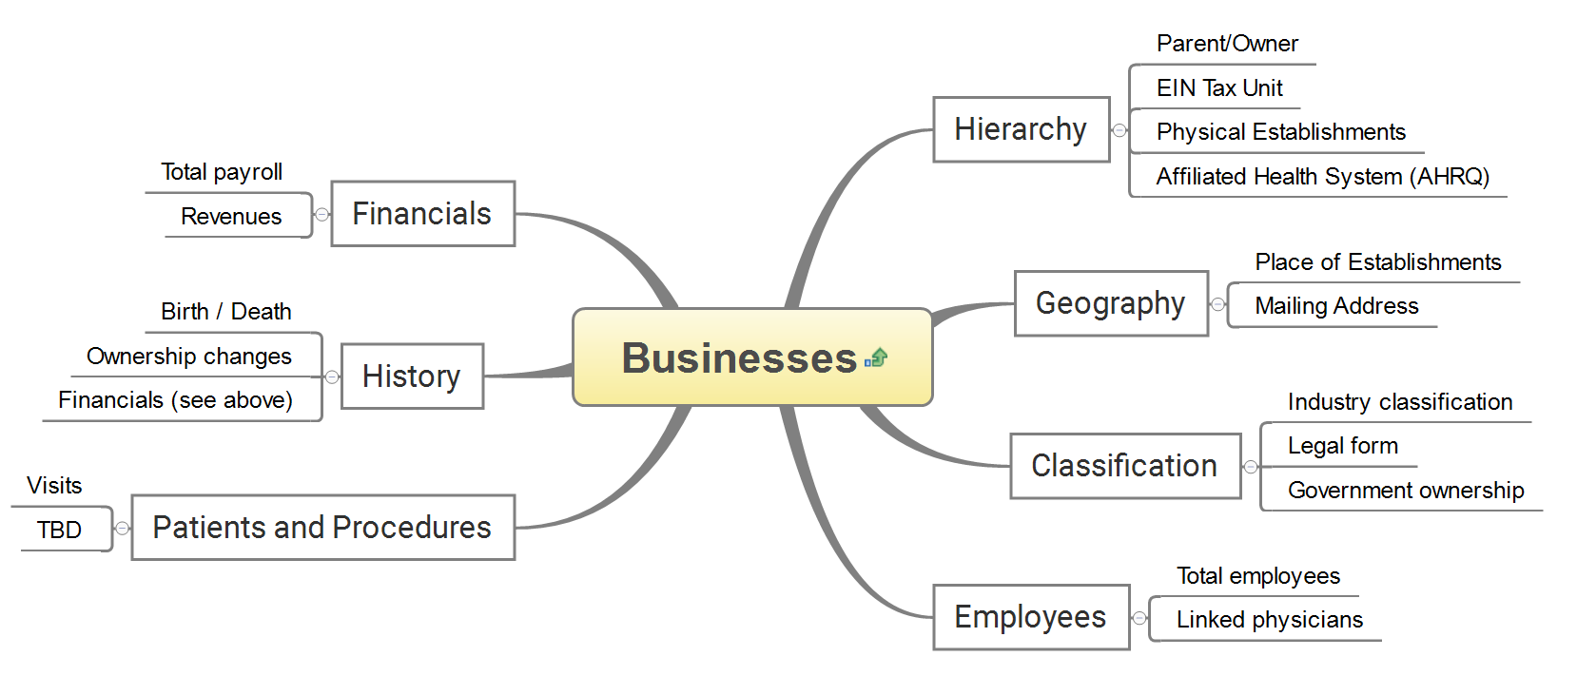
Health Frame - Physicians
business

Slide 20


Data Sources: Identifying Physicians
NPPES/NPI Registry
National Provider Identifier (NPI) for each health care practitioner—mandated by HIPAA and launched in 2005
Over 5.7M active records for practitioners ranging from physicians (1.1M) to nurse practitioners (360K) to athletic trainers; 1.6M registered organizations
Restricted version to assign internal linkage keys – PIKs

Slide 21


Data Sources: Identifying Physicians’ Employers
IRS Form W2
Employer Identification Number (EIN), wages
IRS Form K1
Ownership data

Slide 22


Data Sources: Attaching Business Characteristics
Business Register (BR)
Comprehensive database of business establishments
Updated continuously since 1972 using administrative records from IRS, SSA, BLS, state unemployment insurance records
Covers 5M single-establishment firms, 160K multi-establishment firms with 1.8M establishments, 21M non-employer businesses
Provides info on geography, industry, organization structure, payroll, employment

Slide 23
Use Case: Earnings and Labor Supply of U.S. Physicians
“Who Values Human Capitalists’ Human Capital? The Earnings and Labor Supply of U.S. Physicians” (Joshua D. Gottlieb, Maria Polyakova, Kevin Rinz, Hugh Shiplett, Victoria Udalova)
https://www.nber.org/papers/w31469
Examined income and labor supply of U.S. physicians using rich administrative tax data linkages

Slide 24
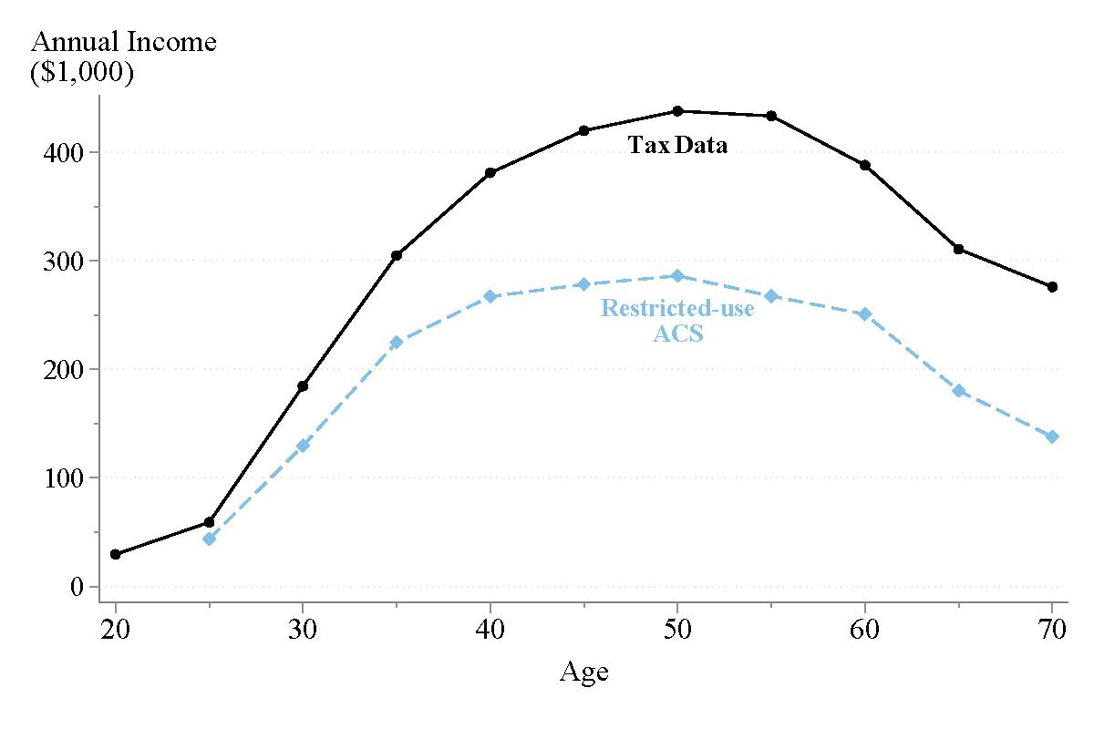
Underreported Physician Earnings in ACS

Slide 25
Concluding Remarks
Strategically reusing existing administrative records and linking multiple data sources can be a great way to complement direct data collection
We rely on our partners for health records and their subject matter expertise
Goal is to produce public facing data products and research findings allowing a wider range of users to access the information
Navigating challenges (restricted data, disclosure avoidance, data use agreements)
Protecting data and privacy is a top priority
Continuous innovation to identify best solutions for data sharing, secure record linkage, and disclosure avoidance methods

Slide 26
Contact Information
census.gov/ehealth
Victoria Udalova, PhD
Director, EHealth Program
U.S. Census Bureau
victoria.m.udalova@census.gov

