Slide 1
Primary Sampling Unit Stratification for the Current Population Survey 2020 Sample Redesign
Brian Shaffer, Yarissa Gonzalez, Tim Trudell
U.S. Census Bureau
Views expressed in this paper are those of the authors and do not reflect the views or policies of the U.S. Census Bureau or the Bureau of Labor Statistics.

Slide 2
Introduction
Current Population Survey (CPS) purpose: to estimate the number of unemployed (UE) persons in the Civilian Noninstitutional Population, 16+ (CNP).
In some states, we also consider:
Children in poverty (CHPOV) – to improve Childrens Health Insurance Program (CHIP) estimates
Number of Native Americans / Alaska Natives (AIAN).
CPS sample design: two-stage.
First stage = Primary Sampling Units (PSUs)
PSU composition: single/contiguous counties
Self-Representing (SR): PSU in sample with certainty.
Non-Self-Representing (NSR): Stratify PSUs and select one per stratum.
Second stage = Housing Units + GQs

Slide 3
How many NSR strata?
Try to keep NSR workloads similar to 2010.
Hypothetical Example:
2010: 506 SR, 346 NSR
2020: More SR, fewer NSR
 | Design | SR | NSR | Tot_SS | SR_SS | NSR_SS | NSR Strata | NSR Workload
State A | 2010 | 9 | 43 | 1,329 | 578 | 751 | 11 | 68
 | 2020 | 10 | 42 | 1,329 | 650 | 679 | 10 | 68

Slide 4
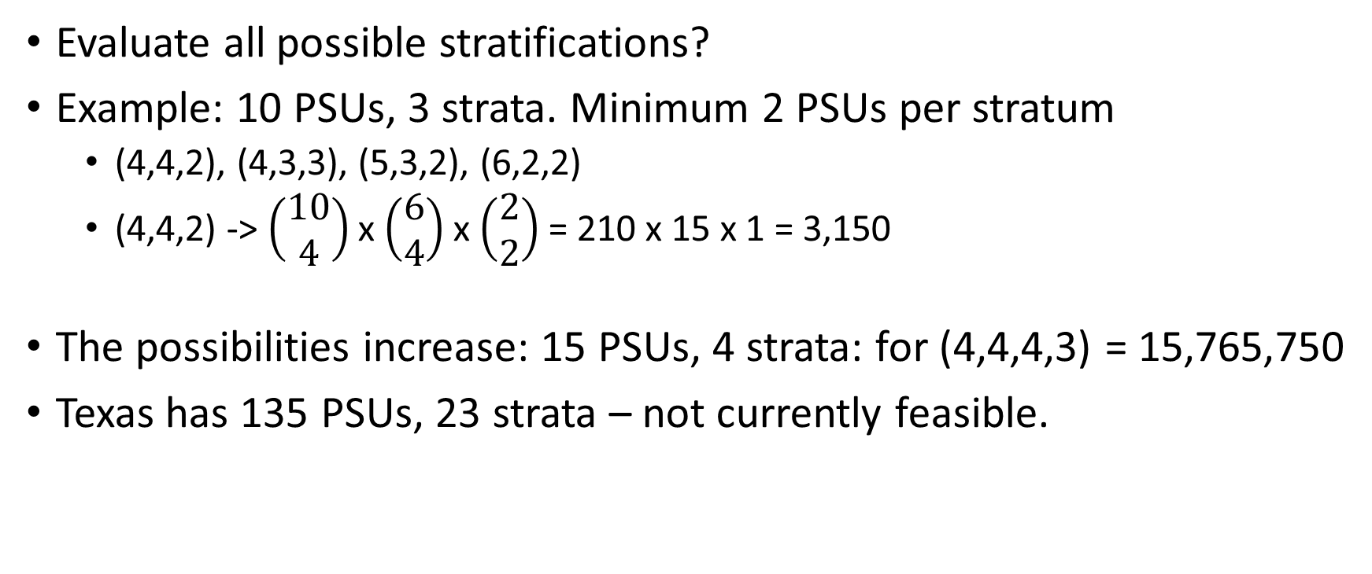
Picking the Stratification
Evaluate all possible stratifications?
Example: 10 PSUs, 3 strata. Minimum 2 PSUs per stratum
(4,4,2), (4,3,3), (5,3,2), (6,2,2)
(4,4,2) -> $\left(\begin{matrix}10 \\ 4\end{matrix}\right)$ x $\left(\begin{matrix}6 \\ 4\end{matrix}\right)$ x $\left(\begin{matrix}2 \\ 2\end{matrix}\right)$ = 210 x 15 x 1 = 3,150
The possibilities increase: 15 PSUs, 4 strata: for (4,4,4,3) = 15,765,750
Texas has 135 PSUs, 23 strata – not currently feasible.

Slide 5
PSU Stratification Program (PSP)
Modified Friedman & Rubin (1967) “Hill Climbing”
Single-PSU moves
User defines how similar to keep stratum sizes.
Repeat this process four more times.

Slide 6
PSU Stratification Program (PSP)
Exchange Pass
PSU swaps
Stratum sizes stay similar, within tolerance level.
Repeat this process four more times.

Slide 7
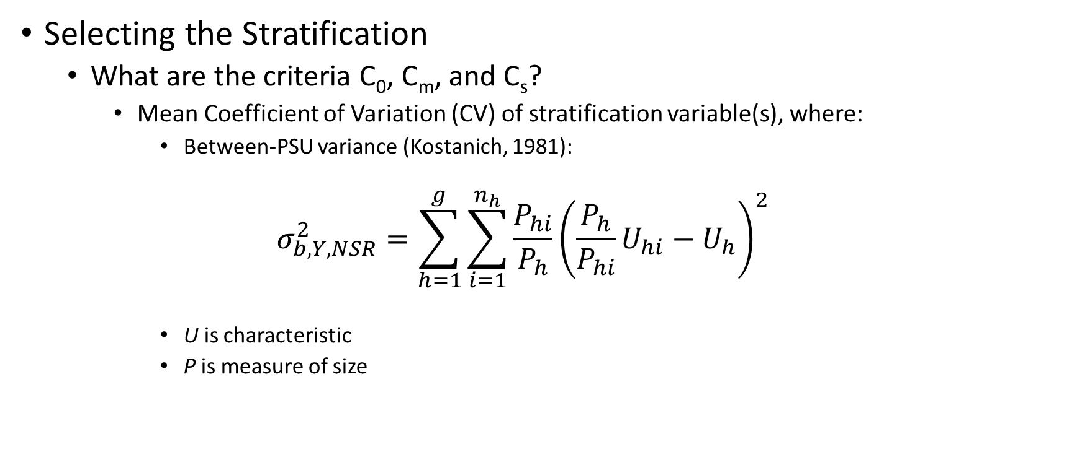
PSU Stratification Program (PSP)
Selecting the Stratification
What are the criteria C₀, C_{m}, and C_{s}?
Mean Coefficient of Variation (CV) of stratification variable(s), where:
Between-PSU variance (Kostanich, 1981):
$$σ_{b,Y,NSR}^{2}=\sum_{h=1}^{g}{\sum_{i=1}^{n_{h}}{\frac{P_{hi}}{P_{h}}{\left(\frac{P_{h}}{P_{hi}}U_{hi}−U_{h}\right)}^{2}}}$$
U is characteristic
P is measure of size

Slide 8
Stratification Variables
Candidate Methods:
Update 2010-design variables with ACS, Census, et al:
Unemployed Females, Unemployed Males, Households with 3+ persons, Households with Female head, Total Unemployed, Quarterly Census of Earnings and Wages (QCEW) variables
Variables correlated with Unemployment, CHPOV, and AIAN
Stepwise Regression Selection of Auxiliary Variables to predict UE
2010 Unemployed, 2020 Unemployed, 2020 Labor Force, AIAN Alone, Children in Poverty
Ten Variations, 100 PSP runs per variation, per state.

Slide 9
Good Stratification
Minimizes Between-PSU variance in Total UE across two time points.
Also: CHPOV / AIAN, where applicable.
Each NSR PSU has a similar workload.
Alaska: Cost of interviewing.

Slide 10
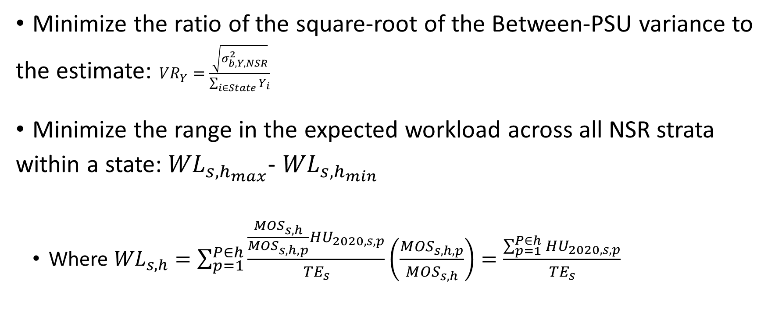
Evaluation Criteria
Minimize the ratio of the square-root of the Between-PSU variance to the estimate: ${VR}_{Y}=\frac{\sqrt{σ_{b,Y,NSR}^{2}}}{\sum_{i∈State}{Y_{i}}}$
Minimize the range in the expected workload across all NSR strata within a state:${WL}_{s,h_{max}}$- ${WL}_{s,h_{min}}$
Where ${WL}_{s,h}=\sum_{p=1}^{P∈h}{\frac{{\frac{{MOS}_{s,h}}{{MOS}_{s,h,p}}HU}_{2020,s,p}}{{TE}_{s}}\left(\frac{{MOS}_{s,h,p}}{{MOS}_{s,h}}\right)}=\frac{\sum_{p=1}^{P∈h}{{HU}_{2020,s,p}}}{{TE}_{s}}$

Slide 11
Evaluation Criteria (cont.)
Express each metric relative to the 2010-design:
Expected Workload Range
UE 2010
UE 2020
CHPOV
AIAN
Add weight to metrics we want to consider.
For each state: identify the stratification with the smallest weighted sum of the 1,000.

Slide 12
Stratification Variables – What we used
26 states: combination of 2010 Unemployed, 2020 Unemployed, 2020 Labor Force, AIAN Alone, Children in Poverty
5 states: Updated 2010 variables + AIAN
3 states: 2020 Unemployment
2 states: Updated 2010 variables
2 states: combination of 2020 Unemployed, 2020 Labor Force, AIAN Alone, Children in Poverty
2 states: Correlations
1 state: Correlations + AIAN
The remaining states are all SR

Slide 13
Results
Apply 2010 Stratification to characteristics of interest.
Make Geography fixes as needed.
Apply 2020 Stratification to the same characteristics.
Calculate Evaluation Criteria using each Stratification.

Slide 14
Results – National Level
Using the current and new designs:
Excludes states that are all SR in 2020

Slide 15
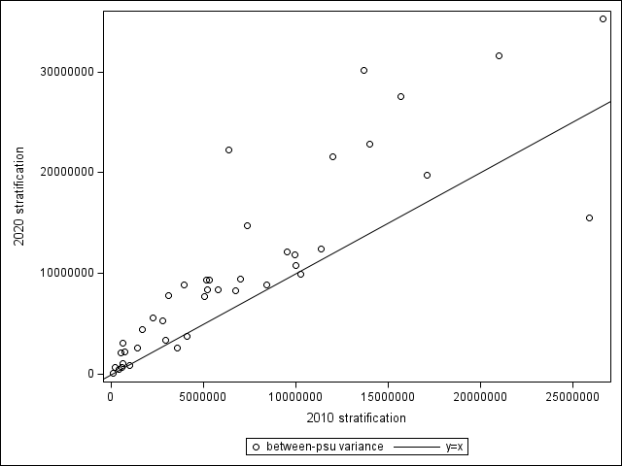
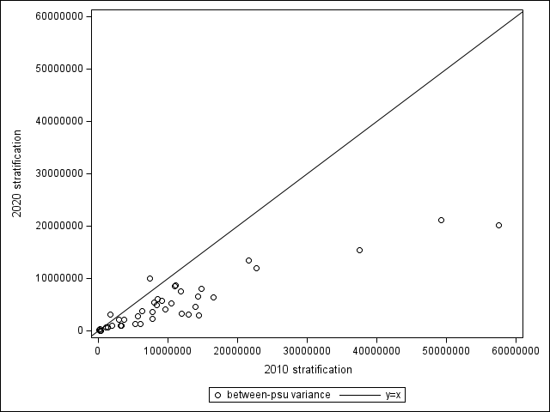
Results – Across 41 states
Between-PSU variance for ACS Total Unemployed, by Design:
2006-2010 Total Unemployed | 2017-2021 Total Unemployed

Slide 16
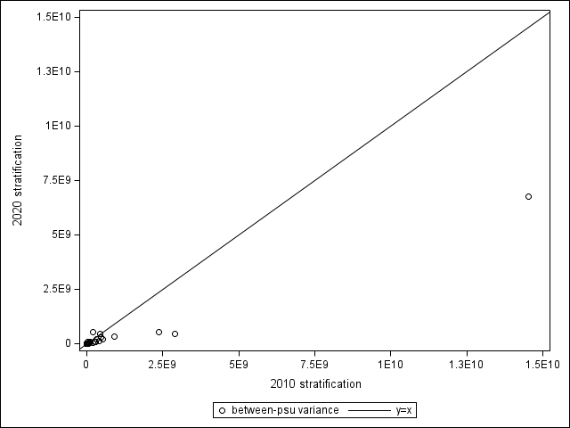
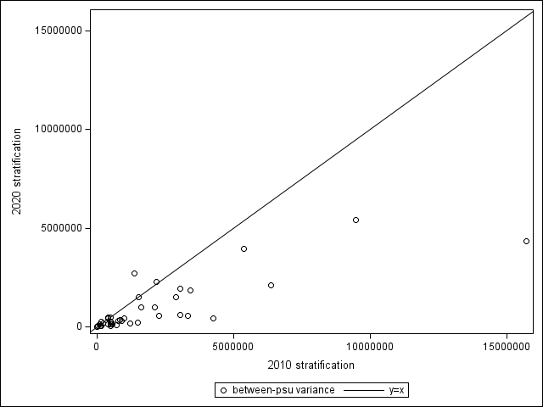
Results – Across 41 states
Between-PSU variance for AIAN & CHPV, by Design:
2020 Census AIAN Alone | 2017-2021 Children in Poverty

Slide 17

Total Variance
Total = Within + Between
Within-PSU Variance:
$$σ_{w,s}^{2}=\frac{{N_{s,p}}^{2}{\hat{p}}_{s}{\hat{q}}_{s}({deff}_{s})}{n_{s,p}}$$
N_{s,p} = Measure of size for state s (CNP 16+) at person level (s,p)
n_{s,p} = Sample size for state s (persons in CNP 16+)
${\hat{p}}_{s}$ = Proportion of sample in state s who are unemployed. ${\hat{p}}_{s}=\frac{n_{s,ue}}{n_{s,p}}$
${\hat{q}}_{s}$ = 1 - ${\hat{p}}_{s}$
deff_{s,p} = design effect for state s

Slide 18
Total Variance
Total = Within + Between
Within-PSU Variance:
$$σ_{w,s}^{2}=\frac{{N_{s,p}}^{2}{\hat{p}}_{s}{\hat{q}}_{s}({deff}_{s})}{n_{s,p}}$$
N_{s,p} = Measure of size for state s (CNP 16+) at person level (s,p)
n_{s,p} = Sample size for state s (persons in CNP 16+)
${\hat{p}}_{s}$ = Proportion of sample in state s who are unemployed. ${\hat{p}}_{s}=\frac{n_{s,ue}}{n_{s,p}}$
${\hat{q}}_{s}$ = 1 - ${\hat{p}}_{s}$
deff_{s,p} = design effect for state s

Slide 19
Total Variance
Total = Within + Between
Within-PSU Variance:
$$σ_{w,s}^{2}=\frac{{N_{s,p}}^{2}{\hat{p}}_{s}{\hat{q}}_{s}({deff}_{s})}{n_{s,p}}$$
N_{s,p} = Measure of size for state s (CNP 16+) at person level (s,p)
n_{s,p} = Sample size for state s (persons in CNP 16+)
${\hat{p}}_{s}$ = Proportion of sample in state s who are unemployed. ${\hat{p}}_{s}=\frac{n_{s,ue}}{n_{s,p}}$
${\hat{q}}_{s}$ = 1 - ${\hat{p}}_{s}$
deff_{s,p} = design effect for state s

Slide 20
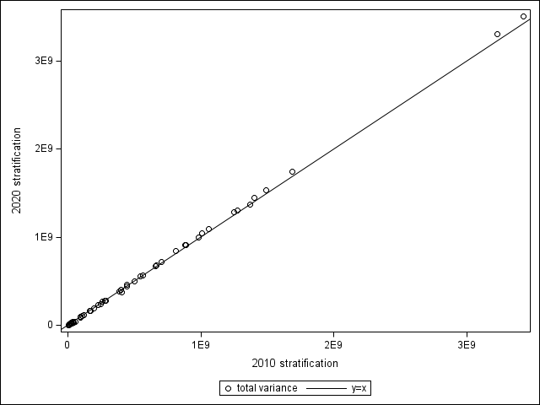
Total Variance – 2020 Total Unemployed

Slide 21
References
Friedman, H. P., & Rubin, J. (1967). On Some Invariant Criteria for Grouping Data. Journal of the American Statistical Association, 62 , 1159-1178.
Kostanich, D., Judkins, D., Singh, R., & Schautz, M. (1981). Modification of Friedman-Rubin’s Clustering Algorithm for Use in Stratified PPS Sampling. In Proceedings of the Joint Statistical Meetings, Survey Research Methods Section (p. 285-290). Alexandria, VA: American Statistical Association.

Slide 22
Thank you
Brian.Shaffer@census.gov
Tim.Trudell@census.gov
Yarissa.Gonzalez@census.gov

