Slide 1
Unit-level Survey Weighted Hierarchical Bayes Small Area Estimation for Binary Outcomes –
A Tribute to Dr. Ralph E. Folsom
Akhil K. Vaish, Ph.D.
RTI International
3040 Cornwallis Road
Durham, NC 27709
Notes:
Hello Everyone, many thanks for attending this session in Ralph’s memory. Special thanks to our speakers and our discussant Phil.

Slide 2

Outline
Dr. Ralph E. Folsom
  Personal and Professional Life
Contributions to Small Area Estimation
  Survey Weighted Empirical Bayes
  Survey Weighted Hierarchical Bayes
  Additive Random Coefficients
Notes:
This is a brief outline. On top right you can see a photo of Ralph.

Slide 3
Dr. Ralph E. Folsom
He was born in Broken Bow, Oklahoma, on March 15, 1942, and passed away in Raleigh, North Carolina on December 14, 2022.
He joined RTI International in 1969 as a Statistician and became a Chief Scientist in 1998.
He worked at RTI for 47 years.
He was an ASA Fellow and won the 2015 Margaret Knox Excellence Award.
More details about his personal and professional life:
  June 2023 AMSTAT NEWS:
    https://magazine.amstat.org/blog/2023/06/01/obituaries-june-2023/
  Thomas Funeral Home – Centerville, IA
    https://www.thomasfh.com/obituaries/Ralph-Edward-Folsom-Jr?obId=26760085

Slide 4
Dr. Ralph E. Folsom: Recollections
Ralph interviewed me when I joined RTI in 1998. I had the good fortune to work with him every day until he retired.
  He was a well-dressed gentleman. Treated everyone with respect and dignity.
  His door was always open for statistical consultation. He was a teacher and mentor to many of us.
  He loved outdoor activities: Fishing, horse riding, participating in Pointing breed field trials.
  Care and love for animals: Persian and exotic shorthair cats, horses, many dogs
  Connoisseur: Handmade English leather boots, wood flooring made from extinct trees reclaimed from river bottoms, collection of guns and knives with intricate carving and engravings.
Notes:
He enjoyed having handmade custom things form local and international artisans. Some of the things which he shared with me are given here. When he got his leather boots, he gave me a course on boots 101, how they are made, what kind of leather is used, types and quality of various leather grades. He will do extensive research whether it is related to statistics or related to anything else.

Slide 5
Dr. Ralph E. Folsom: Recollections
Did not do computer programming.
Uncanny ability to see the connections between the numbers and the formulas.
  He could look at the numbers and easily point out the mistakes due to programming errors because the numbers did not make sense based on his theoretical formulation.
Most of his innovative statistical contributions arose due to solving practical problems related to complex survey data analyses.
  Published in conference proceedings papers and internal RTI project reports.
  As a result, he did not feel the necessity to document his work in refereed journals.

Slide 6
Contribution to Small Area Estimation: Background
In the late 1980s, the nation’s substance abuse problem became a major concern of the public and of politicians.
As a result, Congress passed new legislation that increased funding for substance abuse data collection and research.
Congress and the Clinton administration concluded that it would be useful to have state-level estimates of substance abuse.
In the mid-1990s, Ralph started working on developing small area estimation (SAE) methodologies to enable the Substance Abuse and Mental Health Services Administration (SAMHSA) to produce reliable and cost-effective state and local area level estimates in a timely manner.

Slide 7
Survey Weighted Empirical Bayes
Ralph developed Survey Weighted Empirical Bayes (SWEB) (Folsom and Judkins, 1997) SAE methodology for unit-level binary outcomes from complex survey data.
The SWEB methodology was used on the 1991-1993 National Household Surveys on Drug Abuse (currently known as National Survey on Drug Use and Health (NSDUH).
  Estimates for 26 states and 25 metropolitan statistical areas (MSAs) were produced for 11 binary outcome measures using SWEB methodology.

Slide 8
Survey Weighted Empirical Bayes (continued)
Successful development and implementation of SWEB methodology demonstrated the utility of SAE methodology to SAMHSA for producing reliable state-level estimates using only modest sample sizes.
The House Appropriations Committee Report accompanying the Department of Health and Human Services FY 1997 appropriations bill called for SAMHSA to expand NSDUH (NHSDA) and use the new state-level data to improve the provision of treatment and prevention services in states with high levels of substance abuse.
Ralph’s innovative work played a critical role in the expansion of NSDUH in 1999 from a national design to the current state stratified design to facilitate production of reliable state estimates using SAE methodology.
Notes:
About the same time, Fiscal Year 1997 appropriations bill, called for SAMHSA to expand NSDUH to provide state level information so that targeted treatment and prevention services can be implemented. Being able to produce reliable and cost effective state estimates in a timely manner, enabled SAMHSA to expand NSDUH from a national design to state stratified design.

Slide 9
Survey Weighted Empirical Bayes: Features
Unit/person-level mixed logistic regression model with state and substate level random effects.
Used survey weights in the estimation process; as a result, small area estimates were design consistent.
  Survey weights were not used in unit-level SAE modeling of binary outcomes before Ralph’s work on SWEB methodology.
Small area estimates of states with large samples and national aggregates of state small area estimates were close to the associate robust design-based estimates (self-calibrating).

Slide 10
Survey Weighted Empirical Bayes: Features (continued)
Predictor variables at person (age, race/ethnicity, gender), block group, tract, county, and state level were used.
Estimates were produced for ~230,000 block groups by 32 cells (4 age group x 4 race/ethnicity x 2 gender) and aggregated using associated population counts to produce state-level estimates.
This project was one of the first SAE projects outside of Census Bureau to use block group-level data.
The process of producing estimates using SWEB methodology is akin to the popular Multilevel Regression and Poststratification (MRP) methodology published 6 months later in December 1997 by Gelman and Little.

Slide 11
Survey Weighted Empirical Bayes: Limitations
Because of limited computational resources at that time (e.g., smaller RAM), to speed up convergence of SWEB methodology, age group-specific random effects were treated independent of each other (i.e., data were subset by age groups).
  Generally, the correlations are positive and ignoring them is expected to underestimate the variance of the small area estimates.
Assumptions that the survey weights were non-informative led to a solution that underestimated the weighting effect on interval estimates.
The SWEB methodology used the penalized quasi-likelihood (PQL) estimation approach. The underestimation bias inherent in PQL estimates of variance components also led to biased point estimates and interval estimates that were too narrow.
Most importantly, SWEB approach to SAE interval estimation ignored the uncertainty in the variance components.
Notes:
Because NSDUH sample design allows selection 0,1,2 persons from a household, as a result correlation among the age groups is expected and ignoring them is expected to underestimate the variance of the small area estimates.

Slide 12
Survey Weighted Hierarchical Bayes (SWHB)
To remove these limitations, Ralph developed unit-level Survey-Weighted Hierarchical Bayes (SWHB) SAE methodology (Folsom, Shah, Vaish, 1999; Rao & Molina, 2015, p. 397) for binary outcomes from complex survey data.
He collaborated with Babu Shah (developer of SUDAAN®) and developed highly efficient C programming language-based software for binary outcome variables. Since then, SWHB software is being used to produce annual state estimates and biennial substate estimates for 35+ binary NSDUH outcome variables.
Before being employed for NSDUH to produce state and substate estimates, the SWHB methodology was reviewed and approved by a panel of SAE experts in 1999 and 2000. The panel included the following:
  Dr. William Bell (U.S. Census Bureau),
  Prof. Partha Lahiri (University of Maryland)
  Prof. Balgobin Nandram (Worcester Polytechnic Institute),
  Mr. Wesley Schaible (Bureau of Labor Statistics),
  Prof. J.N.K. Rao (Carleton University), and
  Prof. Alan Zaslavsky (Harvard University).
Notes:
As I mentioned, Ralph did not know programming but he understood the importance of having an efficient software for doing a large scale production of small area estimates.

Slide 13
Survey Weighted Hierarchical Bayes: Features
In addition to keeping all features of SWEB methodology, the SWHB methodology has the following features:
  Employs full hierarchical Bayes solution.
  Multivariate state and substate level random effects with general variance-covariance matrices.
  Allows separate domain level (e.g., age group) fixed effects predictors.
  Most importantly, it uses effective sample size adjustment factors in the estimation process.
    In the context of unit-level mixed logistic regression models for SAE, such adjustments were not used earlier.
Notes:
Because NSDUH prevalence rates vary significantly from age group to age group, having separate age group level predictors is beneficial.

Slide 14

NSDUH State SAE Model
The state SAE model is a complex unit-level mixed (including fixed and random effects) logistic regression model of the following form:
: probability of engaging in the behavior of interest (e.g., using marijuana in the past month).
A: age group (12-17, 18-25, 26-34, 35+)
i : state (1,..,51); j: substate area (1,…,250), k: person
X: vector of predictor variables (fixed effect) associated with age group A, and β denotes the associated vector of parameters (fixed parameters).
$$\log{[}π_{Aijk}/(1−π_{Aijk})]=X_{Aijk}^{′}β_{A}+η_{Ai}+ν_{Aij}$$
$$π_{Aijk}$$

Slide 15
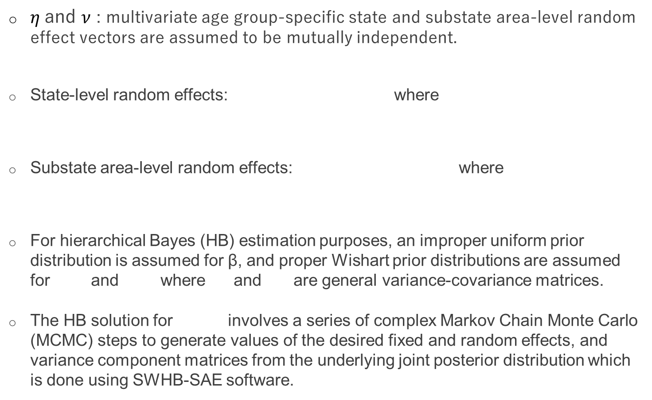

NSDUH State SAE Model (continued)
$η$and $ν$ : multivariate age group-specific state and substate area-level random effect vectors are assumed to be mutually independent.
State-level random effects: where
Substate area-level random effects: where
For hierarchical Bayes (HB) estimation purposes, an improper uniform prior distribution is assumed for β, and proper Wishart prior distributions are assumed for and where and are general variance-covariance matrices.
The HB solution for involves a series of complex Markov Chain Monte Carlo (MCMC) steps to generate values of the desired fixed and random effects, and variance component matrices from the underlying joint posterior distribution which is done using SWHB-SAE software.
$$π_{Aijk}$$
Notes:
Proper Wishart distributions are used for inverse of the variance-covariance matrices of state and substate area level random effects. The SWHB-software is used for generating MCMC samples of desired fixed and random effects and variance component matrices from the underlying joint posterior distribution.

Slide 16
SWHB-SAE Software: Features
Specially designed and optimized to efficiently process large datasets like NSDUH for producing small area estimates for binary outcomes.
Two procedures: Proc GIBBS and Proc GSTAT, coded in C programming language, DOS command-line standalone executable programs.
Proc GIBBS | Generates MCMC samples of fixed and random effects and variance-covariance matrices of random effects from posterior distributions Allows multiple nested random effects and different fixed-effect predictors for different domain levels (e.g., age group-specific fixed predictors). Pooling of levels for random effects is also allowed.
Proc GSTAT | Uses generated MCMC samples and the population datafile to produce block group by age group by race/ethnicity by gender-level prevalence estimates. Aggregates them using population count projections to produce age group-specific state or substate-level small area estimates

Slide 17
Proc GIBBS: Computation Burden and Processing Times
Description | State Estimates | Substate Estimates
Number of outcome variables | ~40 | ~40
Data | Pooled 2 years (~135,000) | Pooled 3 years (~202,500)
Number of domains | States (51) × age group (4) | Substate regions (~400) × age group (4)
Number of parameters | ~25 (fixed) + ~1,200 (random) + 20 variance components = ~1,250 | ~25 (fixed) + ~1,600 (random) + 20 variance components = ~1,650
Time taken* to produce 10,000 MCMC samples for one outcome variable | ~30 minutes | ~1 hour
*Processing time is based on use of an Intel® Core™ i7-7700 CPU with 3.60 GHz and 16.0 GB RAM.

Slide 18
Proc GSTAT: Computation Burden and Processing Times
Description | State Estimates | Substate Estimates
Number of block groups in the United States | 217,000 | 217,000
Age group (4) × race/ethnicity (4) × gender (2) cells per block group | 32 | 32
Number of MCMC samples selected for producing estimates | 1,250 | 1,250
Number of years of population data files | 2 | 3
Number of block group level estimates generated for one outcome variable | 217,000 × 32 × 1,250 × 2 = 17,360,000,000 | 217,000 × 32 × 1,250 × 3 = 26,040,000,000
Time* taken to produce state/substate level estimates for one outcome variable | ~25 minutes | ~40 minutes
*Processing time is based on use of an Intel® Core™ i7-7700 CPU with 3.60 GHz and 16.0 GB RAM.

Slide 19
Concluding Remarks
After developing SWHB methodology, Ralph started working on developing robust SAE methods applicable for informative samples (e.g., Singh, Folsom, and Vaish, 2002; Vaish, Folsom, and Singh, 2003; Singh, Folsom, and Vaish, 2006).
He developed unit-level Additive Random Coefficient (ARC) SAE methodology for linear, logistic, and log-linear models applicable to data from informative samples (Folsom, Vaish, and Singh, 2011).
  Until his retirement in January 2017, he continued to make improvements to the ARC methodology and helped developed associated software.

Slide 20
Concluding Remarks (continued)
Some comments from his memorial published in June 2023 AMSTAT NEWS:
“He was so generous with his time, always stopping whatever he was doing to answer my questions and provide additional guidance. What a remarkable teacher, statistician, and person.”
“His technical genius is well known, but it was his kind and generous nature that really made him outstanding.”
“I don’t think we can even imagine the magnitude of his impact on RTI staff and projects. His intelligence and humble nature will forever be a shining remembrance of him.”
Personally, I am forever indebted to him for his guidance and support and dearly miss my daily interactions with him!

Slide 21
References
Folsom R. E., & Judkins D. R. (1997). Substance abuse in states and metropolitan areas: Model based estimates from the 1991-1993 NHSDA methodology report. Office of Applied Studies, Substance Abuse and Mental Health Services Administration, Methodological Series M-1 (DHHS Pub. No. SMA 97-3140). Rockville, MD.
Folsom, R. E., Shah, B. V., & Vaish, A. K. (1999). Substance abuse in states: A methodological report on model based estimates from the 1994–1996 National Household Survey on Drug Abuse. Proceedings of the American Statistical Association, Section on Survey Research Methods, pp. 371–375.
Gelman, A., and T. C. Little. 1997. ‘‘Postratification into Many Categories Using Hierarchical Logistic Regression.’’ Survey Methodology 23:127–135.
Singh, A. C., Folsom, R. E., & Vaish, A. K. (2002). A hierarchical Bayes generalization of the Fay-Herriot method to unit level nonlinear mixed models for small area estimation. Proceedings of the American Statistical Association, Section on Survey Research Methods, pp. 3258–3263.
Vaish, A. K., Folsom, R. E., & Singh, A. C. (2003). A simulation study to compare unit-level linear mixed model methods for small area estimation for survey data. Proceedings of the American Statistical Association, Section on Survey Research Methods, pp. 4340–4344.
Singh, A. C., Folsom, R. E., & Vaish, A. K. (2006). Small area modeling for survey data with smoothed error covariance structure via generalized design effects. Proceedings of the American Statistical Association, Section on Survey Research Methods, pp. 3684–3688.
Folsom, R. E., Vaish, A. K., Singh A. (2011). Additive Random Coefficient (ARC) Models for Robust Small Area Estimation. Proceedings of the American Statistical Association, Section on Survey Research Methods, pp. 4723–4729.
Rao, J., & Molina, I. (2015). Small area estimation. John Wiley & Sons.

Slide 22

Thank you
Contact: Akhil Vaish| email: avaish@rti.org

