Slide 1
Revisiting Response Error and the Medicaid Undercount in the Current Population Survey
James Noon and Maria Perez-Patron
U.S. Census Bureau
2024 Joint Statistical Meetings
August 7, 2024
Any opinions and conclusions expressed herein are those of the authors and do not represent the views of the U.S. Census Bureau. The Census Bureau has ensured appropriate access and use of confidential data and has reviewed these results for disclosure avoidance protection (Project 7527013: CBDRB-FY24-CES014-028).

Slide 2
Background
Health insurance data collected by the CPS ASEC is used to estimate the number, percentage and characteristics of the uninsured population
CPS ASEC estimates of Medicaid enrollment are consistently lower than the enrollment rates reported in the Medicaid Statistical Information System (MSIS) database
2

Slide 3
Background
SHADAC project on the Medicaid undercount, 2000-2005
(https://www.shadac.org/sites/default/files/publications/SNACC_Phase_V_Full_Report.pdf)
Our research previously expanded analysis of the undercount to CY 2006-2010
(Noon, Fernandez, Porter 2019)
Factors associated with the undercount:
Point in time versus retrospective reporting
Program name confusion
Shared enrollment in household
3

Slide 4
2014 CPS ASEC Health Insurance Module Redesign
 | Pre-2014 Traditional Design | 2014 Redesigned Questionnaire
Reference period | Previous calendar year | Starts with current year then goes to previous year
Types of coverage | Laundry-list style questions | General to specific questions
How questions are asked | Collected at the household level | Collected at person level and asks if others in household are covered by plan
Source: Medalia, O’Hara, and Smith (2015)
4

Slide 5
Affordable Care Act (ACA) Medicaid Expansion
Beginning in 2014, states could opt to extend Medicaid coverage to non-elderly adults with income up to 138% of the federal poverty level
By the end of 2014, 28 states (including the District of Columbia) had expanded Medicaid
By the end of 2016, 5 additional states implemented expansion
To date, 41 states including DC have expanded Medicaid
5

Slide 6
Research Questions
What was the trend in the Medicaid undercount for calendar years 2011-2016*?
What was the trend in Medicaid survey response error in the CPS?
To what extent does respondent reporting error versus edit/imputation process error account for Medicaid survey response error in the CPS?
What is the “other health insurance” status of persons in the CPS with incorrectly measured Medicaid status?
6

Slide 7
Data and Methods
CPS ASEC 2012-2017
Medicaid Statistical Information System (MSIS) and Transformed Medicaid Statistical Information System (T-MSIS), 2011-2016
Medicaid undercount
Enrollment totals in CPS ASEC universe compared to MSIS/T-MSIS universe
Response error
Linked MSIS/T-MSIS and CPS ASEC data using an anonymized Protected Identification Key (PIK)
(Wagner and Layne 2014)
7

Slide 8
Undercount Methodologies
Unadjusted measures:
Cases with full or partial benefits
Medicaid participants residing in institutional group quarters
Duplicates arising from individuals having multiple accounts
Adjusted measures:
Receiving full Medicaid benefits
Non-institutionalized participants
Limited to unduplicated person enrollment records
8

Slide 9
Research Question #1
What was the trend in the Medicaid undercount for calendar years 2011-2016?
9

Slide 10
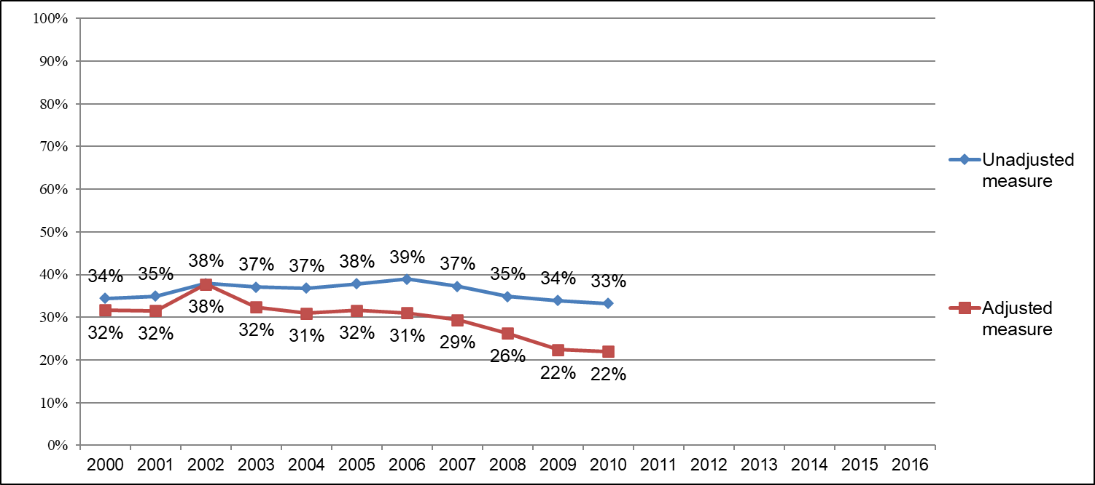
Medicaid Undercount in CPS ASEC, 2000-2016
Sources: SNACC (2010) for years 2000-2005; authors’ computations for years 2006-2016; CPS ASEC,MSIS,T-MSIS.
10

Slide 11
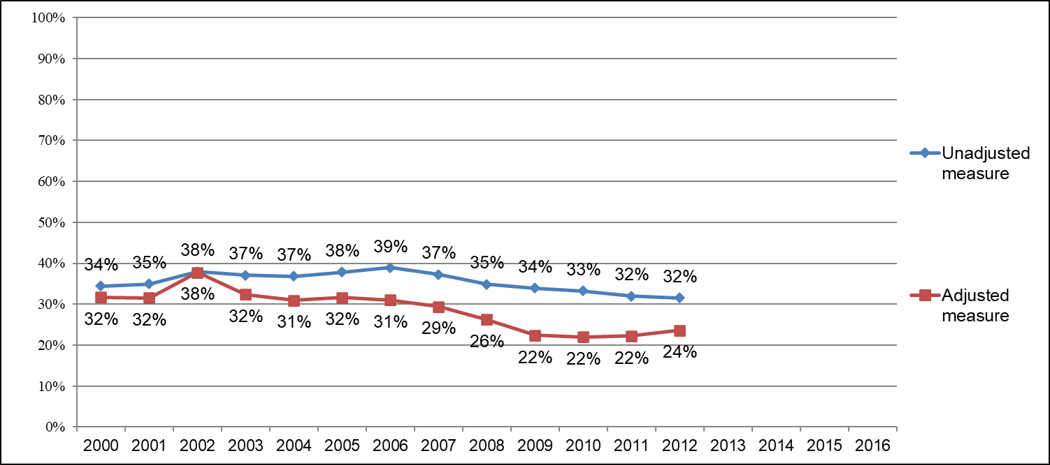
Medicaid Undercount in CPS ASEC, 2000-2016
Sources: SNACC (2010) for years 2000-2005; authors’ computations for years 2006-2016; CPS ASEC,MSIS,T-MSIS.
11

Slide 12
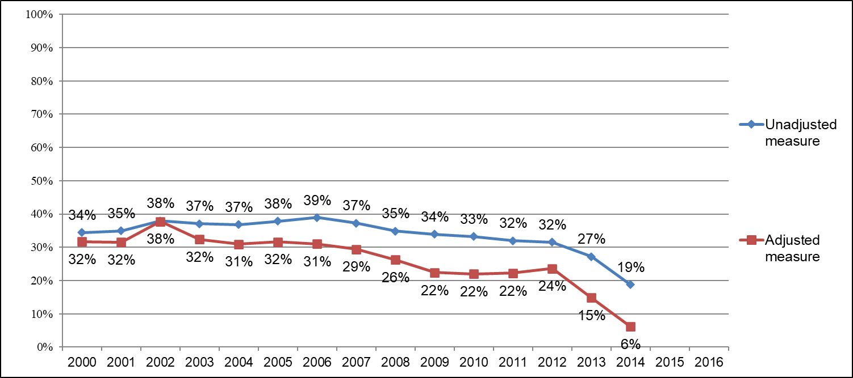
Medicaid Undercount in CPS ASEC, 2000-2016
Sources: SNACC (2010) for years 2000-2005; authors’ computations for years 2006-2016; CPS ASEC,MSIS,T-MSIS.
12

Slide 13
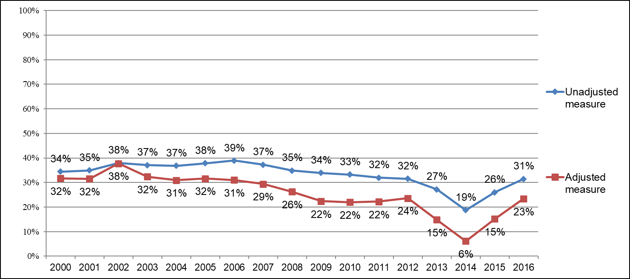
Medicaid Undercount in CPS ASEC, 2000-2016
Sources: SNACC (2010) for years 2000-2005; authors’ computations for years 2006-2016; CPS ASEC,MSIS,T-MSIS.
13

Slide 14
Research Question #2 & 3
What was the trend in Medicaid survey response error in the CPS for calendar years 2011-2016?
To what extent does unedited respondent reporting error versus edit/imputation process error account for Medicaid survey response error in the CPS?
14

Slide 15
Measuring Response Error in the CPS ASEC
Linked CPS and Medicaid enrollment data
False Negative Rate measured as: Among all CPS person records with Medicaid coverage in MSIS/T-MSIS, what percentage report “No” for Medicaid coverage in CPS
False Positive Rate measured as: Among all CPS person records reporting “Yes” for Medicaid coverage, what percentage do not have any Medicaid coverage in MSIS/T-MSIS
15

Slide 16
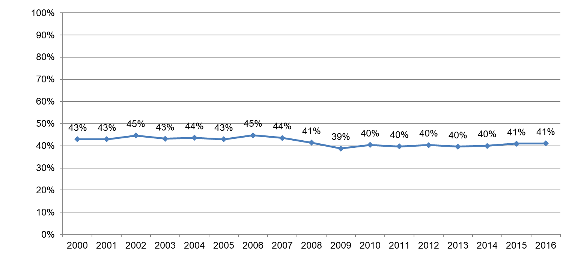
Percentage Reporting False Negative Errors, CY 2000-2016
Sources: SNACC (2010) for years 2000-2005; authors’ computations for years 2006-2016; CPS ASEC,MSIS,T-MSIS.
16

Slide 17
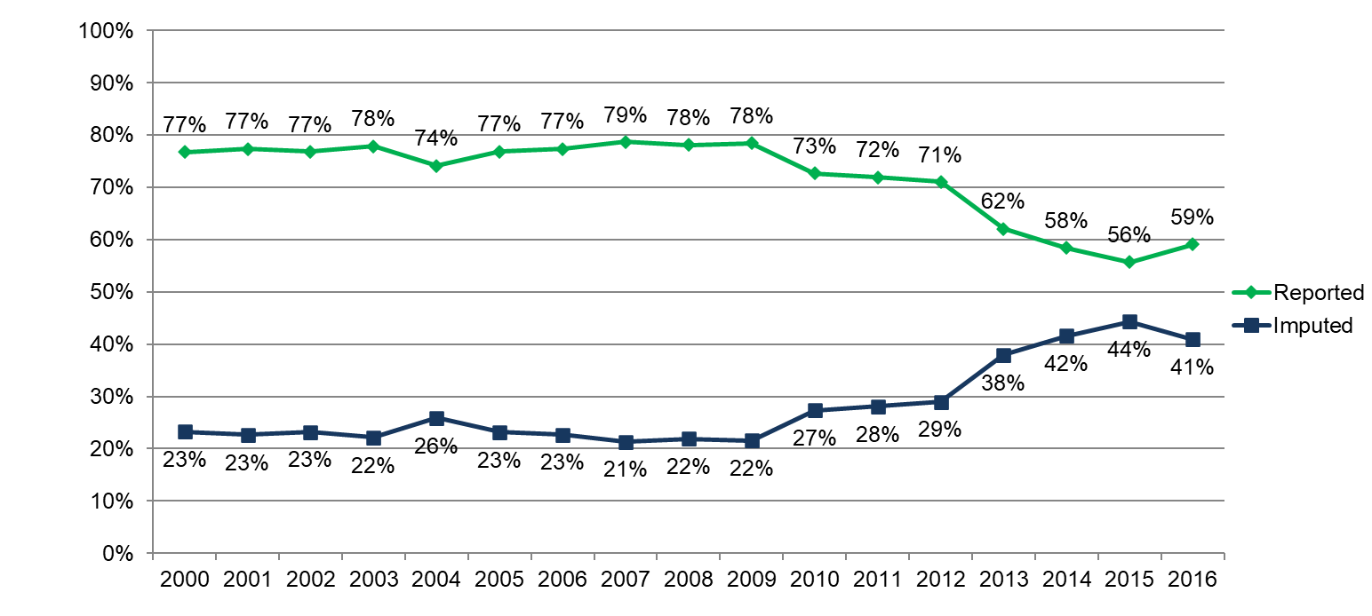
Source of Enrollment Status among False Negative Errors, CY 2000-2016
Sources: SNACC (2010) for years 2000-2005; authors’ computations for years 2006-2016; CPS ASEC,MSIS,T-MSIS.
17

Slide 18
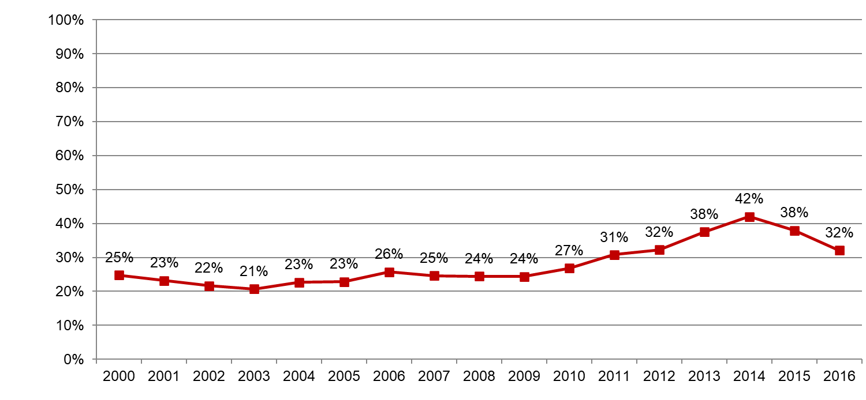
Percentage Reporting False Positive Errors, CY 2000-2016
Sources: SNACC (2010) for years 2000-2005; authors’ computations for years 2006-2016; CPS ASEC,MSIS,T-MSIS.
18

Slide 19
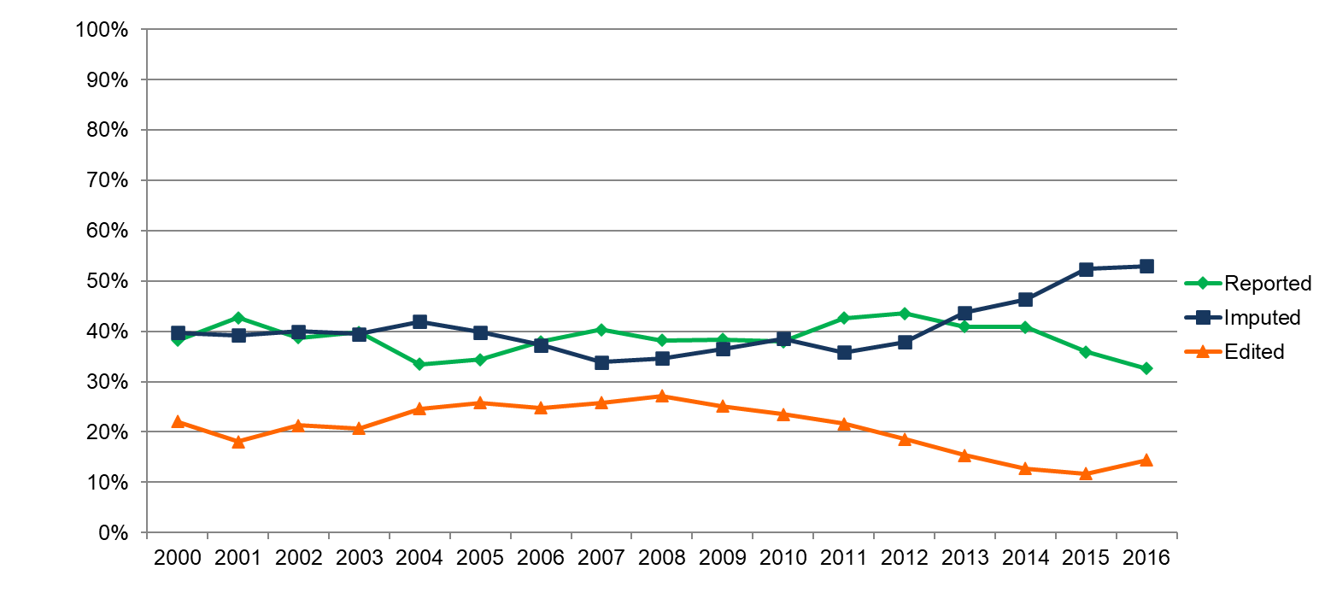
Source of Enrollment Status among False Positive Errors, CY 2000-2016
Sources: SNACC (2010) for years 2000-2005; authors’ computations for years 2006-2016; CPS ASEC,MSIS,T-MSIS.
19

Slide 20
Research Question #4
What is the “other health insurance” status of persons in the CPS with false negatives or false positive response error?
20

Slide 21
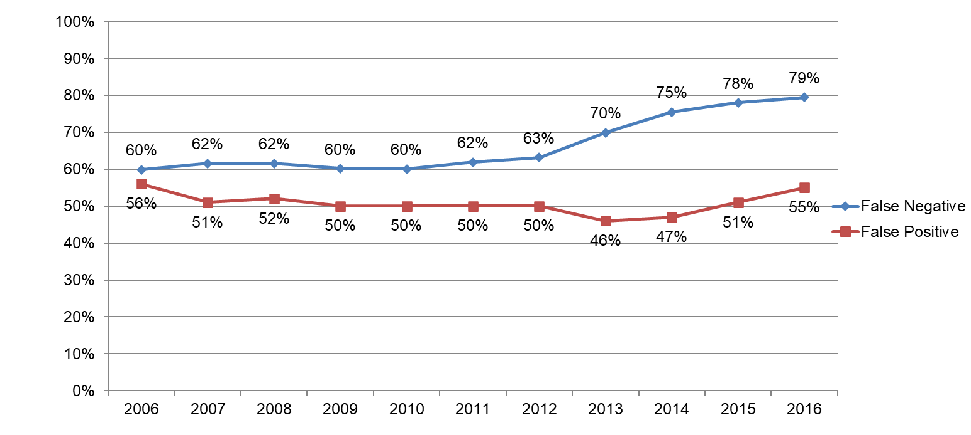
Response Errors with Other Health Insurance, CY 2006-2016
Sources: CPS ASEC 2007-2017,MSIS,T-MSIS 2006-2016.
21

Slide 22
Conclusions
The CPS ASEC undercount declined with the introduction of the redesigned questionnaire but saw an increase with Medicaid expansion
False negative errors have remained consistent; false positive errors declined with the introduction of the redesigned questionnaire but saw an increase with Medicaid expansion
Imputation as a source of response error has increased while unedited reporting has decreased as a source of error
False negative and false positive responses are both more likely to have other forms of health insurance
22

Slide 23
Next Steps
Additional years of analysis to include Families First Coronavirus Response Act enacted during the COVID pandemic
State measures for Medicaid expansion
Logistic regressions on response error including demographic, household, and state measures
Estimate impact of Medicaid response error on national uninsured rates
23

Slide 24
Thank You!
james.noon@census.gov
24

