Slide 1
The Use of Big Data-Based Model Prediction for Stratification of Household Addresses
Noah Bassel, NORC at the University of Chicago August 6, 2024

Slide 2
Study Overview

Slide 3
NSECE
National Survey of Early Care and Education (NSECE)
The most comprehensive study of the availability and use of early care and education in the U.S.
Cross-sectional: 2012, 2019, 2024

Slide 4
Target population(s)

Slide 5
Sample Design

Slide 6
Sample Design
Nationally representative
Clustered design allows description of local-level ECE supply and its interaction with nearby households
Also for in-person visits
Address-based sampling
Household frame: USPS Delivery Sequence File (DSF) + listing in areas of low DSF coverage
Targets
10,000 completed HH interviews
33% of completes should be low-income

Slide 7
Clustered Design
Selected primary sampling units (PSUs) across all 50 states and Washington DC.
Counties or clusters of adjacent counties
Selected secondary sampling units (SSUs) for the household sample.
One or more adjacent census tracts
Oversampled low-income SSUs
Constructed provider clusters
Clusters of census tracts surrounding SSUs
Sample of Household Addresses
2012 and 2019: Simple random sample of addresses in each SSU

Slide 8
Household Sample: Challenges

Slide 9
Challenges of the NSECE HH Survey
Comparatively rare study populations
HH with children 12 and under: 24% of US HH
Low-income HH with eligible children: 6% of US HH
Multistage screening/interview process
A lot of resources need to be devoted to screening out ineligible HH
Multiple chances for non-response to occur

Slide 10
NSECE Historical Yields
Year | Attempted Addresses | Completed HH Interviews | Yield
2012 | 98,646 | 11,629 | 11.8%
2019 | 109,783 | 8,576 | 7.8%

Slide 11
Secular Decline in Survey Response Rates

Slide 12
2024 NSECE Household Sample

Slide 13
Proposed Solution for 2024
NORC Big Data Classifier™ (BDC)
Train a machine learning model on NORC’s AmeriSpeak™ panel (https://amerispeak.norc.org/) that models HH survey eligibility against commercial vendor data
Append commercial vendor data (Merkle) to all addresses on sampling frame, where available
Use model to stratify all addresses with data:
Likely age eligible
Likely age ineligible
Oversample the likely eligible stratum and undersample the likely ineligible stratum

Slide 14
HH Frame Construction
In-Office Listing Procedures
USPS DSF
Commercial Data (Merkle)
Big Data Classifier
No Vendor Data Match
Likely Age Eligible
Likely Age Ineligible

Slide 15
Challenges and Tradeoffs

Slide 16
Missing Data Cases
Merkle advertises a match rate of 85-95%
By definition: no commercial data available for addresses obtained by listing
Cases with no data cannot be stratified via the BDC
What can we say about missing data cases compared to their matched and classified counterparts?

Slide 17
Stratification of Addresses

Slide 18
Stratification of Addresses

Slide 19
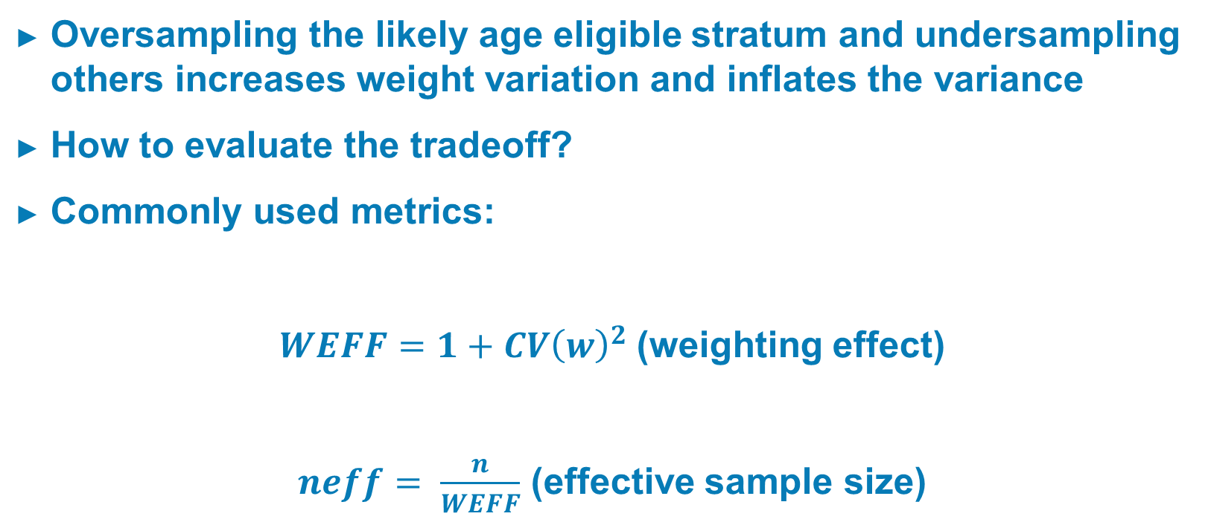
Reduction in Screening Costs vs Variance Inflation
Oversampling the likely age eligible stratum and undersampling others increases weight variation and inflates the variance
How to evaluate the tradeoff?
Commonly used metrics:
$WEFF=1+{CV\left(w\right)}^{2}$(weighting effect)
$neff= \frac{n}{WEFF}$ (effective sample size)

Slide 20
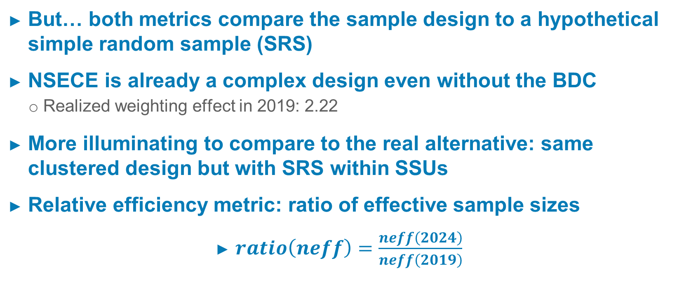
Reduction in Screening Costs vs Variance Inflation, Cont.
But… both metrics compare the sample design to a hypothetical simple random sample (SRS)
NSECE is already a complex design even without the BDC
Realized weighting effect in 2019: 2.22
More illuminating to compare to the real alternative: same clustered design but with SRS within SSUs
Relative efficiency metric: ratio of effective sample sizes
$ratio\left(neff\right)=\frac{neff\left(2024\right)}{neff\left(2019\right)}$

Slide 21
Reduction in Screening Costs vs Variance Inflation, Cont.

Slide 22
Conclusions
No-vendor-data cases cannot be ignored and must be handled with care during stratification
Based on observed eligibility neither oversampled nor undersampled
Clear tradeoff between variance inflation and sample size reduction
“Optimal” sampling strategy depends upon resource constraints and willingness to accept variance inflation
Note of caution: too much oversampling of the likely age eligible stratum may also reduce the percent of low-income HH

Slide 23
Co-Project Officers: Ivelisse Martinez-Beck Ivelisse.Martinezbeck@acf.hhs.gov
Ann Rivera
Ann.Rivera@ACF.hhs.gov

