Slide 1
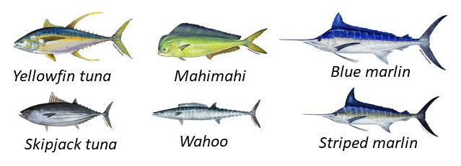
Non-commercial catch estimation of pelagic species in the main Hawaiian Islands
Hongguang Ma and Toby Matthews
NOAA Pacific Islands Fisheries Science Center
Notes:
Our presentation is on non-commercial catch estimation for six pelagic species in the main Hawaiian Islands. My coauthor and I work for NOAA Fisheries Pacific Islands Fisheries Science Center in Honolulu, Hawaii.
Shown on the slide are the six pelagic fish species covered by our study.

Slide 2
Outline
1. Background on pelagic fishery and Hawaii Marine Recreational Fishing Survey (HMRFS)
2. Modifications to HMRFS catch number estimation
3. Catch weight estimation
4. Summary and conclusion
Notes:
1. At the beginning we will provide some background on the pelagic fishery and an introduction to the Hawaii Marine Recreational Fishing Survey.
2. The second section will be on the methods we modified for the non-commercial catch estimation.
3. Then we will present our explorations for converting catch number to catch weight depending on the available weight measurement data.
4. We will conclude the presentation with main findings.

Slide 3
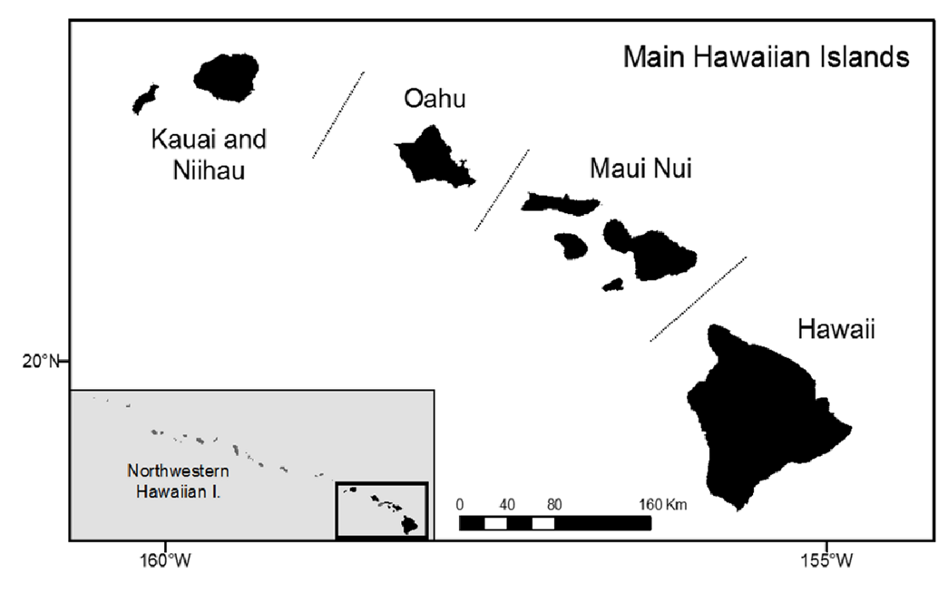
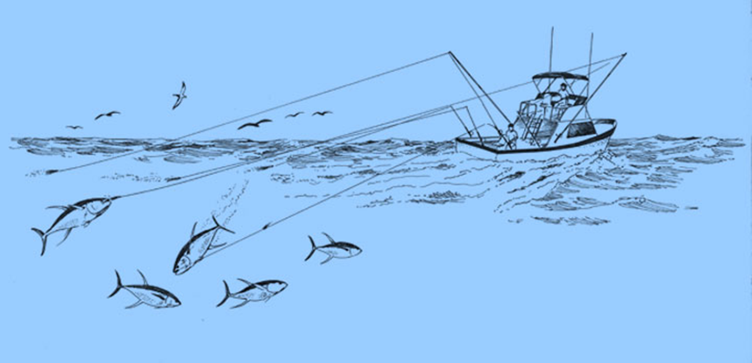
Pelagic fishery in the main Hawaiian Islands (MHI)
Mainly trolling from small boats
Non-commercial and commercial
Commercial longline fishing outside of MHI
Hawaii Trolling - Illustration by Les Hata
Notes:
The pelagic fishery in the main Hawaiian Islands is mainly conducted through trolling from small boats including non-commercial and commercial fishing.
The longline fishing is conducted outside of the main Hawaiian Islands and is for commercial only.

Slide 4

Hawaii Marine Recreational Fishing Survey
Access Point Angler Intercept Survey (APAIS) for catch rate (catch/angler trip)
Fishing Effort Survey to estimate number of angler trips
Notes:
There are mandatory fishing report requirements for the commercial fishing sector in Hawaii. Such reports are not required for non-commercial fishing.
The Hawaii Marine Recreational Fishing Survey is used to estimate non-commercial fishing catch. The survey consists of two independent and complementary surveys: an onsite Access Point Angler Intercept Survey for catch rate and an offsite survey for fishing effort.

Slide 5
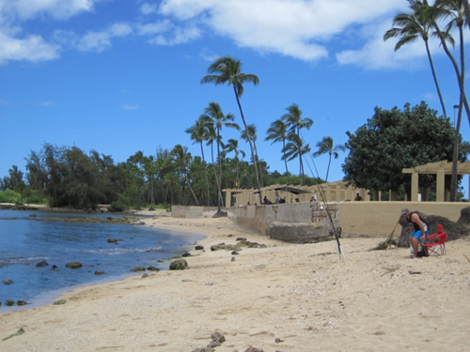
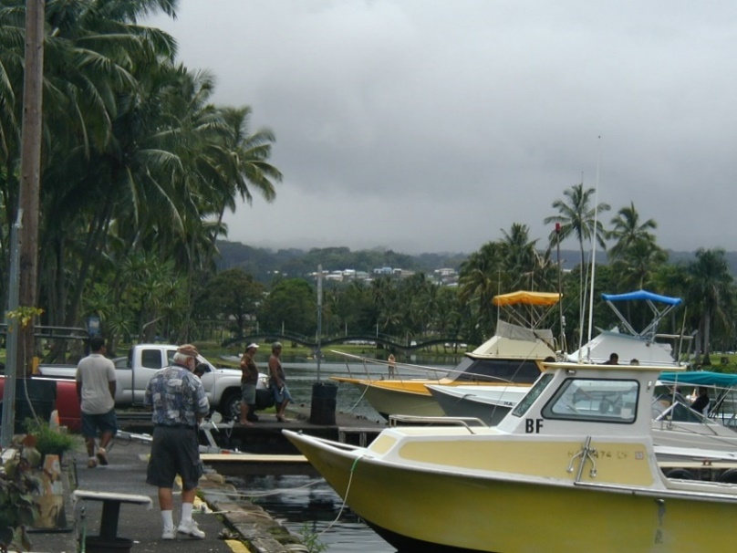
Access Point Angler Intercept Survey
Sampling frame is stratified by fishing mode:
Shore fishing
Private-boat fishing
& by wave:
Wave 1 (January − February)
Wave 2 (March − April)
Wave 3 (May − June)
Wave 4 (July − July)
Wave 5 (September − October)
Wave 6 (November − December)
Shoreline
Kauai
Oahu
Molokai
Maui
Hawaii
Private boat
Notes:
The Access Point Angler Intercept Survey for catch rate is stratified by fishing mode and wave. The fishing mode includes shore fishing and private-boat fishing. There are six waves in a year, wave 1 is January to February and wave 6 is November to December.
For the intercept survey, anglers are interviewed at shore fishing sites or boat ramps across five main Hawaiian Islands including Hawaii, Maui, Molokai, Oahu, and Kauai.

Slide 6
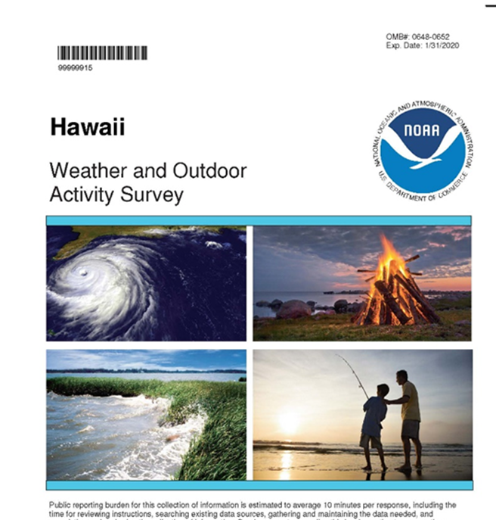



Fishing Effort Survey
Pre-2018
2018 − present
Notes:
For the fishing effort survey, two to three thousand households in Hawaii are randomly selected each two months to collect information on the number of angler trips for non-commercial/recreational fishing from shore and from private boats. In the Pacific Islands region, the term non-commercial fishing is more commonly used when the fish harvested are not intended to enter commerce. For the rest of the presentation I will use the term non-commercial only.
The fishing effort survey has been conducted through a mail survey since 2018. Prior to 2018, the survey was conducted through a landline telephone survey.

Slide 7
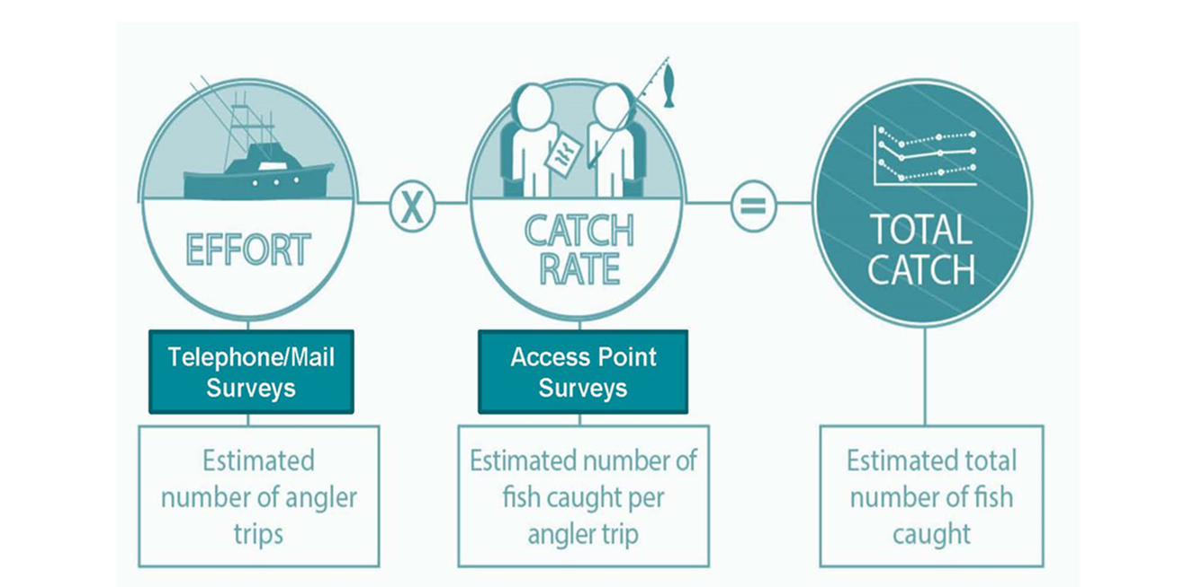
Catch estimation
Catch rate and fishing effort are separated by fishing mode (i.e., shore fishing or private boat fishing)
Notes:
Fishing effort and catch rate are estimated separately by fishing mode. The pelagic species covered in this study are caught from boat fishing. Catch as the product of catch rate and fishing effort is estimated for catch number first. The general estimation methods in HMRFS were modified for non-commercial catch.

Slide 8
Outline
1. Background on pelagic fishery and Hawaii Marine Recreational Fishing Survey (HMRFS)
2. Modifications to HMRFS catch number estimation
3. Catch weight estimation
4. Summary and conclusion
Notes:
We used catch disposition information in the HMRFS survey data to specify non-commercial catch

Slide 9
Catch dispositions
Eaten/plan to eat (3), sold/plan to sell (5), used for bait (4)…
Notes:
Fishermen selling the catch are required to have a commercial marine license and submit their fishing reports. Some of the fishermen intercepted by HMRFS may sell their catch.
To avoid double counting between HMRFS catch estimates and the catch reported in the commercial fishing reports, the catch with disposition of “sold/plan to sell” in the survey data was excluded for non-commercial catch estimation. This approach has been used for some important fish stocks in Hawaii such as Deep7 bottomfish and uku in the main Hawaiian Islands. We are applying this approach to the pelagic species as well.

Slide 10
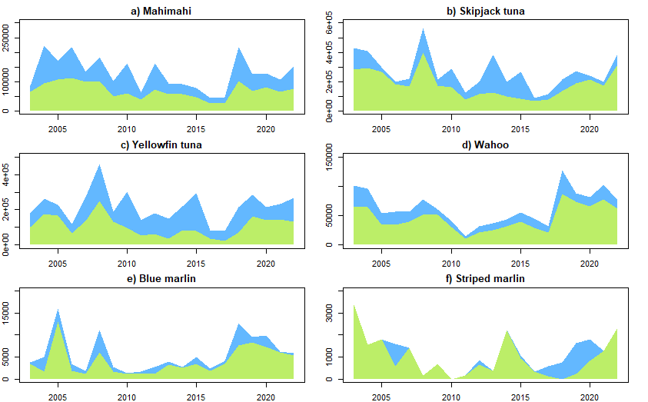
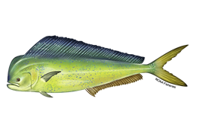
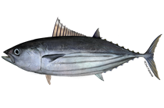
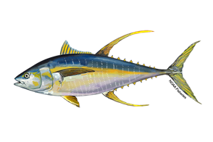
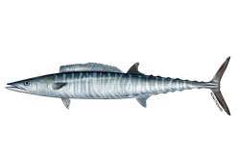
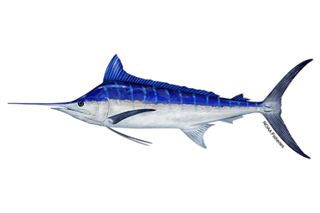
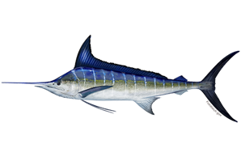
HMRFS: total catch ( ) vs non-sold catch ( )
Catch (number of fish)
Notes:
Shown on the panels are the catch number estimates for six pelagic species in 2003 to 2022. Skipjack and yellowfin tuna had the highest total catch numbers. Mahimahi and wahoo had the intermediate catch numbers. Blue marlin and striped marlin were an order of magnitude lower in catch number.
By removing the sold catch from the HMRFS survey data, the non-sold catch estimates (shown in green) decreased by approximately 50% for mahimahi and yellowfin tuna. The non-sold catch estimates for other four species decreased by 20-30%. Without removing the sold catch from HMRFS data, the sum of HMRFS catch estimate and the catch from the commercial reports would overestimate total fish removal for fish stock assessment and for fisheries management.

Slide 11
Outline
1. Background on pelagic fishery and Hawaii Marine Recreational Fishing Survey (HMRFS)
2. Modifications to HMRFS catch number estimation
3. Catch weight estimation (catch weight = catch number*mean weight)
4. Summary and conclusion
Notes:
Catch weight was estimated as the product of the catch number and an average weight of a fish in an estimation domain. Previously the average of the weight measurements from all years was used to estimate annual catch weights from annual catch numbers for Deep 7 bottomfish and uku, due to a limited number of weight measurements at finer time scales. For the six pelagic species, we also considered other options

Slide 12
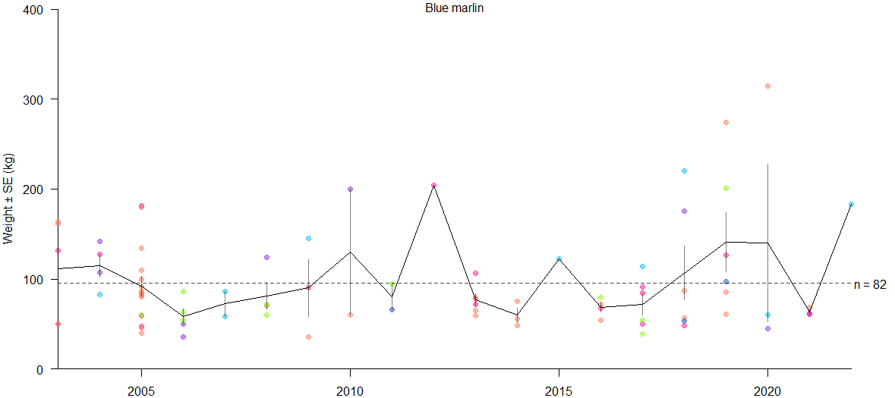
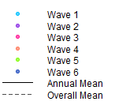
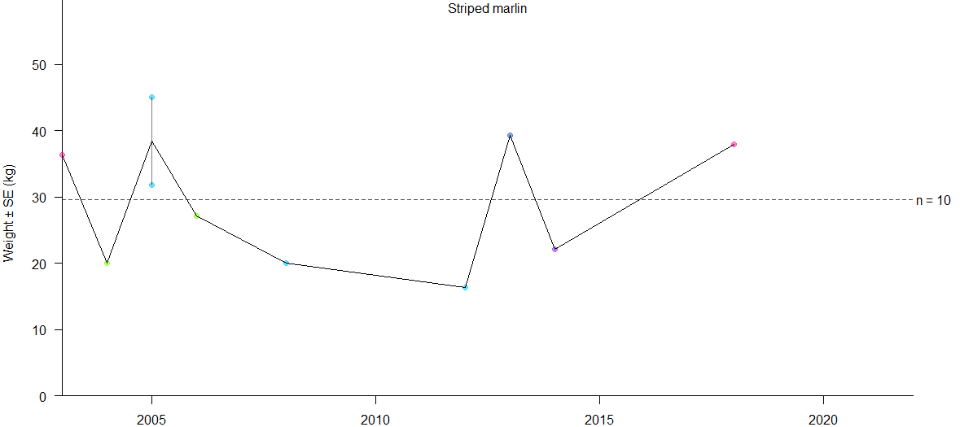
Mean weight estimation
Notes:
There were less than 100 weight measurements during the past 20 years for blue marlin and striped marlin, so only the overall mean weights were used for catch weight estimation.
The color dots aligned vertically represent individual weight measurements in kilogram within each year in 2003-2022. The solid line indicates the mean weights for individual years and dash line for the mean weight from all years combined.

Slide 13
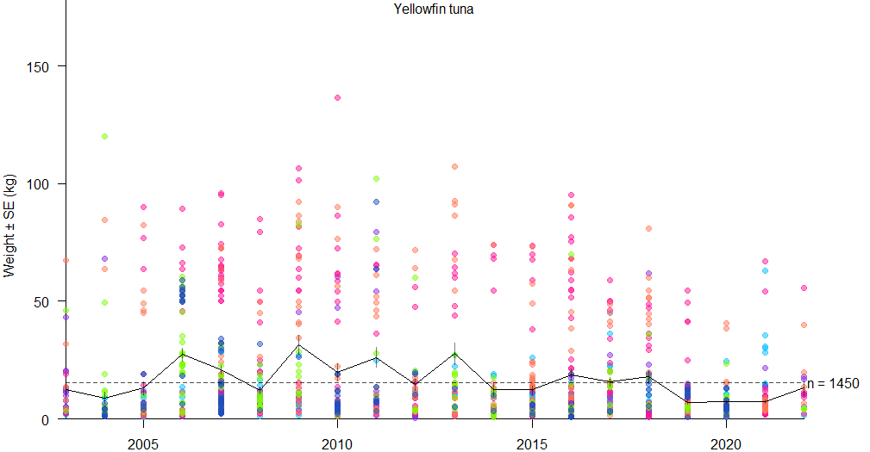
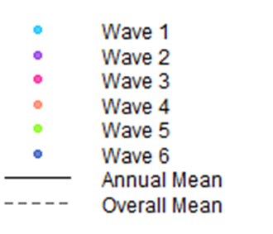
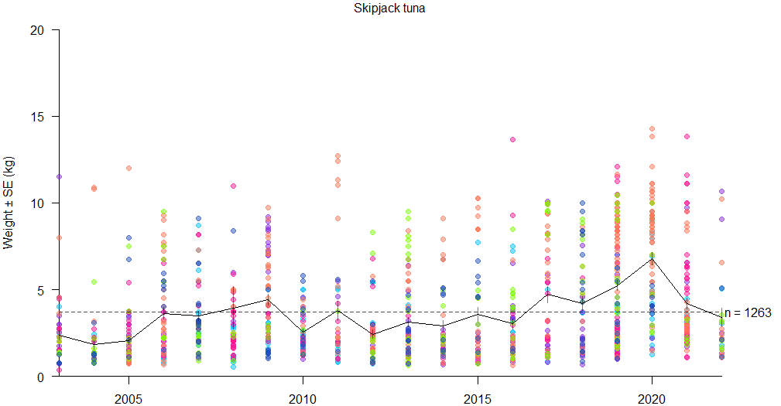
Notes:
The other four pelagic species had more than 1,000 weight measurements each during the past 20 years, allowing annual mean weights to be used. There were noticeable changes in annual mean weight over time for yellowfin tuna and skipjack tuna. For yellowfin tuna, the annual mean weights were lower in recent years. Yellowfin tuna caught appeared to be bigger in wave 3 and wave 4 shown in pink and orange.
The annual mean weights for skipjack appeared to be higher in recent years. The highest mean weights in 2019 and 2020 were driven by larger skipjack in wave 4 shown in orange. The trend in skipjack tuna mean weight was also evident in the commercial catch data.

Slide 14
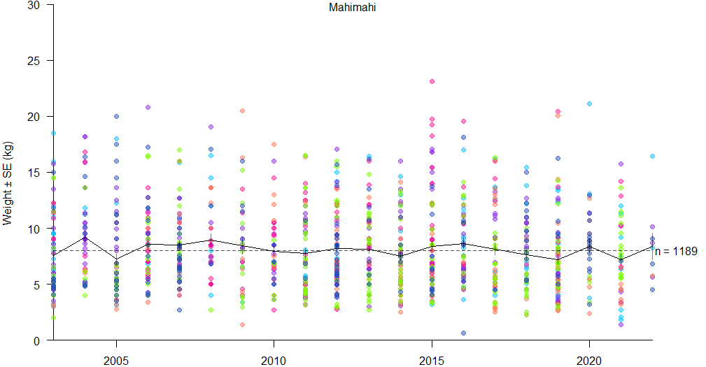
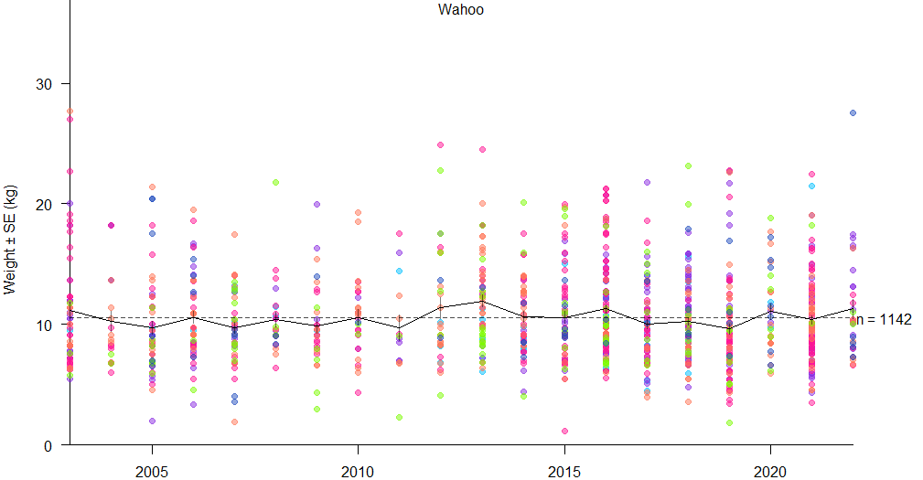
Notes:
The annual mean weights of mahimahi and wahoo didn’t show obvious trends over the years. For wahoo on the bottom panel the annual mean weights were around 10 kilograms and there were no clear patterns among waves.

Slide 15
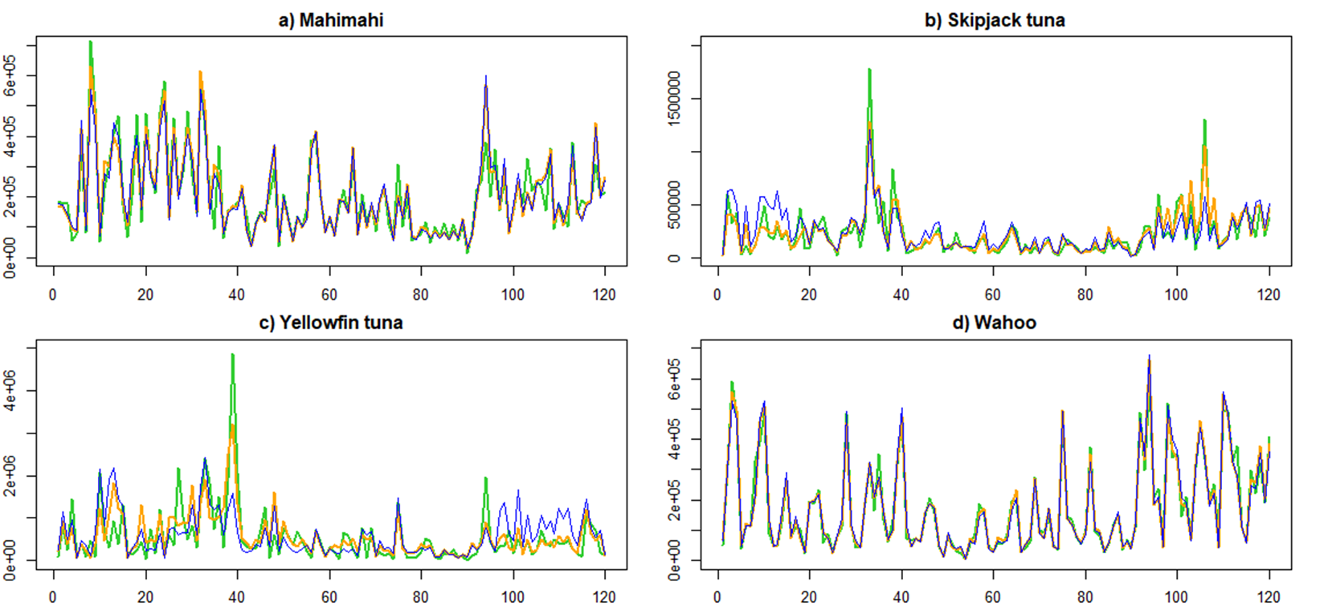
Catch weight by wave (2-month period)
overall mean weight annual mean wave mean
Catch weight (lb)
Wave in years 2003-2022
Notes:
The catch numbers were always estimated by wave. The catch weight estimates presented at the wave level can be sensitive to the kind of mean weight used depending on the species: it is nearly insensitive for wahoo, little sensitive for mahimahi, a bit more sensitive for yellowfin tuna and skipjack tuna.
The blue lines are the catch weight estimates using overall mean weight, orange lines using annual mean weight, and green lines using wave mean weight. You can barely see differences among three colored lines for wahoo. There were some minor differences for mahimahi. There were notable differences in some waves for yellowfin tuna and skipjack tuna.

Slide 16
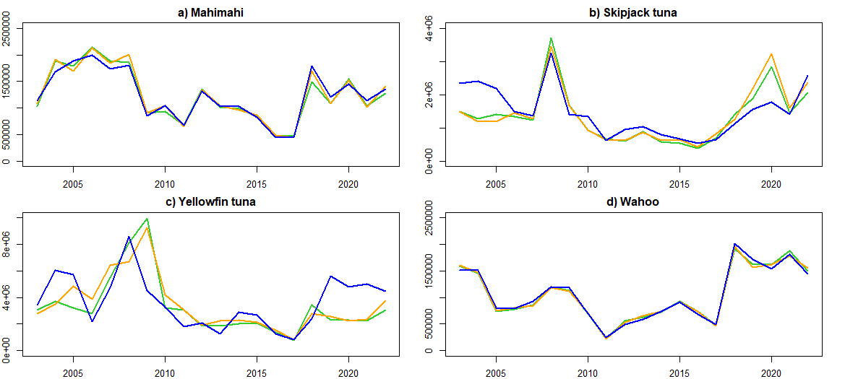
Annual catch weight estimates
Overall mean weight annual mean wave mean
Catch weight (lb)
Year
Notes:
The panels on this slide show the catch weight estimates summarized by year. Depending on the mean weight used, there were noticeable differences in annual catch for yellowfin tuna and skipjack tuna. The major differences were due to using overall mean weight (shown in blue) vs using annual mean or wave mean (orange or green). For skipjack tuna, the major differences are shown in the beginning 3 years and in 2019-2020. For yellowfin tuna, the differences are shown in the first 7 years and the last 4 years.
The differences in annual catch estimate between using annual mean weight shown in orange versus using wave mean weight in green were minor.
For wahoo, the annual catch weight estimates were very similar regardless of which mean weight being used. The annual catch weight estimates using 3 different mean weights were also similar for mahimahi.

Slide 17
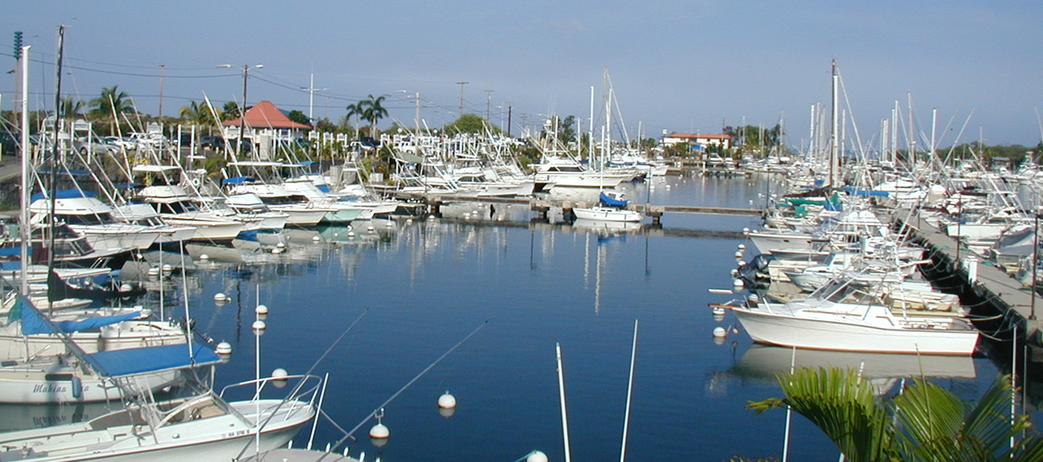
Summary and conclusion
Separating the sold catch from HMRFS resulted in significant changes in the non-commercial catch estimates.
Using annual mean weight may be able to capture the mean-weight changes over the years.
Further investigations are needed to use wave mean weight to track seasonal variations.
Notes:
1. In summary, by excluding sold catch in the survey data, the non-commercial catch estimates had significant changes for yellowfin tuna and mahimahi.
2. There were variations in annual mean weight for yellowfin and skipjack tuna. Using annual mean weight resulted in changes in annual catch weight estimates for these two species compared with the estimates using overall mean weights. (Using mean weight by wave did not change the annual catch weight estimates much compared with using annual mean weight).
3. When the catch weight estimates by a 2-month period are needed, these estimates can differ depending on whether annual mean weight or wave mean weight is used. The mean weight estimates at the wave level may capture seasonal variation but these mean weight estimates can be limited by small sample size in some waves.

Slide 18
Acknowledgments
HMRFS survey team for collecting the survey data
Working group of the Western Pacific Regional Fishery Management Council’s Archipelagic Plan Team
Colleagues at NOAA Pacific Islands Fisheries Science Center’s Stock Assessment Program
Notes:
We would like to thank HMRFS survey team for collecting the survey data, the Council’s APT working group for helpful discussion, PIFSC SAP for constructive review/comments.

Slide 19
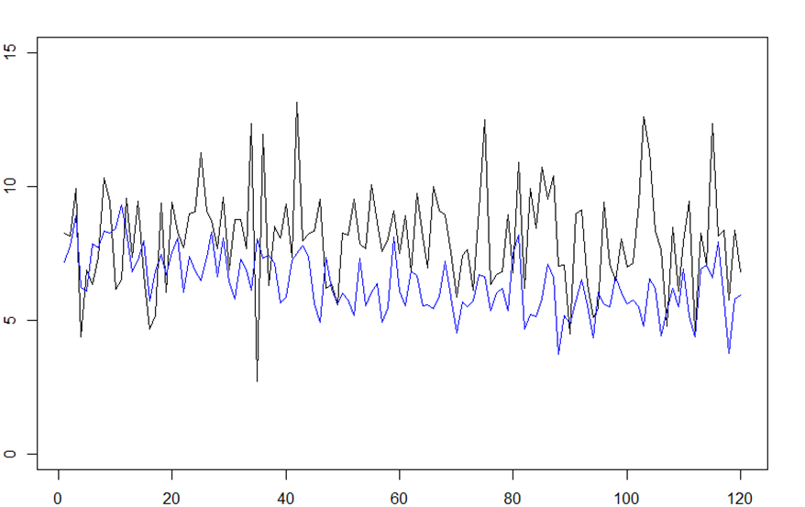
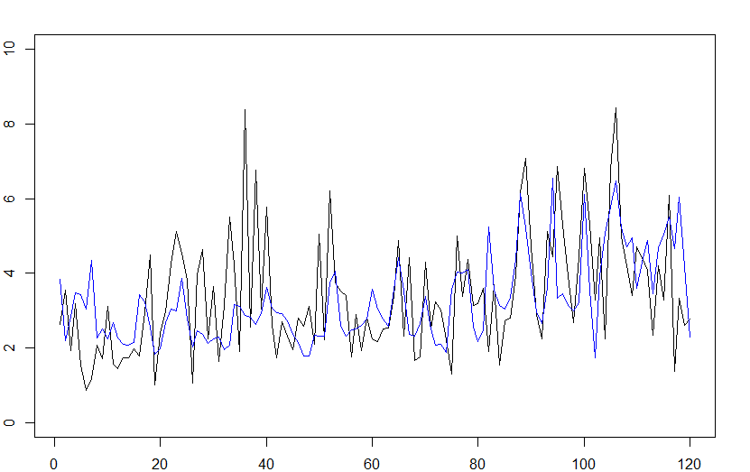
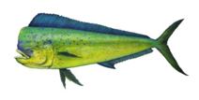

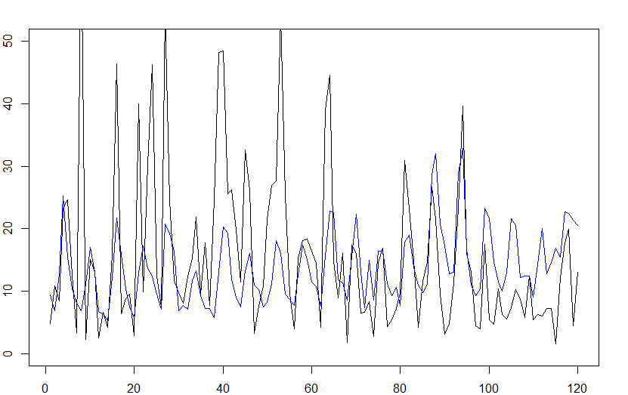
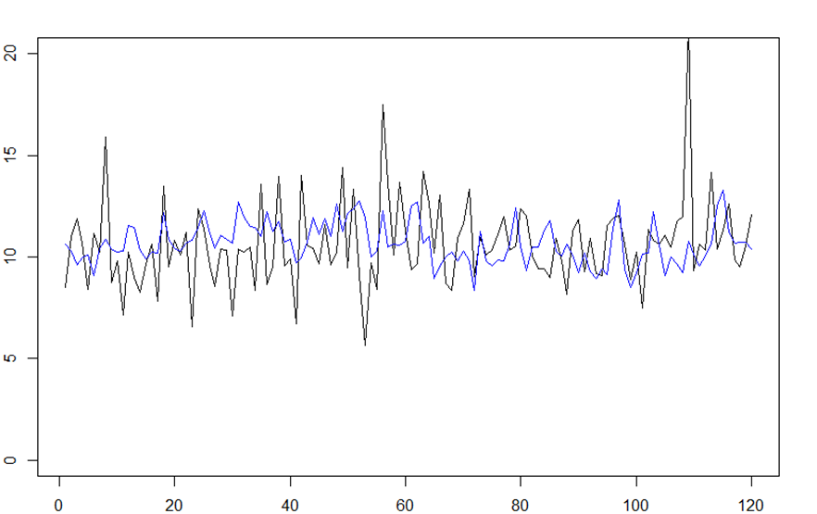
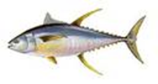
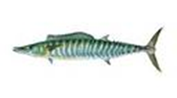
Additional slides – wave mean weights from HMRFS (black) vs from commercial reports
Notes:
Wave mean weights from survey (black) vs from commercial fishing reports (blue) for mahimahi, skipjack, yellowfin tuna, and wahoo.
There were larger fluctuations in mean weight from HMRFS. Some of these high mean weights are associated with small sample size (<5) marked with asterisk, especially for yellowfin tuna.
For skipjack, there were similar trends between the survey mean weights and the mean weights from the commercial data, especially in later years. The magnitude of the mean weight for wahoo was very similar between survey and commercial reports.

Slide 20
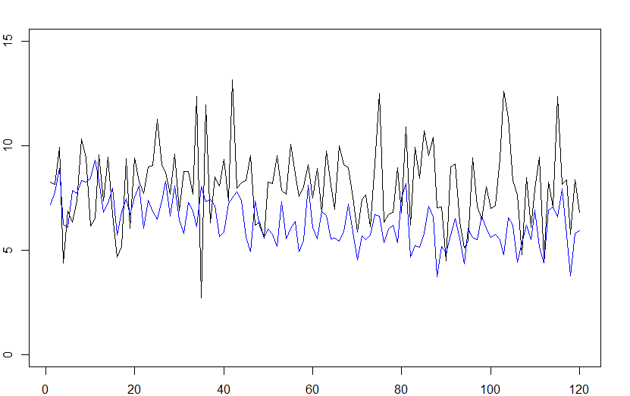
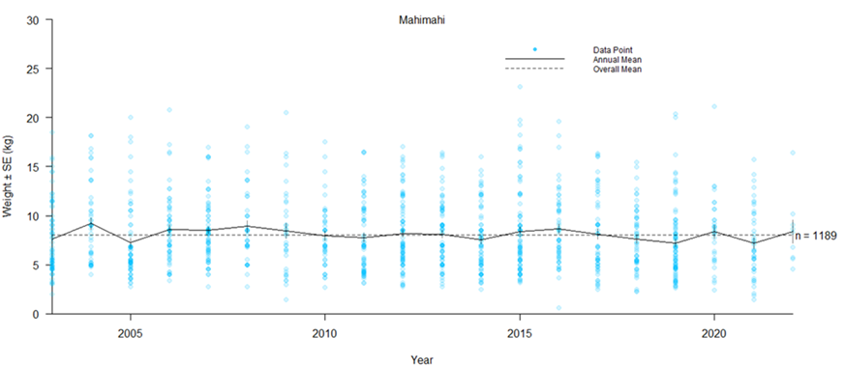
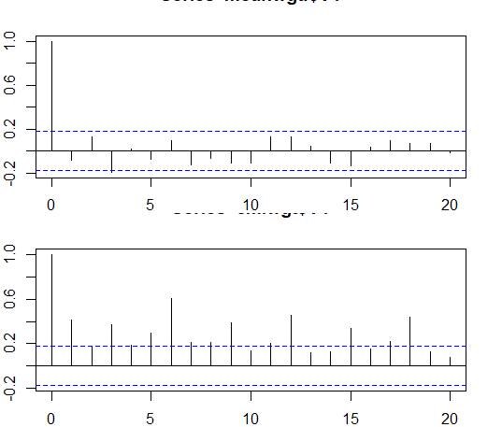
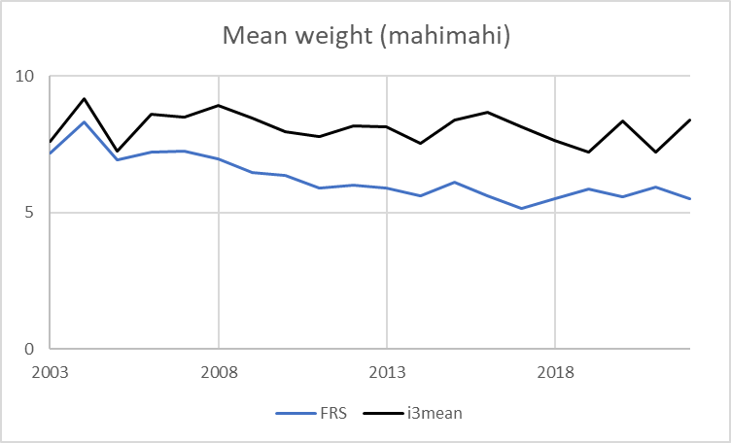
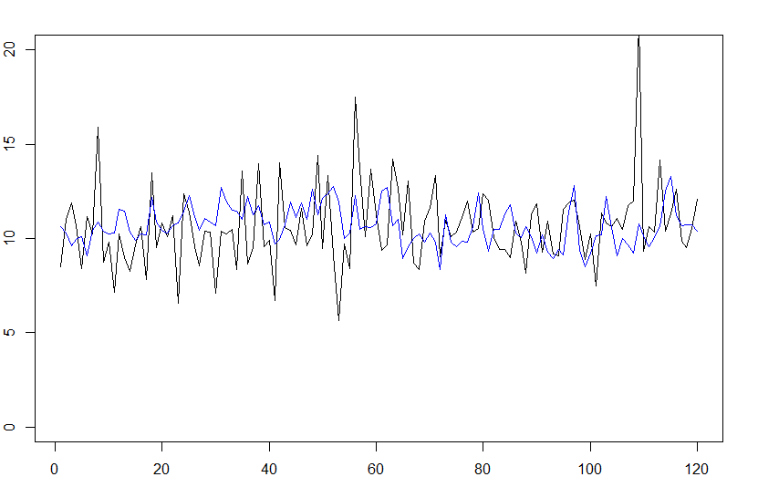
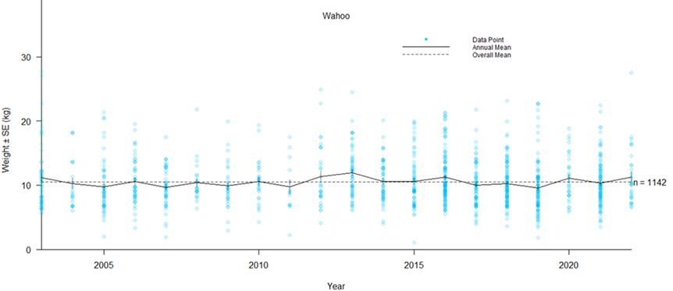
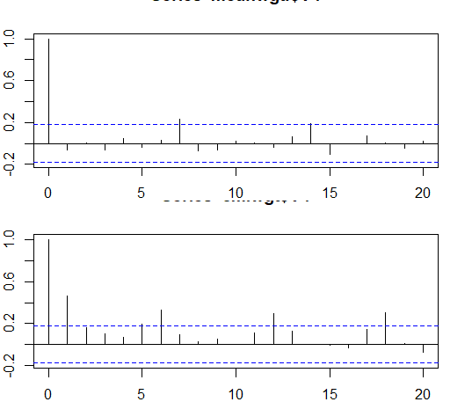
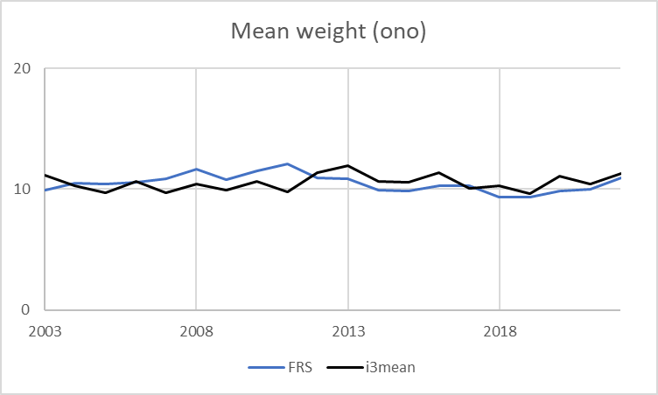
ACF
Notes:
Seasonal cycle is not clear based on acf (top panels on the right, 1st survey &2nd commercial for comparison) for mahimahi and wahoo.
Left panels showing annual mean weights from survey (black) vs the annual mean weights in commercial fishing reports (blue). The annual mean weights were very similar for wahoo between the two sources.
There is no significant correlation between FRS mean weight and HMRFS mean weight for wahoo. There is a significant correlation for mahimahi (P=0.04)

Slide 21
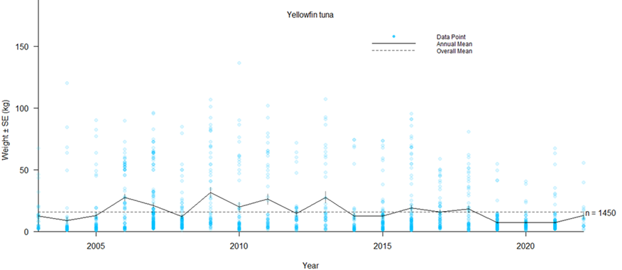
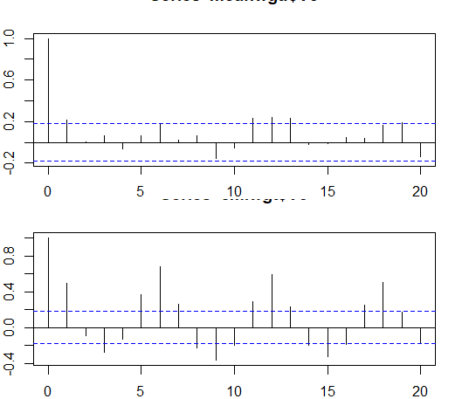
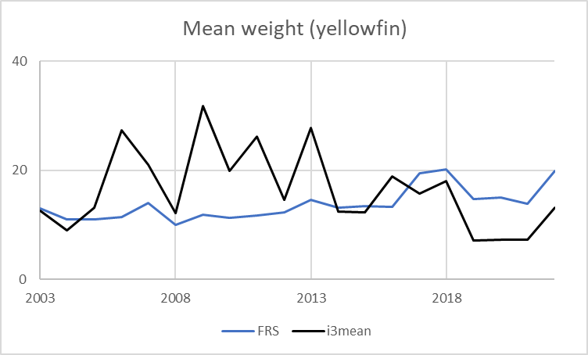
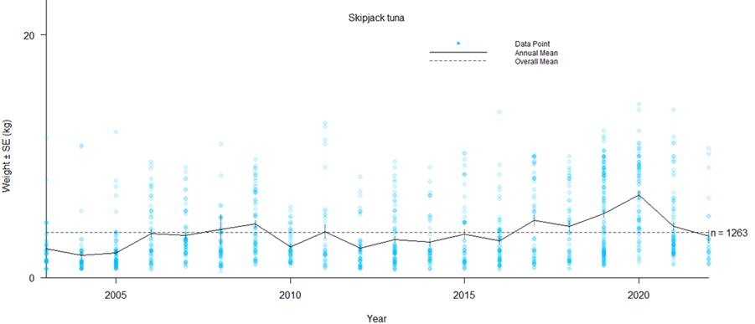
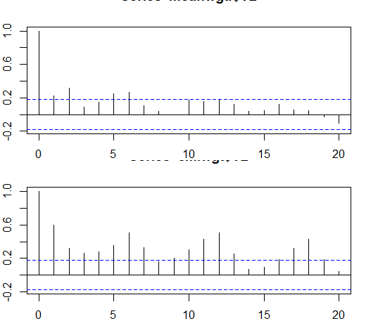
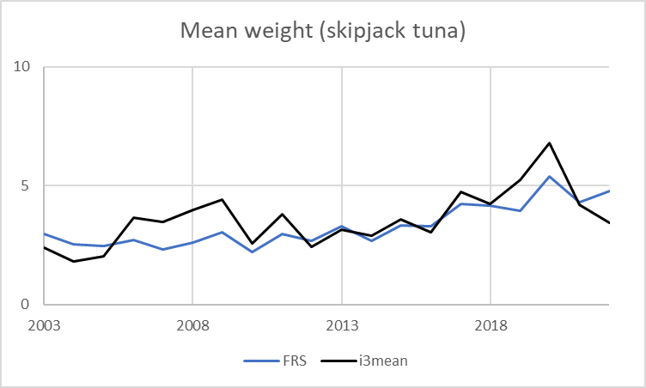
Notes:
There appear to be a seasonal cycle for yellowfin and skipjack. The trend in skipjack tuna mean weight was also evident in commercial fishing reports.
There is a significant correlation between FRS mean weight and HMRFS mean weight for skipjack and yellowfin. But there were larger fluctuations in HMRFS means, especially for yellowfin in early years.

Slide 22
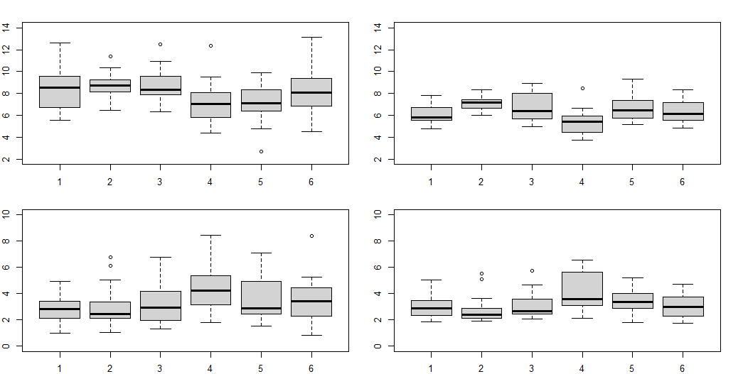

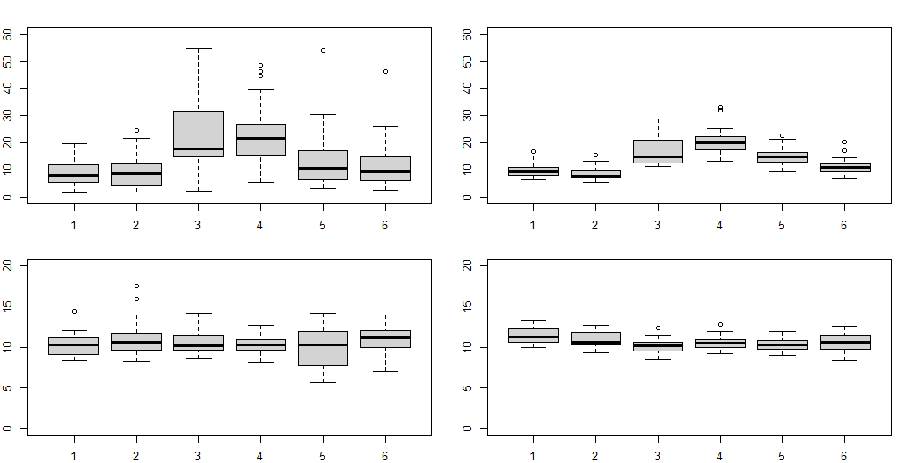
Mean weight by wave (boxplot) in 2003-2022 (left-HMRFS, right-commercial)
Notes:
Average wave-mean weights in 2003-2022 from survey (left) and from commercial fishing reports (right) for mahimahi, skipjack, yellowfin, and wahoo. The mean weights were higher for yellowfin tuna in waves 3&4 in both data sources

