Slide 1

Leveraging Wearable Sensor Data to Improve Self-Reports in Survey Research
Deji Suolang , Brady T. West
University of Michigan – Ann Arbor
Presented at JSM on August 7, 2024

Slide 2
Acknowledgement
I would like to thank my advisor, Dr. Brady West, and other committee members, Drs. Trivellore Raghunathan, Frederick Conrad, and Bella Struminskaya for their guidance and support during the research process.

Slide 3
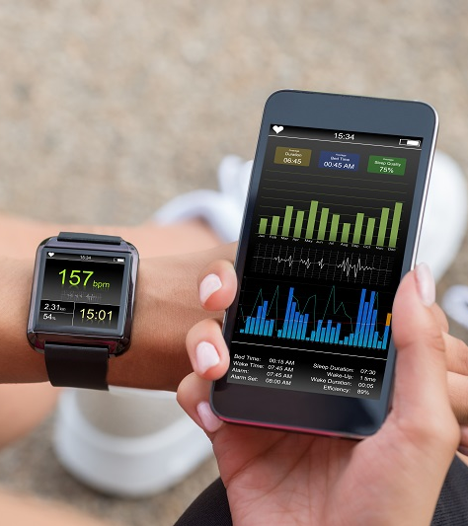
Background
Survey self-reports
Easy implementation, less expensive, and general public acceptance.
Large sample data collection is common.
Prone to measurement error.
Wearable sensor data
Objective measurement for behaviors and factual occurrences.
  e.g., physical movement, step count, geolocation.
Minimal response burden, but rich data with detailed precision.
Expensive and challenging to administer to a large sample.

Slide 4
Data integration
Purpose: Improve measurement
Cost constraints and implementation challenges prevent researchers from collecting sensor data from a large probability-based sample.
Large size
Affordable
Error-prone
Small size
Higher precision
Expensive
New insights
(Selection bias)
Keusch & Conrad, 2022

Slide 5
Mass imputation
Variables that are lacking in one data source are “filled in” using information available in other sources.
  e.g., missing sensor measurements in a larger probability sample
Researchers have explored various imputation techniques, combining surveys with other probability-based surveys, administrative records, or clinical data.
  While much work has advanced these techniques, there is a gap in applying them to combine survey with sensor data, especially when there are multiple target variables.
Davern et al., 2019; Gelman et al., 1998; Kim et al., 2021;
Lohr & Raghunathan, 2017; Schenker & Raghunathan, 2007; Spiegelman et al., 1997

Slide 6
Motivating Datasets
The National Health and Nutrition Examination Survey (NHANES) and the National Health Interview Survey (NHIS), both conducted by the U.S. National Center for Health Statistics from 2011 to 2014, collect sociodemographic and health data through interviews.
NHANES additionally collects objective physical activity data from a wrist-worn accelerometer. However, it is limited to a small number of PSUs (n = 10,669).
NHIS, one of the largest health surveys in the U.S., solely relies on self-report survey interviews (n=117,665).

Slide 7
Physical activity as an example
  Measurement error in self-reports
  Recall error
  Social desirability bias
Past research has shown substantial discrepancies between self-reports of physical activity and corresponding sensor measurements, and these discrepancies vary by different subgroups.
Lee et al., 2011; Troiano et al., 2008; Tully et al., 2020

Slide 8
Can we leverage data containing both sensor and survey measurements to improve other surveys relying solely on self-reports through imputation?

Slide 9
Proposed idea
Data source 1: donor
observed Y
Data source 2: receiver
imputed Y*
Data sources 1 and 2 share a set of common variables as a bridge between them.

Slide 10
  Shared survey variables in NHANES and NHIS
  Physical activity frequency and duration
    MPA duration: Total duration of leisure-time moderate-intensity physical activity that lasts at least 10 minutes continuously.
    VPA duration: Total duration of leisure-time vigorous-intensity physical activity that lasts at least 10 minutes continuously.
  Other variables
    Socio-demographic characteristics
      Age, race-ethnicity, gender, marital status, education level, income poverty ratio, work status, and insurance status, year of data collection
    Lifestyle and health
      Self-rated health, insurance coverage, BMI, smoking behavior, and alcohol usage
    Health conditions
      Hypertension, diabetes, heart disease, cancer, stroke

Slide 11
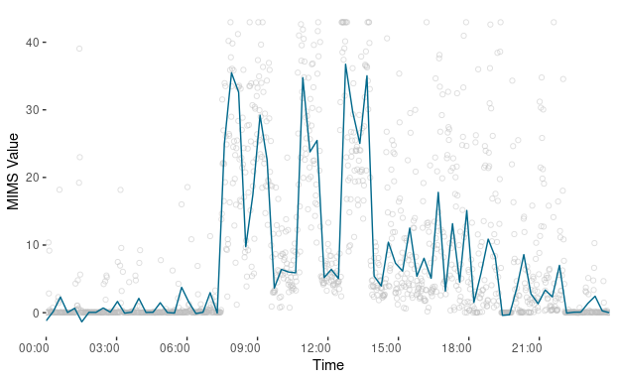
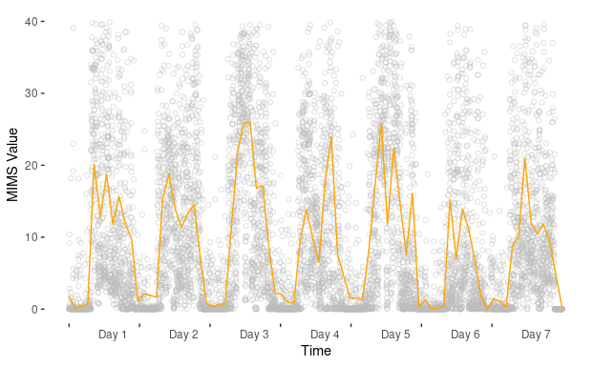
What does sensor data look like?
An individual’s MIMS values in one day and one week, as an example.
  In NHANES, the acceleration the wearable sensor device detects on three axes at the minute level is recorded in the monitor-independent-movement-summary (MIMS) units.

Slide 12
Sensor-measured variables
  We analyze the MIMS values to create the following variables:
  Summary measures that are analogous to the ones in the survey
  Functional Principal Component Analysis (FPCA)
    The scores of the top four Functional Principal Components (FPCs) are considered variables reflecting the activity pattern.
  After the imputation, we perform Latent Profile Analysis (LPA) on FPC scores to interpret the activity patterns.
MIMS value
Activity count
Intensity level
MPA duration
VPA duration

Slide 13
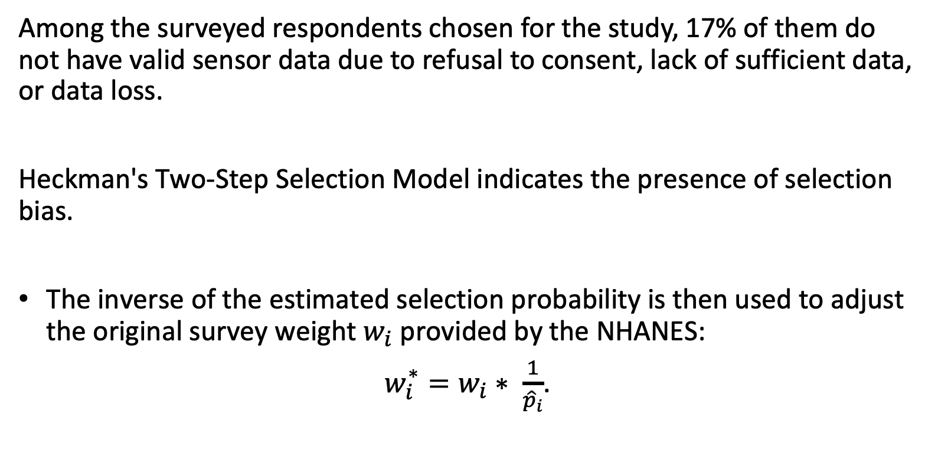
Selection bias in NHANES sensor data
Among the surveyed respondents chosen for the study, 17% of them do not have valid sensor data due to refusal to consent, lack of sufficient data, or data loss.
Heckman's Two-Step Selection Model indicates the presence of selection bias.
The inverse of the estimated selection probability is then used to adjust the original survey weight $w_{i}$ provided by the NHANES:
$w_{i}^{∗}=w_{i}∗ \frac{1}{{\hat{p}}_{i}}$.

Slide 14
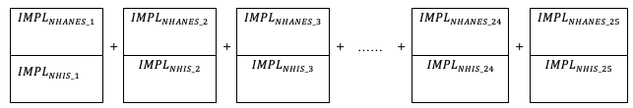
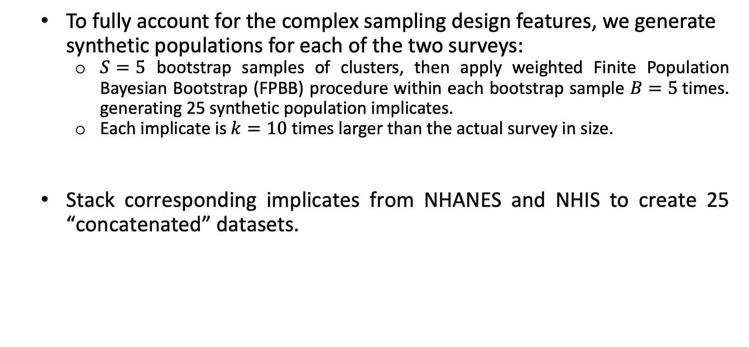
Synthetic populations
  To fully account for the complex sampling design features, we generate synthetic populations for each of the two surveys:
    $S=5$ bootstrap samples of clusters, then apply weighted Finite Population Bayesian Bootstrap (FPBB) procedure within each bootstrap sample $B=5$times. generating 25 synthetic population implicates.
    Each implicate is $k=10$ times larger than the actual survey in size.
  Stack corresponding implicates from NHANES and NHIS to create 25 “concatenated” datasets.
Dong et al., 2014a, 2014b

Slide 15
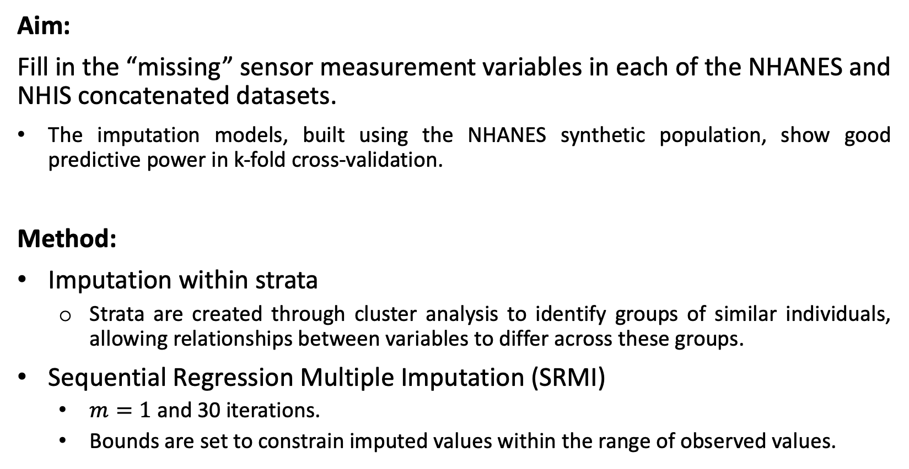
  Missing data imputation
Aim:
Fill in the “missing” sensor measurement variables in each of the NHANES and NHIS concatenated datasets.
The imputation models, built using the NHANES synthetic population, show good predictive power in k-fold cross-validation.
Method:
Imputation within strata
  Strata are created through cluster analysis to identify groups of similar individuals, allowing relationships between variables to differ across these groups.
Sequential Regression Multiple Imputation (SRMI)
  $m=1$ and 30 iterations.
  Bounds are set to constrain imputed values within the range of observed values.

Slide 16
  Missing data imputation (Cont.)
Software:
Imputation and Variance Estimation Software (IVEware)
  It supports imputation with bounds set to ensure the realistic imputed values.
Combine the estimates with FPBB rules:
The posterior variance is entirely a function of the “between” synthetic population variances.
Raghunathan, 2006

Slide 17
Results: Comparison of population inferences
 | NHANES (observed) |  | NHIS (imputed) |  | Concatenated
Survey Self-Report | Mean | SE | Mean | SE | Mean | SE
MPA duration in minutes | 71.2937 | 1.1633 | 100.6809 | 0.4725 | 98.6207 | 0.5025
VPA duration in minutes | 44.1447 | 2.2396 | 82.1089 | 0.4667 | 79.4473 | 0.3764
Sensor Measurement
MPA duration in minutes | 114.0963 | 1.947 | 114.2546 | 2.6073 | 114.2435 | 2.5475
VPA duration in minutes | 90.2646 | 1.748 | 99.7628 | 4.1638 | 99.0969 | 3.9769
Activity pattern 1 (proportion) | 0.0998 | 0.0025 | 0.1020 | 0.0053 | 0.1018 | 0.0051
Activity pattern 2 (proportion) | 0.4419 | 0.0085 | 0.4403 | 0.0104 | 0.4404 | 0.0103
Activity pattern 3 (proportion) | 0.2675 | 0.0064 | 0.3372 | 0.0120 | 0.3324 | 0.0116
Activity pattern 4 (proportion) | 0.1909 | 0.0061 | 0.1204 | 0.0075 | 0.1254 | 0.0073
Activity pattern:
1. Highly active, early riser, biphasic peak, active evening; 2. Moderately active, mid-morning riser, monophasic peak, active evening;
3. Moderately active, late riser, biphasic peak, restful evening; 4. Lightly active, somewhat early riser, monophasic peak, restful evening.
Notes:
These slides contain animation effects.
After the imputation and we have the complete dataset, then we look the population inference we could draw based on different measurement methods and data sources.

Slide 18
Results: Differences by subgroup
Whether and how the findings are different by subgroups defined by age, race/ethnicity, and education level.
Subgroups characterized by older age (>=50), lower education levels, and racial minorities (non-Hispanic Black, Hispanic, and other minorities) show larger discrepancies between self-reports and sensor measurements.
  This suggests that utilizing sensor measurements could be particularly beneficial for enhancing measurement accuracy among these subgroups.

Slide 19
Ability to predict health conditions
Self-reported and sensor-measured physical activity values in the concatenated synthetic population data are used to predict health conditions as a means for evaluating data quality, using logistic regression.
Hypertension, diabetes, heart disease, cancer, and stroke
Model 1 uses self-reported MPA and VPA durations (in hours) as physical activity measurements
Model 2 uses sensor-measured MPA and VPA durations (in hours) and activity patterns as physical activity measurements.
Both models control for age, gender, race, and education.

Slide 20

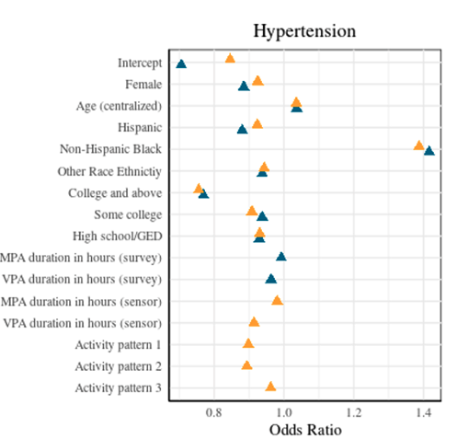
Results: Coefficients in logistic regression
Both measurements suggest increases in MPA and VPA durations are associated with reduced risk of various health conditions. Smaller odds ratios are observed in Model 2.
Modest shifts are observed for the coefficients between Models 1 and 2.
Activity patterns show statistical significance as predictors.
Hypertension is an example

Slide 21
Results: Prediction model performance
Metric | Hypertension | Diabetes | Heart Disease | Cancer | Stroke
 | Model 1 (self-reports)
R² | 0.1761 | 0.1203 | 0.1350 | 0.1573 | 0.1386
Deviance | 1,293,734 | 759,808 | 756,137 | 641,159 | 277,976
AIC | 1,293,756 | 759,830 | 756,159 | 641,181 | 277,998
BIC | 1,293,888 | 759,963 | 756,292 | 641,314 | 278,130
 | Model 2 (sensor measurement)
R² | 0.1825 | 0.1324 | 0.1453 | 0.1591 | 0.1548
Deviance | 1,283,572 | 749,362 | 747,128 | 639,787 | 272,753
AIC | 1,283,600 | 749,390 | 747,156 | 639,815 | 272,781
BIC | 1,283,769 | 749,559 | 747,325 | 639,984 | 272,949

Slide 22
Summary
Mean estimates of self-reported physical activity differ between data sources, whereas sensor measurements are more similar.
Survey self-reports appear to underestimate physical activity duration, and therefore it is important to have sensor measurement as an additional source for the validation.
Utilizing sensor measurements could be particularly beneficial for enhancing measurement accuracy among subgroups characterized by older age, lower education levels, and racial minorities.
Models predicting health conditions using sensor measurements demonstrate better performance and fit.
Broad applicability for survey methodologists and analysts in clinical, health, social, and behavioral sciences research, providing methods to enhance survey measurements by integrating multiple data sources, particularly using wearable sensor data.

Slide 23
Future direction
We propose a simulation study to assess whether the integration of wearable sensor measurements and self-reported data, through the imputation, can maintain its effectiveness under various scenarios.

Slide 24
References
Davern, M. E., Meyer, B. D., & Mittag, N. K. (2019). Creating Improved Survey Data Products Using Linked Administrative-Survey Data. Journal of Survey Statistics and Methodology, 7(3). https://doi.org/10.1093/jssam/smy017
Dong, Q., Elliott, M. R., & Raghunathan, T. E. (2014a). A nonparametric method to generate synthetic populations to adjust for complex sampling design features. Survey Methodology, 40(1).
Dong, Q., Elliott, M. R., & Raghunathan, T. E. (2014b). Combining information from multiple complex surveys. Survey Methodology, 40(2).
Gelman, A., King, G., & Liu, C. (1998). Not asked and not answered: Multiple imputation for multiple surveys. Journal of the American Statistical Association, 93(443). https://doi.org/10.1080/01621459.1998.10473737
Keusch, F., & Conrad, F. G. (2022). Using Smartphones to Capture and Combine Self-Reports and Passively Measured Behavior in Social Research. Journal of Survey Statistics and Methodology, 10(4). https://doi.org/10.1093/jssam/smab035
Kim, J. K., Park, S., Chen, Y., & Wu, C. (2021). Combining non-probability and probability survey samples through mass imputation. Journal of the Royal Statistical Society Series A: Statistics in Society, 184(3), 941-963.
Lee, P. H., Macfarlane, D. J., Lam, T. H., & Stewart, S. M. (2011). Validity of the international physical activity questionnaire short form (IPAQ-SF): A systematic review. In International Journal of Behavioral Nutrition and Physical Activity (Vol. 8). https://doi.org/10.1186/1479-5868-8-115
Lohr, S. L., & Raghunathan, T. E. (2017). Combining survey data with other data sources. Statistical Science, 32(2). https://doi.org/10.1214/16-STS584

Slide 25
References (Cont.)
Schenker, N., Raghunathan, T. E., & Bondarenko, I. (2010). Improving on analyses of self-reported data in a large-scale health survey by using information from an examination-based survey. Statistics in Medicine, 29(5). https://doi.org/10.1002/sim.3809
Spiegelman, D., McDermott, A., & Rosner, B. (1997). Regression calibration method for correcting measurement-error bias in nutritional epidemiology. American Journal of Clinical Nutrition, 65(4 SUPPL.). https://doi.org/10.1093/ajcn/65.4.1179S
Struminskaya, B., Lugtig, P., Keusch, F., & Höhne, J. K. (2020). Augmenting Surveys With Data From Sensors and Apps: Opportunities and Challenges. Social Science Computer Review. https://doi.org/10.1177/0894439320979951
Troiano, R. P., Berrigan, D., Dodd, K. W., Mâsse, L. C., Tilert, T., & Mcdowell, M. (2008). Physical activity in the United States measured by accelerometer. Medicine and Science in Sports and Exercise, 40(1). https://doi.org/10.1249/mss.0b013e31815a51b3
Tully, M. A., McMullan, I., Blackburn, N. E., Wilson, J. J., Bunting, B., Smith, L., Kee, F., Deidda, M., Giné-Garriga, M., Coll-Planas, L., Dallmeier, D., Denkinger, M., Rothenbacher, D., & Caserotti, P. (2020). Sedentary behavior, physical activity, and mental health in older adults: An isotemporal substitution model. Scandinavian Journal of Medicine and Science in Sports, 30(10). https://doi.org/10.1111/sms.13762

Slide 26
Thank you!
Contact information:
dsuolang@umich.edu

Slide 27
Supplemental slide 1
We evaluate the imputation model’s performance through a 5-fold cross-validation using NHANES synthetic population data. The models show promise in predicting six target variables.
Outcome variables | R² | RMSE | MAE
MPA duration in minutes | 0.3854 | 3.8493 | 3.0276
VPA duration in minutes | 0.5921 | 3.8597 | 3.0541
FPC1 score | 0.6219 | 25.1031 | 19.4322
FPC2 score | 0.1829 | 21.3284 | 16.1202
FPC3 score | 0.0983 | 14.7286 | 11.0816
FPC4 score | 0.1855 | 11.1648 | 8.4049

