Slide 1


Automating Quality Control in Recorded Interviews with Machine Learning
JSM, August 2024
Kirsty Weitzel; Peter Baumgartner; Jerry Timbrook
Notes:
Quality Understanding, Intelligence, and Neural Transcription Evaluation Technology

Slide 2
Typical CATI Quality Control Process
Telephone Survey
Audio Recording of Interviews
Manual Quality Control of Random 10%
Interviewer Feedback
Notes:
RTI performs many CATI = Computer Assisted Telephone Interviewing survey projects
Surveys typically over telephone, audio recordings of interviews
A random subsample of interviews are selected for review (e.g., 10%)
Trained Quality Assurance (QA) staff:
Listen to selected interviews (e.g., in-person, recordings)
Note whether interviewers’ performance meets quality expectations
Quality Control (QC) experts generally review ~10% of cases across all interviewer-administered studies manually
Cost prohibitive to manually review 100% of cases
Cases selected at random for review, so QC primarily spend their time reviewing cases that do meet expectations
QC’s time would be better spent reviewing cases that likely do not meet expectations, so QC staff can identify and re-train interviewers with quality issues, improving data quality

Slide 3
Quality Evaluation Background
Initial Contact
Was informed consent was read exactly as worded?
Question Administration
Were questions read exactly as worded in the questionnaire?
Authenticity
Is the interview with the correct sample member?
Notes:
RTI’s Quality Evaluation System
Used to score aspects of interviews like:
Initial Contact (e.g., Was informed consent was read exactly as worded?)
Question Administration (e.g., Were questions are read exactly as worded in the questionnaire?)
Authenticity (e.g., Is the interview with the correct sample member?)
Aspect scores are aggregated to indicate whether interviewer met expectations
Interviewers who do not meet expectations are re-trained

Slide 4
Deviations from Standardization...
Are not uncommon when asking questions
Bradburn et al. 1979
Cannell & Oksenberg 1988
Groves 1989
Fowler & Mangione 1990
Ongena & Dijkstra 2006
Vary by interviewer
Ongena & Dijkstra 2006
Schaeffer & Dykema 2011
Olson et al. 2019
Can identify interviewers who need re-training and questions that need revision
Fowler & Mangione 1990

Slide 5
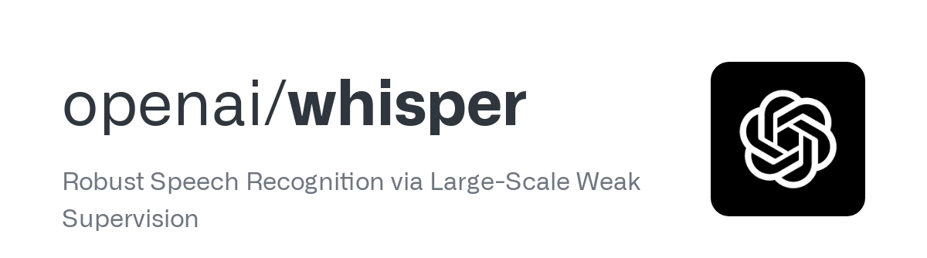
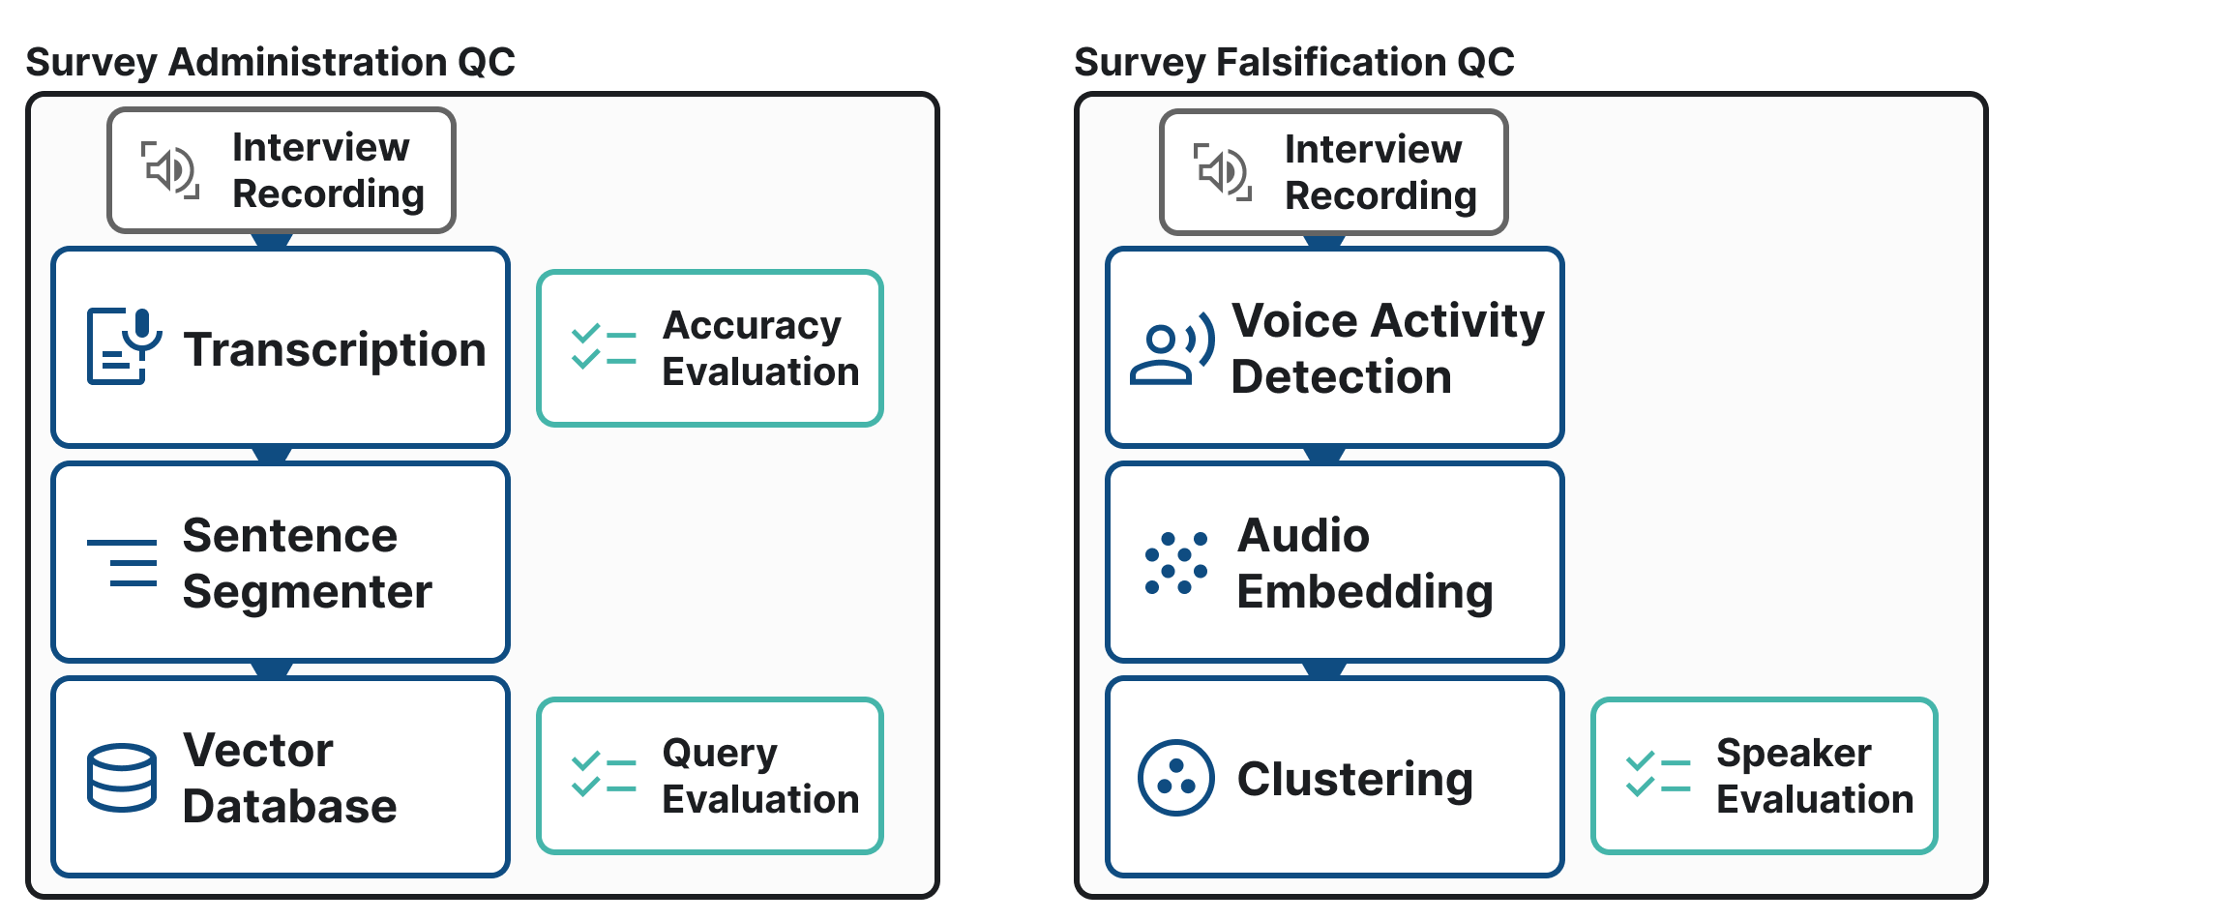

Slide 6
Experiment #1: Transcription – Accuracy Evaluation
Data:
923 recordings
Single-state CATI health study
Methods:
Human Transcription
random subset of n=21 recordings
Whisper Transcription
Same n=21 recordings for each of 5 different whisper models
Analysis:
Calculated the Word Error Rate (WER) of the human-created transcripts vs. Whisper-created
Lower numbers represent less error
< 20% is acceptable
<= 10% is excellent
Notes:
Less than 20% is acceptable/excellent? Why?
Thresholds depend on your usecase
Performance worse on recordings with background noise, distance from microphone, shorter recordings (5 min vs. 60 mins)

Slide 7
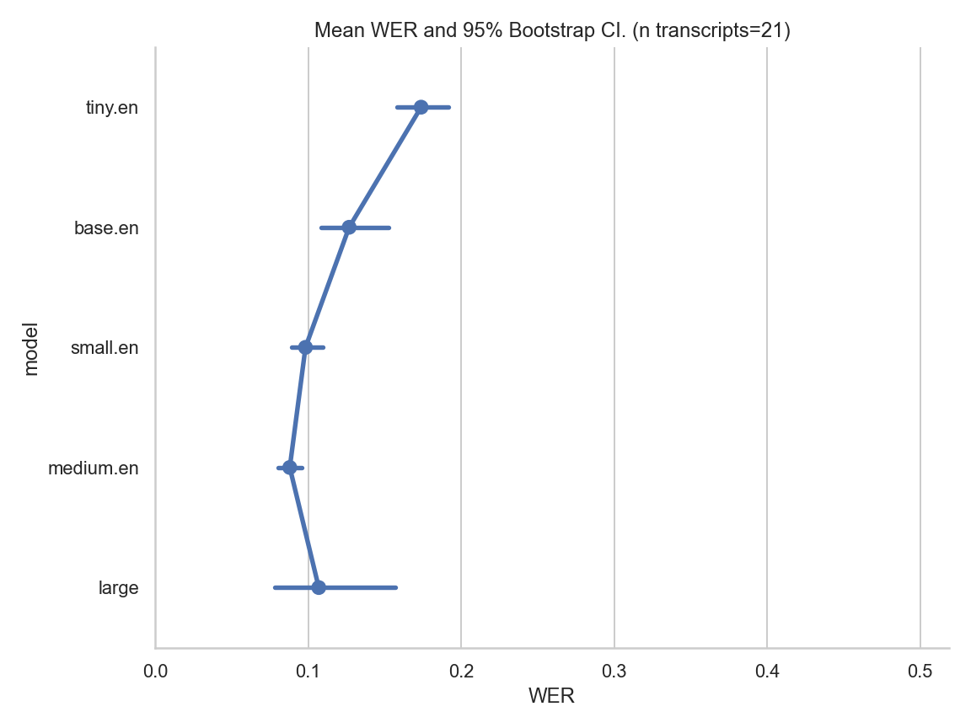
RTI QUINTET Accuracy Evaluation
Transcription Timing:
(recording duration / transcription time)
tiny.en - 77.8x
base.en - 46.1x
small.en - 16.2x
medium.en - 6.3x
large - 3.5x
Notes:
These are results from 21 transcripts from a large healthcare survey.
The metric here is word error rate. Another way to look at it is one minus this value: with a WER of 0.1, we’re transcribing 90% of the words correctly when compared to a reference transcript from a human.
Another important value here is timing: we don’t want to use a larger model if there’s no accuracy benefit because it’ll just take longer. Because of this, we’ve sort of settled on the small.en model which has a transcription ratio of 16.2x, meaning that it can transcribe 16x faster than if you were just to listen to the full recording in real time. Another way to think about it is that at 16 minute interview would be transcribed in 1 minute with the small model.
Large is a multilingual model – set of words/characters that could be predicted is much larger

Slide 8
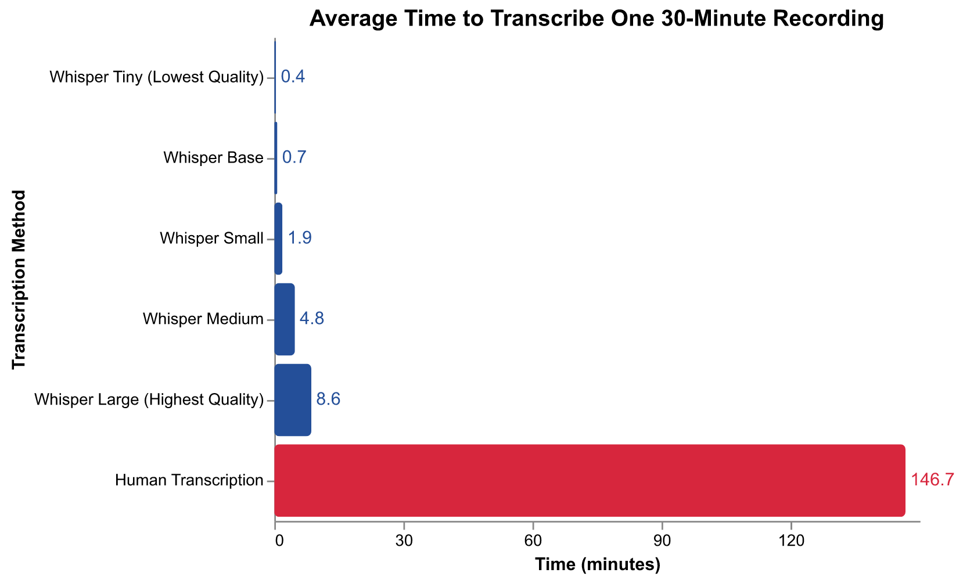
Comparison to Human Effort
​Transcription | Hours
Whisper | 10​
Human​ | 2,256​
Notes:
*Typical labor hours to implement Whisper via QUINTET
**Typical labor hours to transcribe 923 interviews at an average duration of 30 mins ​

Slide 9

Notes:
Openai/whisper
Pysbd: pragmatic sentence boundary disambiguation
vector database: Lancedb
[Walk through problem]
As an example of a specific motivating use case from QC, we want to know whether an interviewer read the consent statement to the respondent, and that they read it correctly.
In our system, we are taking the recording of that administration of the survey and transcribing it with whisper, and this is the first place we do an evaluation of whisper’s accuracy. We're evaluating that by doing human transcription of a set of transcripts, and I'll show you the results of those coming up.
Now, if you've used whisper, one of the things that you'll note is that it sort of transcribes line by line, but a line might be arbitrarily defined, which means that when you look at a transcript from whisper, it’s likely a line going to cut off in the middle of a sentence — it doesn't always have a full sentence as a line in the transcription. What we do there to account for that to get something a little bit more useful, is we sort of mash the whole transcript together and then use a sentence segmenter to break apart the interview into various sentences that are said during the interview so that we can sort of parse it a little bit more easily.
Then finally what we do is we take those sentences and store each of those sentences plus some metadata in a vector database. What a vector database allows us to do is do semantic searches on all of the sentences that occurred within a transcript. The use case here is if we want to understand whether someone read the consent statement in a recording, what we can do is query on each sentence in the consent statement and know whether that sentence or a minor variation of that sentence appeared within the transcript. This is where the vector database and embedding each of these sentences is really handy because of two reasons. One, people don't always say the sentences exactly as written like they should. They may just start a sentence with the word "and" for example, but in that case they haven't lost the meaning of the sentence. So that's fine if they're doing that. Another thing that happens is the transcription isn't 100% accurate. So we need to account for these minor points in variation, which means that we can't do just a search across the transcript for "did someone say this sentence exactly as written in the protocol?" We want some differences there, but we don't really want to specify what those differences could be explicitly. A vector database allows us to embed each of those sentences from a transcript and then search on them in a sort of fuzzy but semantically meaningful way. That's how the survey administration portion works.

Slide 10
Experiment #2: Transcription – Query Evaluation
Evaluation
If consent statement was read
If consent statement was read verbatim
Data:
Used QUINTET to transcribe all n=923 recordings
Methods:
Sentence segmented each transcript
Embedded each transcript’s sentences and added them to a vector database
Searched each transcript in the database for the 4-sentence consent statement
Analysis
Calculated cosine similarity between questionnaire transcript and consent
Higher scores mean more similarity
Averaged across all consent sentences

Slide 11
Experiment #2: Transcription – Query Evaluation
7% of our cases were prioritized for review based on a low query similarity between the consent statement and content from the transcript

Slide 12
Experiment #2: Transcription – Query Evaluation
7% of our cases were prioritized for review based on a low query similarity between the consent statement and content from the transcript
Notes:
2%

Slide 13
Additional Features/Future Work
Additional Features
Audio Pre-processing Module
Speaker Verification
Speaker Diarization
Voice Activity Detection
Future Work
Implementation on in-person surveys

Slide 14

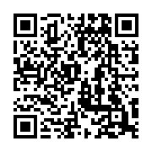
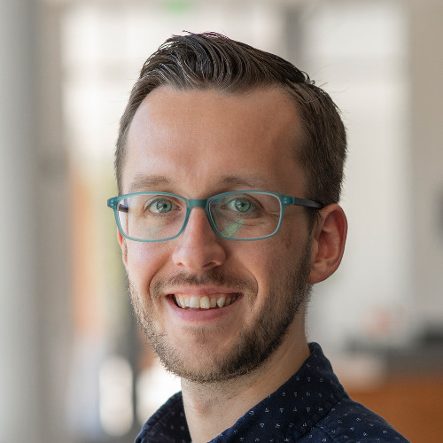
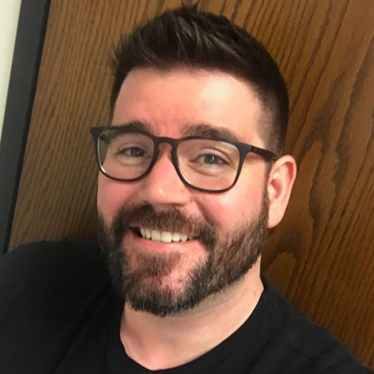
Thank You
Kirsty Weitzel
kweitzel@rti.org
Peter Baumgartner
pbaumgartner@rti.org
Jerry Timbrook
jtimbrook@rti.org
Learn more about RTI Quintet
Notes:
QR code to blog post: https://www.rti.org/insights/rti-quintet-ai-audio-data-analysis-tool

