Slide 1
Age-Eligibility Oversampling to Reduce Screening Costs in a Multimode Survey
Stephanie Zimmer
Joe McMichael
Taylor Lewis
The National Survey of Family Growth (NSFG) is conducted by the Centers for Disease Control and Prevention's (CDC's) National Center for Health Statistics (NCHS), under contract #200-2020-09732 with RTI International with funding from CDC/NCHS and several other cosponsors within the U.S. Department of Health and Human Services, as listed on the NSFG webpage (see http://www.cdc.gov/nchs/nsfg/). The views expressed here do not represent those of NCHS or the other funding partners.

Slide 2
Motivating problem
National Survey of Family Growth (NSFG) is a national survey of the non-institutionalized population age 15-49
Data collection is done online and in person so design is clustered with SSUs being Census Block Groups (CBGs) or groups of CBGs
Household selection is through an ABS frame in most SSUs (~90%)
Would like to minimize the number of households with no residents age 15-49
Notes:
- Sample design MOS counts only age-eligible population so some senior community is less likely to be sampled, as an example
- enhanced listing used in non-ABS segments

Slide 3
RTI’s Enhanced ABS Frame
ABS frames are derived from the USPS Computerized Delivery Sequence (CDS) file which has coverage over 90% in the US [Harter, Morton, Amaya, & Brown, 2021]
Addresses are geocoded and assigned to census geographical areas
Easily append auxiliary variables at the geographic level (decennial census, ACS, CDC PLACES, and more)
Enhanced ABS frame appends consumer marketing data to the addresses – referred to as vendor data throughout
Notes:
- some marketing data

Slide 4
Building a predictive model

Slide 5
Merge inputs together
Ground truth data – data from prior survey (not NSFG) with indicator of whether a resident is aged 13-49
ACS and Decennial Census data – using the Census planning database (PDB) Block Group file
Available for all addresses, continuous variables (e.g., Percentage of population who is female)
Enhanced ABS Frame
Categorical variables for vendor data at the “person” level
Notes:
- Note that the outcome doesn’t exactly match NSFG but we were using an unrelated survey to build the model
- Ground truth data is from a survey other than NSFG, has address information so that it can be linked to other data
- Vendor data has “person” records for each address

Slide 6
Data prep
Collapsed person level vendor data to address level
Created categorical vendor data variables
Level for addresses matching vendor database but for a variable individually
Level for addresses not on vendor database
E.g. – Presence of a child was coded as -2=No match to vendor data, -1=Missing data on vendor data, 0=No children indicated, 1=Children indicated
This prep step ends up with no missing data
Removed colinear variables
Notes:
- Collapse vendor level data to one row per address. Use an “any” approach. If anyone at the address has a flag, flag that address

Slide 7
Model fitting
Variable selection and modeling done via SAS PROC HPLOGISTIC
Data split into train and validation dataset
Stepwise variable selection
Up to 2-way interactions
Fit summary (validation)
80% AUC
89% TPR
Source | Description
Vendor | Age 18-24
Vendor | Age 25-34
Vendor | Age 35-49
Vendor | Age 50+
Vendor | Age 55-64
Vendor | Age 65-74
Vendor | Age 75+
Vendor | (Age 18-24)*(Age 25-34)
Vendor | (Age 25-34)*(Age 50+)
Vendor | Number of children in HH
Census PDB and Vendor | (Percent Age 65+)*(Age 50+)
Census PDB | Percent Age 45-64
Census PDB | Percent Age 65+
Census PDB | Percent speaking language other than English at home
Age variables are indicators of anyone in HH being that age
Notes:
- For this project, logistic was chosen but actively comparing logistic, xgboot, and other ensemble models. Logistic works pretty well
- Vendor age indicators are indicating whether ANYONE in the household is that age

Slide 8
Scoring the frame and sampling

Slide 9
Score the frame and stratify
Calculate propensity for all addresses in ABS segments
Divide this list of address into tertiles – low, medium, and high likelihood of being an age-eligible household to form strata
For addresses in listed segments, put them all in another strata

Slide 10
Sample allocation and selection
Allocate sample to minimize UWE of eligible HHs subject to the constraints:
Equal sample size in each SSU
Predicted eligibility rate is 67.2%. Note: 63.2% is predicted eligibility rate under proportional allocation
In ABS segments addresses allocated such that: 18.4% in low stratum, 37.5% in medium stratum, and 44.1% in high stratum
Sample systematically within each SSU and age-eligibility stratum. Systematically sorted by ZIP code, carrier route, and walking sequence
Notes:
- Increase of 4% eligibility rate

Slide 11
Models in the wild

Slide 12
Data collection overview – mixed mode design
Phase 1: Web mode only (CAWI) – 4 weeks
Phase 2: Web (CAWI) and in-person (CAPI) – 8 weeks
Phase 3: Web (CAWI) and in-person (CAPI) with increased incentive on subsample – 4 weeks
Household screener to roster residents and select participant is then followed by a survey – focusing on screener
Notes:
- Four quarters of data collection
- PAPI was used in Phase 3 in 2 quarters – results for that mode alone will not be shown as the response mode was small

Slide 13
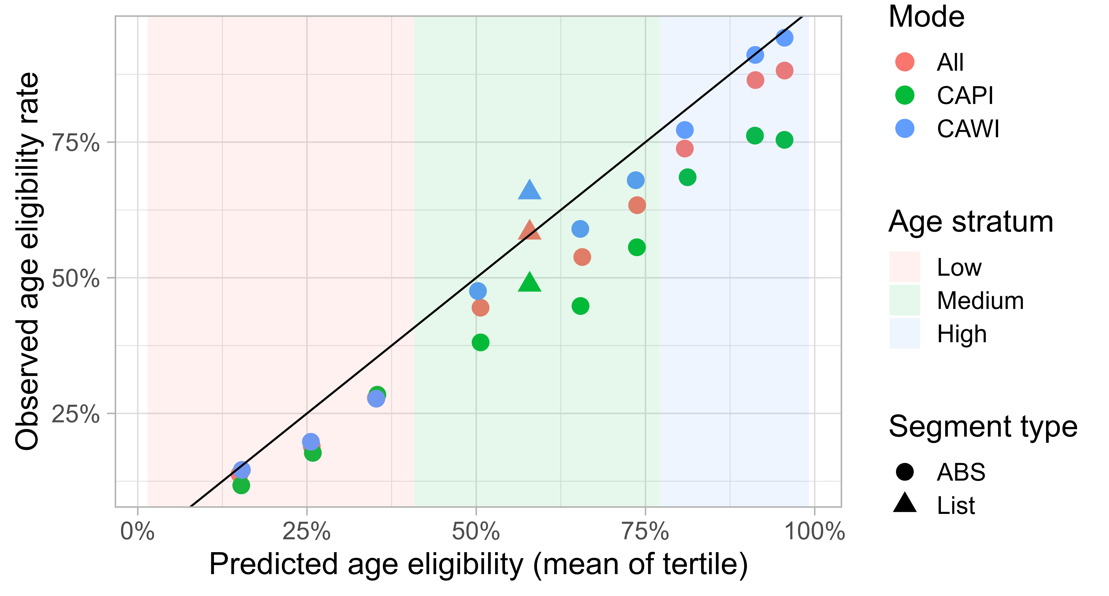
Predicted vs actual eligibility rates, 2022 Among completed screeners
Notes:
- among completed screeners
- Among sampled addresses, divided each age stratum into tertiles to provide more groupings for plots. Banded columns are age stratum groups
- generally under predicted but ordering is correct
- note this as among screener respondents. Is yield related to eligibility?

Slide 14
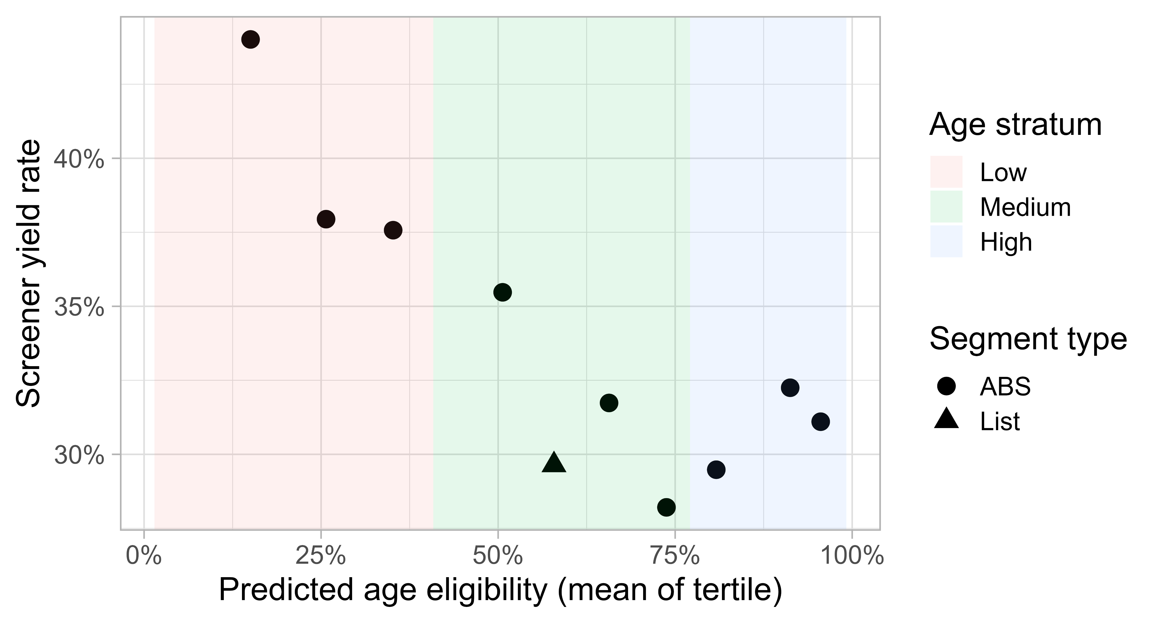
Predicted eligibility vs yield rates, 2022
Notes:
- Eligibility generally inversely related to yield rate

Slide 15
Preparing for 2023
Model wasn’t updated but predictions were ratio adjusted based on data collected in 2022
Allocate sample to minimize UWE of eligible HHs subject to the constraints:
Equal sample size in each SSU
Predicted eligibility rate is 60%. Note: 53.3% is predicted eligibility rate under proportional allocation
In ABS segments addresses allocated such that: 21.5% in low stratum, 35.4% in medium stratum, and 43.1% in high stratum
Notes:
- Increase of 6.7% percentage points

Slide 16
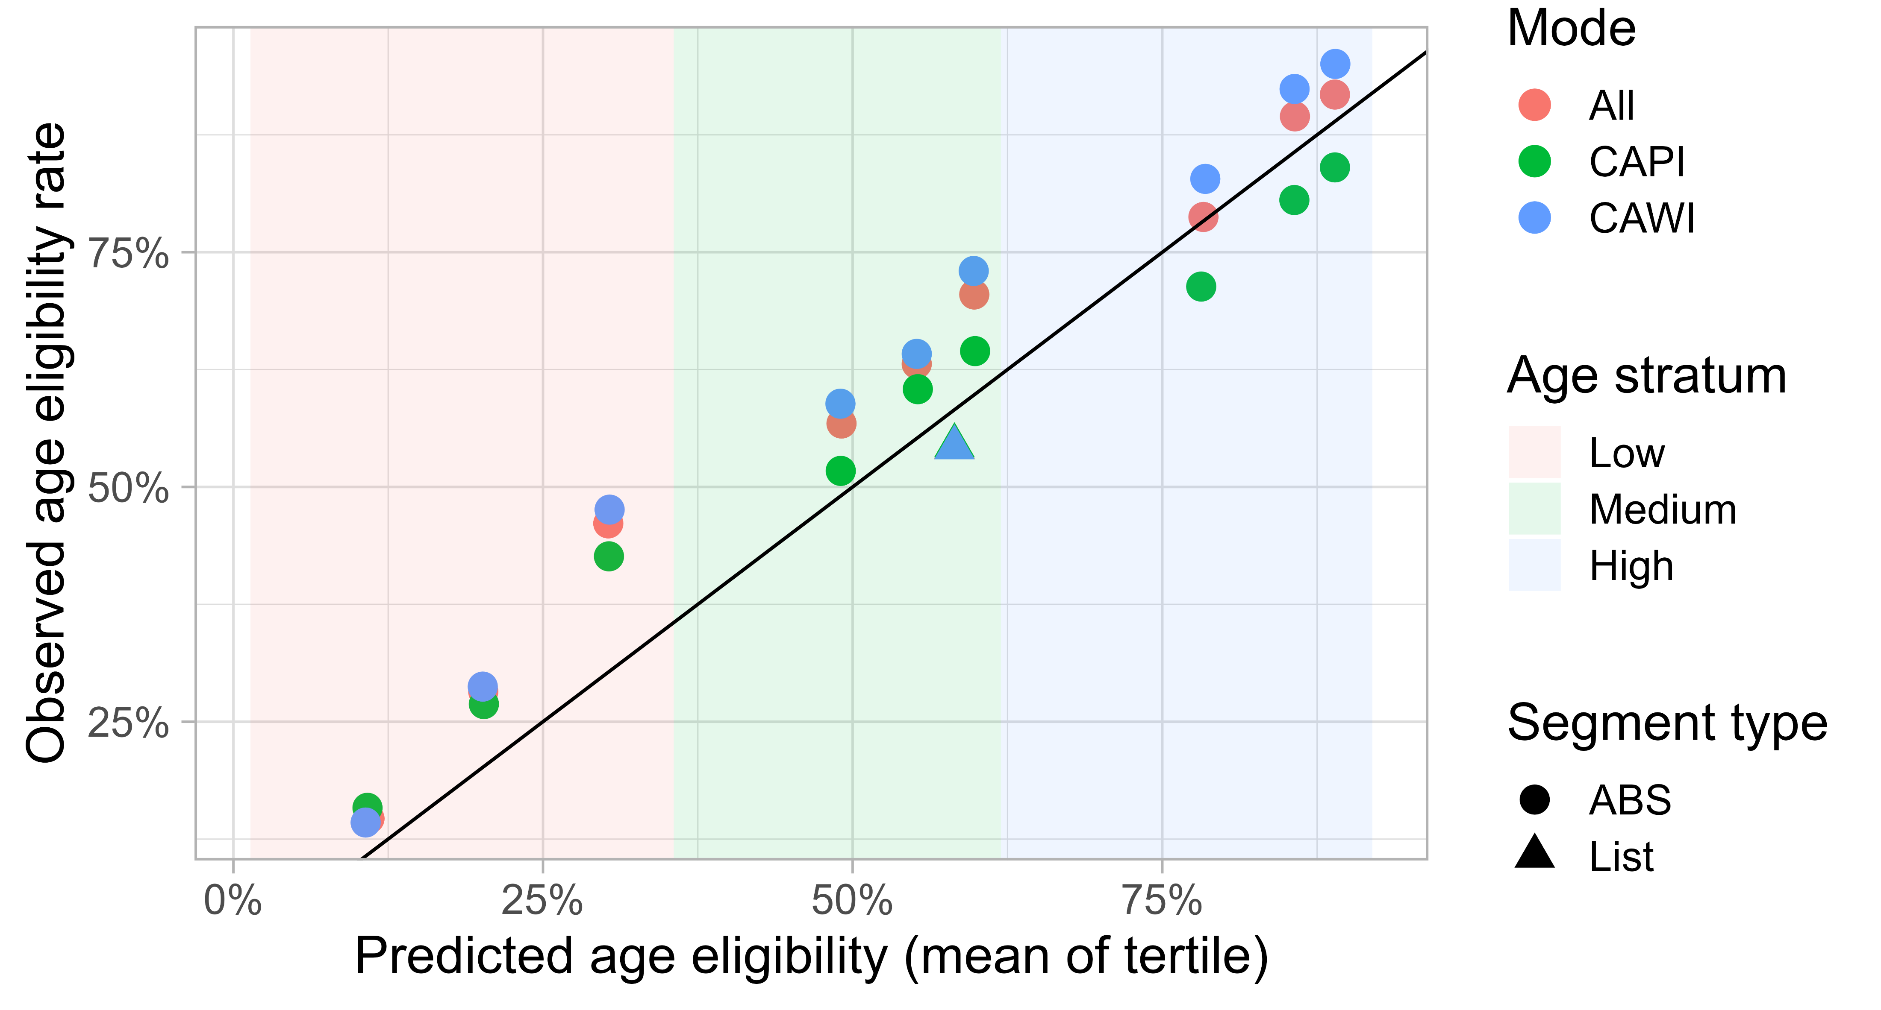
Predicted vs actual eligibility rates, 2023 Among completed screeners
Notes:
- among completed screeners
- generally over predicted but ordering is correct
- note this as among screener respondents. Is yield related to eligibility?

Slide 17
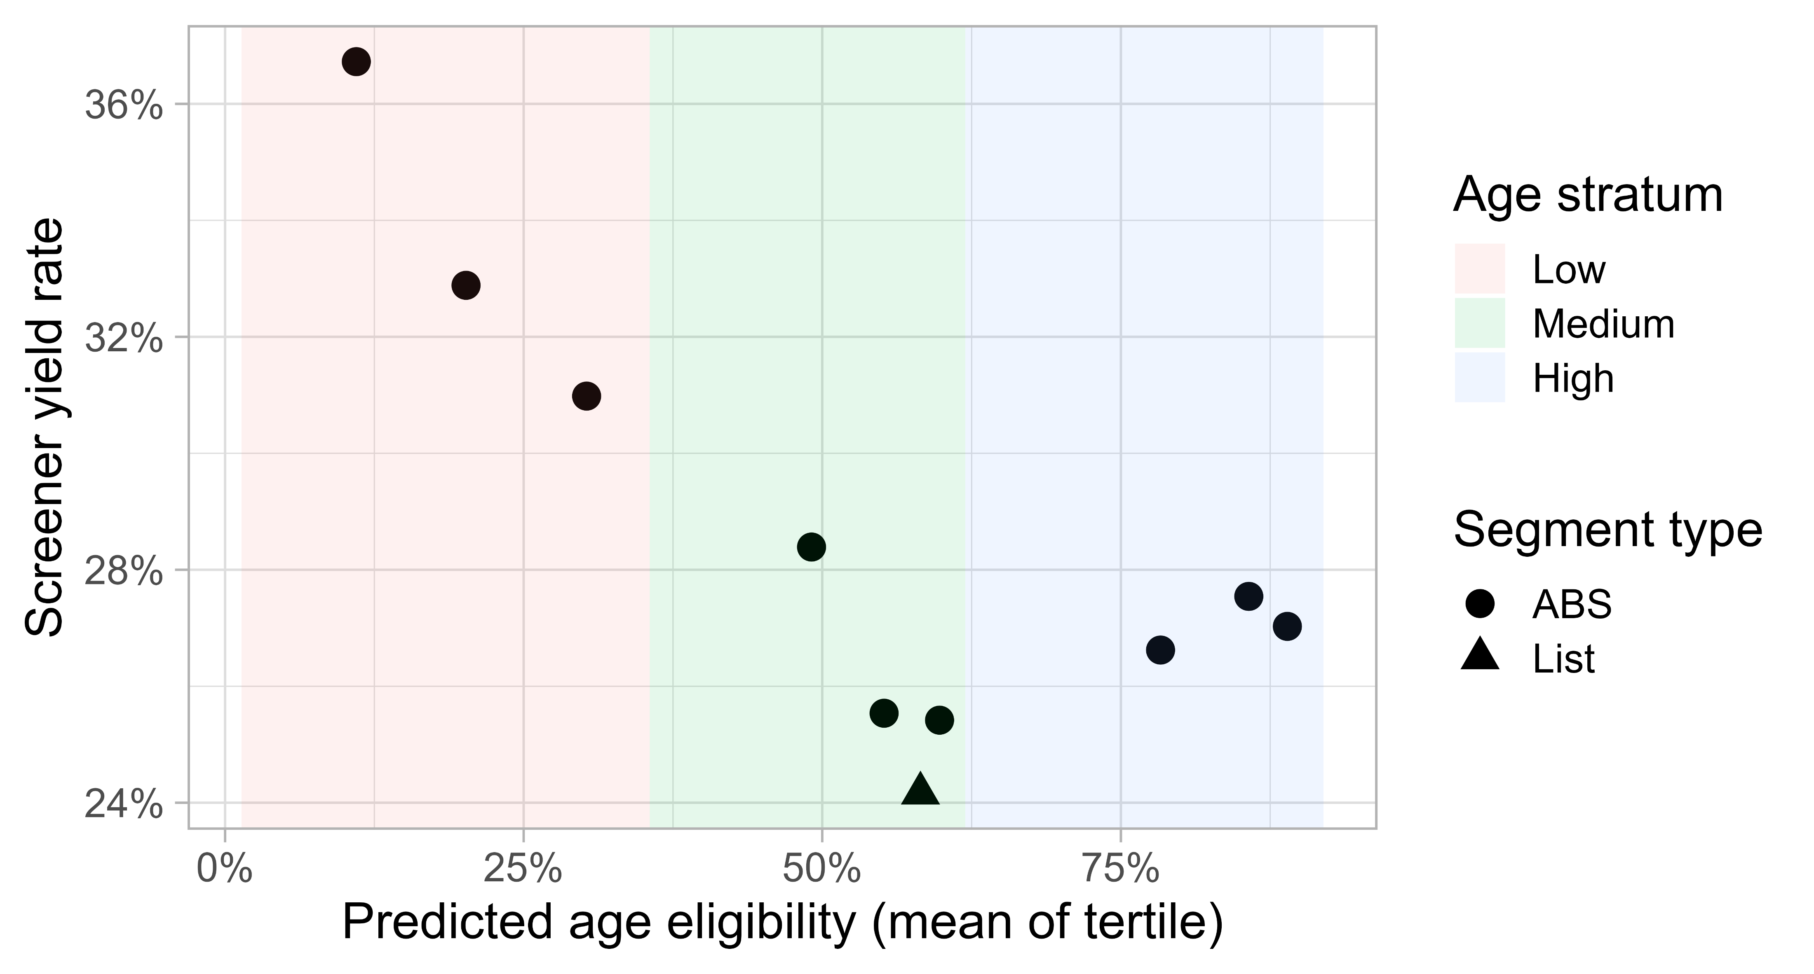
Predicted eligibility vs yield rates, 2023
Notes:
- Eligibility generally inversely related to yield rate

Slide 18
Conclusions
Prior survey data provided a good foundation for initial years of NSFG address sampling.
For this target group (age 15-49), eligibility is inversely related to yield
Observed eligibility lower than expected in 2022, higher than expected in 2023

Slide 19
What’s next
Building new model
Use NSFG data rather than prior survey data
Explore other model types [Dutwin, Coyle, Lerner, Bilgin, & English, 2024] + [West, Wagner, Hubbard, & Gu, 2015]
Revised sample allocation
Incorporate expected yield rates into allocation. High eligibility group is low yield rate, not currently accounted for in allocation

Slide 20
References
Harter, R., Morton, K. B., Amaya, A., & Brown, D. (2021). Estimating Net Coverage of Segments in ABS Frames. Field Methods, 33(1), 68-84. https://doi.org/10.1177/1525822X20960936
David Dutwin, Patrick Coyle, Joshua Lerner, Ipek Bilgen, Ned English, Leveraging Predictive Modelling from Multiple Sources of Big Data to Improve Sample Efficiency and Reduce Survey Nonresponse Error, Journal of Survey Statistics and Methodology, Volume 12, Issue 2, April 2024, Pages 435–457, https://doi.org/10.1093/jssam/smad016
Brady T. West, James Wagner, Frost Hubbard, Haoyu Gu, The Utility of Alternative Commercial Data Sources for Survey Operations and Estimation: Evidence from the National Survey of Family Growth, Journal of Survey Statistics and Methodology, Volume 3, Issue 2, June 2015, Pages 240–264, https://doi.org/10.1093/jssam/smv004

Slide 21

Thank you
Contact: Stephanie Zimmer| email: sazimmer@rti.org

