Slide 1
Evaluating Alternative Estimation Methods using Probability and Nonprobability Samples
Joint Statistical Meetings
August 5, 2024
Michael Yang
Edward Mulrow
Evan Herring-Nathan
Chien-Min Huang
Notes:
Good afternoon!
My talk is about evaluating alternative estimation methods using probability and nonprobability samples.
I would like to acknowledge my coauthors: Ed, Evan, and Chien-Min.
Chien-Min has a talk on Thursday morning to discuss another method developed at NORC, a tree-based dual-frame method. Hope to see you there as well!

Slide 2
Agenda
01 | Overview of the Methods Evaluated
02 | Simulation Setup
03 | Simulation Results
04 | Concluding Remarks
Notes:
I’ll start with an overview of the 7 methods we evaluated using Monte Carlo simulations;
I’ll then show you our simulation setup.
Next, I will present some key simulation results in a set of graphics.
Finally, I will make a few concluding remarks.

Slide 3
Overview of the Methods Evaluated
Notes:
First, the Overview!

Slide 4
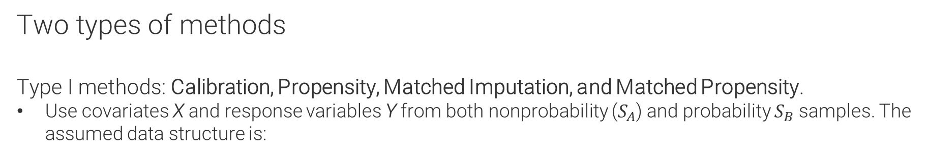
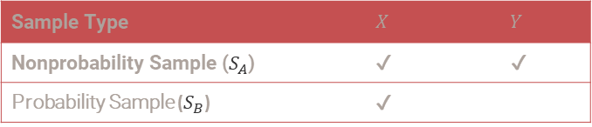
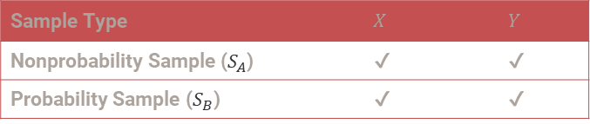
Overview
Two types of methods
Type I methods: Calibration, Propensity, Matched Imputation, and Matched Propensity.
Use covariates X and response variables Y from both nonprobability ($S_{A}$) and probability $S_{B}$ samples. The assumed data structure is:
Sample Type | $$X$$ | $$Y$$
Nonprobability Sample ($S_{A}$) | ✔ | ✔
Probability Sample ($S_{B}$) | ✔ | ✔
Type II methods: Inverse Probability Weighting, Mass Imputation, and Doubly Robust.
Use covariates X from both nonprobability ($S_{A}$) and probability $(S_{B})$ samples; assume response variables Y only available from $S_{A}$. The assumed data structure is:
Sample Type | $$X$$ | $$Y$$
Nonprobability Sample ($S_{A}$) | ✔ | ✔
Probability Sample ($S_{B}$) | ✔
Type II methods are implemented in the R package nonprobsvy.
Notes:
We divide a set of 7 methods into 2 types.
Type I methods include Calibration, Propensity, Matched Imputation, and Matched Propensity. These 4 methods use covariates X and response variables Y from both the nonprobability sample $S_{A}$ and the probability sample $S_{B}$. The assumed data structure is shown in the first table.
Type II methods include Inverse Probability Weighting, Mass Imputation, and Doubly Robust. These 3 methods use covariates X from both samples, but they assume that response variables Y are only available in the $S_{A}$ sample. The assumed data structure is shown in the second table.
The 3 Type II methods are currently implemented in the R package nonprobsvy.

Slide 5

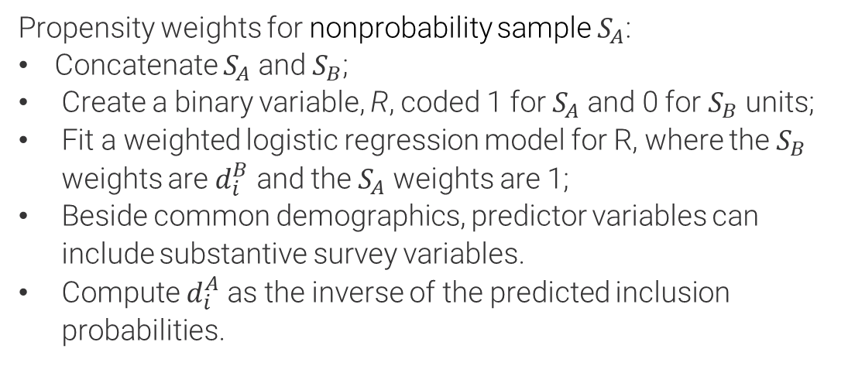

Overview: type I methods
Calibration and Propensity
CALIBRATION
PROPENSITY
Calibration weights for nonprobability sample $S_{A}$:
Assign an initial weight of 1 to all sample units in $S_{A}$.
Rake the initial $S_{A}$weights to match common population benchmarks.
Propensity weights for nonprobability sample $S_{A}$:
Concatenate $S_{A}$ and $S_{B}$;
Create a binary variable, R, coded 1 for $S_{A}$ and 0 for $S_{B}$ units;
Fit a weighted logistic regression model for R, where the $S_{B}$ weights are $d_{i}^{B}$ and the $S_{A}$ weights are 1;
Beside common demographics, predictor variables can include substantive survey variables.
Compute $d_{i}^{A}$ as the inverse of the predicted inclusion probabilities.
Combined sample weights: $d_{i}={R_{i}^{A}(1−λ)d_{i}^{A}+{(1−R}_{i}^{A})λd}_{i}^{B}$
Estimator of population total: $\hat{Y}=\sum_{i∈S_{A}}{(1−λ)d_{i}^{A}}+\sum_{i∈S_{B}}{λd_{i}^{B}}$
Notes:
The Type I methods are all weighting methods.
Calibration weights for $S_{A}$ are developed in 2 steps: first, each unit gets an initial weight of 1; second, the initial weights are raked to common population benchmarks.
Propensity weights for $S_{A}$ are developed in a few more steps: First, we concatenate $S_{A}$ and $S_{B}$; next, we define a binary response variable, coded 1 for $S_{A}$ units and 0 for $S_{B}$ units; we then fit a weighted logistic regression model to estimate the inclusion probabilities for $S_{A}$ units; finally, we compute the $S_{A}$ weights as the inverse of the estimated probabilities.
For both methods, to derive the final weights, we combine the $S_{A}$ weights with the known $S_{B}$ weights through a combination factor $λ$. The estimator of the population total is this composite estimator. For all Type I methods, we use $λ$=.5.

Slide 6
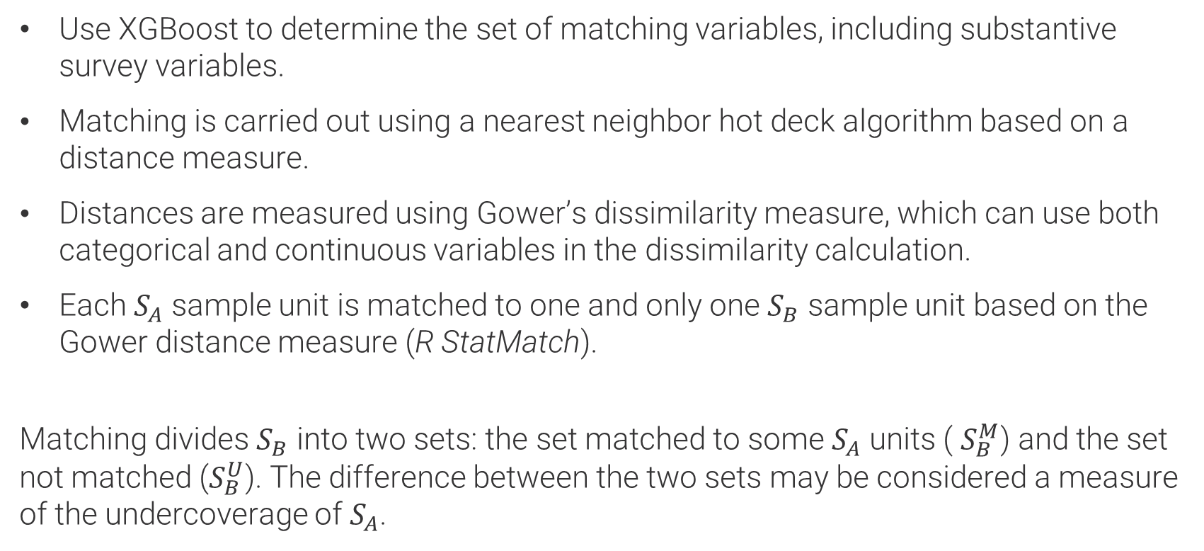
Overview: type I methods
Statistical Matching
Use XGBoost to determine the set of matching variables, including substantive survey variables.
Matching is carried out using a nearest neighbor hot deck algorithm based on a distance measure.
Distances are measured using Gower’s dissimilarity measure, which can use both categorical and continuous variables in the dissimilarity calculation.
Each $S_{A}$ sample unit is matched to one and only one $S_{B}$ sample unit based on the Gower distance measure (R StatMatch).
Matching divides $S_{B}$ into two sets: the set matched to some $S_{A}$ units ( $S_{B}^{M}$) and the set not matched ($S_{B}^{U}$). The difference between the two sets may be considered a measure of the undercoverage of $S_{A}$.
Notes:
Both Matched Imputation and Matched Propensity, the other 2 Type I methods, depend on matching the $S_{A}$ and $S_{B}$ samples.
We first use XGBoost to determine the set of matching variables, including substantive survey variables. Matching is then carried out using a hot deck method based on Gower’s dissimilarity measure.
Finally, each $S_{A}$ sample unit is matched to one and only one $S_{B}$ sample unit using the R package StatMatch.
Matching divides $S_{B}$ into two sets: the set matched to some $S_{A}$ units ( $S_{B}^{M}$) and the set not matched ($S_{B}^{U}$). The difference between the 2 sets may be considered a measure of the undercoverage of $S_{A}$.

Slide 7
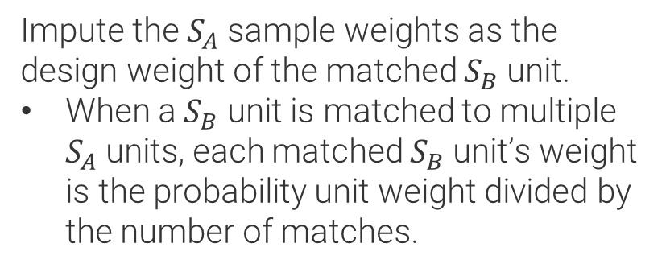
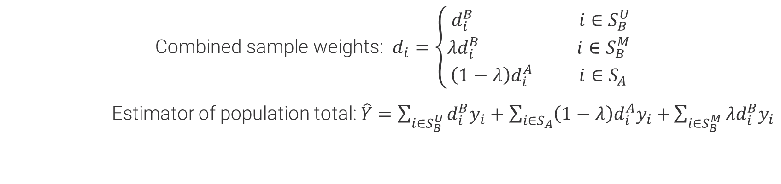
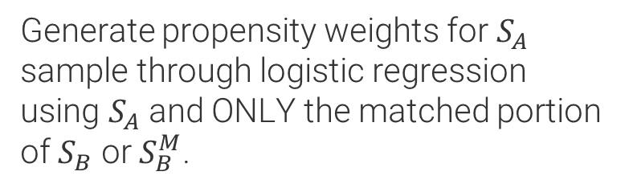
Overview: type I methods
Matched Imputation and Matched Propensity
MATCHED IMPUTATION
MATCHED PROPENSITY
Impute the $S_{A}$ sample weights as the design weight of the matched $S_{B}$ unit.
When a $S_{B}$ unit is matched to multiple $S_{A}$ units, each matched $S_{B}$unit’s weight is the probability unit weight divided by the number of matches.
Generate propensity weights for $S_{A}$ sample through logistic regression using $S_{A}$ and ONLY the matched portion of $S_{B}$ or $S_{B}^{M}$.
Combined sample weights: $d_{i}=\left\{\begin{aligned} d_{i}^{B} i∈S_{B}^{U} \\ λd_{i}^{B} i∈S_{B}^{M} \\ \left(1−λ\right)d_{i}^{A} i∈S_{A}\end{aligned}\right.$
Estimator of population total: $\hat{Y}=\sum_{i∈S_{B}^{U}}{d_{i}^{B}y_{i}}+\sum_{i∈S_{A}}{{\left(1−λ\right)d}_{i}^{A}y_{i}+}\sum_{i∈S_{B}^{M}}{{λd}_{i}^{B}y_{i}}$
Notes:
Both Matched Imputation and Matched Propensity are built upon the matching results!
For Matched Imputation, we impute the $S_{A}$ weights as the weight of the matched $S_{B}$ unit. When a $S_{B}$ unit is matched to multiple $S_{A}$units, these $S_{A}$ units share the $S_{B}$ unit weight evenly. So, if a $S_{B}$ unit with a weight of 100 is matched to 2 $S_{A}$ units, then each $S_{A}$ unit will have an imputed weight of 50.
For Matched Propensity, we develop propensity weights for $S_{A}$ sample through logistic regression, just like with the Propensity method, but here we use $S_{A}$ and ONLY the matched portion of $S_{B}$ to fit the model.
For both methods, the $S_{A}$ weights are combined with the $S_{B}$ weights to derive the final weights: the unmatched $S_{B}$ units retain their original weights; the matched $S_{B}$ and $S_{A}$ units have their weights combined through $λ$. The estimator of the population total is also a composite estimator, but now with 3 components based on the matching pattern.

Slide 8
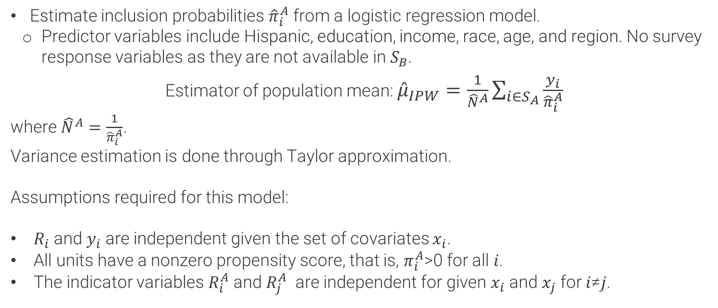
Overview: type ii methods
Inverse Probability Weighting (IPW)
Estimate inclusion probabilities ${\hat{π}}_{i}^{A}$ from a logistic regression model.
Predictor variables include Hispanic, education, income, race, age, and region. No survey response variables as they are not available in $S_{B}$.
Estimator of population mean: ${\hat{μ}}_{IPW}=\frac{1}{{\hat{N}}^{A}}\sum_{i∈S_{A}}{\frac{y_{i}}{{\hat{π}}_{i}^{A}}}$
where ${\hat{N}}^{A}=\frac{1}{{\hat{π}}_{i}^{A}}$.
Variance estimation is done through Taylor approximation.
Assumptions required for this model:
$R_{i}$ and $y_{i}$ are independent given the set of covariates $x_{i}$.
All units have a nonzero propensity score, that is, $π_{i}^{A}$>0 for all 𝑖.
The indicator variables $R_{i}^{A}$ and $R_{j}^{A}$ are independent for given $x_{i}$ and $x_{j}$ for 𝑖≠𝑗.
Notes:
On to the Type II methods. My description here is based on information available from the developers of the R package.
IPW uses logistic regression to estimate inclusion probabilities for the $S_{A}$ units, which is like the Type I Propensity method, but here the predictor variables are limited to a small set of common covariates because response variables are missing in $S_{B}$.
The $S_{B}$ units help to fit the propensity model. But the final estimator is based on the $S_{A}$ units alone because the Y variables are only available in the $S_{A}$ sample.
The R package provides a variance estimator based on Taylor series.

Slide 9

Overview: type II methods
Mass Imputation (MI)
Use nonprobability sample $S_{A}$ as a training dataset to build an imputation model.
Use logistic regression model for binary variables.
Predictor variables include Hispanic, education, income, race, age, and region. No survey response variables as they are not available in $S_{B}$.
Use the imputation model to impute response variables for probability sample $S_{B}$.
Construct MI estimator based on known design weights and imputed values for the $S_{B}$ sample.
Estimator of population mean: ${\hat{μ}}_{MI}=\frac{1}{{\hat{N}}^{B}}\sum_{i∈S_{B}}{d_{i}^{B}m(x_{i}, \hat{β})}$
Variance estimator has a complex form.
Notes:
MI treats the absence of response variables in $S_{B}$ as a missing data problem;
The solution is to use sample $S_{A}$ as a training dataset to build an imputation model, and then use the imputation model to impute the response variables for $S_{B}.$
We chose the logit model for imputation, but the R package has other options.
The estimator of the population mean is based on the imputed response variables and the design weights for $S_{B}.$
Again, the R package comes with a variance estimator.

Slide 10

Overview: type ii methods
Doubly Robust (DR)
The IPW and MI estimators are sensitive to mis-specified models for propensity score and outcome variables, respectively. DR combines propensity and imputation models and uses units from both probability and nonprobability samples for inference.
Estimator of the population mean is:
$${\hat{μ}}_{DR}=\frac{1}{{\hat{N}}^{A}}\sum_{i∈S_{A}}{d_{i}^{A}\left\{y_{i}−m\left(x_{i}, \hat{β}\right)\right\}+\frac{1}{{\hat{N}}^{B}}\sum_{i∈S_{B}}{d_{i}^{B}m\left(x_{i}, \hat{β}\right)}}$$
where $d_{i}^{A}={π(x_{i}, θ)}^{−1}$, ${\hat{N}}^{A}=\sum_{i∈S_{A}}{d_{i}^{A}}$, and ${\hat{N}}^{B}=\sum_{i∈S_{B}}{d_{i}^{B}}$.
Notice that the first part of DR estimator is the IPW estimator with $y_{i}$ replaced by ${ y}_{i}$ $−m\left(x_{i},\hat{β}\right)$and the second part is the MI estimator.
Notes:
Both IPW and MI estimators may be sensitive to model mis-specification.
DR combines propensity and imputation models and uses units from both $S_{A}$ and $S_{B}$ samples for inference.
Therefore, the DR estimator of the population mean has two parts: the first part is the IPW estimator, and the second part is the MI estimator.

Slide 11
Simulation Setup
Notes:
Alright, here is our simulation setup!

Slide 12
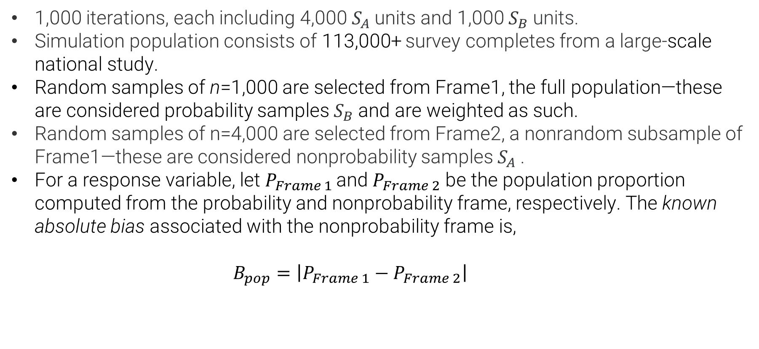
Simulation setup
Simulation Samples
1,000 iterations, each including 4,000 $S_{A}$units and 1,000 $S_{B}$units.
Simulation population consists of 113,000+ survey completes from a large-scale national study.
Random samples of n=1,000 are selected from Frame1, the full population—these are considered probability samples $S_{B}$and are weighted as such.
Random samples of n=4,000 are selected from Frame2, a nonrandom subsample of Frame1—these are considered nonprobability samples $S_{A}$.
For a response variable, let $P_{Frame 1 }$and $P_{Frame 2}$ be the population proportion computed from the probability and nonprobability frame, respectively. The known absolute bias associated with the nonprobability frame is,
$$B_{pop}=\left|P_{Frame 1}−P_{Frame 2}\right|$$
Notes:
We did 1000 iterations; each iteration includes 4,000 $S_{A}$sample units and 1,000 $S_{B}$sample units.
The simulation population includes all the complete surveys from a large national study.
The $S_{B}$samples are selected from the full population with known selection probabilities; while the $S_{A}$samples are selected from a nonrandom subset of the population.
The known absolute bias associated with the $S_{A}$sample frame has this expression; Here, Frame1 is the $S_{B}$sample frame and Frame2 is the $S_{A}$sample frame.

Slide 13
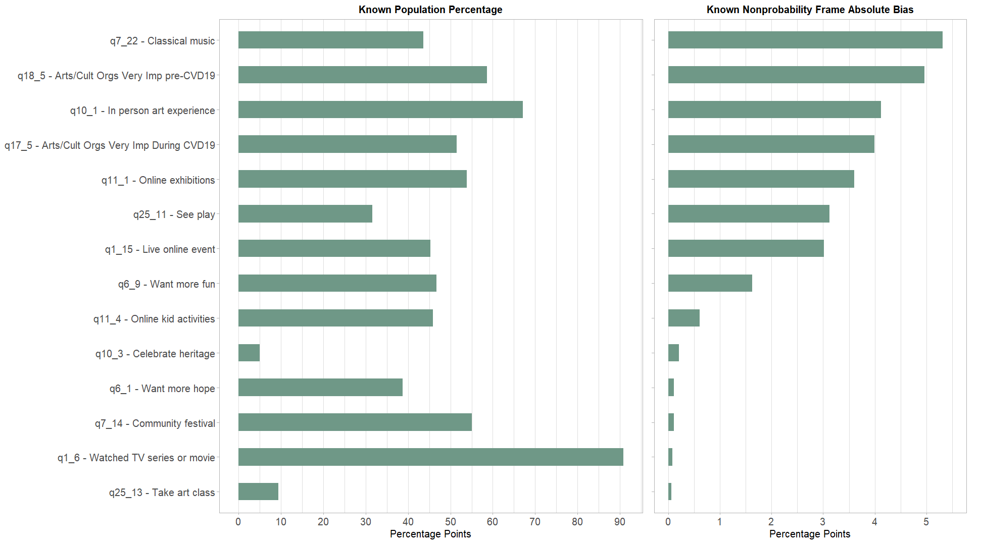
Simulation setup
Known population proportion and known absolute bias
Notes:
OK, two graphs here with different scales.
The graph on the left shows the true population P for each variable. This is later used to compute relative bias and root mean square error.
The graph on the right shows the known absolute bias for the nonprobability sample frame; They range from almost 0 to just over 5 percentage points. The reason to have a range here is to see how the different estimation methods perform with variables that have different levels of bias. A good estimator should overcome large known bias but do no harm when the known bias is small to begin with.
In all our graphics, the 14 variables are ordered so that the most biased is at the top and the least biased is at the bottom.

Slide 14
Simulation Results
Notes:
Now we are ready to look at some simulation results;

Slide 15
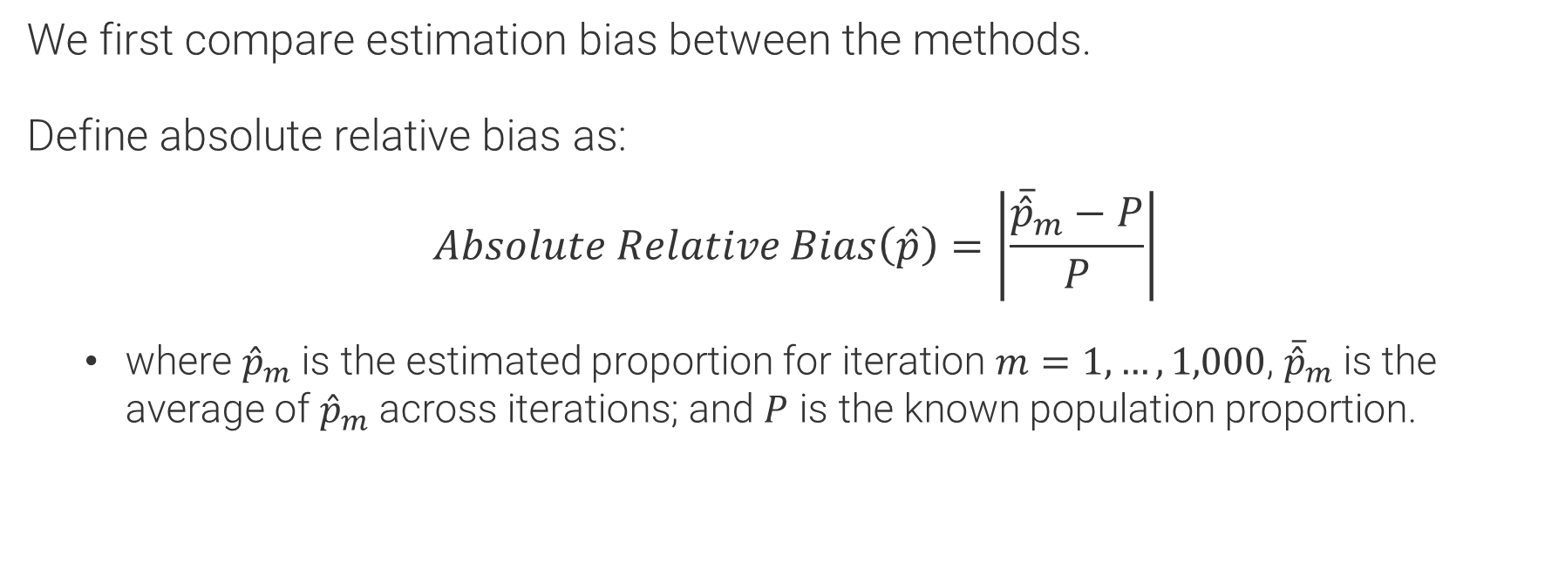
Simulation results: absolute relative bias
Absolute relative bias
We first compare estimation bias between the methods.
Define absolute relative bias as:
$$Absolute Relative Bias\left(\hat{p}\right)=\left|\frac{{\overline{\hat{p}}}_{m}−P}{P}\right|$$
where ${\hat{p}}_{m}$ is the estimated proportion for iteration $m=1,…,1,000$, ${\overline{\hat{p}}}_{m}$ is the average of ${\hat{p}}_{m}$ across iterations; and $P$ is the known population proportion.
Notes:
We first compare estimation bias between these methods.
Define absolute relative bias as this. In this formula, ${\hat{p}}_{m}$ is the estimated proportion for each iteration, ${\overline{\hat{p}}}_{m}$ is the average across iterations; and uppercase $P$ is the known population proportion.

Slide 16
Simulation results: absolute relative bias
Notes:
Here are the relative bias comparisons between the Type I methods.
The orange dots show the size of the relative bias; the vertical dashed line in each box marks the median relative bias across the 14 variables.
Calibration and Propensity have larger relative bias; Also, variables start with larger known bias tend to have larger relative bias.
The two matching methods perform better in terms of overcoming large known bias; Matched Imputation seems to be the winner here as their estimates have the smallest relative bias.

Slide 17
Simulation results: absolute relative bias
Notes:
Relative bias is very similar between theType II methods; The median is about 5%, much larger than under Type I methods.
Some variables (like these 3) do have low relative bias, but these are the ones with small known bias to begin with.
Without response variables from the $S_{B}$sample, these methods are not very successful in terms of overcoming large known bias in the $S_{A}$sample.
Based on a limited set of covariates, their underlying models are apparently not very predictive.
We looked at the other MI approaches. Nearest neighbor (NN) is very similar to logistic (glm for the methods statement in the R package), but PMM provided very different and unstable results. Our wild speculation is that the limited covariates were insufficient to provide a good fitting model for PMM.

Slide 18
Simulation results: true variance
True/Simulation Variance
Variance of each estimator based on Monte Carlo simulations, taken across 1,000 iterations.
$ν\left(\hat{p}\right)= \frac{1}{1000}\sum{{({\hat{p}}_{m}−\overline{\hat{p}})}^{2}}$
Notes:
For each estimator, we also computed their simulation variance, which we consider the true variance for each estimator.
This is based on the variation of the point estimates across the 1,000 iterations.

Slide 19
Simulation results: true variance
Notes:
In terms of true variance, Calibration and Propensity are similar; they have smaller variances than the other Type I methods.
Matched Imputation has the smallest relative bias, but the largest variance.
Matched Propensity is somewhere in between on this measure.
Note that there are 3 outliers with very small variance: these are the 3 variables with the smallest population variance because P is close to 0 or 1.

Slide 20
Simulation results: true variance
Notes:
The 3 Type II methods are again very similar to each other;
While they have much larger relative bias, they have smaller variance than under the Type I methods.
And, we have the same 3 outliers with the smallest variance.

Slide 21

Simulation results: root mean square error
Root mean square error (RMSE)
Square root of the average of squared errors for each estimator based on Monte Carlo simulations, taken across 1,000 iterations.
$$RMSE\left(\hat{p}\right)=\sqrt{\frac{1}{1000}\sum{{({\hat{p}}_{m}−P)}^{2}}}$$
Notes:
We now look at RMSE, a summary measure that incorporates both bias and variance.
This is based on the variation of the point estimate ${\hat{p}}_{m}$ relative to the true population value P across 1,000 iterations.

Slide 22
Simulation results: root mean square error
Notes:
These are the Type I method comparisons, looking like two pairs, right?
The median RMSE is about the same for all methods, but the first two are a lot more uneven between variables. Variables that have larger known bias tend to have larger RMSE.
In contrast, the two Matching methods seem to do a good job for all variables regardless of the size of the known bias.

Slide 23
Simulation results: root mean square error
Notes:
For the Type II methods, RMSEs are much larger.
The RMSE seems to be dominated by bias, as this graph looks very similar to the relative bias comparisons we saw earlier (slide 17).

Slide 24
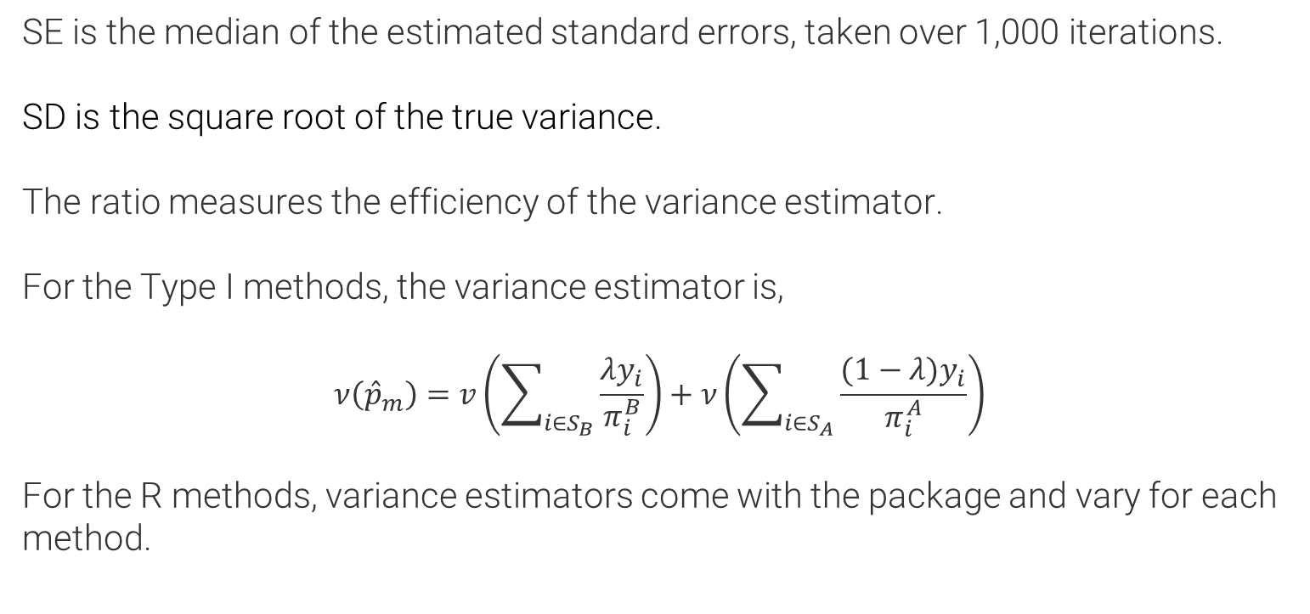
Simulation results: se/sd ratio
Ratio of estimated standard error (SE) to true standard deviation (SD)
SE is the median of the estimated standard errors, taken over 1,000 iterations.
SD is the square root of the true variance.
The ratio measures the efficiency of the variance estimator.
For the Type I methods, the variance estimator is,
$$ν\left({\hat{p}}_{m}\right)=v\left(\sum_{i∈S_{B}}{\frac{λy_{i}}{π_{i}^{B}}}\right)+ν\left(\sum_{i∈S_{A}}{\frac{(1−λ{)y}_{i}}{π_{i}^{A}}}\right)$$
For the R methods, variance estimators come with the package and vary for each method.
Notes:
We now look at the ratio of SE to SD.
SE is the median of the estimated standard errors, taken over 1,000 iterations. SD is the square root of the true variance. The ratio measures the efficiency of the variance estimator.
A ratio of 1 would be right on target; a ratio below 1 means the variance estimator underestimates the true variance; and a ratio above 1 means the variance estimator overerestimates the true variance.

Slide 25
Simulation results: se/sd ratio
Notes:
For the Type I methods, the ratio is between .9 and 1.1;
The variance estimator tends to overestimate the true variance for Calibration and Matched Propensity; and underestimate the true variance for Propensity and Matched Imputation.
Overall, however, we did not see dramatic over- or under-estimation.

Slide 26
Simulation results: se/sd ratio
Notes:
The ratio is greater than 1 for all the Type II methods, so all the variance estimators tend to overestimate their true variance, which is especially true for IPW.

Slide 27
Concluding Remarks
Notes:
So, what did we learn from all these?

Slide 28
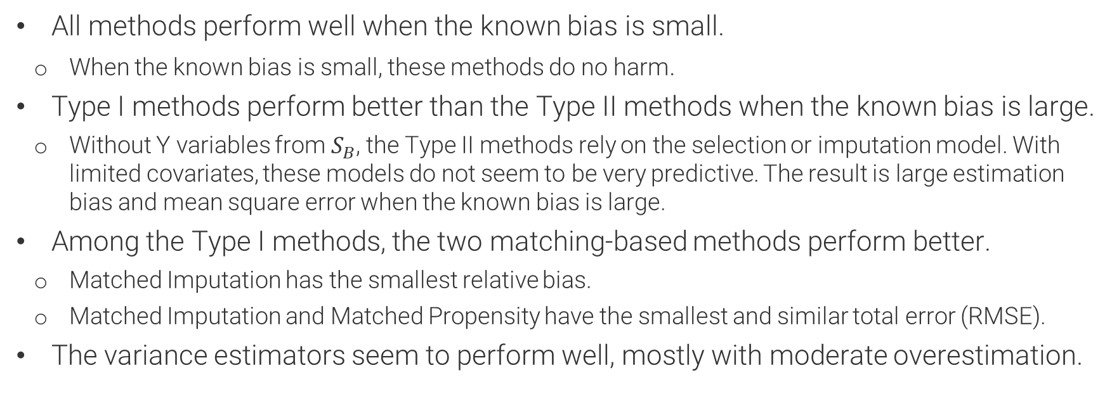
Concluding remarks
Concluding remarks
All methods perform well when the known bias is small.
When the known bias is small, these methods do no harm.
Type I methods perform better than the Type II methods when the known bias is large.
Without Y variables from $S_{B}$, the Type II methods rely on the selection or imputation model. With limited covariates, these models do not seem to be very predictive. The result is large estimation bias and mean square error when the known bias is large.
Among the Type I methods, the two matching-based methods perform better.
Matched Imputation has the smallest relative bias.
Matched Imputation and Matched Propensity have the smallest and similar total error (RMSE).
The variance estimators seem to perform well, mostly with moderate overestimation.
Notes:
All methods perform well when the known bias is small: they don’t seem to introduce additional bias when there is little known bias to begin with.
When the known bias is large, Type I methods perform better with smaller relative bias and RMSE.
With limited covariates, the models underlying the Type II methods do not seem to be predictive. The result is larger bias and mean square error.
Among the Type I methods, the matching-based methods perform better.
Matched Imputation has the smallest relative bias.
Matched Imputation and Matched Propensity have the smallest and similar total error (RMSE).
Finally, the variance estimators seem to perform well, with only moderate over- or under-estimation.

Slide 29
references
Chen, Y., Li, P., & Wu, C. (2020). Doubly robust inference with nonprobability survey samples. Journal of the American Statistical Association, 115(532), 2011-2021.
D'Orazio, M. (2017). StatMatch: Statistical Matching. R package version 1.2.5. https://CRAN.R-project.org/package=StatMatch.
Elliot, M. R., Valliant, R. (2017). “Inference for Nonprobability Samples,” Statistical Science 2017, Vol. 32, No. 2, 249–264.
Kim, J. K., Park, S., Chen, Y., & Wu, C. (2021). Combining non-probability and probability survey samples through mass imputation. Journal of the Royal Statistical Society Series A: Statistics in Society, 184(3), 941-963.
Mulrow, Edward, Nada Ganesh, Vicki Pineau, and Michael Yang. (2020). “Using Statistical Matching to Account for Coverage Bias When Combining Probability and Nonprobability Samples,” Joint Statistical Meetings 2018 Proceedings.
Valliant, R. (2020). “Comparing Alternatives for Estimation from Nonprobability Samples,” Journal for Survey Statistics and Methodology, vol. 8, 231-263.
Wu, C. (2022). Statistical inference with non-probability survey samples. Survey Methodology, 48, 283-311.
Yang, S., Kim, J. K., & Song, R. (2020). Doubly robust inference when combining probability and non-probability samples with high dimensional data. Journal of the Royal Statistical Society. Series B, Statistical Methodology, 82(2), 445.
Yang, Y. Michael, Nada Ganesh, Ed Mulrow, and Vicki Pineau. (2018). “Estimation Methods for Nonprobability Samples with a Companion Probability Sample,” Joint Statistical Meetings 2018 Proceedings.
Yang, Y. Michael, Nada Ganesh, Ed Mulrow, and Vicki Pineau. (2019). “Evaluating Estimation Methods for Combining Probability and Nonprobability Samples through a Simulation Study,” Joint Statistical Meetings 2019 Proceedings.
Yang, Y. Michael, Nada Ganesh, Ed Mulrow, Evan-Herring Nathan, and Vicki Pineau. (2021).
“Estimators with Combined Probability and Nonprobability Samples Using Small Area Models,” Joint Statistical Meetings 2021 Proceedings.
Yang, Y. Michael, Jay Breidt, Nada Ganesh, Evan Herring-Nathan, Edward Mulrow, and Vicki Pineau. “Hybrid Methods for Combining Probability and Nonprobability Samples for Estimation,” Joint Statistical Meetings Proceedings, 2022.
Notes:
I listed the key references here
That’s all I have, thank you!

Slide 30
Thank you!
Michael Yang, Ph.D.
Principal Statistician
Yang-Michael@norc.org

