Slide 1
Research, Applied Analytics, & Statistics
Integrating Probability and Nonprobability Data to Estimate Tax Compliance: Selection Bias and Measurement Error
Ishani Roy
Internal Revenue Service
Collaborators: Brandon Anderson, Sean Roh, Brett Collins, Mark Payne, Austin Miller, Alex Turk Joint Statistical Meetings, August 8, 2024
Disclaimer: “The findings, interpretations, and conclusions expressed in this paper are entirely those of the authors and do not necessarily reflect the views or the official positions of the U.S. Department of the Treasury or the Internal Revenue Service. All results have been reviewed to ensure that no confidential information is disclosed.”

Slide 2
Research, Applied Analytics, & Statistics
Overview
Background
Leveraging Operational Audit (OP) for reporting compliance risk assessment is a key feature of the National Research Program (NRP) redesign. This work looks at new methods for combining the OP and NRP audits for risk model estimation. This research is developing and testing new methodologies that will help integrate a large swath of IRS audit data and potentially improve compliance risk prediction without adding to the overall cost.
Research questions
Can we use flexible machine learning models along with approximate Bayesian computation techniques for IRS data integration and create unbiased risk models without adding to the cost?
Key observations
Theoretical and methodological tools are available and can be effectively applied to build tax compliance risk models at low opportunity cost.
Parts of OP data can be used along with the NRP data to enhance tax compliance risk prediction.
Preliminary investigation shows potential benefits of the use of flexible machine learning models in data integration to expand the scope and power of models based only of smaller probability samples such as the NRP sample.

Slide 3
Research, Applied Analytics, & Statistics
National Research Program
The National Research Program (NRP) is an initiative of the Internal Revenue Service that began in 2001 with 45,000 randomly selected audits and then in 2006 moved to a rolling sample of about 14,000 cases per year. The sample (stratified) is a representative sample of Individual Income tax returns.
NRP audits are primary conducted with Field (Revenue Agents, RA) and Office (Tax Compliance Officers, TCO) audits.
NRP audits are designed to be comprehensive, focusing on the entire return, rather than being limited to some specific issues that are identified prior to the audit.
The fact that the NRP is a probability sample and that audits are comprehensive means that measures of average tax change and changes to line items can be estimated with a known sampling error and limited sources of non-sampling error. They can be considered as ‘gold-standard’ data for studying non-compliance distribution.
NRP data provides a “ground truth” version of the population, allowing for validation of exploratory methods. NRP audits have been used to estimate voluntary compliance levels, develop audit selection strategies and to estimate the percentage and amounts of improper payment of refundable credits.

Slide 4
Research, Applied Analytics, & Statistics
Need for Data Integration: Combining NRP and OP
Declining resources for the NRP has led to the reduction in overall NRP sample size. Beginning in TY 2015 the NRP sample sizes have been reduced, which has resulted in a reduction in the precision of estimates.
To retain statistical efficiency of risk prediction it has become imperative to use all available data sources that can help increase risk prediction efficiency without adding to the overall cost to the IRS.
If non-probability samples can be augmented to probability samples without introducing biases and without sacrificing inferential power, then it will be significant cost-savings or for the same cost can make gains in terms of estimation and predictive accuracy.
Operational audits (OP) are conducted each year as a part of normal IRS tax compliance assurance operations. A much larger number of operational audits is conducted than NRP audits. An NRP redesign working group recommended exploring methods to leverage operational (OP) audits without extra cost to the IRS.
OP audit done by RA/TCO are more comparable to NRP audits and hence we focused on leveraging the RA/TCO part of OP for the data integration work and risk estimation.
Improved risk estimation from integrated data may provide an “active learning” approach to NRP sampling.

Slide 5
Research, Applied Analytics, & Statistics
Challenges in Integrating NRP and OP data
Operational audits are not selected through a known probability mechanism but according to multi-objective operational procedures. It is a “non-probability” sample.
Selection Bias: How are the OP cases selected? A possible paradigm is that there is a probability scheme but unknown. The probability scheme is different from the way the NRP cases are selected.
OP is not representative of the population without knowing the proper weights.
There are measurement differences between NRP and OP samples.
OP audits are not designed to be comprehensive, but typically focus on a particular set of issues identified prior to the audit.
Measurement Error: The response in the NRP and the OP are answers to a different set of questions . The responses are related but not identical.

Slide 6
Research, Applied Analytics, & Statistics
Accounting for Selection Bias and Measurement Error
Combining probability and non-probability sample to increase the overall sample size comes at a cost. A challenge is to account for both sample selection bias in the non-probability sample and measurement errors between the two samples.
Previous modeling exercise included two-stage parametric models for developing bias controls (Heckman correction) and outcome regression with measurement error control.
We focus our investigation on comparing model abilities to estimate the tax misreporting (predicted tax change) when OP data are added to NRP data (for returns claiming EITC) and flexible models are used to learn the selection bias mechanism, nature of measurement error in audit data and the overall compliance behavior.

Slide 7
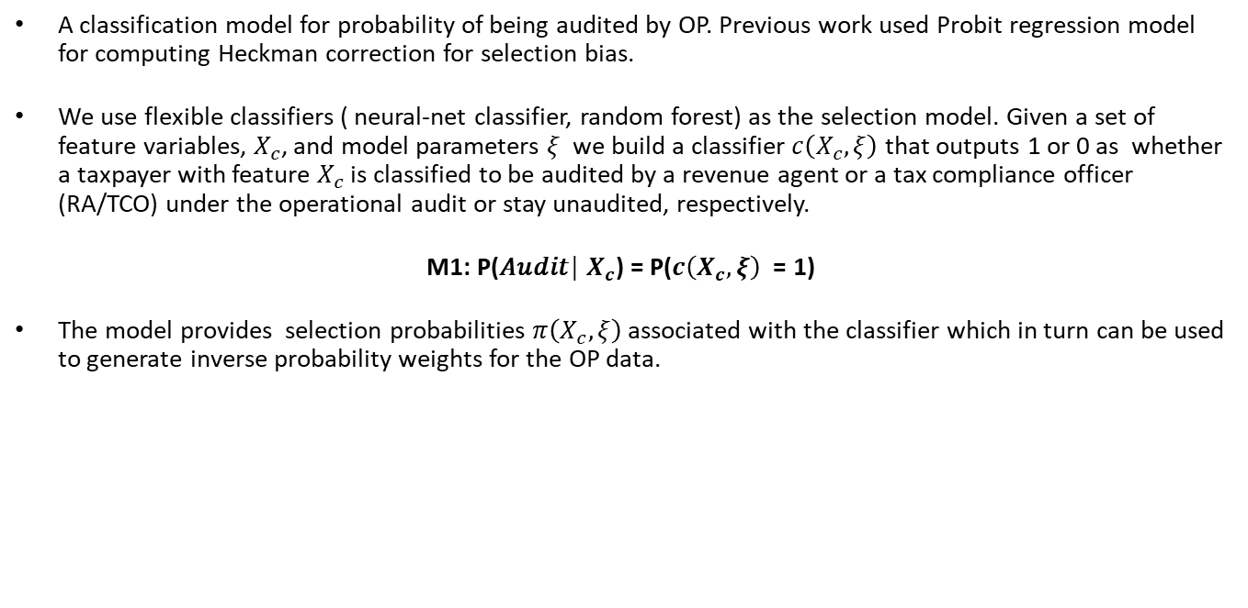
Research, Applied Analytics, & Statistics
Selection Probability Model for OP
A classification model for probability of being audited by OP. Previous work used Probit regression model for computing Heckman correction for selection bias.
We use flexible classifiers ( neural-net classifier, random forest) as the selection model. Given a set of feature variables, $X_{c}$, and model parameters $ξ$ we build a classifier $c\left(X_{c},ξ\right)$ that outputs 1 or 0 as whether a taxpayer with feature $X_{c}$ is classified to be audited by a revenue agent or a tax compliance officer (RA/TCO) under the operational audit or stay unaudited, respectively.
M1: P(𝐴𝑢𝑑𝑖𝑡│ $X_{c}$) = P($c\left(X_{c},ξ\right)$ = 1)
The model provides selection probabilities $π\left(X_{c},ξ\right)$ associated with the classifier which in turn can be used to generate inverse probability weights for the OP data.

Slide 8
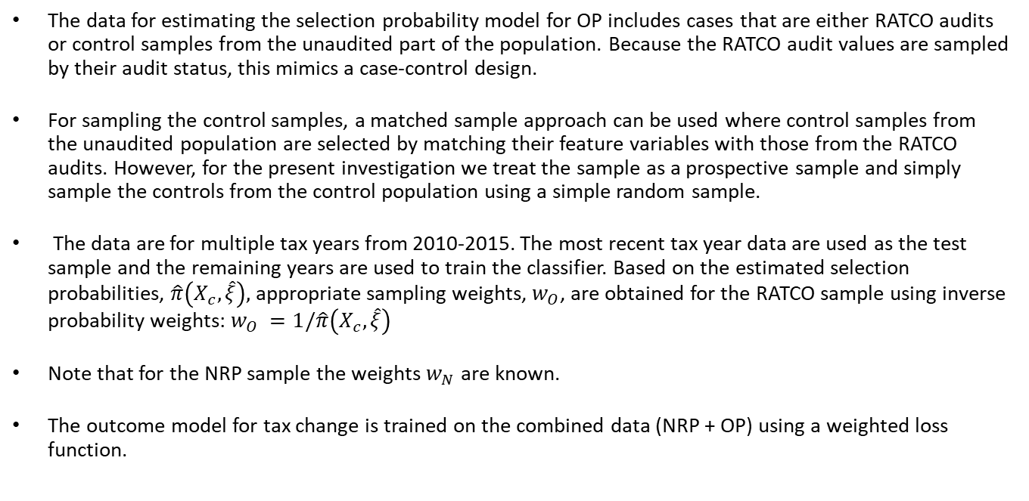
Research, Applied Analytics, & Statistics
Data for Selection Probability Model for OP
The data for estimating the selection probability model for OP includes cases that are either RATCO audits or control samples from the unaudited part of the population. Because the RATCO audit values are sampled by their audit status, this mimics a case-control design.
For sampling the control samples, a matched sample approach can be used where control samples from the unaudited population are selected by matching their feature variables with those from the RATCO audits. However, for the present investigation we treat the sample as a prospective sample and simply sample the controls from the control population using a simple random sample.
The data are for multiple tax years from 2010-2015. The most recent tax year data are used as the test sample and the remaining years are used to train the classifier. Based on the estimated selection probabilities, $\hat{π}\left(X_{c},\hat{ξ}\right),$ appropriate sampling weights, $w_{O}$, are obtained for the RATCO sample using inverse probability weights: $w_{O} =1/\hat{π}\left(X_{c},\hat{ξ}\right)$
Note that for the NRP sample the weights $w_{N}$ are known.
The outcome model for tax change is trained on the combined data (NRP + OP) using a weighted loss function.

Slide 9
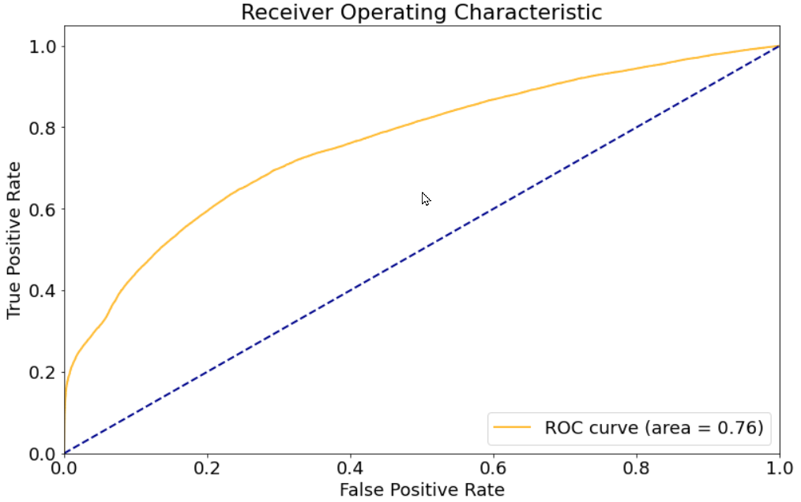
Research, Applied Analytics, & Statistics
Performance of the NN Classifier for the Audit Selection Model
Receiver Operating Characteristics curve for classification of cases to OP
Neural net classifier is used for predicting the probability of being audited under OP

Slide 10
Research, Applied Analytics, & Statistics
Outcome Model for Tax Change Post Audit
Post audit tax change is a continuous variable Y depending on taxpayer characteristics and other features as
M2 : Y ≈ g(X, θ )
where g is learned using a flexible model such as a feed-forward neural net (NN). The parameters θ are the weights from the trained NN. The combined model M1×M2 has parameters ψ=(ξ,θ) where the parameter ξ only enters the model in selection of the feature matrix corresponding to the OP data. For this presentation we will treat ξ as known based on the fitted selection probability model for estimation and uncertainty quantification of the second stage model.

Slide 11
Research, Applied Analytics, & Statistics
Measurement Error Correction
Measurement error control: The outcome Y for the OP part of the data is a response to a different audit process/survey questions. The tax change in OP thus can be thought of as if the audit process was NRP plus a measurement error. We construct a measurement error control using auxiliary information.
A simple shift captured by including the NRP indicator dummy in the risk model.
Other possible control: use issue-based classification rate differences or differences in exam hours.
Use a control for difference in exam hours: NRP is more extensive and takes longer.
Control = (Actual OP hours - Predicted OP hours)/(Predicted OP hours as if NRP) to use in model M2. For the NRP sample, the value is set to zero.

Slide 12
Research, Applied Analytics, & Statistics
Approximate Bayesian Computation (ABC)
The main objective is to provide estimation of the outcome model M2, predict tax change Y based on the fitted model and provide measures of prediction uncertainty. Generally, the combined likelihood for a flexible M1xM2 model or that of M2 will be hard to evaluate and optimize. For inference and uncertainty quantification we need more flexible tools. We will use Approximate Bayesian Computation to achieve this goal.
Approximate Bayesian Computation is a simulation-based method for parameter estimation/inference/prediction that can circumvent the problem of intractable likelihood and hence suitable for modern complex statistical models.
In the data integration set up, the predictive risk model can be highly non-linear, and/or propensity models can be highly nonlinear and complex but given a set of model parameters it is possible to simulate synthetic data.
As long as, given some values of the parameters, synthetic copies of the data can be generated using the statistical model of interest, ABC can produce pseudo posterior samples that can be used for inference and uncertainty quantification.

Slide 13
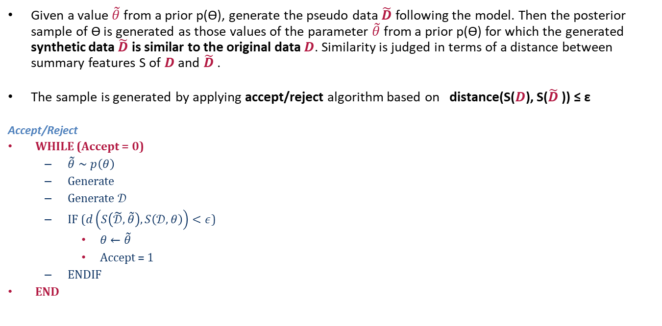
Research, Applied Analytics, & Statistics
Pseudo Posterior Sampling for ABC
Given a value $\tilde{θ}$ from a prior p(ϴ), generate the pseudo data $\tilde{D}$ following the model. Then the posterior sample of ϴ is generated as those values of the parameter $\tilde{θ}$ from a prior p(ϴ) for which the generated synthetic data $\tilde{D}$ is similar to the original data $D$. Similarity is judged in terms of a distance between summary features S of $D$ and $\tilde{D}$ .
The sample is generated by applying accept/reject algorithm based on distance(S($D$), S($\tilde{D}$ )) ≤ ε
Accept/Reject
WHILE (Accept = 0)
$\tilde{θ}∼p\left(θ\right)$
Generate
Generate $𝒟$
IF ($d\left(S\left(\tilde{𝒟},\tilde{θ}\right),S\left(𝒟,θ\right)\right)<ε$)
$θ←\tilde{θ}$
Accept = 1
ENDIF
END

Slide 14
Research, Applied Analytics, & Statistics
ABC for High-Dimensional Complex models
In high-dimensional model, data driven choice candidate parameter values may be helpful. To overcome higher rejection rate, one could use a weighted strategy where each candidate is weighted according to the “closeness’ of the corresponding synthetic data to the original data.
To judge ‘closeness’ of original data and synthetic data for a test sample we use a simple Gaussian approximation (in terms of mean and variance) to the distribution of tax change in both data sets and then use the overlap area to generate a ‘closeness’ score. For example, if a candidate value generates a tax change distribution with mean and variance nearly identical to that of the NN fit then the corresponding Gaussian approximations will have overlap area close to one, and hence that candidate will get a weight of one. If the mean and variance of the synthetic data is very different from that of the original data, the overlap will be small, and the weight will be close to zero.
Figure shows a perturbation distribution for a candidate parameters (NN weights) obtained as a perturbation of the fitted NN weights.
The pseudo posterior could be a weighted distribution of the candidates based on the overlap score.

Slide 15
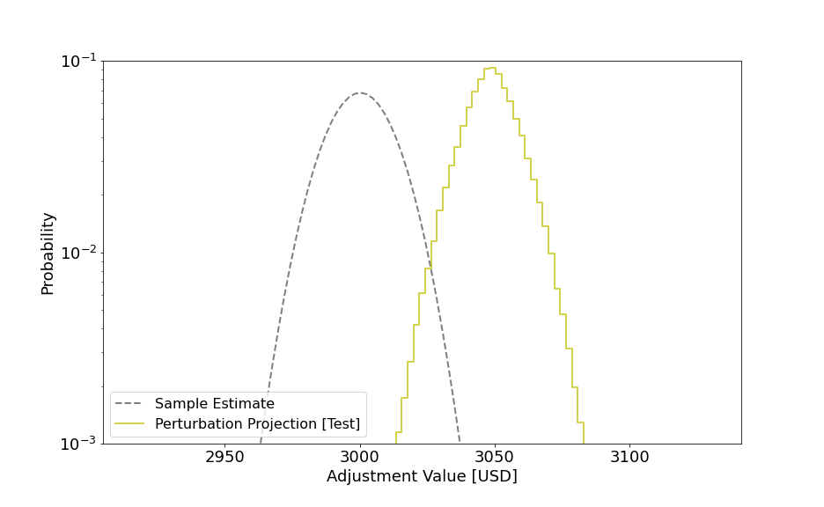
Research, Applied Analytics, & Statistics
Tax Change Distribution under Perturbation
Plot of the fitted Gaussian Distribution to the test data versus perturbed distribution
Perturbations are weighted by their compatibility scores with the original sample

Slide 16
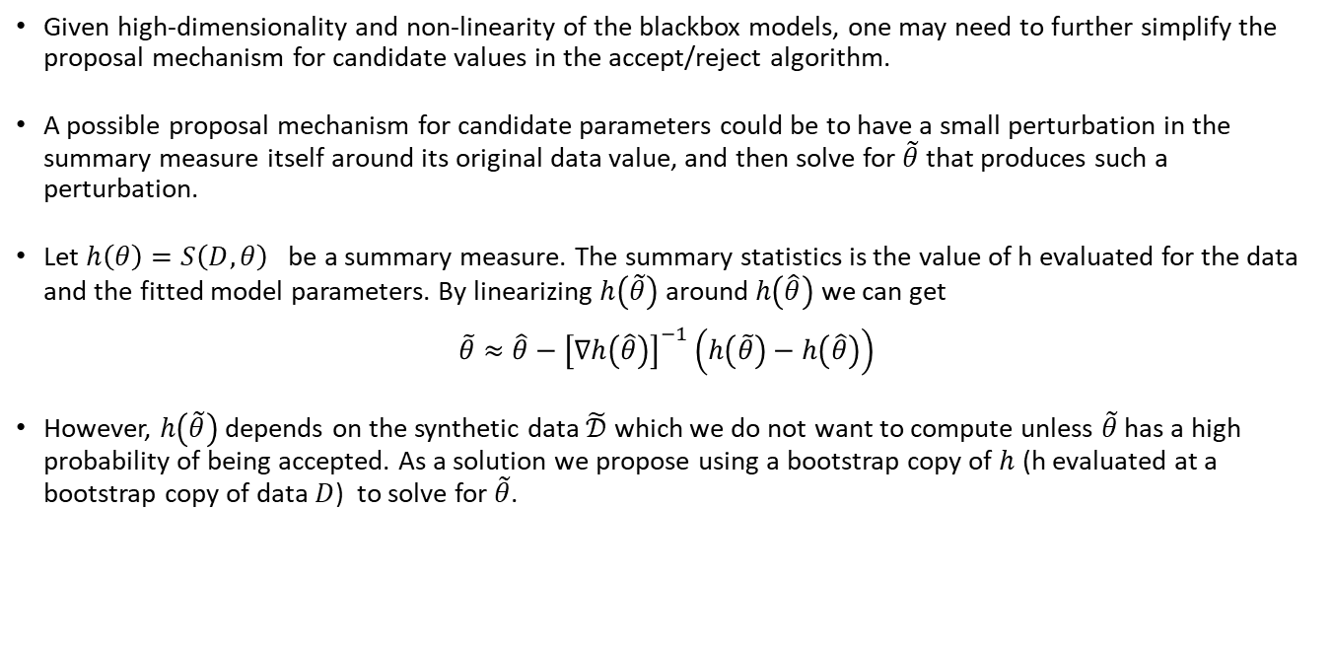
Research, Applied Analytics, & Statistics
Resampling Based Modified ABC
Given high-dimensionality and non-linearity of the blackbox models, one may need to further simplify the proposal mechanism for candidate values in the accept/reject algorithm.
A possible proposal mechanism for candidate parameters could be to have a small perturbation in the summary measure itself around its original data value, and then solve for $\tilde{θ}$ that produces such a perturbation.
Let $h\left(θ\right)=S\left(D,θ\right)$ be a summary measure. The summary statistics is the value of h evaluated for the data and the fitted model parameters. By linearizing $h\left(\tilde{θ}\right)$ around $h\left(\hat{θ}\right)$ we can get
$$\tilde{θ}≈\hat{θ}−{\left[∇h\left(\hat{θ}\right)\right]}^{−1}\left(h\left(\tilde{θ}\right)−h\left(\hat{θ}\right)\right)$$
However, $h\left(\tilde{θ}\right)$ depends on the synthetic data $\tilde{𝒟}$ which we do not want to compute unless $\tilde{θ}$ has a high probability of being accepted. As a solution we propose using a bootstrap copy of $h$ (h evaluated at a bootstrap copy of data $D$) to solve for $\tilde{θ}$.

Slide 17
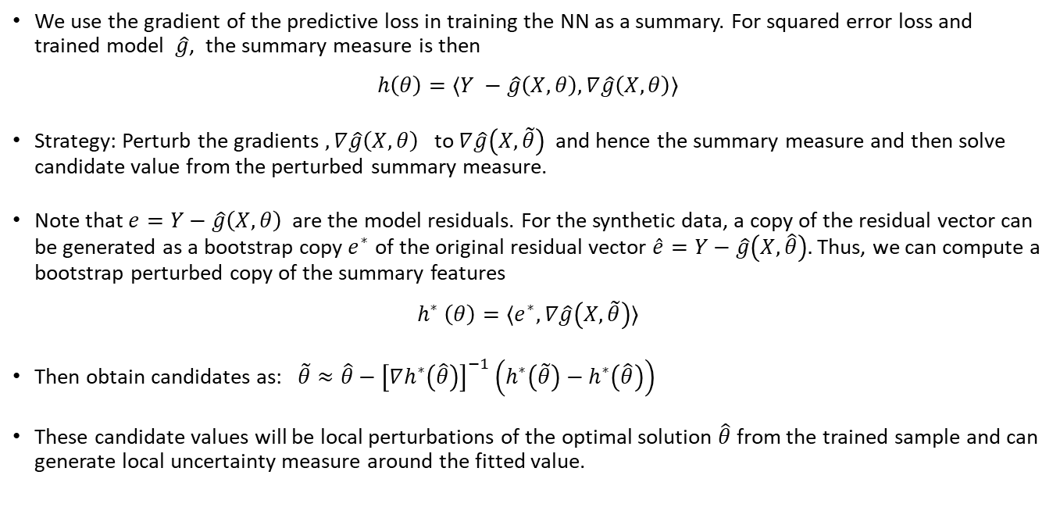
Research, Applied Analytics, & Statistics
Gradient Perturbation and Residual Bootstrap
We use the gradient of the predictive loss in training the NN as a summary. For squared error loss and trained model $\hat{g}$, the summary measure is then
$$h\left(θ\right)=⟨Y −\hat{g}\left(X,θ\right), ∇\hat{g}\left(X,θ\right)⟩$$
Strategy: Perturb the gradients $, ∇\hat{g}\left(X,θ\right)$ to $∇\hat{g}\left(X,\tilde{θ}\right)$ and hence the summary measure and then solve candidate value from the perturbed summary measure.
Note that $e=Y−\hat{g}\left(X,θ\right)$ are the model residuals. For the synthetic data, a copy of the residual vector can be generated as a bootstrap copy $e^{∗}$ of the original residual vector $\hat{e}=Y−\hat{g}\left(X,\hat{θ}\right).$ Thus, we can compute a bootstrap perturbed copy of the summary features
$$h^{∗} \left(θ\right)=⟨e^{∗},∇\hat{g}\left(X,\tilde{θ}\right)⟩$$
Then obtain candidates as: $\tilde{θ}≈\hat{θ}−{\left[∇h^{∗}\left(\hat{θ}\right)\right]}^{−1}\left(h^{∗}\left(\tilde{θ}\right)−h^{∗}\left(\hat{θ}\right)\right)$
These candidate values will be local perturbations of the optimal solution $\hat{θ}$ from the trained sample and can generate local uncertainty measure around the fitted value.

Slide 18
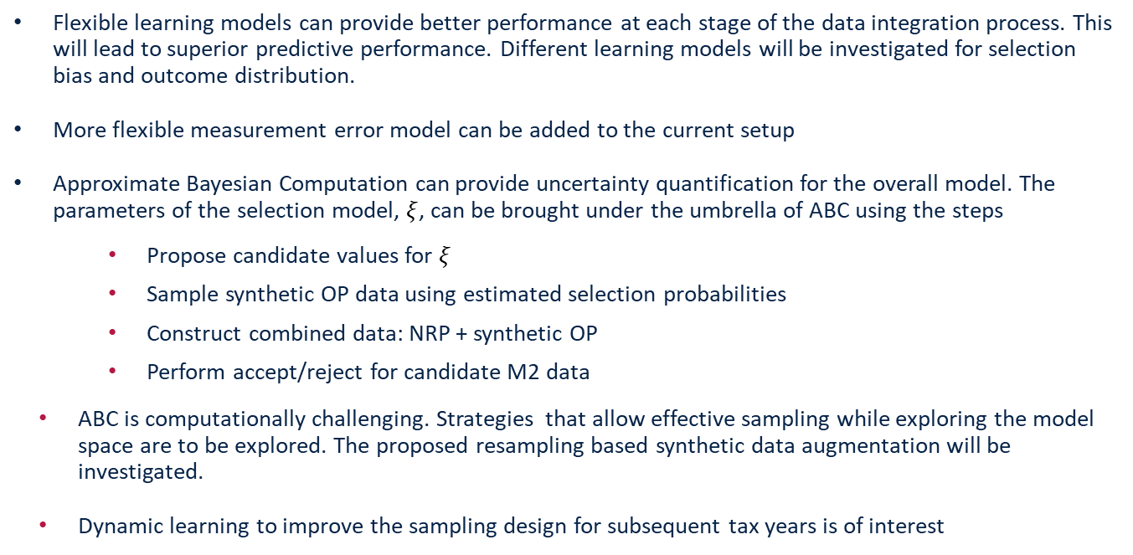
Research, Applied Analytics, & Statistics
Future Work
Flexible learning models can provide better performance at each stage of the data integration process. This will lead to superior predictive performance. Different learning models will be investigated for selection bias and outcome distribution.
More flexible measurement error model can be added to the current setup
Approximate Bayesian Computation can provide uncertainty quantification for the overall model. The parameters of the selection model, $ξ$, can be brought under the umbrella of ABC using the steps
Propose candidate values for $ξ$
Sample synthetic OP data using estimated selection probabilities
Construct combined data: NRP + synthetic OP
Perform accept/reject for candidate M2 data
ABC is computationally challenging. Strategies that allow effective sampling while exploring the model space are to be explored. The proposed resampling based synthetic data augmentation will be investigated.
Dynamic learning to improve the sampling design for subsequent tax years is of interest

Slide 19
Thank you
Research, Applied Analytics, & Statistics

