Slide 1
Developing a Hot Deck Imputation Procedure for the Annual Integrated Economic Survey
Katherine Jenny Thompson
Associate Directorate for Economic Programs
U.S. Census Bureau
Joint Statistical Meetings
August 7, 2024

Slide 2
Any opinions and conclusions expressed herein are those of the author and do not reflect the views of the U.S. Census Bureau. The Census Bureau has reviewed this data product to ensure appropriate access, use, and disclosure avoidance protection of the confidential source data (Project No. P-7529180, Disclosure Review Board (DRB) approval number: CBDRB-FY24-ESMD010-007 ). Note: all my illustrative examples are FICTIONAL.
Any opinions and conclusions expressed herein are those of the authors and do not reflect the views of the U.S. Census Bureau. The Census Bureau has reviewed this data product to ensure appropriate access, use, and disclosure avoidance protection of the confidential source data (Project No. P-7504682, Disclosure Review Board (DRB) approval number: CBDRB-FY23-ESMD010-021).

Slide 3
Acknowledgments
Cell Design for Nonresponse Adjustment Team
Caroline Dennis* & Christina Gouvatsos*
Sunitha Cherussey
Arezou Koohi
Lydia Shia
Adam Sutmiller
Dan Tulp
Kirk White
Yeng Xiong
Hot Deck Imputation (Establishment Data) Team
Jonathan Commike*, Christina Gouvatsos*, & Jenny Thompson*
Laura Bechtel
James Hunt
Kulbhushan Sharma
Alicia Ranae Smith
Katrina Washingon
* Team co-leads

Slide 4
Outline
Background/Definitions
High-level Discussion on Hot Deck Imputation
Imputation Cells
Hot Deck Imputation Procedure
Questions/Comments
Just kidding, there won’t be any time…

Slide 5
Background/Definitions

Slide 6
Definitions
Sector: an area of the economy in which businesses share the same or related business activity, product, or service (www.investopedia.com)
Industry: a group of companies that are related based on their primary business activities or service ( www.investopedia.com)
Industrial classification: industry code assigned to an individual business, usually based on the business’ largest source(s) of revenue
NAICS: North American Industry Classification System
Digits indicate level of detail used for classification (more digits = more criteria)

Slide 7
NAICS Example (Retail Trade Sector)
NAICS 444
Building Material & Garden Equipment and Supplies Dealers
NAICS3
NAICS 4441
Building Material & Supplies Dealers
NAICS4
NAICS 444120
Paint & Wallpaper Retailers
NAICS6
NAICS 444140
Hardware Retailers
NAICS6
NAICS 4442
Lawn and Garden Equipment & Supplies Retailers
NAICS4
NAICS 444180
Other Building Material Dealers
NAICS6
NAICS 444230
Outdoor Power Equipment Retailers
NAICS6
NAICS 444240
Nursery, Garden Center, & Farm Supply Retailers
NAICS6

Slide 8




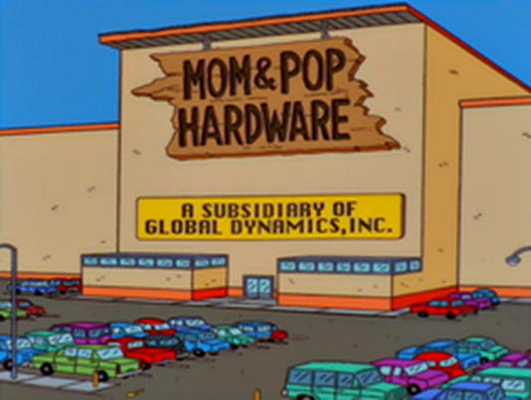
More Definitions
Establishment – a single business location
Company – any formal business entity for profit, which may be a corporation, a partnership, association or individual proprietorship (https://dictionary.law.com/)
Multi-unit (establishment) company

Slide 9

More Definitions
Establishment – a single business location
Company – any formal business entity for profit, which may be a corporation, a partnership, association or individual proprietorship (https://dictionary.law.com/)
Multi-unit (establishment) company
Location #1
Retail Trade Sector
Manufacturing Sector
Location #5
Location #3
Location #4
Location #2
Wholesale Trade Sector

Slide 10
More Definitions
Establishment – a single business location
Company – any formal business entity for profit, which may be a corporation, a partnership, association or individual proprietorship (https://dictionary.law.com/)
Multi-unit (establishment) company
Single-unit (establishment) company

Slide 11
Annual Integrated Economic Survey (AIES)
Economy wide survey conducted by U.S. Census Bureau
Mailout started in March 2024
Replaces seven annual surveys with one annual survey
Publication Requirements
National industry estimates: four key items plus sector-specific items
C.V. target ≈ 2%
Disaggregated industry (NAICS) levels: NAICS3, NAICS4, NAICS6
Subnational (industry x geography) estimates: four key items
C.V. target ≈ 15%
Aggregated industry (NAICS) levels: NAICS3

Slide 12
Annual Integrated Economic Survey (AIES)
Imputation Unit: Establishment – a single business location
Sampling Unit: Company – any formal business entity for profit, which may be a corporation, a partnership, association or individual proprietorship (https://dictionary.law.com/)
ALL establishments associated within a sampled company are included in the AIES sample

Slide 13
Basic Stratification of Companies
Operate in more than one sector or NAICS4
All Companies
Certainty
Noncertainty
Sector 11
…
Sector 81
Industry K
Industry 1
…
Balance of Region 1 Stratum
Direct Use State 1
Region 1
…
Balance of Region 4 Stratum
…
Direct Use State 1
Region 4
…
Multi-State Company
Operates establishments in more than one state
27 Geographic Strata per Industry (NAICS3)
Industry is NAICS3: BROAD STRATUM

Slide 14
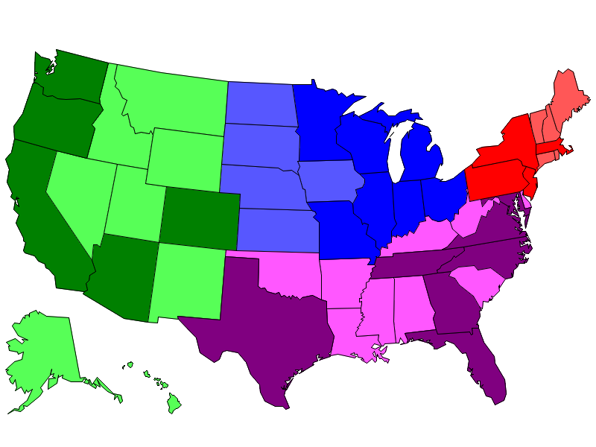
AIES Establishment Sample
Balance of Region Stratum:
Minimum number of sampled (noncertainty) units
Direct Use State:
Minimum number of sampled (noncertainty) units
B
D
B
All states:
Contributions from certainty companies
Contributions from multi-state stratum
B
B
B

Slide 15
AIES Establishment Data (Fake) Retail Trade Example
Auxiliary Data (Available for All Units)
2023 Survey Data (Subject to Missingness)
Imputation Unit
Classification Information
Geographic Information
Measure of Size (MOS)
Establishment | Industry | NAICS6 | State | Region | 2022 Payroll | Payroll | 1st Quarter Payroll | Total Employ-ment | Sales
Mom & Pop Hardware | Hardware Retailers | 444130 | MO | Midwest | 2,551 | 2,767 | 692 | 69 | 5,754
Mom & Pop Hardware | Hardware Retailers | 444130 | MO | Midwest | 2,705 | 4,293 | 1,022 | 107 | 12,542
Mom & Pop Hardware | Hardware Retailers | 444130 | MO | Midwest | 2,629 | 3,179 | 662 | 79 | 8,095
The Hardware Shop | Hardware Retailers | 444130 | MO | Midwest | 6,002 | 7,436 | 1,549 | 186 | 14,946
Lawns Galore | Nursery, Garden Center, & Farm Supply Retailers | 444240 | MO | Midwest | 1,507 | 2,536 | 634 | 56 | 6,942
Lawns Galore | Nursery, Garden Center, & Farm Supply Retailers | 444240 | NE | Midwest | 1,306 | 1,594 | 399 | 35 | 3,368
Lawns Galore | Nursery, Garden Center, & Farm Supply Retailers | 444240 | NE | Midwest | 8,120 | 9,462 | 1,971 | 210 | 28,294
Lawns Galore | Nursery, Garden Center, & Farm Supply Retailers | 444240 | NE | Midwest | 7,777 | 12,451 | 2,594 | 277 | 34,108
Lawns Galore | Nursery, Garden Center, & Farm Supply Retailers | 444240 | NE | Midwest | 6,278 | 11,514 | 2,879 | 256 | 34,298
Darcy's Tractors | Outdoor Power Equipment Retailers | 444230 | NE | Midwest | 3,233 | 4,822 | 1,148 | 138 | 12,108
Wallpaper Heaven | Paint and Wallpaper Retailers | 444120 | MO | Midwest | 1,202 | 1,962 | 467 | 78 | 4,007
Wallpaper Heaven | Paint and Wallpaper Retailers | 444120 | MO | Midwest | 999 | 1,833 | 458 | 73 | 4,458
Wallpaper Fixings | Other Building Material Dealers | 444180 | MO | Midwest | 160 | 239 | 60 | 10 | 631

Slide 16
Hot Deck Imputation
Replace missing values of one or more variables for a nonrespondent (“recipient”) with observed values from a respondent (“donor”) that is similar with respect to characteristics observed for both
Benefits (General)
Impute plausible values using current data collection (fresh data)
Extends to imputing multivariate missingness (preserving associations)

Slide 17
Basic Steps of the Hot Deck
Create set of possible donor(s) for each recipient
Select a single donor for each recipient
Use donor’s observed data to fill in recipient’s missing values
Analyze completed data, with special care taken for variance estimates

Slide 18
Why Use Hot Deck for AIES Establishment Data?
Entirely NEW survey
Survey sample design
Collection instrument (questionnaire)
Processing system
Reporting units
Need to preserve multivariate relationships
HAVE procedures to validate ratio relationships within NAICS4 x geography (Economic Census)
HOT DECK can jointly impute remaining missing or invalid items with current (validated) data

Slide 19
Why Use Hot Deck for AIES Establishment Data (Continued)?
Can easily account for varying unit sizes in imputation procedure
TYPICAL Hot Deck (Direct Substitution)
2023 Survey Data
 | Establishment | Industry | State | Region | 2022 Payroll | Payroll | 1st Quarter Payroll | Total Employ-ment | Sales
RECIPIENT | Mom & Pop Hardware | Hardware Retailers | MO | Midwest | 2,551 | 2,767 | 692
DONOR | The Hardware Shop | Hardware Retailers | MO | Midwest | 6,002 | 7,436 | 1,549 | 186 | 14,946
 | Establishment | Industry | State | Region | 2022 Payroll | Payroll | 1st Quarter Payroll | Total Employ-ment | Sales
RECIPIENT | Mom & Pop Hardware | Hardware Retailers | MO | Midwest | 2,551 | 2,767 | 692 | 186 | 14,946
DONOR | The Hardware Shop | Hardware Retailers | MO | Midwest | 6,002 | 7,436 | 1,549 | 186 | 14,946
Not especially plausible imputed values:
Payroll/Employment ≈ 15 (low)
Sales/Payroll ≈ 5.5 (high)

Slide 20
Why Use Hot Deck for AIES Establishment Data (Continued)?
Can easily account for varying unit sizes in imputation procedure
Hot Deck with RATIO Imputation
 | Establishment | Industry | State | Region | 2022 Payroll | Payroll | 1st Quarter Payroll | Total Employ-ment | Sales
RECIPIENT | Mom & Pop Hardware | Hardware Retailers | MO | Midwest | 2,551 | 2,767 | 692
DONOR | The Hardware Shop | Hardware Retailers | MO | Midwest | 6,002 | 7,436 | 1,549 | 186 | 14,946
Multiply by (valid value of) Payroll
Repeat but donate Sales/Payroll
Donate RATIO of Employment/Payroll ≈ 0.025
(Payroll/Employment ≈ 40)
 | Establishment | Industry | State | Region | 2022 Payroll | Payroll | 1st Quarter Payroll | Total Employ-ment | Sales
RECIPIENT | Mom & Pop Hardware | Hardware Retailers | MO | Midwest | 2,551 | 2,767 | 692 | 69 | 5,561
DONOR | The Hardware Shop | Hardware Retailers | MO | Midwest | 6,002 | 7,436 | 1,549 | 186 | 14,946
Impute plausible value of Total Employment

Slide 21
Returning to Basic Steps of the Hot Deck
Create set of possible donor(s) for each recipient
Adjustment (Imputation) Cells
Select a single donor for each recipient
Nearest Neighbor Imputation
Use donor’s observed data to fill in recipient’s missing values
Nearest Neighbor Ratio Imputation

Slide 22
Hot Deck Imputation: Defining Adjustment Cells

Slide 23
Adjustment (Imputation) Cells
Partition sample data into disjoint cells
Units within a cell “similar” on some criteria
Use variables available for all sampled units
Industry (NAICS6) + higher aggregations (NAICS4, NAICS3)
Geography (State) + higher aggregations (AIES weighting cells, AIES sampling strata, division, region)
Frame measure of size (2022 annual payroll from administrative data)
Baseline cells – most granular partition (minimum of 5 sampled companies)
Collapsed cells – coarser partitions
Donor “sufficiency” criteria in each imputation cell
Minimum number of donors (5) or
Minimum ratio of donors/recipients (0.30)

Slide 24
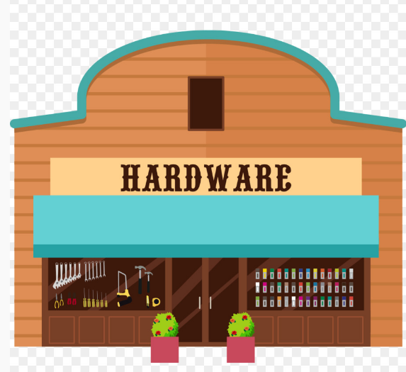


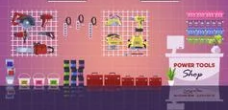

Adjustment Cell Data (Research)
How should we group “similar” establishments?
FRAME Data (Available for All Units)
How do we create an initial donor pool?
Establishment | Industry | NAICS6 | State | Region | 2022 Payroll
Mom & Pop Hardware | Hardware Retailers | 444130 | MO | Midwest | 2,551
Mom & Pop Hardware | Hardware Retailers | 444130 | MO | Midwest | 2,705
Mom & Pop Hardware | Hardware Retailers | 444130 | MO | Midwest | 2,629
The Hardware Shop | Hardware Retailers | 444130 | MO | Midwest | 6,002
Lawns Galore | Nursery, Garden Center, & Farm Supply Retailers | 444240 | MO | Midwest | 1,507
Lawns Galore | Nursery, Garden Center, & Farm Supply Retailers | 444240 | NE | Midwest | 1,306
Lawns Galore | Nursery, Garden Center, & Farm Supply Retailers | 444240 | NE | Midwest | 8,120
Lawns Galore | Nursery, Garden Center, & Farm Supply Retailers | 444240 | NE | Midwest | 7,777
Lawns Galore | Nursery, Garden Center, & Farm Supply Retailers | 444240 | NE | Midwest | 6,278
Darcy's Tractors | Outdoor Power Equipment Retailers | 444230 | NE | Midwest | 3,233
Wallpaper Heaven | Paint and Wallpaper Retailers | 444120 | MO | Midwest | 1,202
Wallpaper Heaven | Paint and Wallpaper Retailers | 444120 | MO | Midwest | 999
Wallpaper Fixings | Other Building Material Dealers | 444180 | MO | Midwest | 160

Slide 25
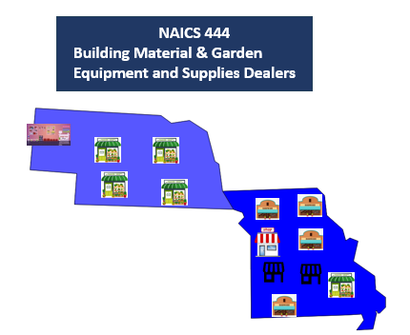
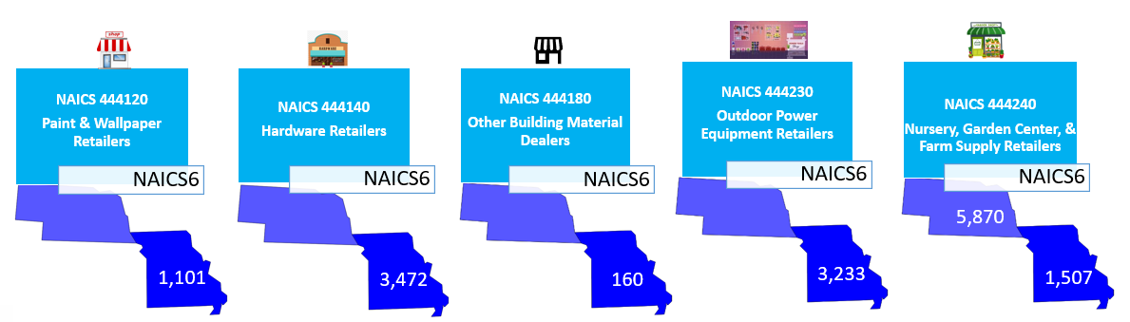
Which Groupings Are “Similar”?
Most Granular (Least Amount of Data)
Less Granular (More Data)

Slide 26

Which Groupings Are “Similar”?
Most Granular (Least Amount of Data)
Least Granular (Most Data)

Slide 27
Adjustment Cell Collapsing Strategy
NAICS6 x State
NAICS6 x Region
NAICS4 x State
NAICS3 x State
NAICS4 x Region
NAICS3 x State
NAICS4
NAICS3 x Region
NAICS3
Determine average MOS (frame payroll) per establishment in each baseline cell

Slide 28
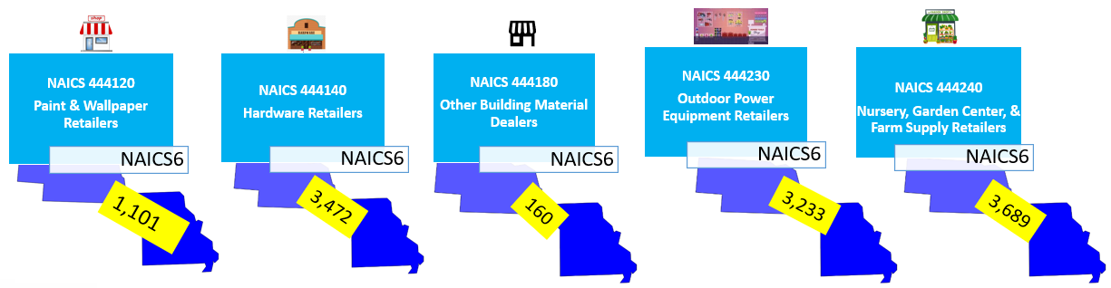
Adjustment Cell Collapsing Strategy
Determine average MOS (frame payroll) per establishment in each baseline cell
Determine all possible next tier collapsing strategies
Compute average MOS within collapsed cell
Compute average distance (Euclidean = Manhattan) from each original to collapsed cell
Compute average overall distance Select collapsed cell scheme with minimum average distance
NAICS6 x State
NAICS6 x Region
NAICS4 x State
NAICS4 x Region
NAICS3 x State
NAICS4
NAICS3 x Region
NAICS3
Average overall distance = 436
Average Distance
0
0
0
0
2,182

Slide 29
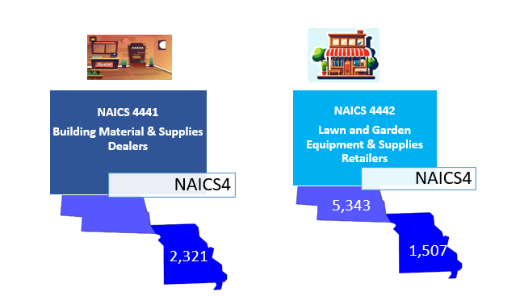
Adjustment Cell Collapsing Strategy
Determine average MOS (frame payroll) per establishment in each baseline cell
Determine all possible next tier collapsing strategies
Compute average MOS within collapsed cell
Compute average distance (Euclidean = Manhattan) from each original to collapsed cell
Compute average overall distance
Select collapsed cell scheme with minimum average distance
NAICS6 x State
NAICS6 x Region
NAICS4 x State
NAICS4 x Region
NAICS3 x State
NAICS4
NAICS3 x Region
NAICS3
Average overall distance = 707

Slide 30
Adjustment Cell Collapsing Strategy
Determine average MOS (frame payroll) per establishment in each baseline cell
Determine all possible next tier collapsing strategies
Compute average MOS within collapsed cell
Compute average distance (Euclidean = Manhattan) from each original to collapsed cell
Compute average overall distance
Select collapsed cell scheme with minimum average distance
NAICS6 x State
NAICS6 x Region
NAICS4 x State
NAICS4 x Region
NAICS3 x State
NAICS4
NAICS3 x Region
NAICS3
Average overall distance = 436
Average overall distance = 707

Slide 31
Adjustment Cell Collapsing Strategy
NAICS6 x State
NAICS6 x Region
NAICS4 x State
NAICS6
NAICS4 x Region
NAICS4
NAICS3 x Region
NAICS3
Baseline
Collapsing Tier 1

Slide 32
Adjustment Cell Collapsing Strategy
NAICS6 x State
NAICS6 x Region
NAICS4 x State
NAICS6
NAICS4 x Region
NAICS4
NAICS3 x Region
NAICS3
Baseline
Collapsing Tier 1
Collapsing Tier 2

Slide 33
Adjustment Cell Collapsing Strategy
NAICS6 x State
NAICS6 x Region
NAICS4 x State
NAICS6
NAICS4 x Region
NAICS4
NAICS3 x Region
NAICS3
Baseline
Collapsing Tier 1
Collapsing Tier 2
Collapsing Tier 3

Slide 34
Adjustment Cell Collapsing Strategy
NAICS6 x State
NAICS6 x Region
NAICS4 x State
NAICS6
NAICS4 x Region
NAICS4
NAICS3 x Region
NAICS3
Baseline
Collapsing Tier 1
Collapsing Tier 2
Collapsing Tier 3
Collapsing Tier 4

Slide 35
AIES Adjustment Cell Determination
Similar procedure applied independently by sector
Additional classification variables in selected sectors
Different numbers of subsectors (NAICS3) within sector
Different levels (tiers) of collapsing by sector
Analyst expertise considered in final recommendations
Cell counts included both certainty & noncertainty establishments
No anticipated nonresponse

Slide 36
Adjustment Cell Collapsing in Practice
Auxiliary Data (Available for All Units)
2023 Survey Data (Subject to Missingness)
Establishment | Industry | NAICS6 | State | Region | 2022 Payroll | Payroll | 1st Quarter Payroll | Total Employ-ment | Sales
Mom & Pop Hardware | Hardware Retailers | 444130 | MO | Midwest | 2,551 | 2,767 | 692 | 69 | 5,754
Mom & Pop Hardware | Hardware Retailers | 444130 | MO | Midwest | 2,705 | 4,293 | 1,022 | 107 | 12,542
Mom & Pop Hardware | Hardware Retailers | 444130 | MO | Midwest | 2,629 | 3,179 | 662 | 79 | 8,095
The Hardware Shop | Hardware Retailers | 444130 | MO | Midwest | 6,002 | 7,436 | 1,549 | 186 | 14,946
Lawns Galore | Nursery, Garden Center, & Farm Supply Retailers | 444240 | MO | Midwest | 1,507 | 2,536 | 634 | 56 | 6,942
Lawns Galore | Nursery, Garden Center, & Farm Supply Retailers | 444240 | NE | Midwest | 1,306 | 1,594 | 399 | 35 | 3,368
Lawns Galore | Nursery, Garden Center, & Farm Supply Retailers | 444240 | NE | Midwest | 8,120 | 9,462 | 1,971 | 210 | 28,294
Lawns Galore | Nursery, Garden Center, & Farm Supply Retailers | 444240 | NE | Midwest | 7,777 | 12,451 | 2,594 | 277 | 34,108
Lawns Galore | Nursery, Garden Center, & Farm Supply Retailers | 444240 | NE | Midwest | 6,278 | 11,514 | 2,879 | 256 | 34,298
Darcy's Tractors | Outdoor Power Equipment Retailers | 444230 | NE | Midwest | 3,233 | 4,822 | 1,148 | 138 | 12,108
Wallpaper Heaven | Paint and Wallpaper Retailers | 444120 | MO | Midwest | 1,202 | 1,962 | 467 | 78 | 4,007
Wallpaper Heaven | Paint and Wallpaper Retailers | 444120 | MO | Midwest | 999 | 1,833 | 458 | 73 | 4,458
Wallpaper Fixings | Other Building Material Dealers | 444180 | MO | Midwest | 160 | 239 | 60 | 10 | 631
Used to define adjustment cells (all tiers)
Used to determine initial donor counts
Initial donor provides positive values for all four collected items
Final adjustment cells based on donor counts and donor/recipient ratios

Slide 37
Hot Deck Imputation: Selecting Donors & Imputing Values

Slide 38
Hot Deck Imputation for AIES Selecting Donors Within Adjustment Cell
Adjustment cells set boundaries based on
Characteristics of categorical values
In this case, predictive of cell mean (payroll)
Ideally, also predictive of probability of response
Number of donors available for hot deck imputation
Within adjustment cell, what criteria yield “similar” donor-to-recipient ratios?
Industry code?
Geography?
Unit size?
Similar distribution of observed data values?

Slide 39
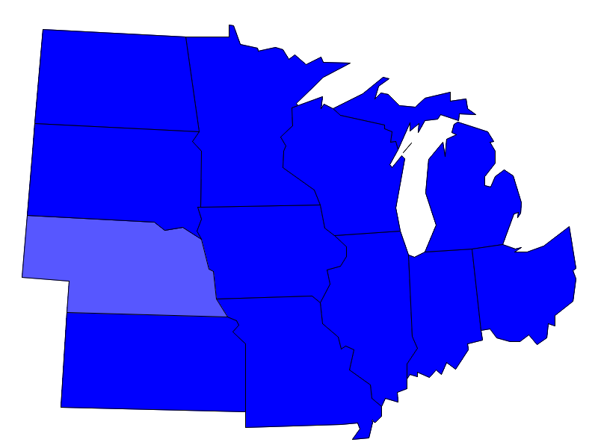


Returning to earlier example Nursery, Garden Center, & Farm Supply Retailers
Donor 1
Payroll | 1st Quarter Payroll | 1st Quarter Employment | Sales
11,514 | 2,879 | 256 | 34,298
Recipient
Donor 2
Payroll | 1st Quarter Payroll | 1st Quarter Employment | Sales
12,451 | 2,594 | 277 | ???
Payroll | 1st Quarter Payroll | 1st Quarter Employment | Sales
9,462 | 1,971 | 210 | 28,294
Too small
Donor 3
Payroll | 1st Quarter Payroll | 1st Quarter Employment | Sales
1,594 | 399 | 35 | 3,368
Too far away
Donor 4
Payroll | 1st Quarter Payroll | 1st Quarter Employment | Sales
2,536 | 634 | 56 | 6,942

Slide 40
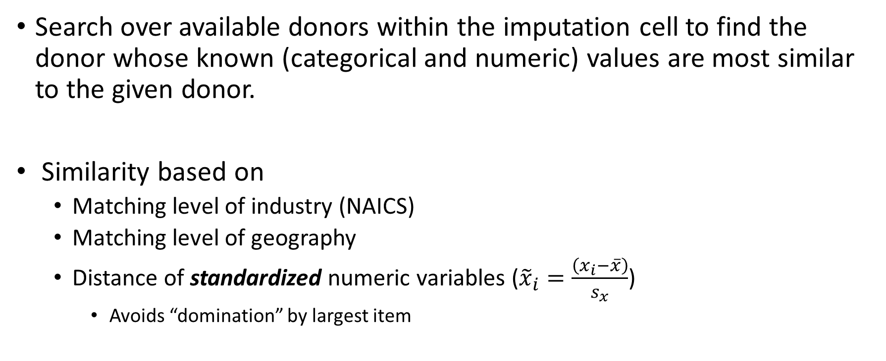
Quantifying “Similar” (Nearest Neighbor)
Search over available donors within the imputation cell to find the donor whose known (categorical and numeric) values are most similar to the given donor.
Similarity based on
Matching level of industry (NAICS)
Matching level of geography
Distance of standardized numeric variables (${\tilde{x}}_{i}=\frac{\left(x_{i}−\overline{x}\right)}{s_{x}}$)
Avoids “domination” by largest item

Slide 41
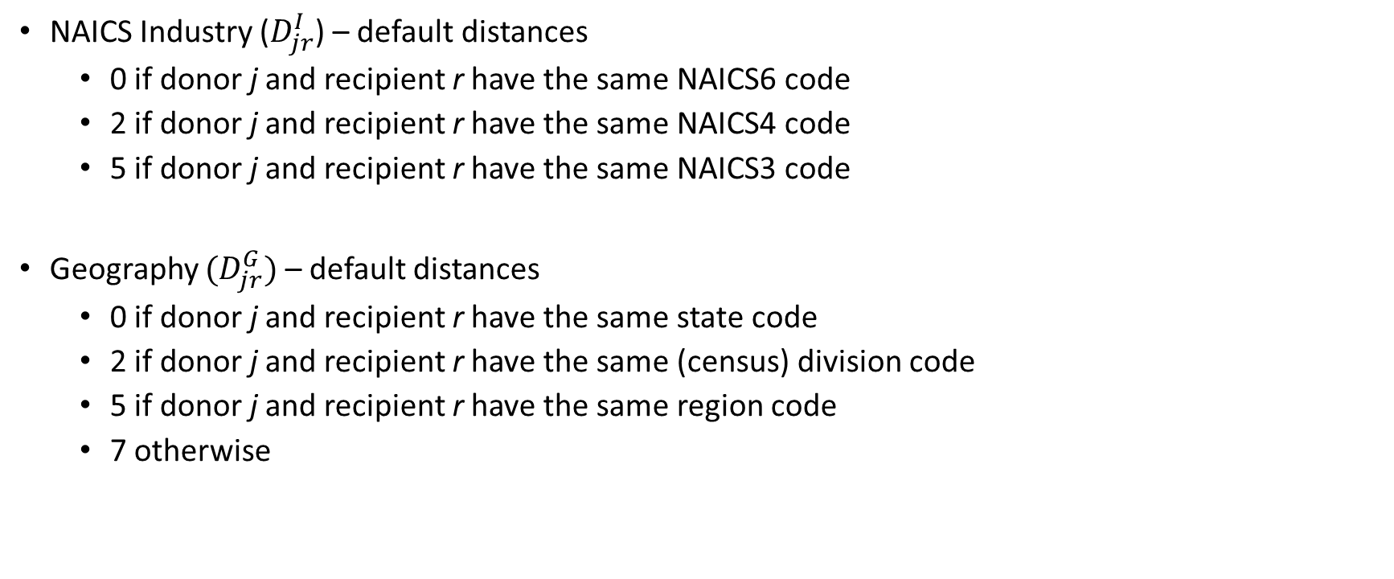
Distance Function Components Categorical Variables (Donor j to Recipient r)
NAICS Industry ($D_{jr}^{I}$) – default distances
0 if donor j and recipient r have the same NAICS6 code
2 if donor j and recipient r have the same NAICS4 code
5 if donor j and recipient r have the same NAICS3 code
Geography $(D_{jr}^{G})$ – default distances
0 if donor j and recipient r have the same state code
2 if donor j and recipient r have the same (census) division code
5 if donor j and recipient r have the same region code
7 otherwise

Slide 42
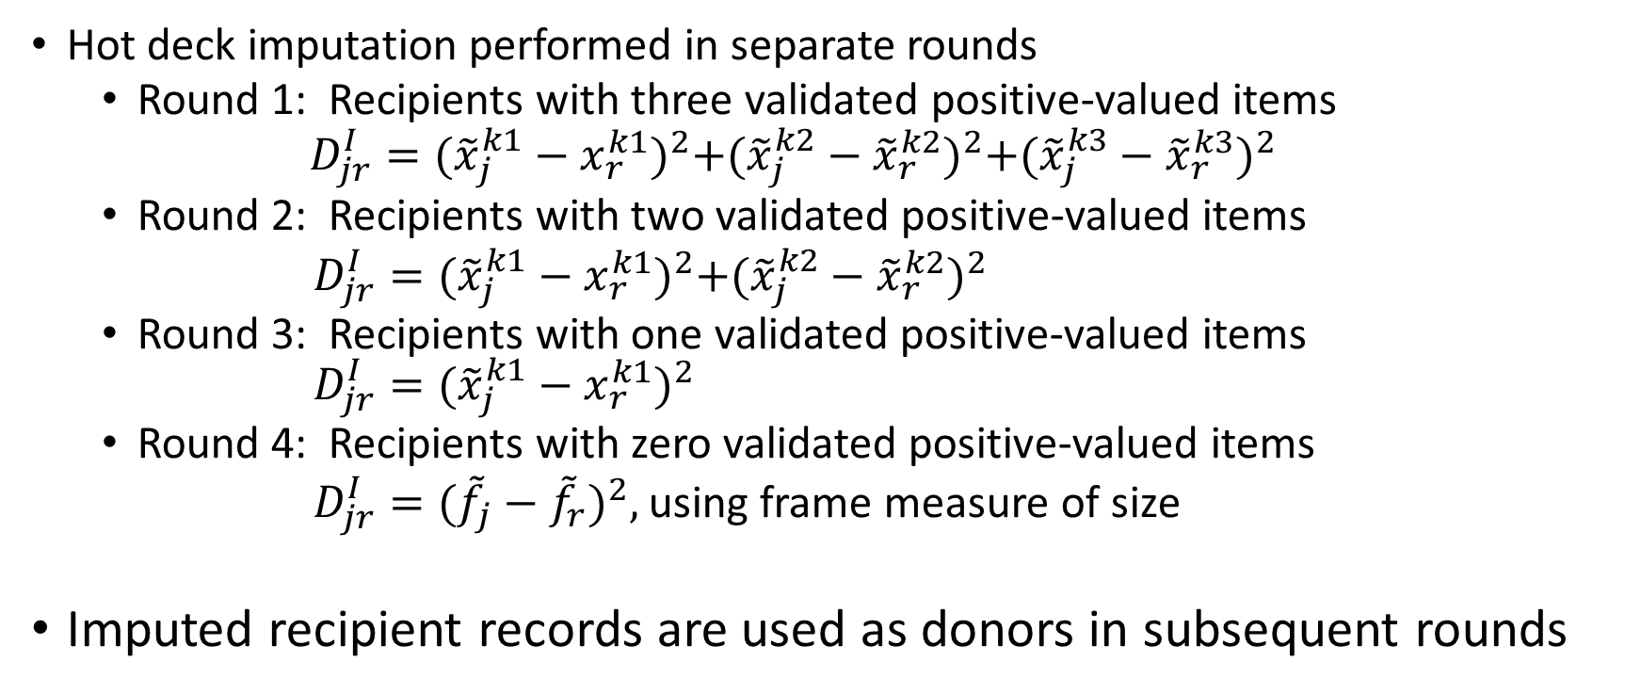
Distance Function Components Numeric Variables (Donor j to Recipient r)
Hot deck imputation performed in separate rounds
Round 1: Recipients with three validated positive-valued items
$$D_{jr}^{I}={({\tilde{x}}_{j}^{k1}−x_{r}^{k1})}^{2}+{({\tilde{x}}_{j}^{k2}−{\tilde{x}}_{r}^{k2})}^{2}{+({\tilde{x}}_{j}^{k3}−{\tilde{x}}_{r}^{k3})}^{2}$$
Round 2: Recipients with two validated positive-valued items
$D_{jr}^{I}={({\tilde{x}}_{j}^{k1}−x_{r}^{k1})}^{2}+{({\tilde{x}}_{j}^{k2}−{\tilde{x}}_{r}^{k2})}^{2}$
Round 3: Recipients with one validated positive-valued items $D_{jr}^{I}={({\tilde{x}}_{j}^{k1}−x_{r}^{k1})}^{2}$
Round 4: Recipients with zero validated positive-valued items
$D_{jr}^{I}={({\tilde{f}}_{j}−{\tilde{f}}_{r})}^{2},$ using frame measure of size
Imputed recipient records are used as donors in subsequent rounds

Slide 43

Nearest Neighbor Distance Function:
$$d_{jr}=\sqrt{D_{jr}^{I}+D_{jr}^{G}+D_{jr}^{N}}$$
Distance for industry (NAICS) match
Distance for Geography match
Distance for rescaled numeric items
Computed for each donor record (same recipient)
Select donor that has minimum distance from recipient

Slide 44

Nearest Neighbor Distance Function: Modified (Special Industries)
$$d_{jr}=\sqrt{D_{jr}^{P}+D_{jr}^{I}+D_{jr}^{G}+D_{jr}^{N}}$$
Distance for subcategory match
0 if donor j and recipient r are in the same category (e.g., both tax-exempt)
50 otherwise

Slide 45
Returning to earlier example Nursery, Garden Center, & Farm Supply Retailers
Donor 1
0.41
Will impute ratios from this nearest neighbor
(annual payroll as denominator)
Donor 2
Recipient
1.12
4.01
Donor 4
Donor 3
3.90

Slide 46
Conclusion
High level presentation of AIES hot deck imputation procedures for establishment data
Methodology based on “first principles”
Collapsed stratum estimator (cell collapsing)
Ratio imputation procedures (hot deck)
Currently moving imputation programs into new production environment
Tested on “created” data
Have not tested on collected data

Slide 47
Thanks
To the army of methodologists who conducted the research, collaborated/developed the methodology, reviewed the specifications, and conducted the unit testing
To Darcy Miller, for organizing the session
To you, for your attention
katherine.j.thompson@census.gov

