Slide 1

Sunshine or rainbows? Deconstructing referendum results in Florida, 2012-2022
Jonathan Fischer
Clinical Assistant Professor
University of Florida Department of Biostatistics
JSM 2024

Slide 2
Ballot referenda in Florida
From 2012-2022, 39 constitutional amendments have been on the general election ballot for voter approval. These require 60% of the vote for passage and can be initiated by citizens or the state legislature
In 2024, there are 6 such amendment proposals on the November ballot. These notably include legal recreational marijuana, codification of abortion access, and campaign finance reform.
On many high-profile issues, voters have passed “liberal-leaning” amendments while simultaneously electing, or nearly electing, Republicans who opposed those amendments.
Florida is a highly heterogeneous state with *somewhat* stably polarized partisan election results. This provides a good basis upon which to investigate the manners in which referenda results deviate from elections for officeholders.

Slide 3
Data and sources
These analyses require precinct-level election results, American Community Survey data, and the corresponding shapefiles for both data types
This information was obtained from:
Florida Division of Elections (election results from 2012-2022)
ACS Census data (2020 survey results)
Redistricting Hub and Voting and Election Science Team (precinct shapefiles for 2016 – 2022)
Some county election websites for older precinct location information

Slide 4
Analysis goals and plan
Want to identify factors associated with deviations from the ”expected” partisan behavior in referenda
Project precinct-level election results to block groups from ACS data so that data can be merged
Establish a partisan baseline using presidential or gubernatorial results depending on the year
Regress residuals from this model fit on selected pieces of ACS data
Finally, combining all referenda across considered years, use SVD to identify voter clusters in an unsupervised fashion
Regress the loadings on ACS data and examine loadings on amendments to characterize clusters
Visualize results on Florida map

Slide 5
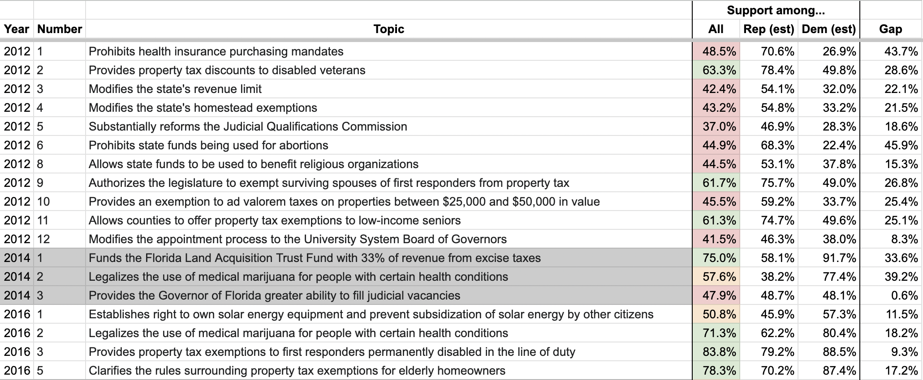
Summary of referenda, 2012-2016

Slide 6
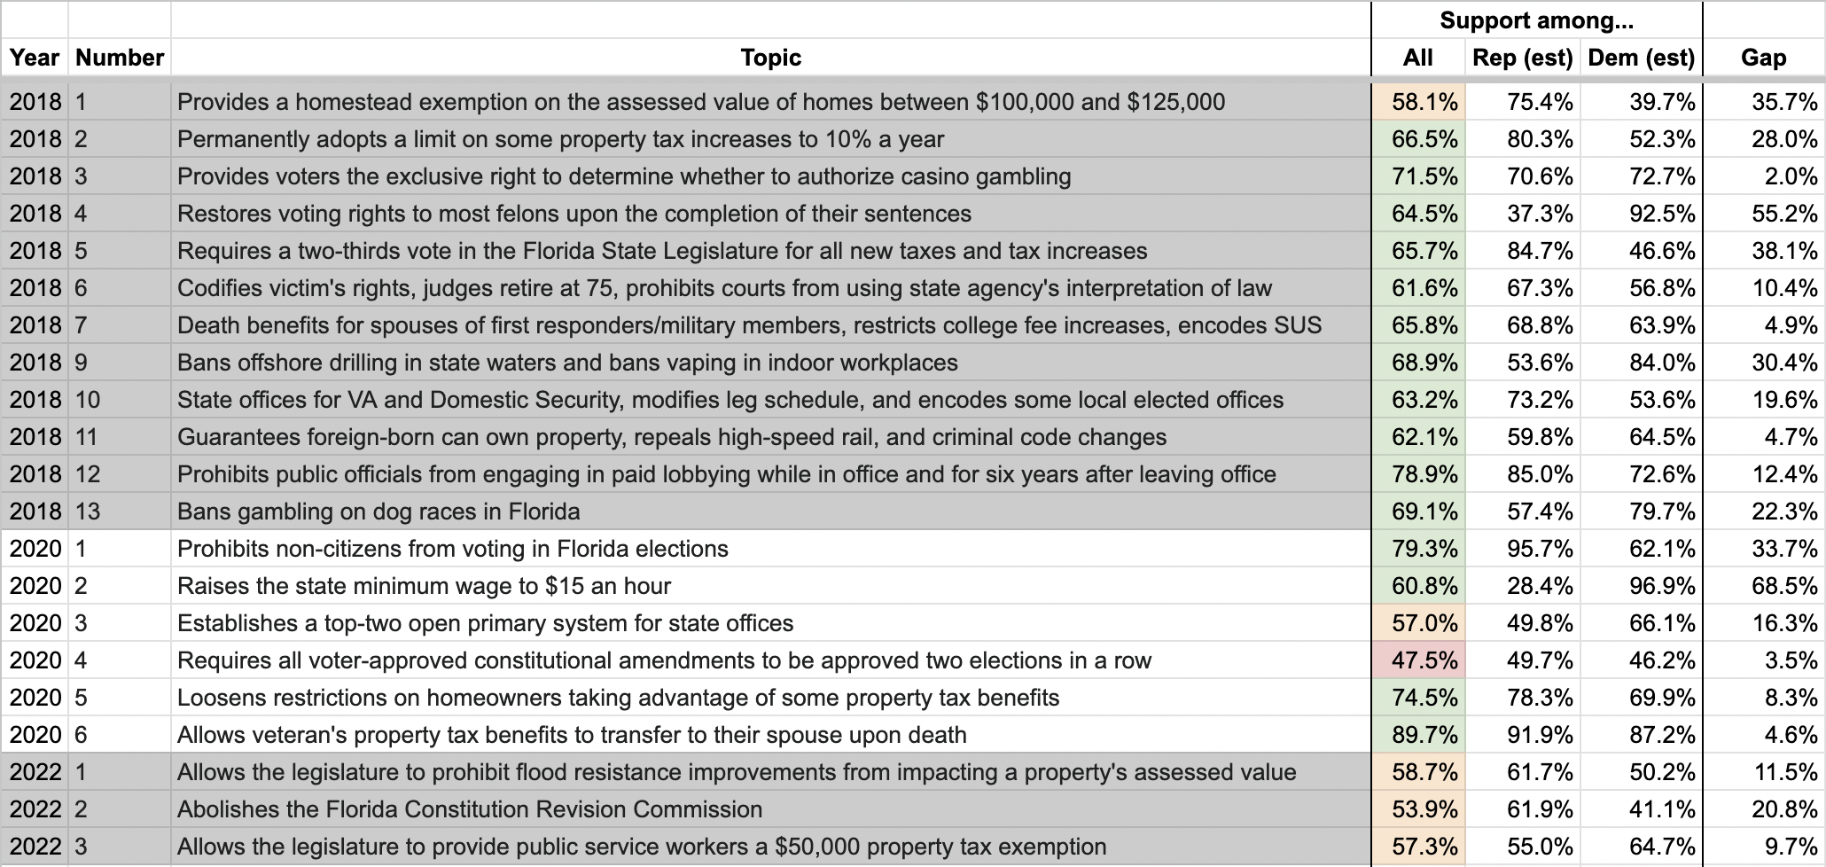
Summary of referenda, 2018-2022

Slide 7
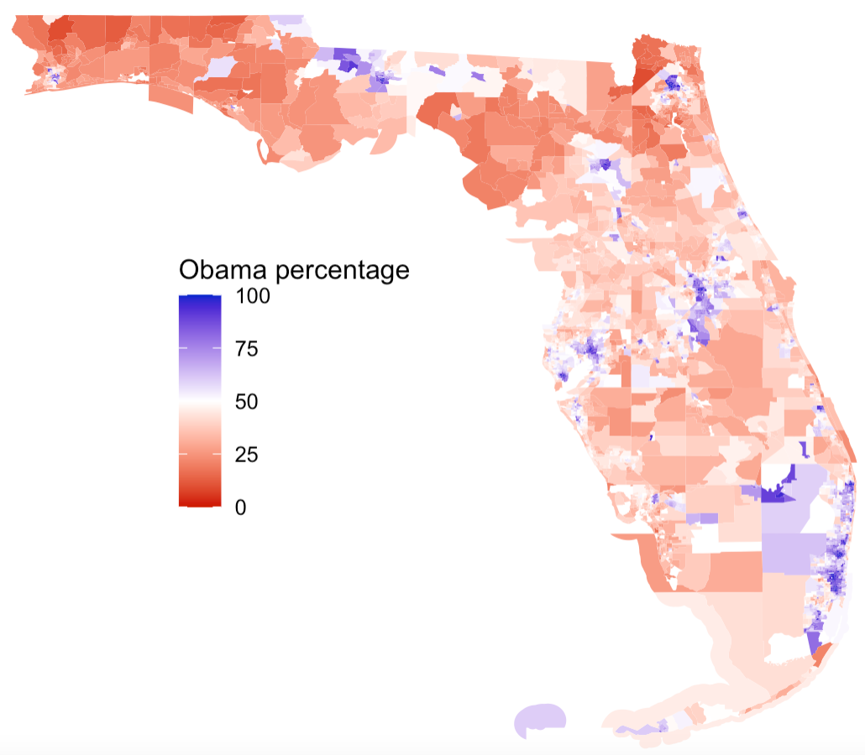
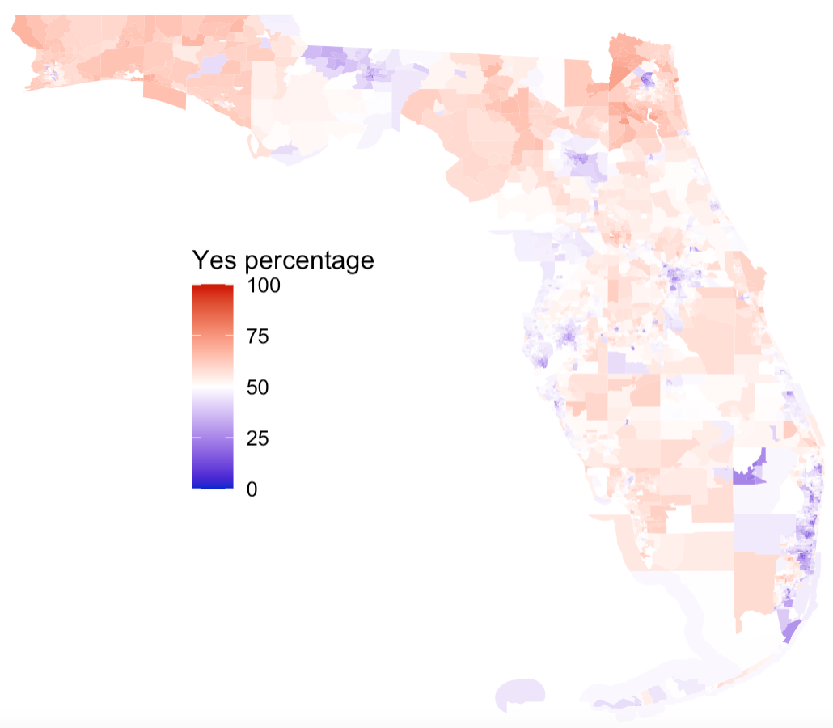
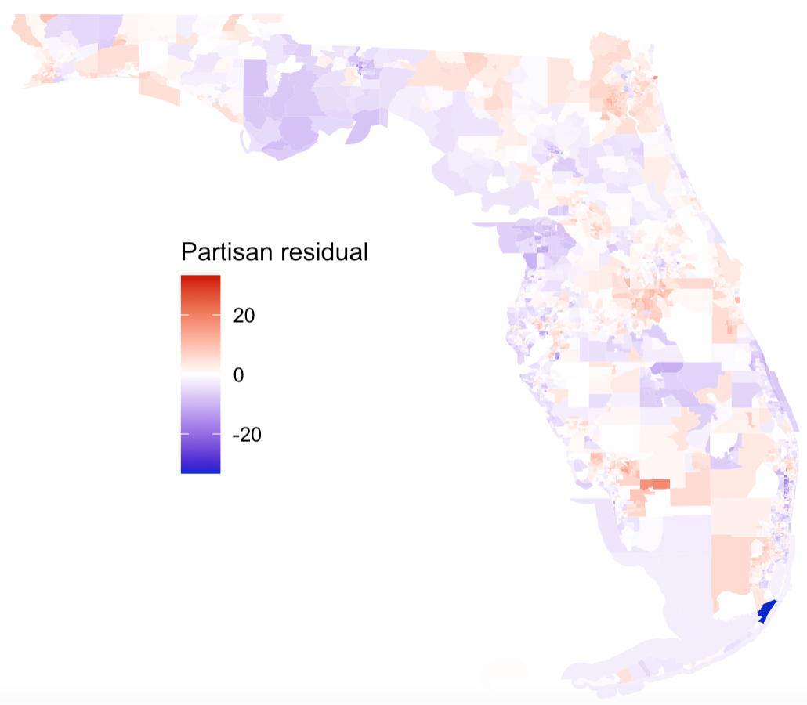
2012 A1: Prohibit healthcare mandates
Amendment failed, 48.5% - 51.5%, with an estimated 70.6% of Romney voters and 26.9% of Obama voters voting in favor.
Analysis of residuals indicated a strong negative association with educational attainment, a weak negative association with age, and a weak positive association with household income.

Slide 8
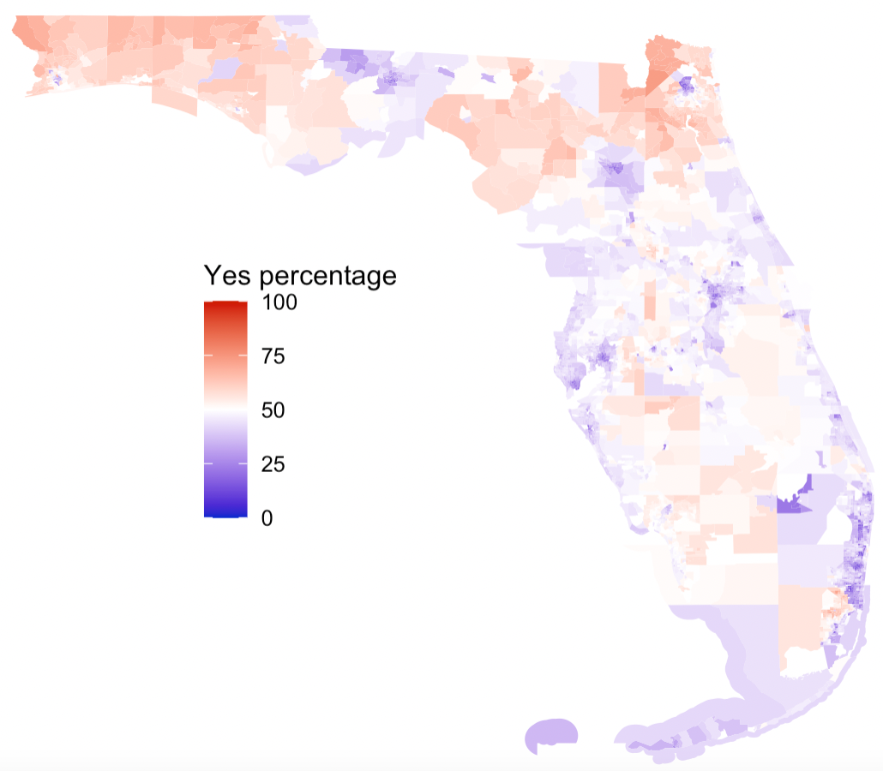
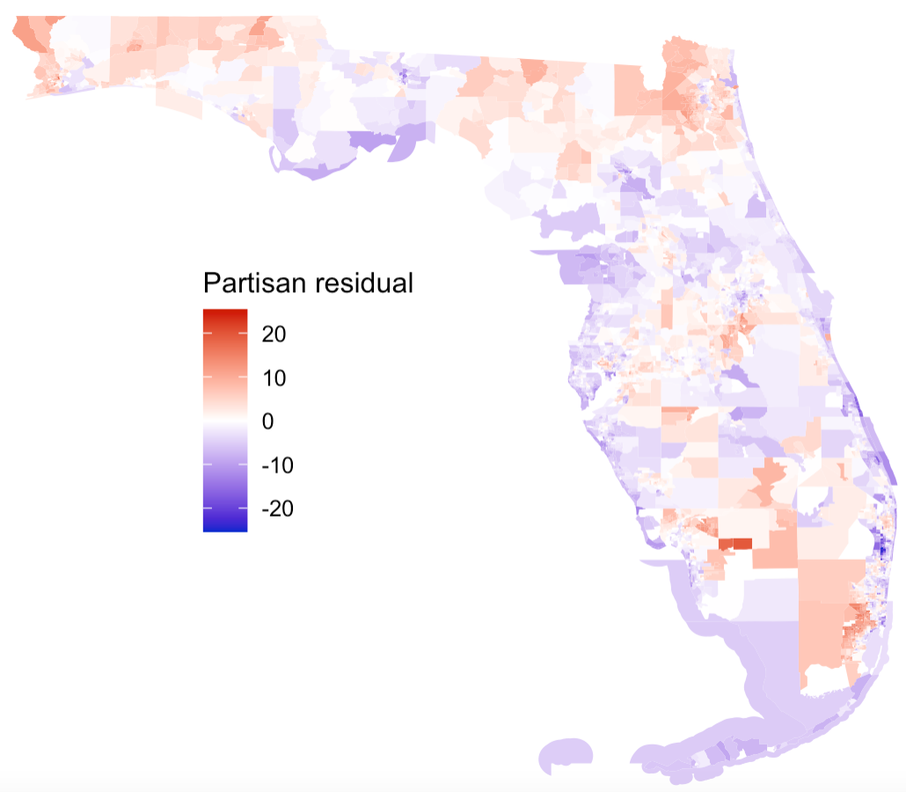
2012 A6: Prohibit state funding for abortions
Failed, 44.9% - 55.1%, with an estimated 68.3% of Romney voters and 22.4% of Obama voters voting in favor.
Analysis of residuals indicated a strong negative association with educational attainment, positive associations with Asian and Hispanic populations, and a possible split between adults with children and those without.

Slide 9
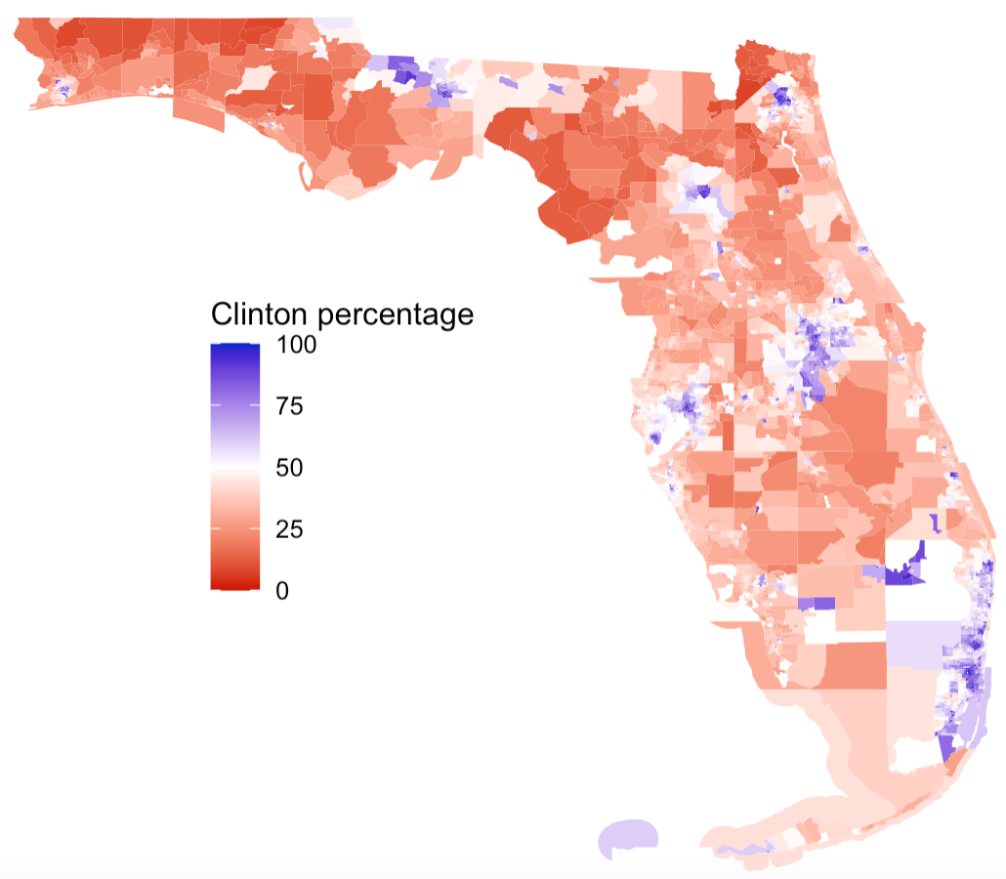
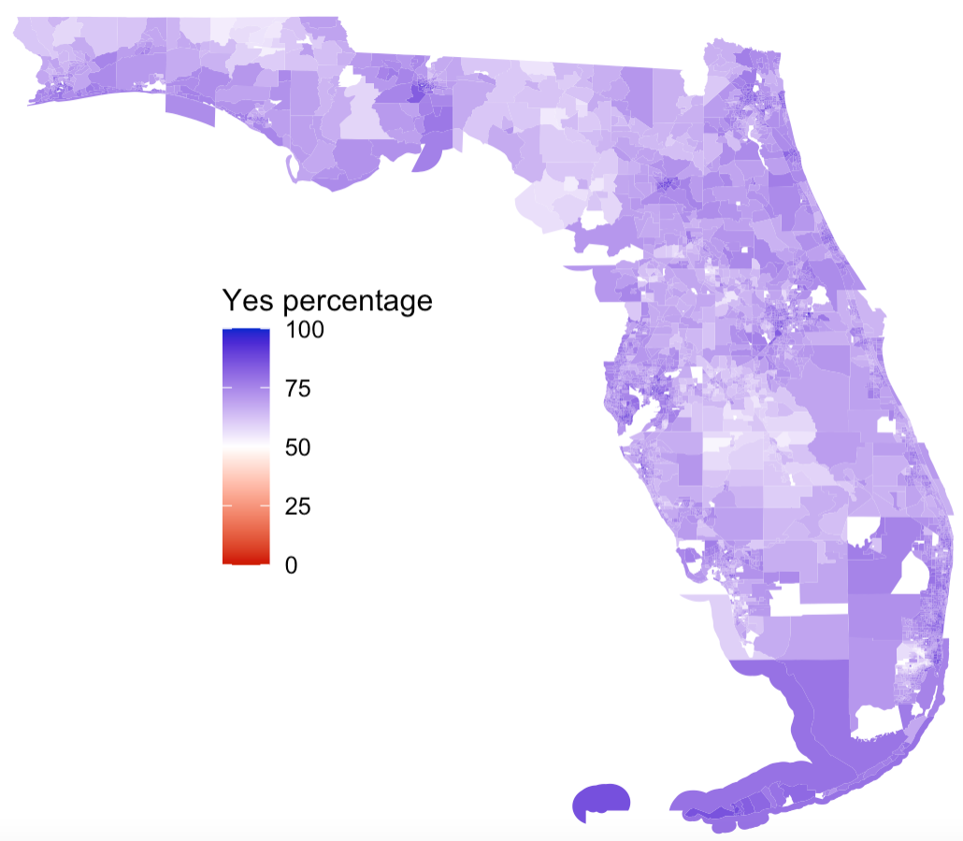
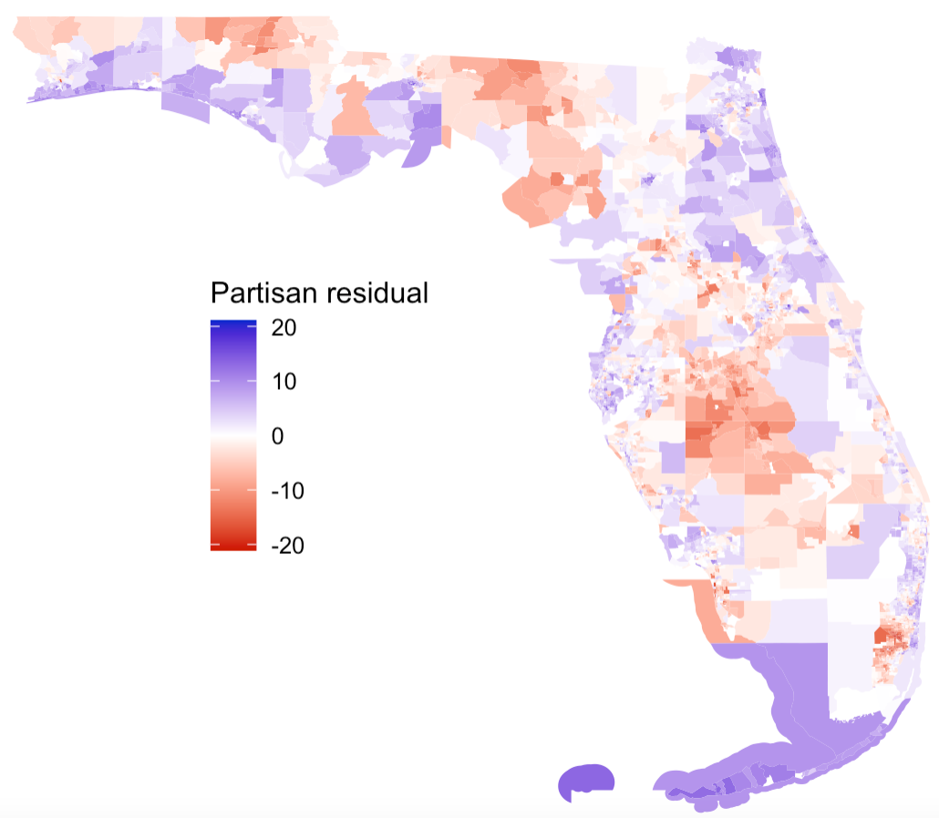
2016 A2: Legal medical marijuana
Passed, 71.3% - 28.7%. An estimated 62.2% of Romney and 80.4% of Obama voters voted in favor.
Failed in 2014, 57.6% - 42.5%. An estimated 38.8% of Scott and 77.4% of Crist voters supported the measure.
Analysis of residuals suggested lower support among minority populations, the elderly and those with children. There was also a positive association with educational attainment and negative association with household income.

Slide 10
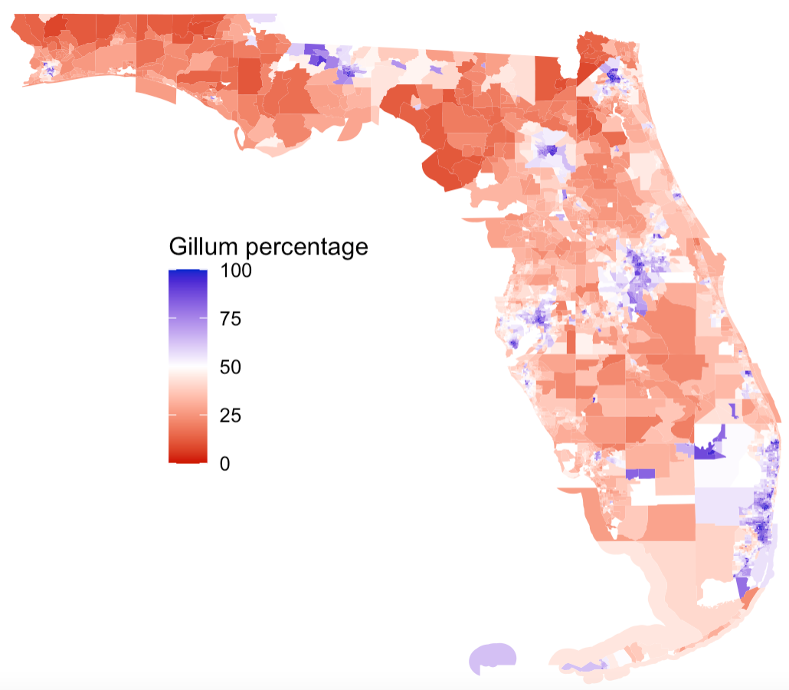
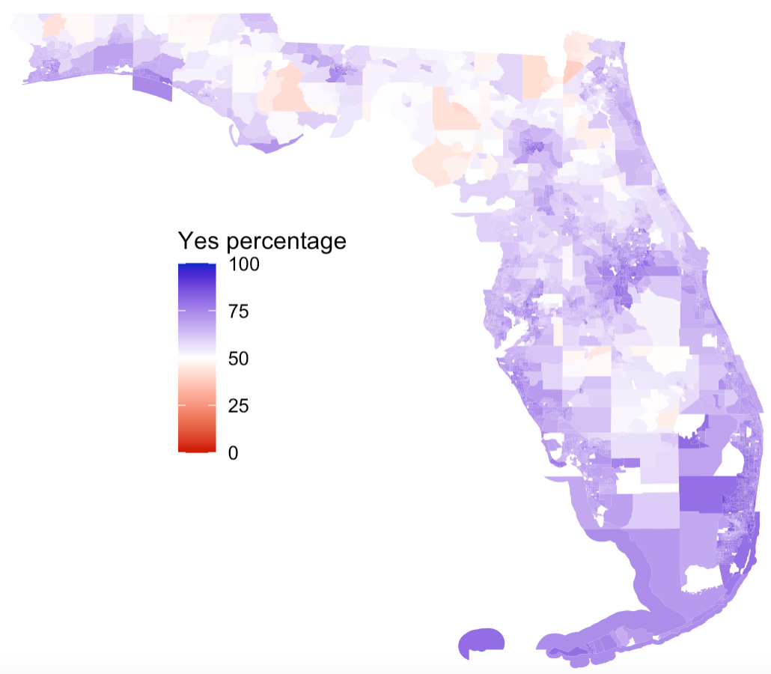
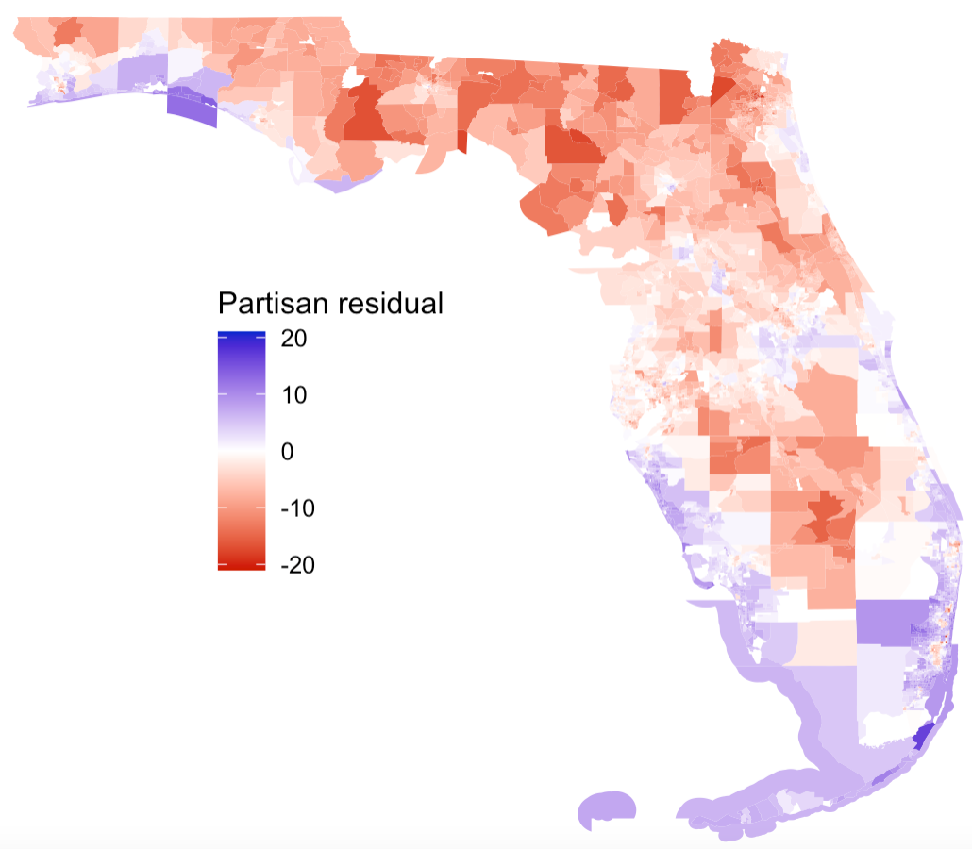
2018 A9: Ban indoor vaping and offshore drilling
Passed 68.9% - 31.1%. An estimated 53.6% of DeSantis and 84.0% of Gillum voters voted in favor.
Regression indicated high support with Hispanic and Asian populations, those with at least some college education, and weaker positive associations with age and household income.
However, whether one lives near the coast seems to be the biggest driver when we visualize the residuals on a map of the state.

Slide 11
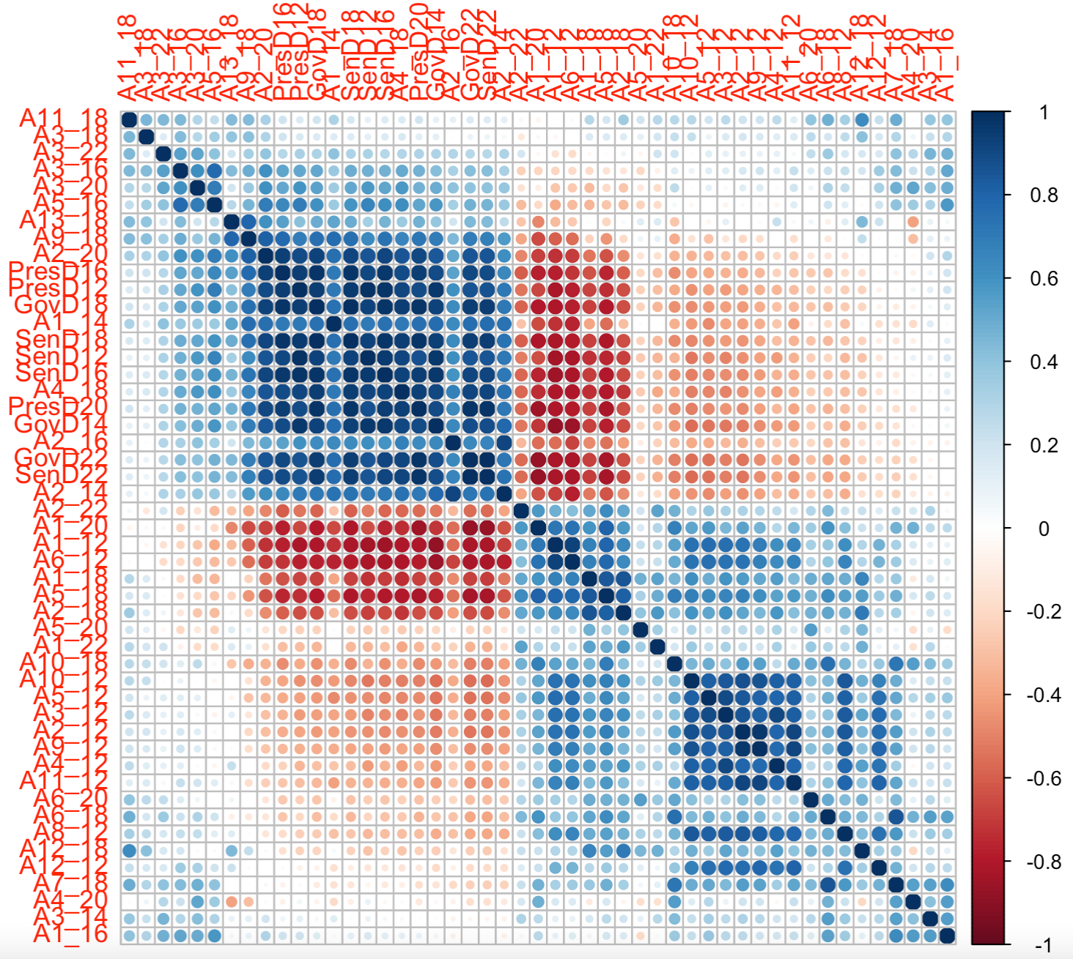
Correlation between all referenda
Spearman correlation matrix of results from all consider referenda and Presidential, Gubernatorial, and Senatorial elections
Quasi-block structure suggests subgroups of referenda and elections based on electorate behavior
Largest block corresponds to partisan elections and polarized ballot measures
Measures not in this block mostly relate to tax policies and civic reforms
Off-diagonal values indicate some partisan associations for most referenda

Slide 12
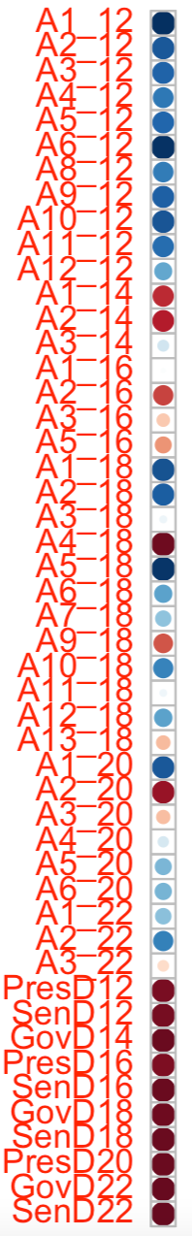
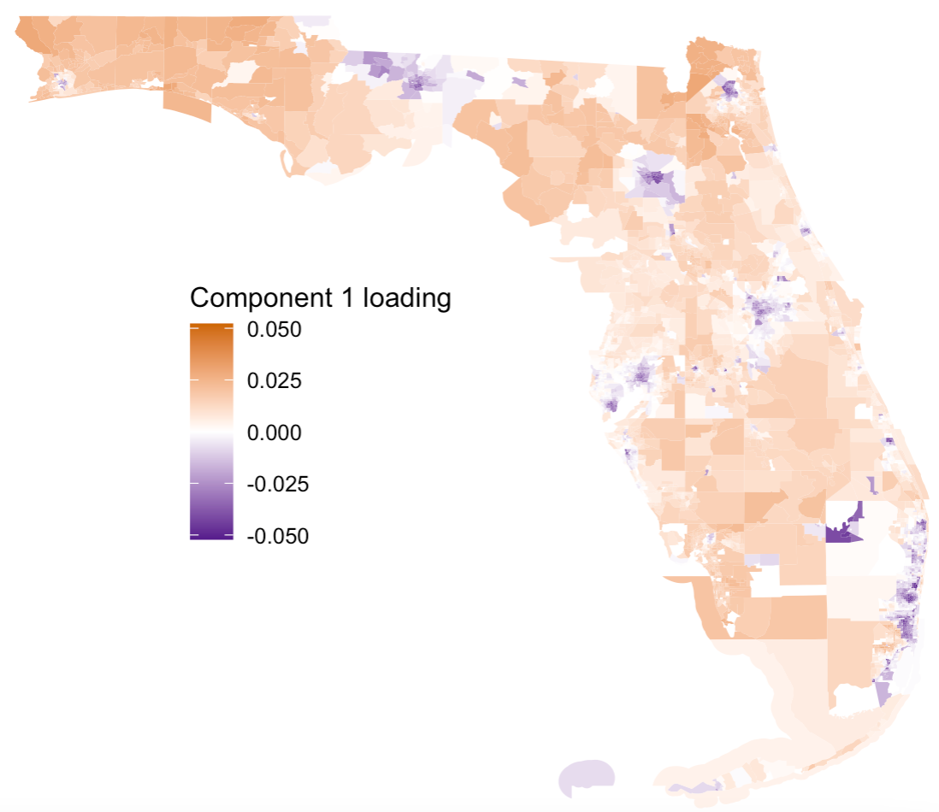
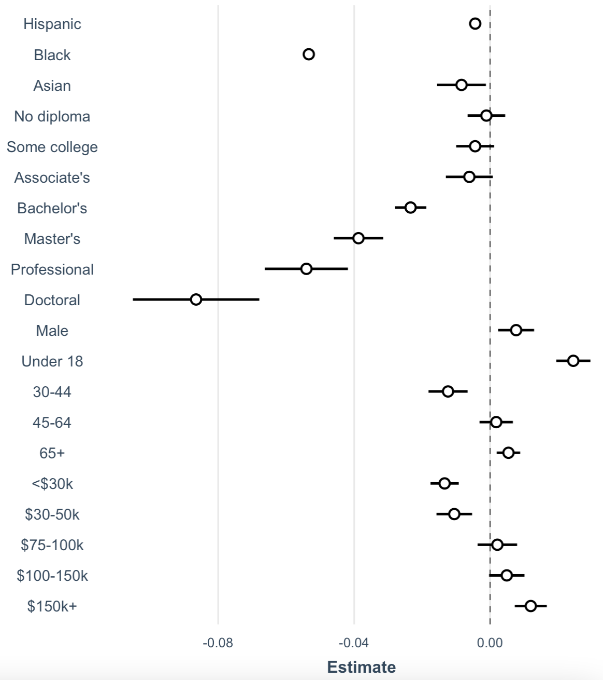
Component 1 (48.2%) – Core partisans

Slide 13
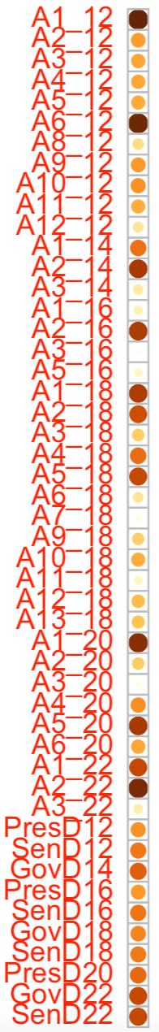
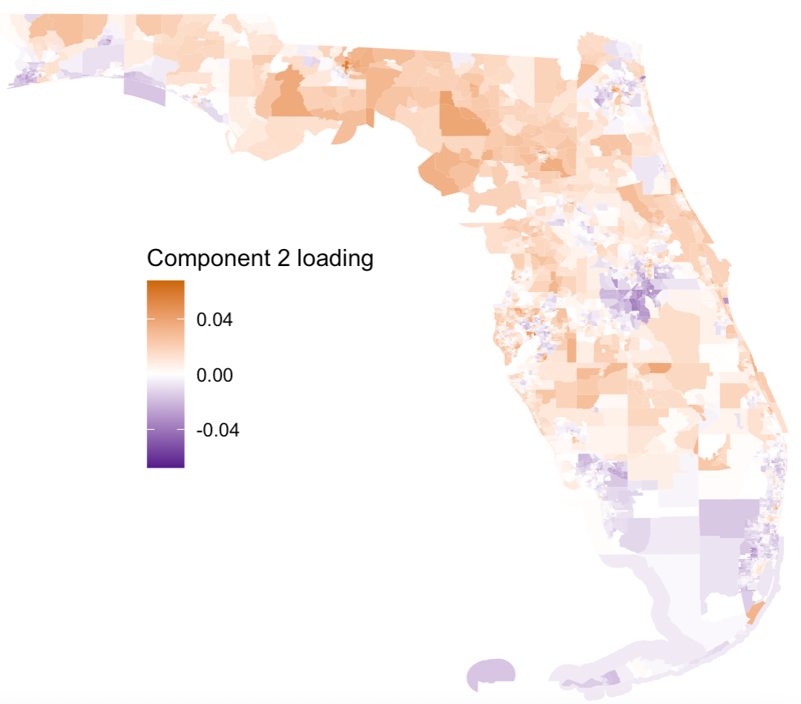
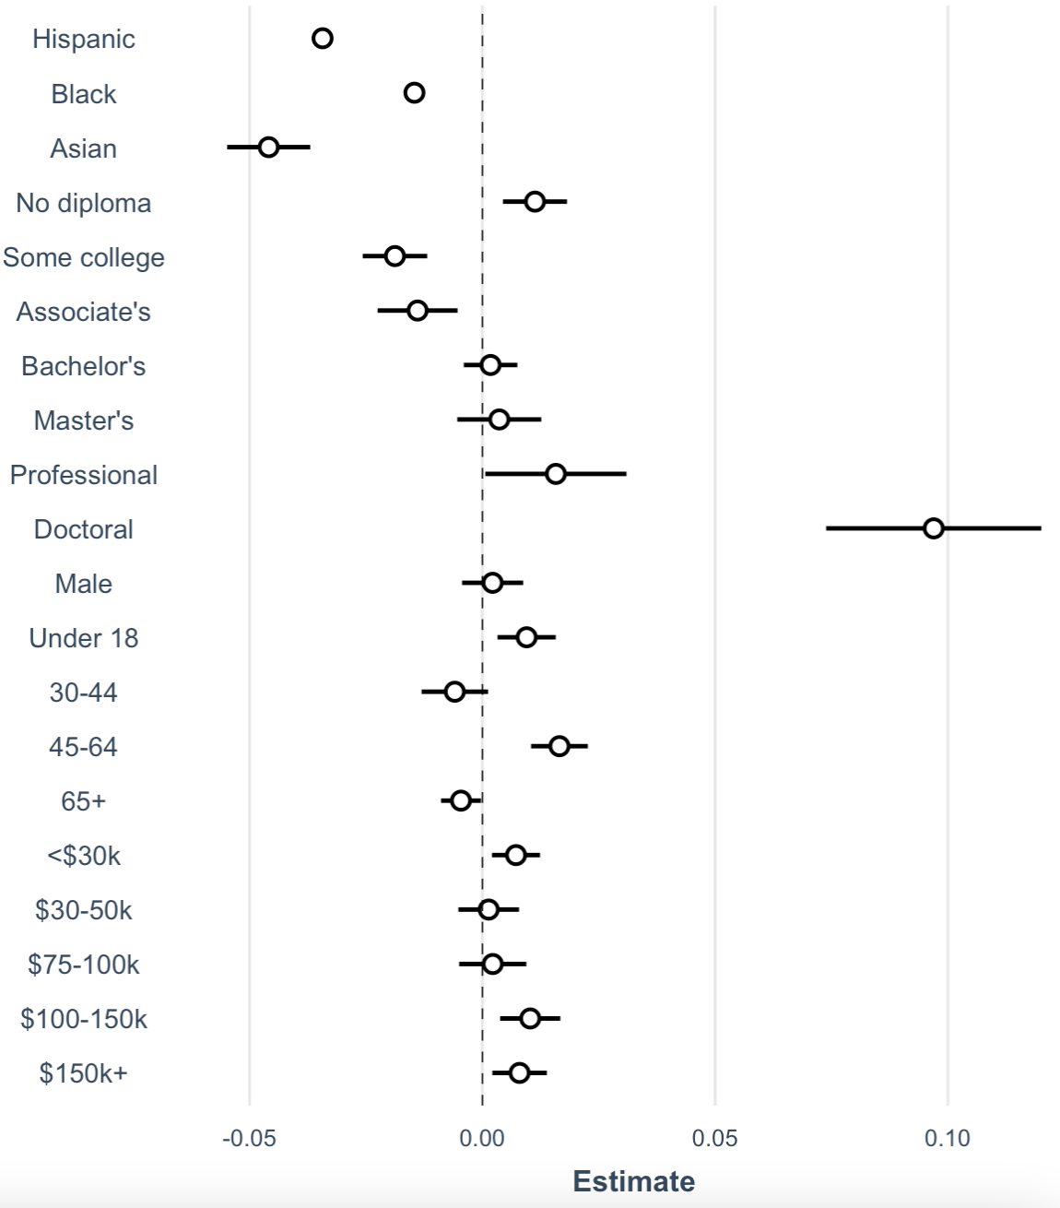
Component 2 (17.7%) – Opposition to reform

Slide 14
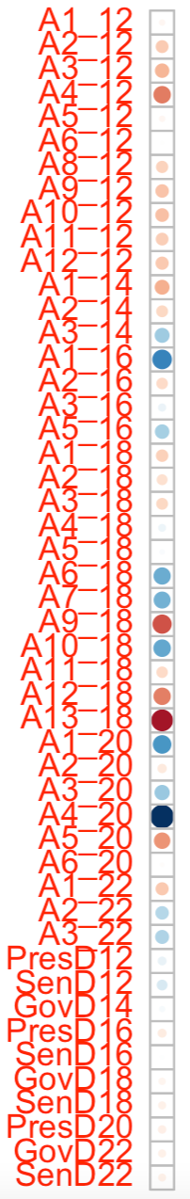
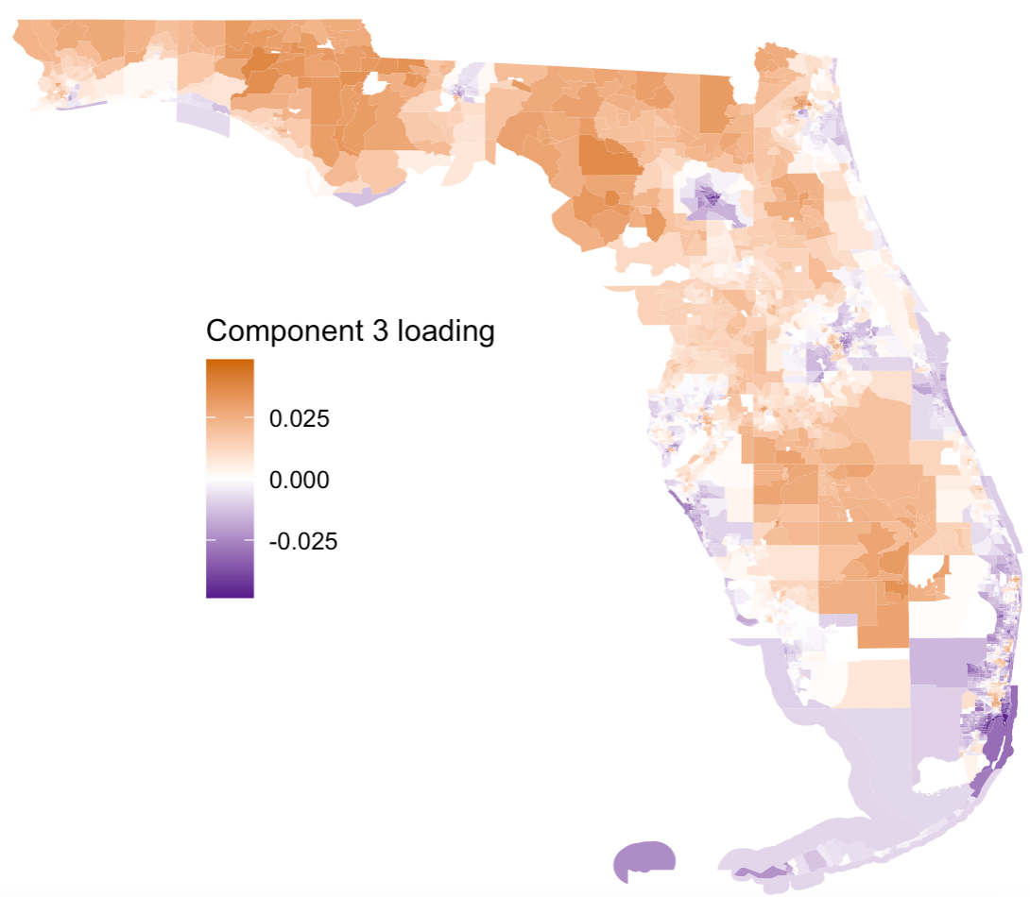
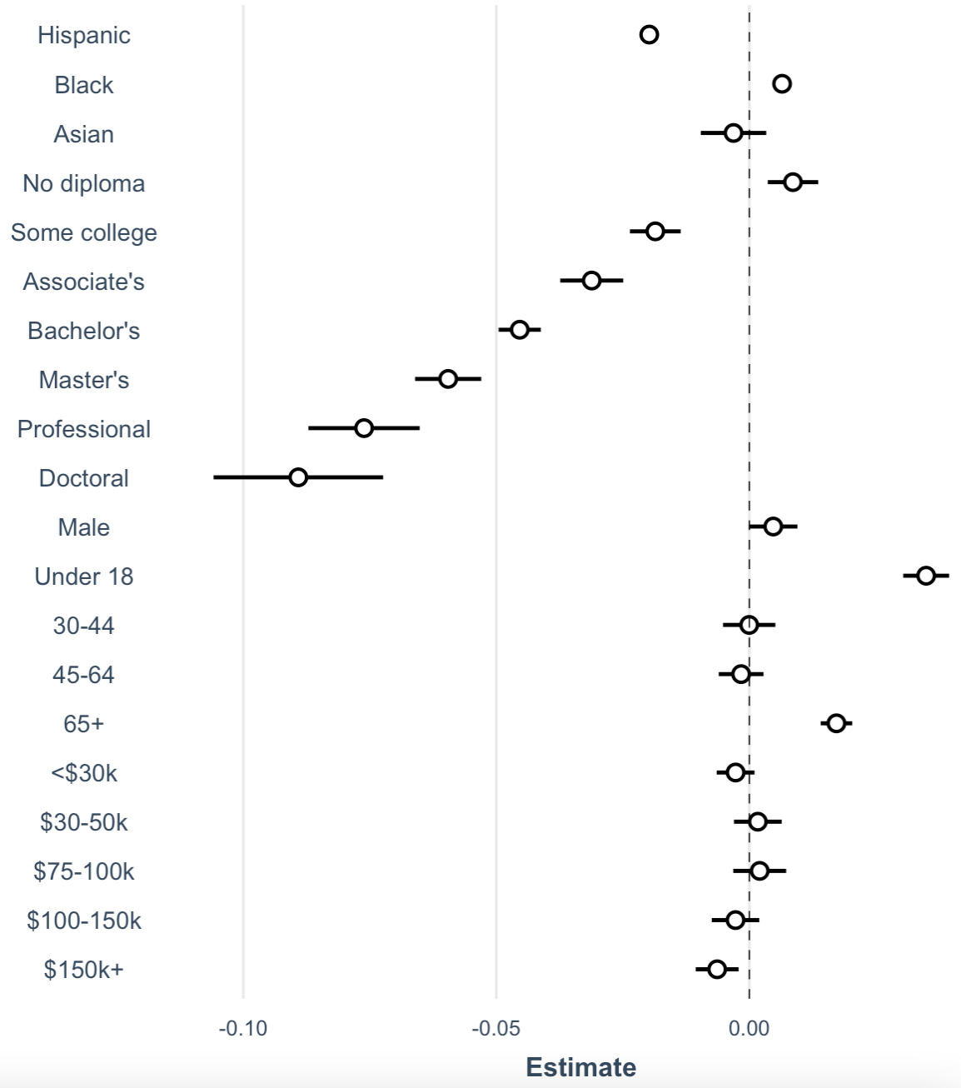
Component 3 (7.7%) – educational attainment

Slide 15
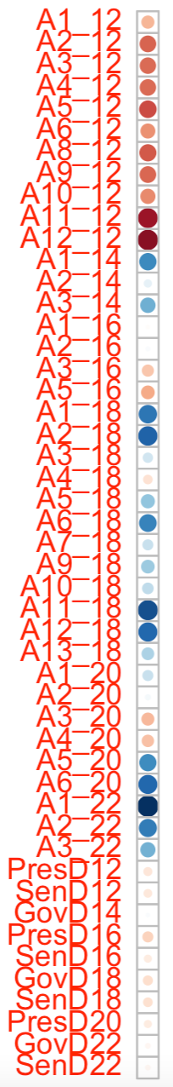
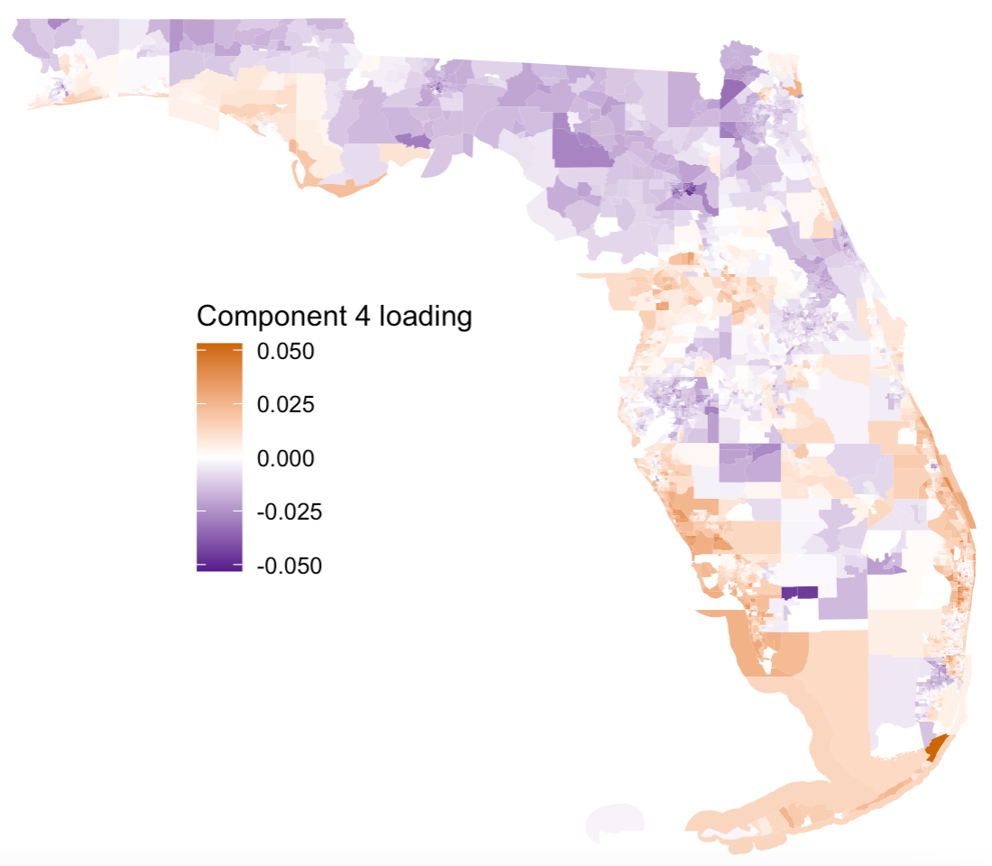
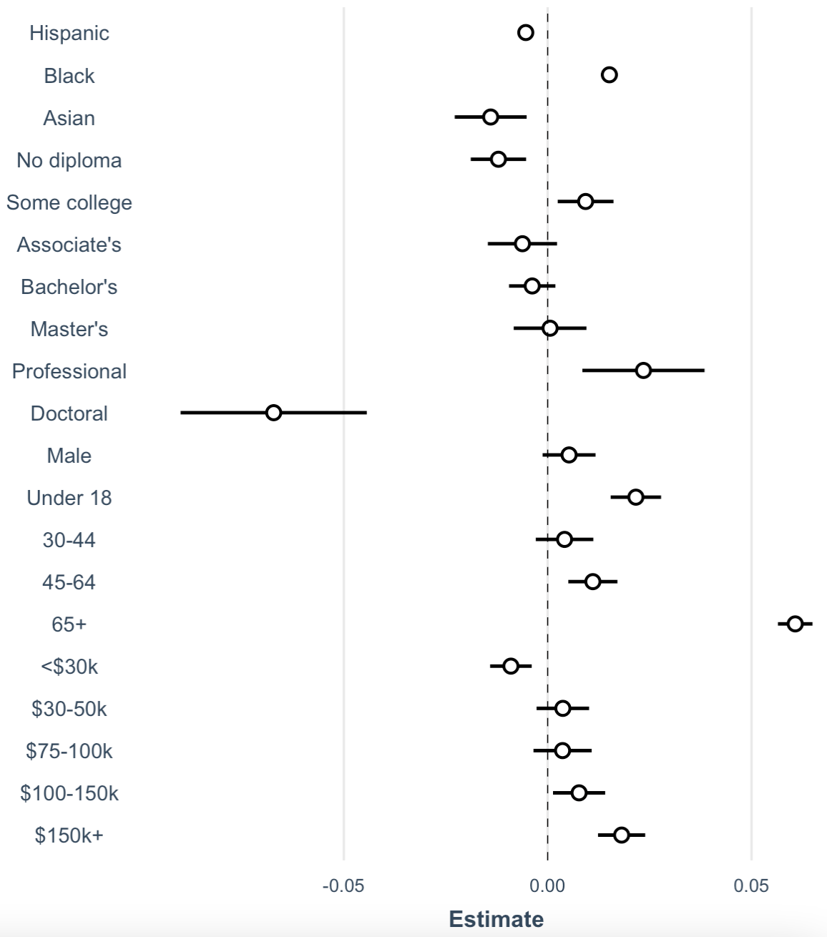
Component 4 (6.3%) – senior citizens

Slide 16
A few takeaways
In general, educational attainment was the strongest driver of deviation from partisan baselines.
Age and Hispanic populations also tended to matter, as did household income to a lesser degree.
The first four components from the SVD analysis of results contain about 80% of the variation present in the data. Results were robust to the inclusion or exclusion of partisan election results.
Lower-ranked components may capture issue-specific behavior, as component 5 is associated with marijuana legalization and component 6 with civil reforms.
Challenges and limitations include:
Ecological inference
Variable turnout and undervoting
Shifting political allegiances (affects baselines)
Imprecision from interpolation required to merge voting and census data
This iteration of the analysis didn’t include campaign expenditures, population density, or region as covariates

Slide 17
Thank you for your attention!
Jonathan Fischer
jfischer1@ufl.edu

