Slide 1
Unbiased Survey Estimation with Population Auxiliary Variables
Robyn Ferg*, Westat
Jim Green, Westat
Johann Gagnon-Bartsch, University of Michigan
Jaylin Lowe, University of Michigan
WESTAT @ JSM 2024 — Statistics and Data Science: Informing Policy and Countering Misinformation
The views presented are those of the author(s) and do not represent the views of any Government Agency/Department or Westat

Slide 2
Introduction
Population auxiliary data are available in many survey applications, often from a sampling frame.
For example: American Hospital Association provides data on hospitals throughout the US, which can be used as a sampling frame for sampling hospitals
Adjustments can be made to account for differences between the sample and population covariates to improve estimation and inference
Predictive modeling algorithms can help in this task to estimate response values for observations not in the sample

Slide 3
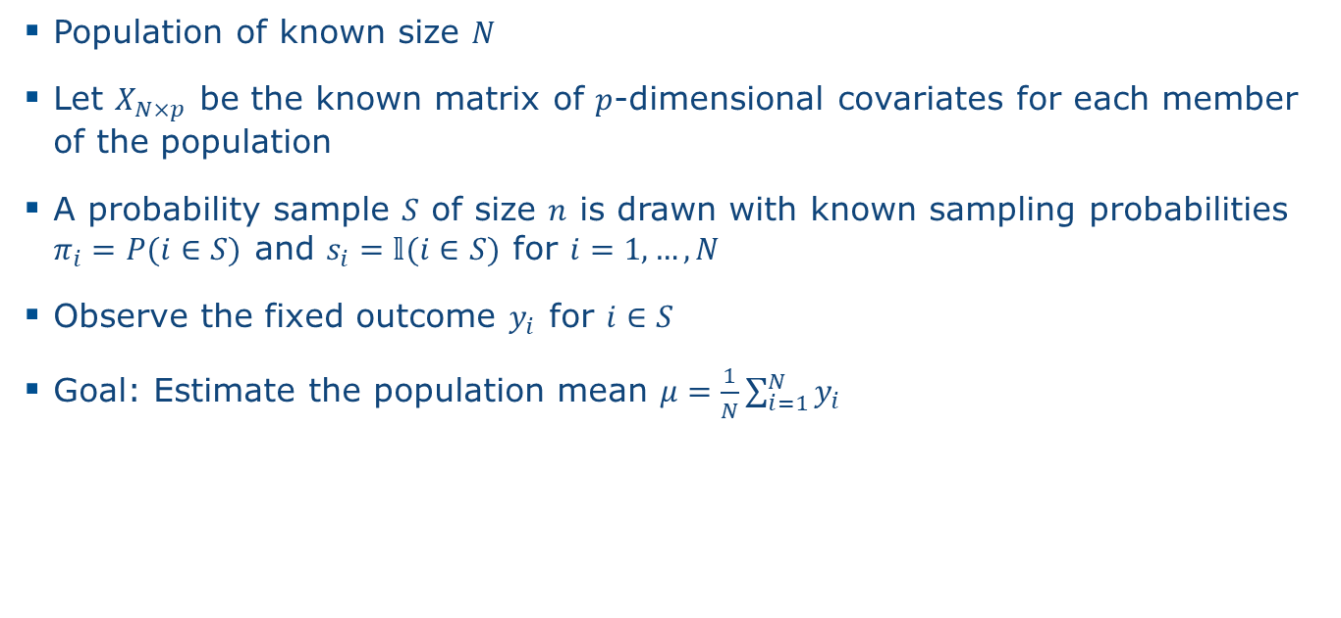
Set-Up
Population of known size $N$
Let $X_{N×p}$ be the known matrix of $p$-dimensional covariates for each member of the population
A probability sample $S$ of size $n$ is drawn with known sampling probabilities $π_{i}=P(i∈S)$ and $s_{i}=𝕝(i∈S)$ for $i=1, …, N$
Observe the fixed outcome $y_{i}$ for $i∈S$
Goal: Estimate the population mean $μ=\frac{1}{N}\sum_{i=1}^{N}{y_{i}}$

Slide 4
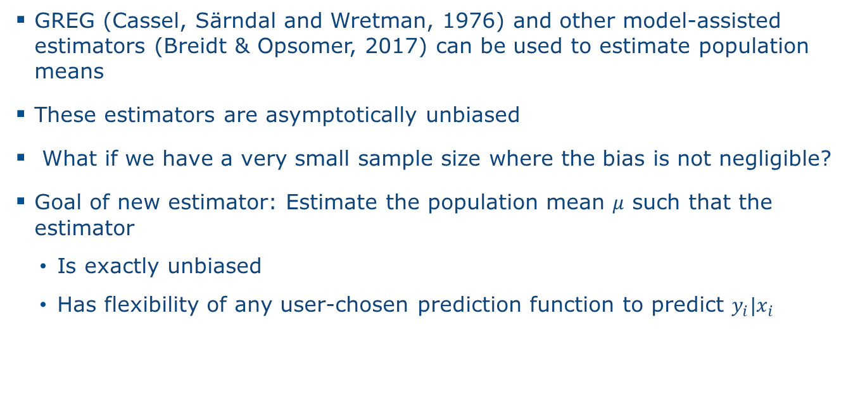
Model-Based Estimation Methods
GREG (Cassel, Särndal and Wretman, 1976) and other model-assisted estimators (Breidt & Opsomer, 2017) can be used to estimate population means
These estimators are asymptotically unbiased
What if we have a very small sample size where the bias is not negligible?
Goal of new estimator: Estimate the population mean $μ$ such that the estimator
Is exactly unbiased
Has flexibility of any user-chosen prediction function to predict $y_{i}|x_{i}$

Slide 5
Rationale Behind Estimator
Use some prediction function to estimate the outcome values for observations not in the sample
The chosen prediction function may be biased
That bias can be estimated using subsamples of the original sample:
For each subsample, train the prediction function on the subsample and estimate the bias of that trained prediction function using the observations not in the subsample

Slide 6

Intuition
$$N$$

Slide 7

Intuition
$$S$$
$$N$$

Slide 8


Intuition
$$S^{(1)}$$
$$S$$
$$S^{(2)}$$
$$N$$

Slide 9

Intuition
$$S^{(1)}$$
$$f\left(⋅;X_{S^{(1)}}, Y_{S^{(1)}}\right)$$
$$S$$
$$S^{(2)}$$
$$N$$

Slide 10

Intuition
$$S^{(1)}$$
$$f\left(⋅;X_{S^{(1)}}, Y_{S^{(1)}}\right)$$
$$S$$
$$S^{(2)}$$
$\hat{bias}={\overline{Y}}_{S^{(2)}}−mean(f(X_{S^{\left(2\right)}};X_{S^{(1)}}, Y_{S^{(1)}}$)
$$N$$

Slide 11

Intuition
$$S^{(1)}$$
$$f\left(⋅;X_{S^{(1)}}, Y_{S^{(1)}}\right)$$
$$S$$
$$S^{(2)}$$
$\hat{bias}={\overline{Y}}_{S^{(2)}}−mean(f(X_{S^{\left(2\right)}};X_{S^{(1)}}, Y_{S^{(1)}}$)
$$N$$
$f(X_{j};$ $X_{S^{(1)}}, Y_{S^{(1)}})+\hat{bias}$ for $j∉S$

Slide 12

Method
Let:
$f_{i}(R)$ be the predicted outcome for observation $i$ when some prediction function $f()$ is trained on set $R$
$f_{i}≡f_{i}(S\backslash i)$ when $i∈S$
$g_{i}≡\sum_{j∈S}{\frac{\left(1−π_{i}\right)π_{i|S\backslash j}}{π_{i}\left(1−π_{i|S\backslash j}\right)}f_{i}\left(S\backslash j\right)}$ when $i∉S$

Slide 13
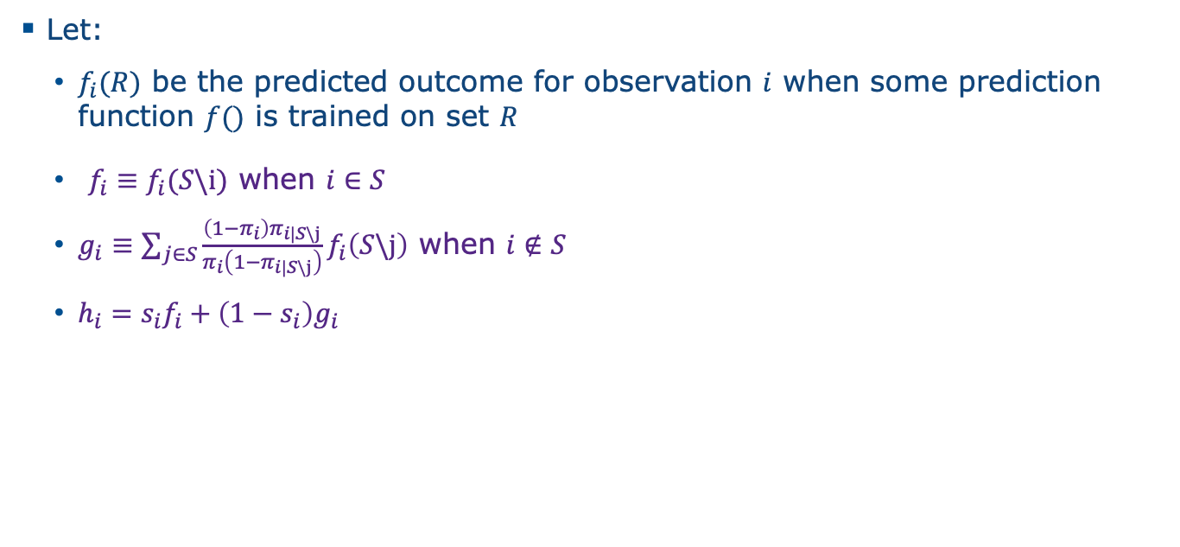
Method
Let:
$f_{i}(R)$ be the predicted outcome for observation $i$ when some prediction function $f()$ is trained on set $R$
$f_{i}≡f_{i}(S\backslash i)$ when $i∈S$
$g_{i}≡\sum_{j∈S}{\frac{\left(1−π_{i}\right)π_{i|S\backslash j}}{π_{i}\left(1−π_{i|S\backslash j}\right)}f_{i}\left(S\backslash j\right)}$ when $i∉S$
$h_{i}=s_{i}f_{i}+\left(1−s_{i}\right)g_{i}$

Slide 14
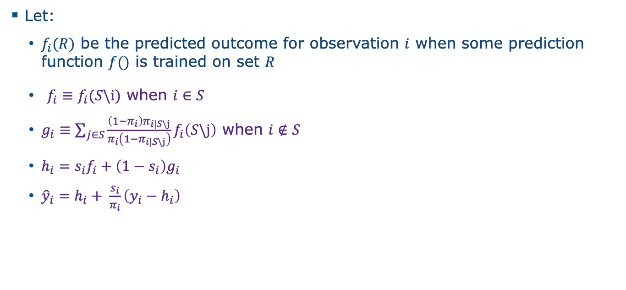
Method
Let:
$f_{i}(R)$ be the predicted outcome for observation $i$ when some prediction function $f()$ is trained on set $R$
$f_{i}≡f_{i}(S\backslash i)$ when $i∈S$
$g_{i}≡\sum_{j∈S}{\frac{\left(1−π_{i}\right)π_{i|S\backslash j}}{π_{i}\left(1−π_{i|S\backslash j}\right)}f_{i}\left(S\backslash j\right)}$ when $i∉S$
$h_{i}=s_{i}f_{i}+\left(1−s_{i}\right)g_{i}$
${\hat{y}}_{i}=h_{i}+ \frac{s_{i}}{π_{i}}\left(y_{i}−h_{i}\right)$

Slide 15
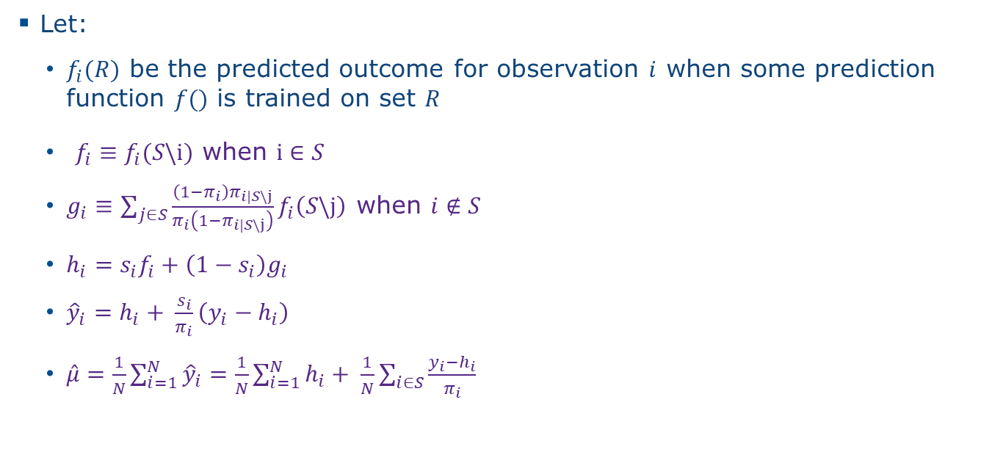
Method
Let:
$f_{i}(R)$ be the predicted outcome for observation $i$ when some prediction function $f()$ is trained on set $R$
$f_{i}≡f_{i}(S\backslash i)$ when $i∈S$
$g_{i}≡\sum_{j∈S}{\frac{\left(1−π_{i}\right)π_{i|S\backslash j}}{π_{i}\left(1−π_{i|S\backslash j}\right)}f_{i}\left(S\backslash j\right)}$ when $i∉S$
$h_{i}=s_{i}f_{i}+\left(1−s_{i}\right)g_{i}$
${\hat{y}}_{i}=h_{i}+ \frac{s_{i}}{π_{i}}\left(y_{i}−h_{i}\right)$
$\hat{μ}=\frac{1}{N}\sum_{i=1}^{N}{{\hat{y}}_{i}}=\frac{1}{N}\sum_{i=1}^{N}{h_{i}}+ \frac{1}{N}\sum_{i∈S}{\frac{y_{i}−h_{i}}{π_{i}}}$

Slide 16
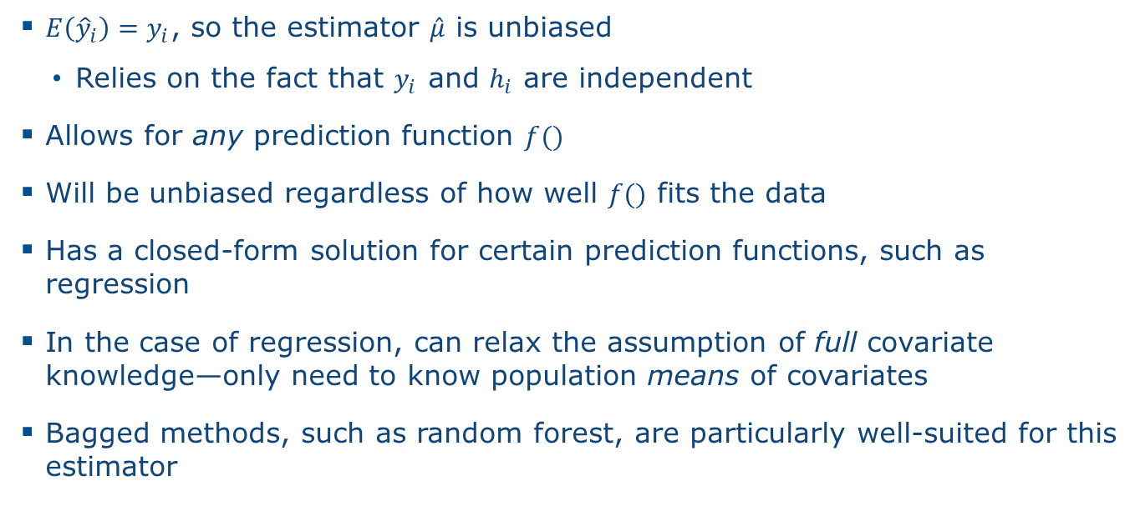
Properties
$E\left({\hat{y}}_{i}\right)=y_{i}$, so the estimator $\hat{μ}$ is unbiased
Relies on the fact that $y_{i}$ and $h_{i}$ are independent
Allows for any prediction function $f()$
Will be unbiased regardless of how well $f()$ fits the data
Has a closed-form solution for certain prediction functions, such as regression
In the case of regression, can relax the assumption of full covariate knowledge—only need to know population means of covariates
Bagged methods, such as random forest, are particularly well-suited for this estimator

Slide 17

Variance Estimation
Variance can be estimated using:
$$\hat{var}\left(\hat{μ}\right)= \frac{1}{N^{2}}\sum_{i∈S}{\frac{1−π_{i}}{π_{i}^{2}}{\left(y_{i}−f_{i}\right)}^{2}}+ \frac{1}{N^{2}}\sum_{i≠j∈S}{\frac{π_{ij}−π_{i}π_{j}}{π_{i}π_{j}π_{ij}}\left(y_{i}−f_{i}\right)\left(y_{j}−f_{j}\right)}$$
where $π_{ij}=P\left(i, j∈S\right)$

Slide 18
Conclusion
We provide a prediction-based method for estimating the mean of a finite population when population auxiliary data are available
The unbiasedness property of this estimator does not depend on the prediction function used
Able to incorporate machine learning prediction models into statistical survey methodology

Slide 19
Thank you
RobynFerg@westat.com
westat.com
Photos are for illustrative purposes only. All persons depicted, unless otherwise stated, are models.

