Slide 1

Transformed Medicaid Statistical Information System (T-MSIS)
Using State-Level Medicaid Claims Data to Enhance Survey Estimation in the MCBS
Nicholas Davis
Michael Trierweiler
Holly Cast
NORC at the University of Chicago
08/08/2024
JSM, Portland OR
This research was conducted under the Medicare Current Beneficiary Survey Contract sponsored by the Centers for Medicare & Medicaid Services (Contract: 75FCMC19D0092; Task order: 75FCMC21F0001). No official endorsement by the Department of Health and Human Services or the Centers for Medicare & Medicaid Services is intended or should be inferred.

Slide 2
MCBS Introduction
The Medicare Current Beneficiary Survey (MCBS):
is a nationally representative survey of the Medicare population, including dually eligible beneficiaries who are also enrolled in Medicaid
is conducted by the Centers for Medicare & Medicaid Services (CMS) through a contract with NORC at the University of Chicago (NORC)
surveys beneficiaries at three points per year for four consecutive years
collects healthcare utilization and cost data to obtain a complete picture of beneficiaries’ usage of services and all sources of payment, including out of pocket
uses Medicare Fee-for-service (FFS) claims data to supplement survey data to account for underreporting of health care services and unknown costs and payments, but these do not include Medicaid claims

Slide 3
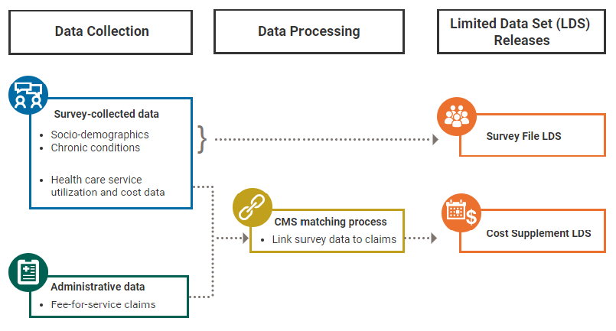
MCBS Data Cycle and FFS Claims
Cost Supplement LDS

Slide 4

Impact of FFS Claims Data
Historically, FFS claims supplement MCBS data in two primary ways:
Fill in or correct payment amounts when matched to survey-reported events
Quantify unreported utilization via FFS claims-only events with no match in survey data

Slide 5
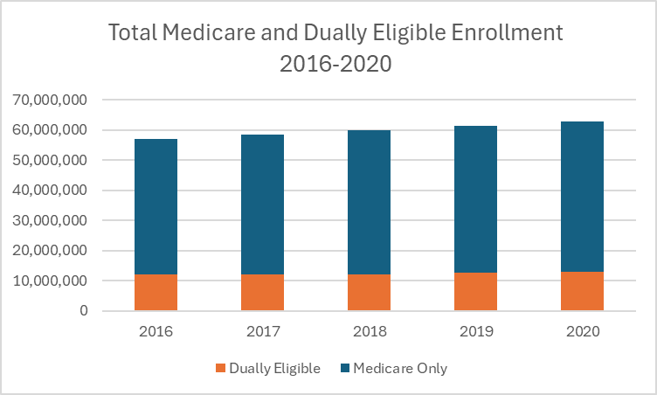
Dually Eligible Enrollment Trends
From 2009 to 2015, the dually eligible population grew rapidly from 8.5 million to 12 million individuals
In more recent years, the dual-eligible population has grown roughly proportionally to the total Medicare enrollee population
The percentage of Medicare enrollees who are dually eligible has held steady at about 20% to 21% since 2016
Source: Kaiser Family Foundation analysis of dual eligibility enrollment, 2016-2020; Medicare Program Statistics Enrollment Dashboard 2016-2020

Slide 6
Research Question
Can Medicaid claims data be leveraged to enhance survey estimation among the dually eligible population, similar to FFS claims?
Beginning with 2017 claims, T-MSIS data are now available for all states that the MCBS covers (AL, UT, RI flagged as lower quality)
T-MSIS might be used to:
Account for underreporting of health care utilization among dual-eligible beneficiaries (but this is already accounted for by other processes)
Populate missing payment amounts to reduce need for imputation (focus of this research)

Slide 7
Goals
Reduce measurement error and increase precision of survey estimates for dually eligible beneficiaries by making data as complete as possible
Establish greater comparability between Medicare-only and dually eligible enrollee data and processing
Monitor changes in dually eligible population and their utilization

Slide 8
T-MSIS Data Contents
Eligible File
Beneficiary Summary File (BSF)
Dual Eligibility (DE) file
Enrollment information for each beneficiary, plan identifiers
Claims Files
Long-Term Care (LT)
Prescription Drug (RX)
Inpatient (IP)
Other (OT) – includes medical provider and outpatient visits; most claims are OT
Provider Files
Record for each provider participating in Managed Care
Provider identifier and provider identifier type
Managed Care Files
Record for each Managed Care plan contracted with state Medicaid agency

Slide 9
New T-MSIS Match Process
MCBS survey-reported event data for years 2018-2022 have been matched to T-MSIS claims
Excludes Prescription Medicine and Home Health Events
Matching dimensions:
Individual ID (MCBS ID mapped to universal BENE_ID)
Total charge amount
Provider ID
Service start date
Service end date
Tested on years 2018-2020, implemented in years 2021-2022
Released 2021 Cost Supplement LDS file contains T-MSIS matched data

Slide 10
T-MSIS Match Details
Each MCBS survey-reported event type is matched to the various setting files in the following order
Adapted from FFS matching process

Slide 11
T-MSIS Match Details
Matching dimensions depend on setting, also adapted from FFS match
Within setting, matches are attempted in order from most to least exact

Slide 12
T-MSIS Match Results
Testing
Implementation
Source: MCBS survey-reported health care utilization (ECC) data, 2018-2022; Transformed Medicaid Statistical Information System (T-MSIS) claims data files, 2018-2022

Slide 13
T-MSIS Matched Records and Payments
In implementation years:
About 25% of events among dually eligible beneficiaries were matched to T-MSIS
Of these, about 75% had a missing or incorrect Medicaid-paid amount prior to the match, and received a corrected value (in most cases, amount was missing)
As a result, nearly 20% of events saw an improvement in data quality
Source: MCBS survey-reported health care utilization (ECC) data, 2018-2022; Transformed Medicaid Statistical Information System (T-MSIS) claims data files, 2018-2022

Slide 14
Impact on 2021 Data (2022 pending)
About 14% of event records that would have required imputation of the Medicaid-paid amount instead had the payment amount sourced directly from the T-MSIS match
Represents a substantial reduction in the rate of imputation needed
The median Medicaid-paid amount among matched records was about 50% higher than historical median imputed amounts, suggesting underestimation among imputed payments
Although raw numbers are small compared to the volume of event data collected by the MCBS, the T-MSIS match improves completeness and accuracy of data among dually eligible beneficiaries

Slide 15
Future and Related Work
The T-MSIS match will allow the MCBS to monitor changes in the dually eligible population and their health care utilization over time and continually assess the added benefit of the match
Future work may involve expanding the T-MSIS match to include prescription medicine and home health events
This work pairs with other MCBS initiatives to integrate the wide range of available administrative data on Medicare beneficiaries, for example:
Medicare Advantage Encounter Data
Coordination of Benefits File
Minimum Data Set

Slide 16
Thank You
davis-nicholas@norc.org

