Slide 1
The rate of student participation in large-scale educational assessments: What is it and why do we care
Joint Statistical Meeting, Portland, 2024
Diego Cortes

Slide 2




Large-scale educational assessments
2

Slide 3
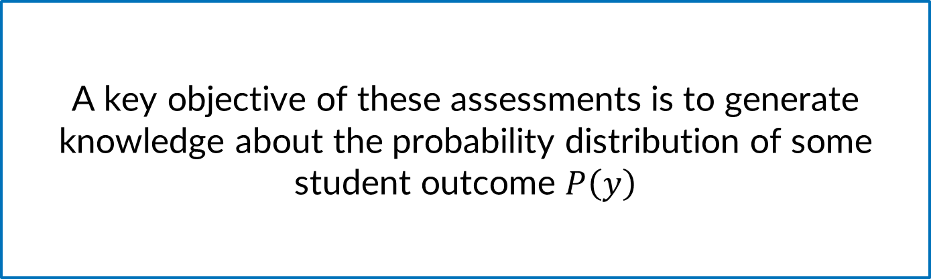
3
A key objective of these assessments is to generate knowledge about the probability distribution of some student outcome $P\left(y\right)$

Slide 4
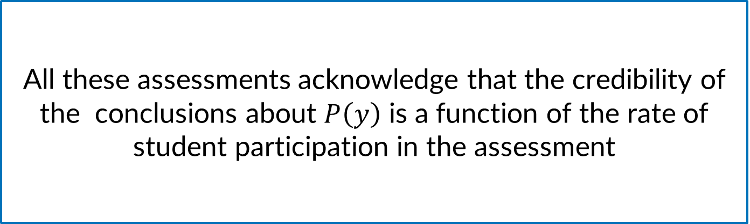
All these assessments acknowledge that the credibility of the conclusions about $P\left(y\right)$ is a function of the rate of student participation in the assessment

Slide 5
Objective
To inform the reporting of participation rates in the assessment by,
Justifying theoretically why are student participation rates relevant for these assessments
Providing an estimation framework for this population parameter
Discussing reporting strategies that account for sampling variability in the estimation

Slide 6
6
THE BASIC STRUCTURE

Slide 7



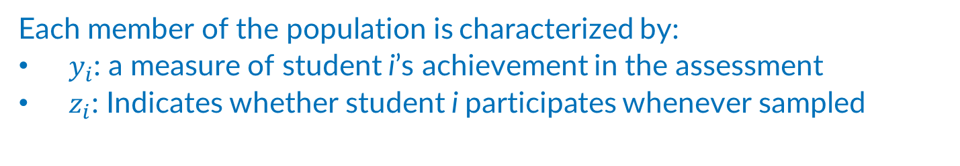














7
$$\left(y_{2},z_{2}\right)$$
$$\left(y_{6},z_{6}\right)$$
$$\left(y_{4},z_{4}\right)$$
$$\left(y_{10},z_{10}\right)$$
$$\left(y_{14},z_{14}\right)$$
$$\left(y_{8},z_{8}\right)$$
$$\left(y_{12},z_{12}\right)$$
$$\left(y_{1},z_{1}\right)$$
$$\left(y_{5},z_{5}\right)$$
$$\left(y_{N},z_{N}\right)$$
$$\left(y_{3},z_{3}\right)$$
$$\left(y_{7},z_{7}\right)$$
$$\left(y_{9},z_{9}\right)$$
$$\left(y_{13},z_{13}\right)$$
$$\left(y_{11},z_{11}\right)$$
$$\left(y_{i},z_{i}\right)$$
Each member of the population is characterized by:
$y_{i}$: a measure of student i’s achievement in the assessment
$z_{i}$: Indicates whether student i participates whenever sampled
We want to know $P\left(y\right)$

Slide 8


















8
Students that participate whenever sampled
($Z_{i}=1)$
Students that do not participate whenever sampled
($Z_{i}=0)$
$$\left(y_{i},z_{i}\right)$$
$$\left(y_{i},z_{i}\right)$$
$$\left(y_{i},z_{i}\right)$$
$$\left(y_{i},z_{i}\right)$$
$$\left(y_{i},z_{i}\right)$$
$$\left(y_{i},z_{i}\right)$$
$$\left(y_{i},z_{i}\right)$$
$$\left(y_{i},z_{i}\right)$$
$$\left(y_{i},z_{i}\right)$$
$$\left(y_{i},z_{i}\right)$$
$$\left(y_{i},z_{i}\right)$$
$$\left(y_{i},z_{i}\right)$$
$$\left(y_{i},z_{i}\right)$$
$$\left(y_{i},z_{i}\right)$$
$$P\left(y|z=1\right)$$
$$P\left(y|z=0\right)$$

Slide 9
9
THE EVENT PROBABILITY OF PARTICIPATION
ITS RELEVANCE

Slide 10

Relevance for $P\left(y\right)$
10
Statistical inference about $P\left(y\right)$
Sample size determination

Slide 11
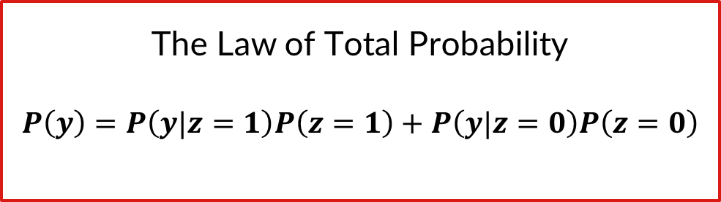
Relevance for $P\left(y\right)$
11
To determine the limits of the knowledge that can be attained with the assessment
The Law of Total Probability
$$P\left(y\right)=P\left(y|z=1\right)P\left(z=1\right)+P\left(y|z=0\right)P\left(z=0\right)$$

Slide 12
12
THE EVENT PROBABILITY OF PARTICIPATION
ESTIMATION

Slide 13









Sampling design
13

Slide 14
Sampling design
14

Slide 15
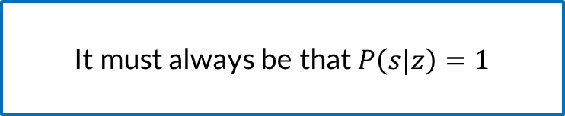
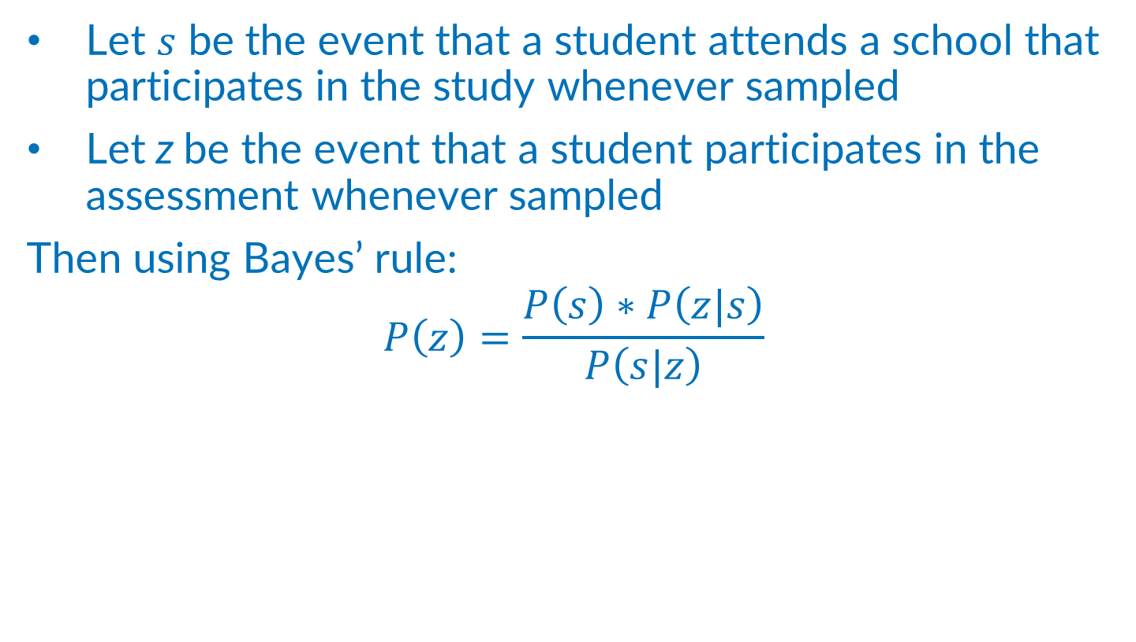
Response probability
15
Let $s$ be the event that a student attends a school that participates in the study whenever sampled
Let z be the event that a student participates in the assessment whenever sampled
Then using Bayes’ rule:
$$P\left(z\right)=\frac{P\left(s\right)∗P\left(z|s\right)}{P\left(s|z\right)}$$
It must always be that $P\left(s|z\right)=1$

Slide 16
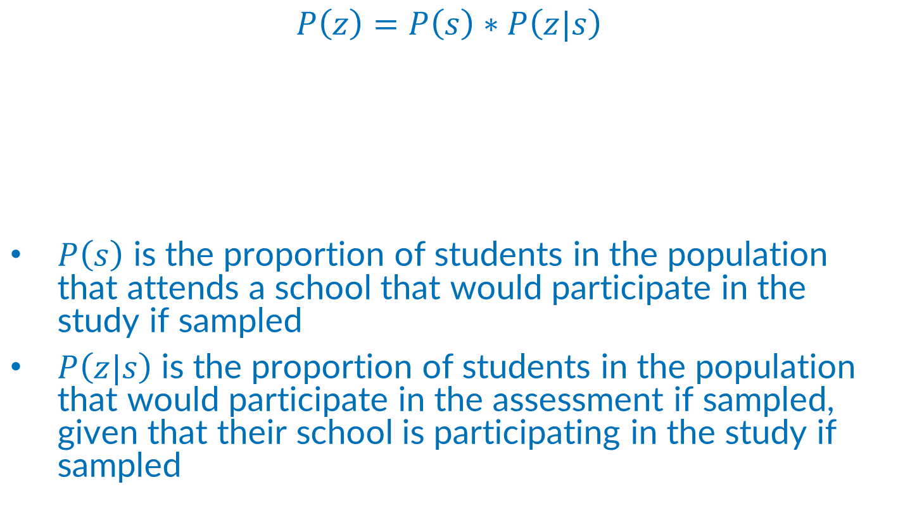
Estimating the probability of participation
16
$$P\left(z\right)=P\left(s\right)∗P\left(z|s\right)$$
$P\left(s\right)$ is the proportion of students in the population that attends a school that would participate in the study if sampled
$P\left(z|s\right)$ is the proportion of students in the population that would participate in the assessment if sampled, given that their school is participating in the study if sampled
From a frequentist perspective, the probability of an event is the limit of the frequency of that event

Slide 17
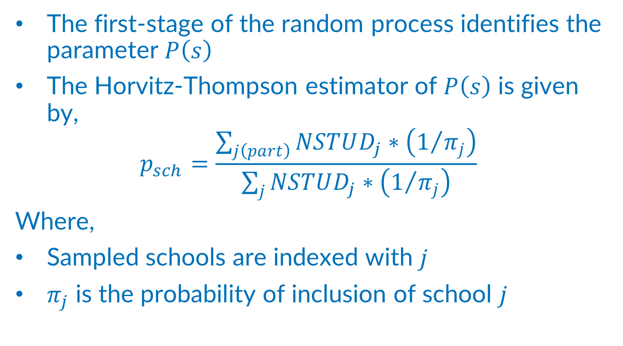
Estimating the probability of participation
17
The first-stage of the random process identifies the parameter $P\left(s\right)$
The Horvitz-Thompson estimator of $P\left(s\right)$ is given by,
$$p_{sch}=\frac{\sum_{j\left(part\right)}{NSTUD_{j}∗\left(1/{π_{j}}\right)}}{\sum_{j}{NSTUD_{j}∗\left(1/{π_{j}}\right)}}$$
Where,
Sampled schools are indexed with $j$
$π_{j}$ is the probability of inclusion of school $j$

Slide 18
Sampling design
18

Slide 19
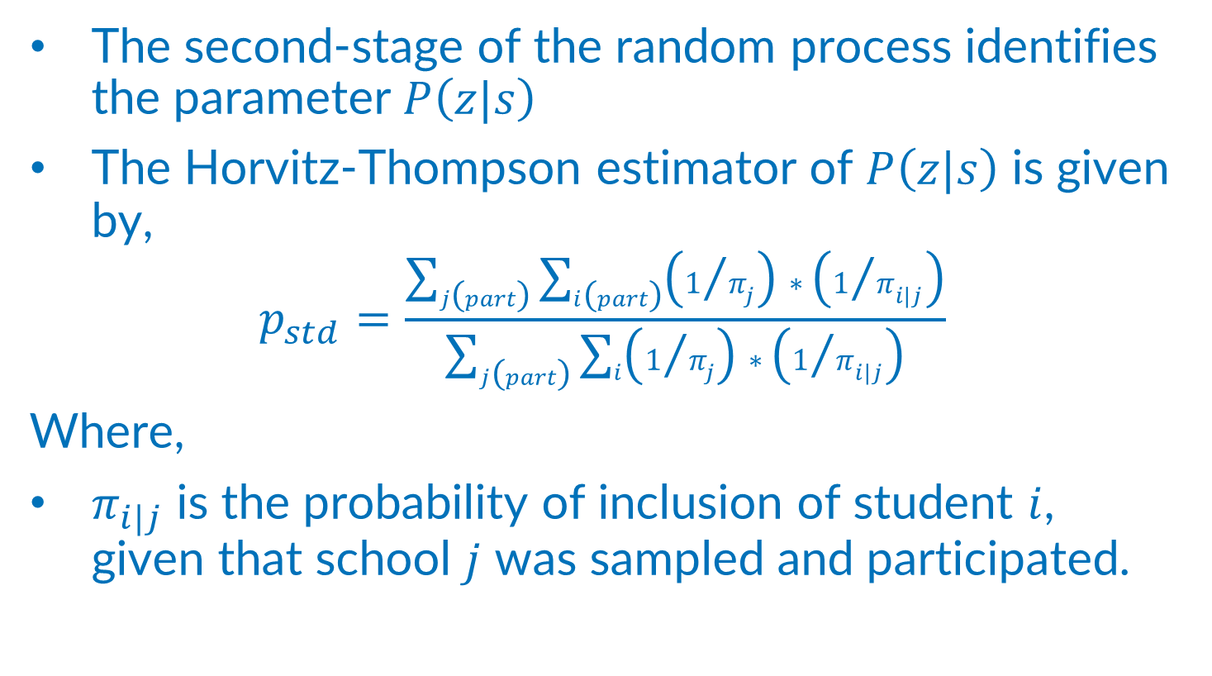
Estimating the probability of participation
19
The second-stage of the random process identifies the parameter $P\left(z|s\right)$
The Horvitz-Thompson estimator of $P\left(z|s\right)$ is given by,
$$p_{std}=\frac{\sum_{j\left(part\right)}{\sum_{i\left(part\right)}{\left(1/{π_{j}}\right)∗\left(1/{π_{i|j}}\right)}}}{\sum_{j\left(part\right)}{\sum_{i}{\left(1/{π_{j}}\right)∗\left(1/{π_{i|j}}\right)}}}$$
Where,
$π_{i|j}$ is the probability of inclusion of student $i$, given that school $j$ was sampled and participated.

Slide 20
Sampling design
20

Slide 21
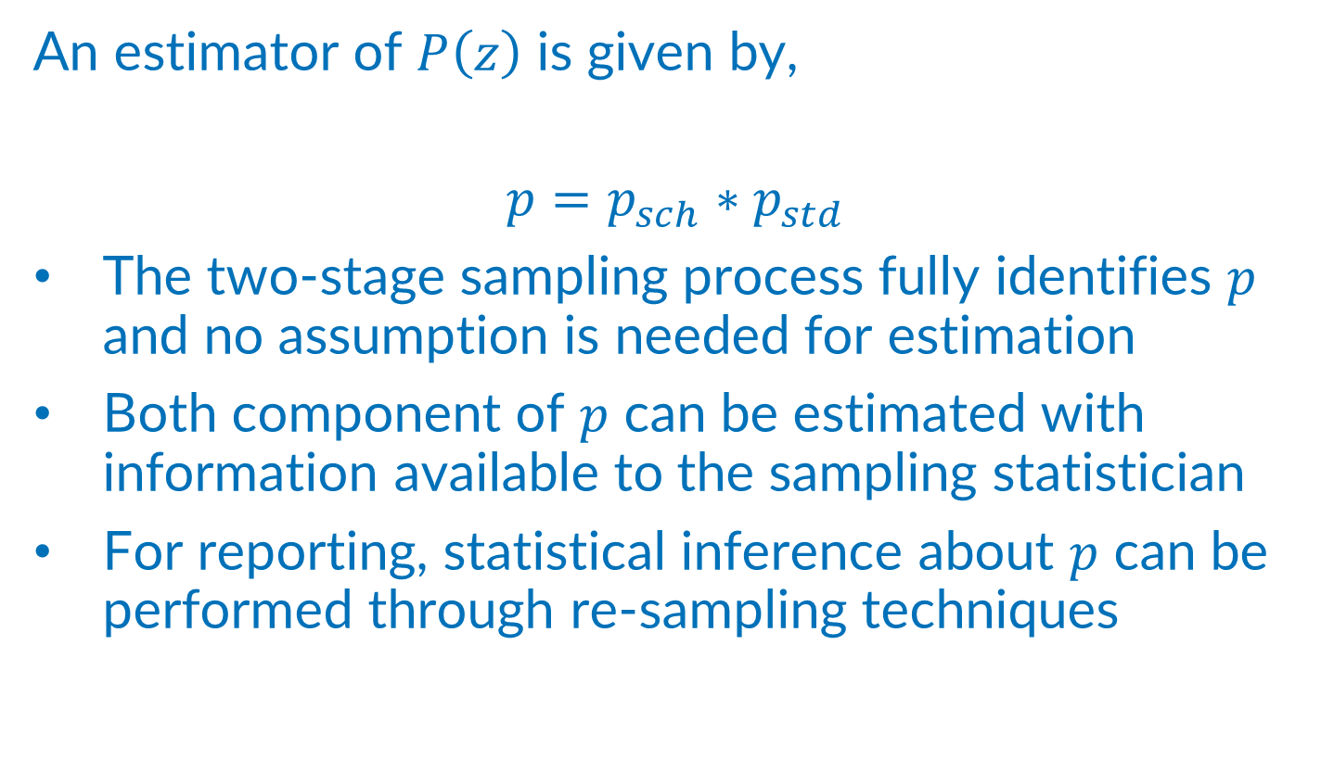
Estimating the probability of participation
21
An estimator of $P\left(z\right)$ is given by,
$$p=p_{sch}∗p_{std}$$
The two-stage sampling process fully identifies $p$ and no assumption is needed for estimation
Both component of $p$ can be estimated with information available to the sampling statistician
For reporting, statistical inference about $p$ can be performed through re-sampling techniques

Slide 22
Thank you!
Diego Cortes
Diego.cortes@iea-hamburg.de

Slide 23
23
THE EVENT PROBABILITY OF PARTICIPATION
STATISTICAL INFERENCE

Slide 24
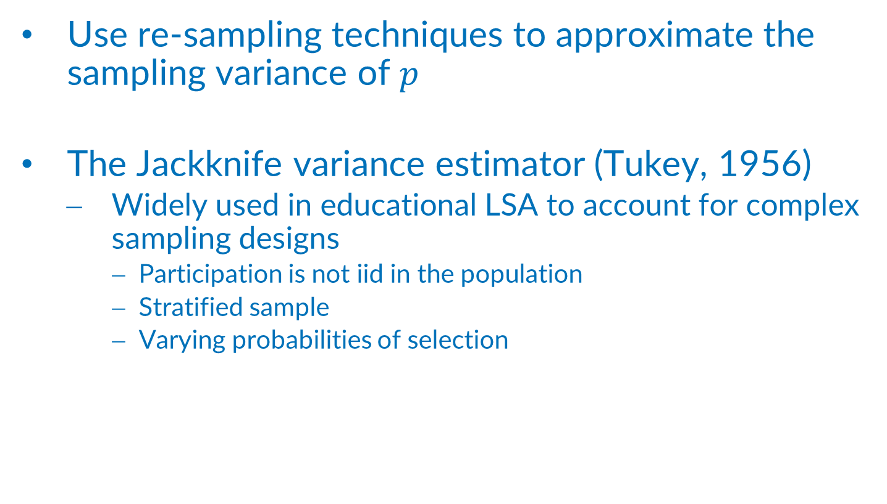
Statistical inference
Use re-sampling techniques to approximate the sampling variance of $p$
The Jackknife variance estimator (Tukey, 1956)
Widely used in educational LSA to account for complex sampling designs
Participation is not iid in the population
Stratified sample
Varying probabilities of selection

Slide 25
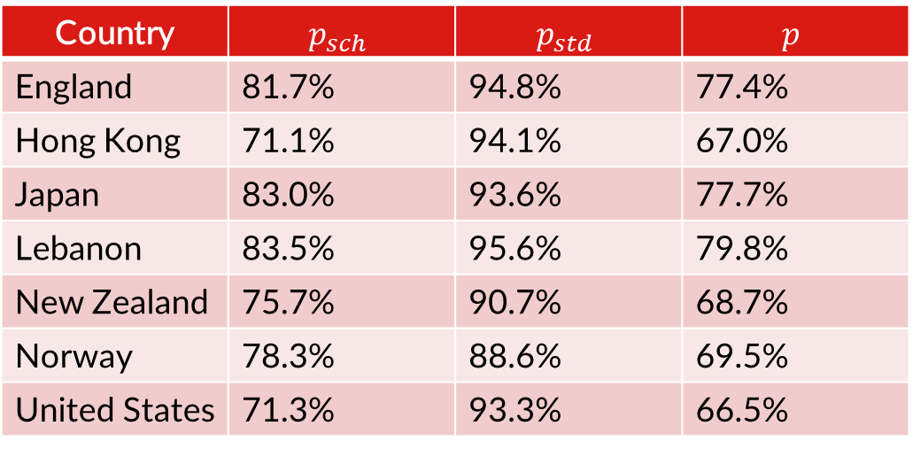

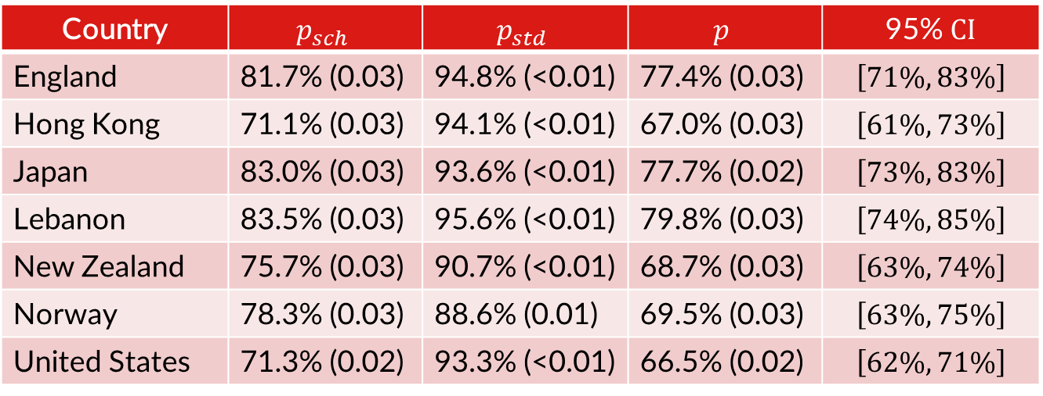
Statistical inference
TIMSS Grade 8
Assesses math and science
46 educational systems participated in 2019
Credibility of the conclusions reached with the study is a function of a point estimate of $p$
75% response rate is a minimum requirement
Country | $$p_{sch}$$ | $$p_{std}$$ | $$p$$ | 95% $CI$
England | 81.7% (0.03) | 94.8% (<0.01) | 77.4% (0.03) | $$\left[71\%, 83\%\right]$$
Hong Kong | 71.1% (0.03) | 94.1% (<0.01) | 67.0% (0.03) | $$\left[61\%, 73\%\right]$$
Japan | 83.0% (0.03) | 93.6% (<0.01) | 77.7% (0.02) | $$\left[73\%, 83\%\right]$$
Lebanon | 83.5% (0.03) | 95.6% (<0.01) | 79.8% (0.03) | $$\left[74\%, 85\%\right]$$
New Zealand | 75.7% (0.03) | 90.7% (<0.01) | 68.7% (0.03) | $$\left[63\%, 74\%\right]$$
Norway | 78.3% (0.03) | 88.6% (0.01) | 69.5% (0.03) | $$\left[63\%, 75\%\right]$$
United States | 71.3% (0.02) | 93.3% (<0.01) | 66.5% (0.02) | $$\left[62\%, 71\%\right]$$
Country | $$p_{sch}$$ | $$p_{std}$$ | $$p$$
England | 81.7% | 94.8% | 77.4%
Hong Kong | 71.1% | 94.1% | 67.0%
Japan | 83.0% | 93.6% | 77.7%
Lebanon | 83.5% | 95.6% | 79.8%
New Zealand | 75.7% | 90.7% | 68.7%
Norway | 78.3% | 88.6% | 69.5%
United States | 71.3% | 93.3% | 66.5%

