Slide 1

Adapting Geographical Sampling Unit Size and Structure for a Changing Survey Landscape
Holly Cast
Chrystine Tadler
Nicholas Davis
Whitney Murphy
Nathaniel Poland
(NORC at the University of Chicago)
08/04/2024
JSM, Portland OR
This research was conducted under the Medicare Current Beneficiary Survey Contract sponsored by the Centers for Medicare & Medicaid Services (Contract: 75FCMC19D0092; Task order: 75FCMC21F0001). No official endorsement by the Department of Health and Human Services or the Centers for Medicare & Medicaid Services is intended or should be inferred.

Slide 2
MCBS Introduction
The Medicare Current Beneficiary Survey (MCBS):
  Is a nationally representative, continuous, longitudinal, multipurpose survey of the Medicare population
  Involves a rotating panel design where panels are selected and fielded for eleven interviews over the course of four years before being retired
  Conducted by the Centers for Medicare & Medicaid Services (CMS) through a contract with NORC at the University of Chicago (NORC)
  Leading source of information on the Medicare program and its impact on beneficiaries
  Uses a three-stage geographically clustered sampling design stratified by age categories and Hispanic/non-Hispanic, to create 14 sampling strata, drawn from the CMS enrollment database

Slide 3
MCBS Sample Design
PSUs
104 Primary Sampling Units, reselected in 2000
Metropolitan Statistical Areas (MSAs) or county groups
SSUs
685 Secondary Sampling Units, redesigned in 2014
USUs
Ultimate Sampling Units
Medicare beneficiaries – New panel is drawn each fall
Census tracts or tract groups

Slide 4
Motivation for SSU Analysis
SSUs
685 Secondary Sampling Units, redesigned in 2014
Census tracts or tract groups
Since 2014, declining response rates and a switch to mostly phone interviewing in 2020 have required larger sample sizes, straining the effectiveness of the existing design
In 2023, an analysis was conducted on options to redesign MCBS SSUs within existing MCBS PSUs

Slide 5
Background for SSU Analysis
SSUs are smaller than optimal to support the size of current Fall panels and accommodate different oversampling goals
  Sample availability means that some groups (such as Hispanic beneficiaries <45 years of age) are often selected with certainty
Higher level of certainty selections has ramifications for precision
More certainty selections
Greater variability in weights
Less precise estimates

Slide 6
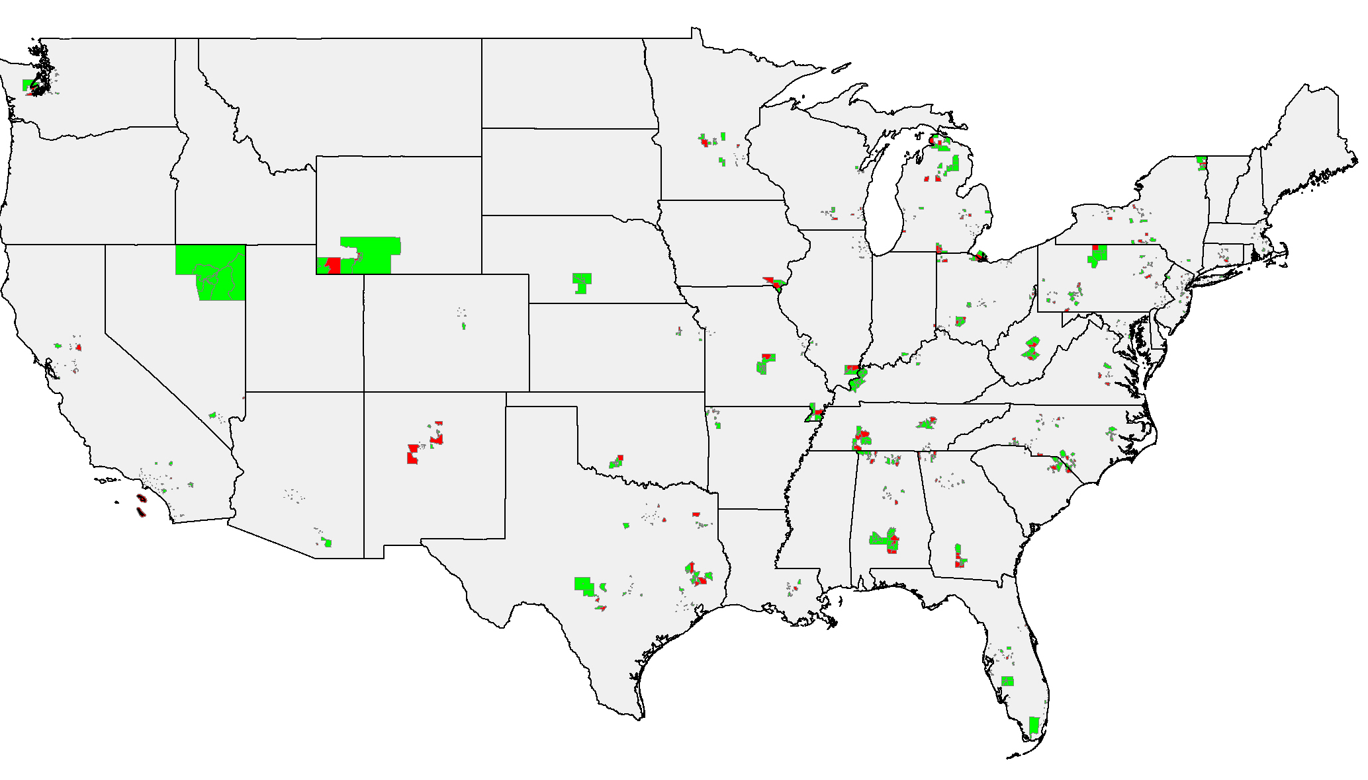
Geography of MCBS SSUs
Core SSUs (685 covering 1,088 tracts)
Buffer SSUs (330 covering 526 tracts)

Slide 7
SSU Analysis Scenarios
Consider impact on…
Sampling from Buffer SSUs
Doubling the Enrollment Database Extracts
Reselecting SSUs
Expanding Current SSUs
Sample frame size
Certainty selection and sample exhaustion
Weights and design effect
Precision around a 50% estimate

Slide 8
Considerations for evaluating geographical sampling unit size and structure
Impact on weights, design effect, and precision of estimates
Ramifications for potential oversampling designs
Maximizing overlap with old and new designs in a longitudinal framework
Logistics of implementing new methods for data collection and interviewing mode
Costs of new methods, such as hiring interviewers in new locations or staffing larger area

Slide 9
Suggested methodology for similar studies evaluating different scenarios
Estimate impact on weights, design effect, and precision by making a few assumptions and then conducting a sample draw as fully as possible
Create an expanded frame that uses existing variables if possible (i.e. including buffer SSUs in sample frame) or simulates one (i.e. estimate what a doubled frame would look like by stacking existing frame twice)
Use existing sampling methodology to conduct a sample draw on hypothetical frame to calculate effect on base weights and other metrics

Slide 10
Scenario 1: Sampling from Buffer SSUs
Utilize 330 Buffer SSUs that were created as a possible future supplement for MCBS sampling but have never been used
Relatively straightforward to implement, though costs are an important factor
Increases the frame size by about 50%
Halves the number of beneficiaries with probabilities of selection equal to 1
Slight increase in precision around a hypothetical 50% estimate for the <45 Hispanic group relative to 2022 data with no changes
  (46.6%, 53.4%) → (46.7%, 53.3%)
  Confidence interval becomes more precise, particularly for groups with highest certainty selections (youngest and oldest beneficiaries)

Slide 11
Scenario 2: Double Enrollment Database Extracts
Double subset of Medicare population used for sampling from 5% to 10%
Doubles the frame size without necessitating changes to SSUs or geography of data collection
Reduces the number of beneficiaries with probabilities of selection equal to 1 by 90%
Slight increase in precision around a hypothetical 50% estimate relative to 2022 data with no changes
  (46.6%, 53.4%) → (46.9%, 53.1%)
  Confidence interval becomes more precise
Ensures maximum overlap of old and new geographies

Slide 12
Scenario 3: Reselect SSUs
Set a new minimum measure of size (MOS) and then recreate the SSU sampling frame
Sampling frame would contain fewer, larger SSUs
Select the same number of SSUs as current design from new frame of larger units
Results of simulation assuming that all potential SSUs would exceed a new minimum MOS by the same amount that they exceeded the old MOS:
  Increases the frame size by 63% under these assumptions
  Would not guarantee overlap between existing and new SSUs
  Simulated effect on weights and precision was very similar as for Buffer SSU scenario

Slide 13
Scenario 4: Expand Current SSUs
Though the current SSUs are smaller than optimal, it may be possible to expand them by capturing adjacent tracts
Start by increasing the minimum MOS of each new SSU
Some existing SSUs would already meet this new minimum measure of size, while others would need expanding
  Some SSUs can’t be expanded (only border tracts that are already in SSUs or do not border enough tracts to expand)
    Approximately 30% of SSUs can’t be expanded, which makes this difficult to test
This method would result in considerable overlap between old and new geographies

Slide 14
Tradeoffs between the scenarios
These four options increase MCBS sample frame sizes by varying amounts and have different impacts on certainty selection:
 | Percent Increase in Frame | Percent Reduction in Beneficiaries Selected with Certainty | Gain in Precision for example strata
Sampling from Buffer SSUs | 50% | 50% | 0.20%
Doubling the Enrollment Database Extracts | 100% | 90% | 0.60%
Reselecting SSUs | 63% | 75% | 0.40%

Slide 15
Conclusions
Doubling the administrative enrollment subset to 10% (Scenario 2) is most effective and least disruptive option
  Maintains same field structure and interviewer spread while increasing frame, relieving sample exhaustion, and increasing precision for smaller groups (youngest and oldest beneficiaries)
  Less help with availability of minorities or other oversampling concerns (better addressed by PSU analyses)
For similar studies, simulating sampling under hypothetical sample frame scenarios can help quantify and compare ramifications of design changes
  Frame changes can alleviate sampling challenges by increasing precision and reducing variability in weights

Slide 16
Other Considerations
This analysis focused on retaining current MCBS PSUs. Re-evaluating the PSUs is another avenue of research, as the Medicare population has moved geographically in some ways since the PSUs were created
  Migration of the 65+ population from northern states to Florida, Arizona, and Nevada has been ongoing
  There have been changes in the distribution of Hispanic, Asian, and other minority populations that may be of oversampling interest
  On average, the density of the Hispanic population has changed by three percentage points per PSU since the PSUs were last selected

Slide 17
Thank You
Tadler-Chrystine@norc.org
Cast-Holly@norc.org

