Slide 1
Enhancing Weighting in the National Health and Nutrition Examination Survey (NHANES) with External Data
Jay Clark, Minsun Riddles, Veronica Salinas (Westat)
Matt Jans, Te-Ching Chen (National Center for Health Statistics)
WESTAT @ JSM 2024 — Statistics and Data Science: Informing Policy and Countering Misinformation
The views presented are those of the author(s) and do not represent the views of any Government Agency/Department or Westat
Notes:
Thank you. Thanks to Minsun for setting up this session. My co-authors for this presentation are Minsun Riddles and Veronica Salinas from Westat, and Matt Jans, and Te-Ching Chen from NCHS.

Slide 2

Agenda
NHANES Background
NHANES Weighting
Auxiliary Data for Nonresponse Adjustment
Auxiliary Data in Calibration
Notes:
I will first give some background on NHANES for those who aren’t familiar with it, then discuss the sample design and general weighting procedures used. Over the years, changes to the sample and response patterns mean we are always looking for ways to improve weighting methods, so the main point of this talk will be the use of external data to enhance the NHANES weighting procedures, both for nonresponse adjustment and calibration.

Slide 3
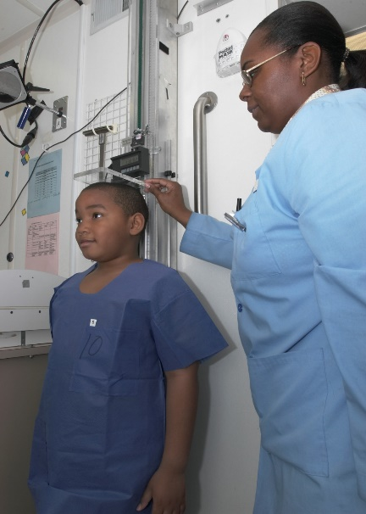
NHANES Background
Sponsor | National Center for Health Statistics (NCHS)
Objective | To assess the health and nutritional status of adults and children in the United States.
U.S. population-based estimates of:
Health conditions
Awareness, treatment and control of selected diseases
Environmental exposures
Nutrition status and diet behaviors
Began in late 1950s/early 1960s
http://www.cdc.gov/nchs/nhanes/
Notes:
NHANES is sponsored by the National Center for Health Statistics, and has been used to monitor the health of our nation for over 60 years. They obtain US population estimates of health conditions and diseases, environmental exposures, nutrition status, and many more research items. Originally the survey would be administered for a few years, then dormant for a few years, but the most recent version of NHANES was in the field from 1999 to 2020. After stopping data collection in March 2020 due to the pandemic, data was again collected August 2021-August 2023, and NHANES will resume continuous data collection next year.

Slide 4
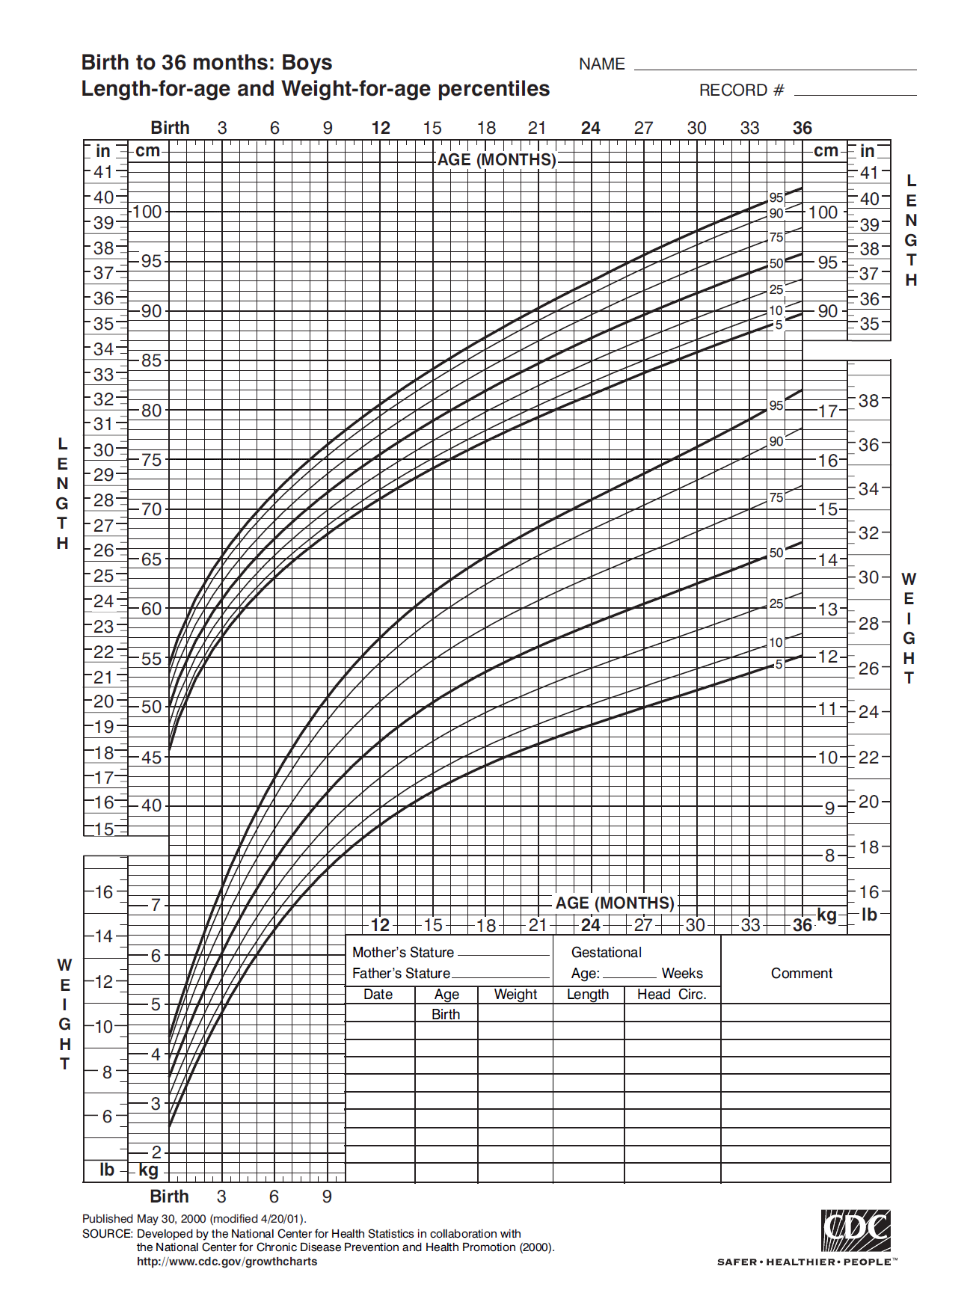
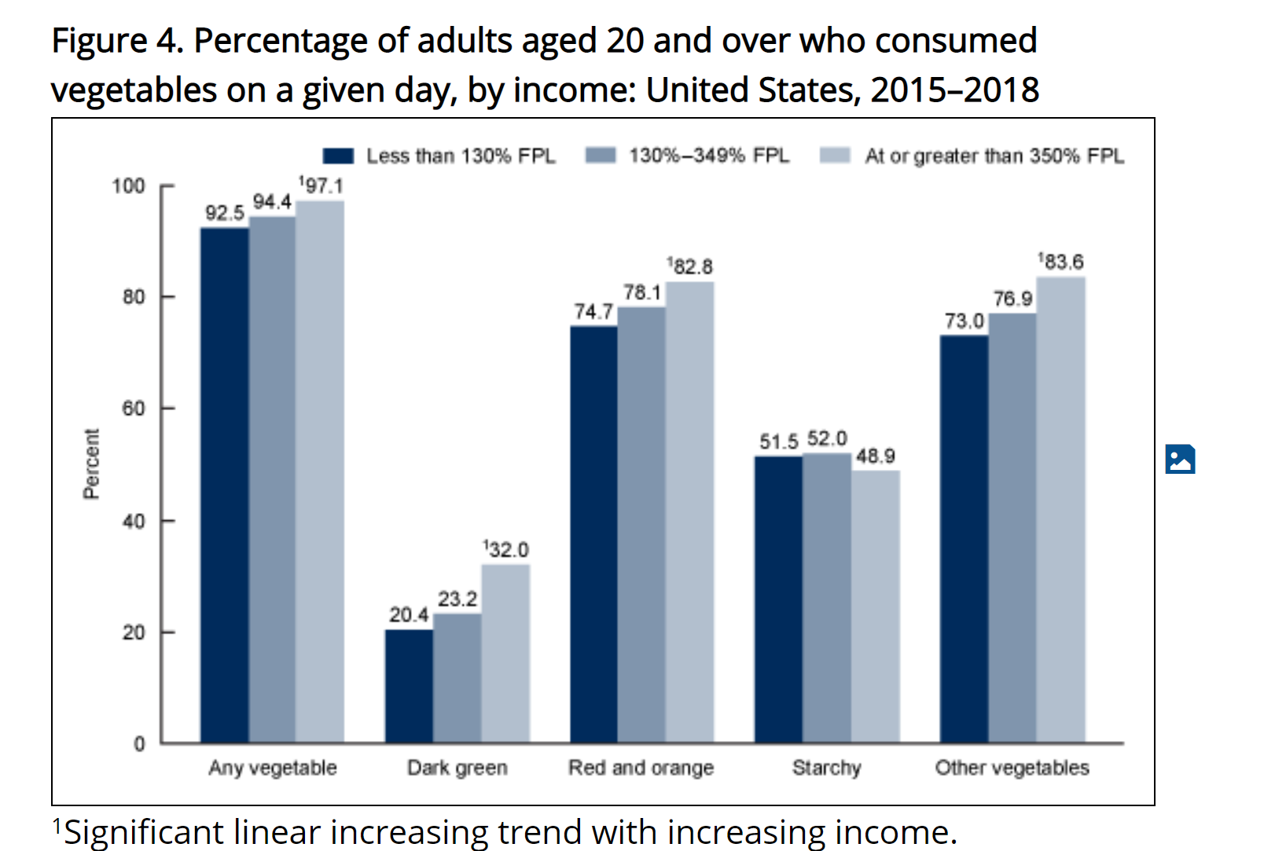
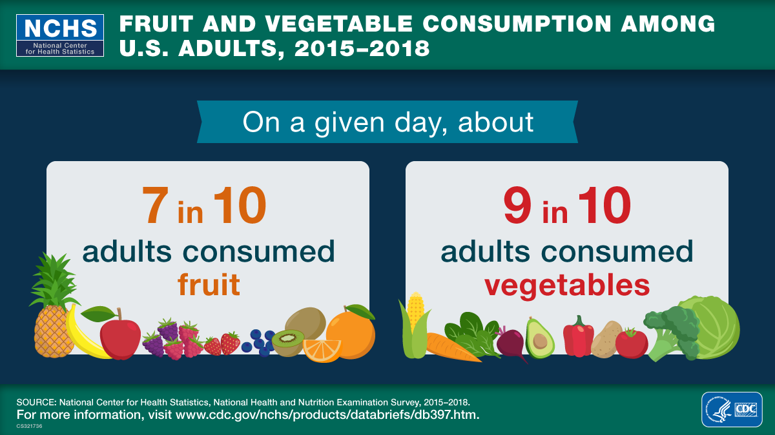
NHANES Results
Pediatric growth charts
Policies about lead
Monitoring HPV
Food nutrition labeling
Thousands of journal articles
Notes:
The results from NHANES have been extremely impactful, as a rich source of health data and the relationship between dietary intake, health behaviors, and health outcomes. Growth charts help pediatricians monitor their patients, and that data comes from NHANES. The reduction of lead in gasoline and paint was aided in part by NHANES data. More recently, NHANES has monitored HPV prevalence among other outcomes, and literally thousands of journal articles have used NHANES data over the years.

Slide 5
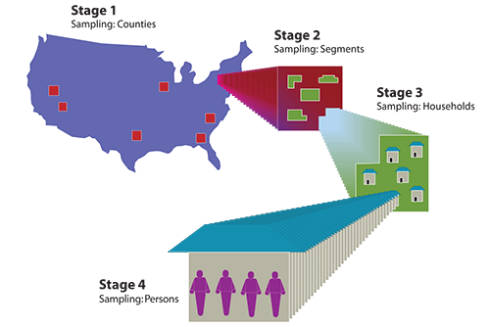
NHANES Sample Design
Four-stage area sample design:
Primary Sampling Units (PSUs), mostly single U.S. counties
Segments (groups of census blocks within PSUs)
Dwelling units (DUs) within segments
Sampled persons (SPs) within sampled DUs
15 PSUs per year
About 5,000 exams per year (average 333 exams/PSU)
5
Notes:
The sample design I will describe is the design for 1999-2023, and not necessarily the design moving forward for NHANES. There are 4 stages – primary sampling units, which are mostly single counties or occasionally part of a large county or two small counties combined, then segments, which are essentially neighborhoods within the counties, then dwelling units, which are essentially households within the neighborhoods. The final stage is selecting persons within the households. The design has been to select 15 PSUs per year and to examine about 5,000 persons per year, among the entire civilian, non-institutionalized US population.

Slide 6
NHANES Screener
Screening done at the household level (both web and in-person)
Screener respondent must be a resident who is at least 18 years old
Five health-related questions added in 2019 for screener respondent
Enumerate household members and their demographic information
Screening used to identify sampled persons (SPs) based on desired sample size, populations and estimated RR
6
Notes:
The first 3 stages of the sample design could be done using administrative data, but the final stage, selecting persons within households, needed to be done by contacting the household to get information about the people living there. NHANES has had different subsample size requirements over the years, so knowing the characteristics of the household residents was required before selecting persons for the sample. For example, we have oversampled certain race/ethnicities, persons in low income households, and certain age groups to meet analysis targets. More recently, some screening has been done using a secure internet site, but generally screening has been done face to face at the doorstep. The screener respondent tells us a little about themselves as a way to engage them in the survey, and then tells us about others in the household, and then none, some, or all persons in the household are selected.

Slide 7
NHANES Interview and Exam
In-home interview (~1 hour)
Sometimes over phone during pandemic
General health conditions
Prescriptions
Questions similar in content to harmonize with the National Health Interview Survey (NHIS)
Travel for physical exam to exam center in PSU
Exams can take 2 or more hours
SPs asked to fast for 8 hours before AM appointments
Phlebotomy, body measures, dental, vision, hearing, others
Dietary interview, audio interview about health behaviors
Notes:
Sampled persons (called SPs) are asked to complete an interview at home with an interviewer (and some sensitive questions are asked on a computer). These questions ask about general health conditions and behaviors and are like the questions used on the National Health Interview Survey. Once the interview is complete, SPs are asked to travel to a mobile exam center within the PSU for a thorough medical exam. Exams are done in the exam center and not local clinics or offices so that they are standardized to reduce measurement error. SPs with morning appointments are asked to fast before the exam. Among many other types of exams, blood and urine samples are taken for testing of environmental exposures, and to compare to a dietary interview about what the person has consumed in the last day. It is very comprehensive.

Slide 8
Response Rates
Notes:
So that’s a description of how NHANES works, and here are the response rates we have seen in recent years. Note that these are all 2-year cycles except for the last one, which combines the 2017-18 data with 2019 and the first couple of months in 2020. The yellow line shows the screener rates, which are at the dwelling unit level and measure the percentage of households that open the door and complete the short screener. These used to be very near 100% - the most recent data has not been released yet, but I can say the screener response rate went down substantially during the pandemic. The purple line shows the interview response rate conditional on screener response, or the number of SPs interviewed out of all the SPs identified in the screener. That rate used to be around 80% but is now in the 50-60% range. The green line is the exam response rate conditional on interview completion, or the number of examined SPs out of the SPs who were interviewed. That rate also went down during the pandemic, as some people were willing to be interviewed, but not travel to an exam center for an exam. Of course these lower response rates trigger concerns about nonresponse bias, and the need to consider adjustments to the weights to make the respondents look more like the sample.

Slide 9
Weighting Process
Screener
In-Home Interview
Examination
Identified SPs
Initial Base Weight Probability of Selection
Identified SPs
Interview Base Weight
Interviewed SPs
Exam Base Weight
Adjustments for
Subsampling,
Growth,
Deselection
Adjustment for Nonresponse to Interview
Adjustment for Nonresponse to Exam
Adjustment for Nonresponse to Screener
Calibration and
Trimming
Calibration and
Trimming
Calibration and
Trimming
Nonresponse Bias Analysis
Control Totals from ACS
*SPs = Sampled Persons
Notes:
This is a somewhat complicated diagram of the NHANES weighting process, and I don’t want to spend much time on this, but just point out that weights are created at each of the three stages of the survey, at the screener, interview, and exam level. At each level there are adjustments for nonresponse as well as calibration to known control totals.

Slide 10
Screener Nonresponse Adjustment
What do we know about screener nonrespondents?
Address
What information can we get about the address?
Tract-level ACS variables
Tract-level PLACES variables
PSU-level variables
For a face-to-face study like NHANES, what else can we learn?
Interviewer observations
Notes:
So what do we know about screener nonrespondents that we can use to adjust the weights of the screener respondents? Well we know the address, and that’s about it. But there is a lot of information about the address and the surrounding area that can be useful for adjusting the screener weights. Information from the American Community Survey, the ACS, can be obtained at the tract or sometimes smaller levels. The same is true for PLACES, a collaboration between CDC, the Robert Wood Johnson Foundation, and the CDC Foundation. PLACES provides health data for small areas across the country. This allows local health departments and jurisdictions, regardless of population size and rurality, to better understand the burden and geographic distribution of health measures in their areas and assist them in planning public health interventions. There are also PSU or county-level variables that can be correlated with response status, such as region of the country or urbanicity. For NHANES, which sends interviewers out to collect data in the field, the observations of these interviewers before the screener is performed can also be obtained.

Slide 11
Tract-Level Information from ACS
Variable | Quartile Values
Percentage of population with college degree | 50.1% | 62.7% | 75.4%
Percentage of population that is Asian | 0.7% | 2.6% | 8.9%
Percentage of housing units that are occupied | 86.1% | 91.7% | 95.9%
Percentage of housing units built in 1980 or later | 19.9% | 44.4% | 69.0%
Percentage of civilians age 45-64 unemployed | 1.1% | 3.3% | 6.2%
Median age | 34.3 | 39.7 | 44.5
Median income | 49,914 | 66,641 | 90,129
Notes:
Here are some examples of information that can be retrieved from the ACS that describe the smaller areas where DUs are sampled. For example, a nonresponding DU in a tract with less than 50% of the population with a college degree may be more like a responding DU in a different tract with less than 50% of the population with a college degree than a DU in the same PSU with over 75%. For each of these continuous variables, we created quartiles of the sampled tracts to make them categorical to use for nonresponse adjustments. There is a lot of demographic information available in the ACS. Some of them are about people (education, age, race/ethnicity) and some about other areas like occupied housing units and when HHs were built.

Slide 12
Tract-Level Information from PLACES
Variable | Quartile Values (%)
Percent obese* | 26.3 | 30.4 | 35.3
Percent hypertensive* | 27.4 | 31.2 | 35.5
Percent diabetic* | 8.2 | 10.1 | 12.5
Percent with frequent mental distress* | 11.3 | 13.4 | 15.5
Percent having visited to doctor for routine checkup within the past year* | 72.6 | 76.1 | 79.1
Percent mammography use among women aged 50–74 years | 75.0 | 77.3 | 79.9
Percent binge drinking* | 15.7 | 18.1 | 20.6
*Among adults aged 18+ years
Notes:
Similarly, here are some examples of information that can be retrieved from the PLACES dataset that describe the smaller areas where DUs are sampled. Unlike ACS, these are small area predictions rather than actual estimates, but they are also grouped into quartiles, so specific estimate accuracy is less important. These are health-related variables that may be more likely to be correlated with both response status and health outcomes, which makes them useful for NHANES weighting adjustments. The bolded variables were used for nonresponse weighting adjustments in 2021-2023. For example, people living in an area that has a lower rate of doctor checkups also had a different response rate than people living in an area with a higher rate of doctor checkups.

Slide 13
Interviewer Observations for Screener Nonresponse
Variable | Values except Unobservable and Unable to Guess
Building Type | Single family home, Townhouse, Apartment/Condo, Mobile home, Student housing, Other, Not a DU
Apartment/Condo Type | Garden, Midrise, Highrise, Single family home converted
Dwelling Income | Low, Lower-middle, Middle, Upper-middle, High
Dwelling Condition | Very poor, Poor, Fair, Good, Excellent
Number of Locks | 0-2, 3+
Sidewalk Condition | Rough, Average, Excellent
Access Barriers | Yes, No
Indication of Children | Yes, No
Number of Residents | 1-2, 3+
Notes:
Any information about selected households that can be used to adjust for nonresponse is helpful, so starting in 2019, we asked interviewers to complete a short observational survey about each selected household. These questions asked things like the type of household (for example, detached home, apartment, townhouse), a guess at the household income relative to other households in the US, the condition of the household and neighborhood, access barriers like gates or guards, and indication of children in the household. All of these showed some indication that response rates differed for different categories, for example, households with access barriers were less likely to respond than those without access barriers. Again, these are examples of external variables that can be used to adjust the weights to reduce potential bias in the estimates.

Slide 14
Using External Variables to Improve Nonresponse Adjustment
Modeling variables against both response status and health outcomes
Training for interviewers to ensure consistency
Idea is that the characteristics of a DU may be more like another DU in a different part of the country than a DU in the next neighborhood over
Notes:
Many external variables can be created this way, especially about addresses or neighborhoods where people live. Many of these variables are highly correlated, so we tried to limit the number of variables we considered for nonresponse adjustments to reduce redundancy. We also ran some models to look at the most significant variables both for response status and for selected health outcomes of NHANES to have a pool of variables that were significant to both as much as possible.
For interviewer observations, intensive training was done to ensure that the interviewers were consistent with each other and between PSUs in their answers to the observation questions. In this way, DUs or households could be grouped more by their characteristics than by their location, since we found that in many cases, DUs could be more similar to DUs in other PSUs than to DUs nearby. For example, a DU that looked like a higher-income household might be more similar to sampled DUs in another PSU than to a possible DU in a lower-income area a few blocks away.

Slide 15
Interview Nonresponse Adjustment
What do we know about interview nonrespondents?
All DU observation, tract-level ACS, and PSU-level variables used in screener NR adjustment
Screener variables
HH-level variables: HH composition, number of children or SPs in the HH, HH size, sex and age of the HH reference and screener respondent, responses to health questions for the screener respondent
SP-level variables: Race/Ethnicity, Sex, Age
Notes:
The interview nonresponse adjustment is similar to the screener nonresponse adjustment, although it is of course done at the person level instead of the DU level since we know some things about the SPs who were interview nonrespondents. In addition to the variables used for screener nonresponse adjustment, the area-level variables and observations, any information gained from the screener about the household or the SPs was used as well. This included things like how many people lived in the HH, and some basic demographics about the SPs.

Slide 16
Exam Nonresponse Adjustment
What do we know about exam nonrespondents?
All variables used in interview NR adjustment
SP interview variables:
Covid-related variables: ever had COVID, ever received a COVID vaccine, have a weakened immune system, and ever received flu vaccine in the past 12 months
High BP, diabetes, obesity, smoking and general health status
How often do you feel depressed or anxious?
Ever received a flu or Hepatitis A vaccine?
Do you use prescription meds or have Medicare?
Notes:
Similarly for exam nonresponse adjustment, we had all the variables used for interview nonresponse adjustment, plus any variables from the interview that could be used to differentiate response status. For example, persons who said in the interview that they had high blood pressure may be more or less likely to participate in the exam. Obviously there are many more variables that can be used for the exam nonresponse adjustment than for previous nonresponse adjustments, since we know more about the exam nonrespondents. We continued to use the area-level information and interviewer observations at all three levels, though, because, for example, the areas with the highest level of college graduates may be less likely to participate in the exam than the areas with the lowest level of college graduates, even if that variable was not good at distinguishing screener-level response.

Slide 17
Interview Nonresponse Adjustments With and Without External Data
To see the effects of including ACS and PLACES variables as potential predictors of nonresponse, we created interview nonresponse cells both with and without these variables
Variables Used for the Original NR Cells (23 total)
11 ACS Variables
1 PLACES Variable
1 DU Observation Variable
3 PSU-level Variables
4 HH-level Variables
3 SP-level Variables
Variables Used for the Alternative NR Cells (16 total)
0 ACS Variables
0 PLACES Variables
3 DU Observation Variables
4 PSU-level Variables
6 HH-level Variables
3 SP-level Variables
Notes:
To see the effects of including ACS and PLACES variables as potential predictors of nonresponse, we created interview nonresponse cells both with and without these variables for the 2021-2023 data. We first included all of the potential predictors in the normal process, including ACS and PLACES tract-level variables, and then used the same set of potential predictors excluding the ACS and PLACES variables. With the original set of predictors, 23 different variables ended up being used to create the nonresponse adjustment cells, including 12 variables from ACS and PLACES, and with the smaller set of predictors, 16 variables were used to create the nonresponse adjustment cells. In both cases, around the same number of cells were created (about 100), and in a few cases cells were defined the same way, but most of the cells were defined differently.

Slide 18
Estimates With and Without External Data
Compared 2021-2023 outcome estimates and standard errors with and without adjusting for nonresponse using ACS and PLACES variables
Used nonresponse-adjusted interview weights
Positive values mean estimates increased without external data
Less Healthy
w/o
External
Healthier
w/o External
Notes:
We looked at several health outcomes where higher levels indicated less healthiness (e.g., body mass index, or percentage of people with high cholesterol), and compared the weighted estimates and standard errors using nonresponse-adjusted interview weights, both with and without using ACS and PLACES variables to create the nonresponse adjustment cells. This graph shows the percent change in the estimates of these variables, sorted by the value of the change. Estimates that increased were less healthy and estimates that decreased were healthier. Most estimates did not change substantially, and those that did changed in both directions (healthier for some variables and less healthy for others). This is likely because the ACS and PLACES variables were not the strongest predictors of response, or other variables were just as good.

Slide 19
Standard Errors With and Without External Data
Standard errors more often increased without external data
Positive values mean standard errors increased
SE Increase
w/o External
SE Decrease
w/o External
Notes:
We did, however, notice that standard errors of the estimates more often increased when the nonresponse adjustment cells did not use ACS and PLACES data. This is likely due to the nonresponse cells created without the external data being correlated with response status, but less correlated with health outcomes. So including that external data in the nonresponse adjustment does affect the precision of the estimates, if not as much the estimates themselves.
Of course the actual 2021-2023 weights that will be released do include the external sources for creating nonresponse adjustment cells.

Slide 20
Using External Variables for Calibration
Reported income is subject to missingness/falsification
(Tract level) Income Deciles
Sort all Census tracts in US by mean income from ACS;
Divide into 10 groups with equal number of tracts in each group;
Approximately 7,300 (2010 Census) or 8,300 (2020 Census) tracts in each decile
Use population totals in each decile as control totals
Apply deciles to tracts in sample
Fakhouri THI, Martin CB, Chen TC, Akinbami LJ, Ogden CL, Paulose-Ram R, et al. An investigation of nonresponse bias and survey location variability in the 2017−2018 National Health and Nutrition Examination Survey. National Center for Health Statistics. Vital Health Stat 2(185). 2020.
Notes:
While nonresponse adjustment is a more obvious and important use of external data for weighting adjustments, calibration can also be done using entirely external data. Household income is well known as a variable that is subject to missingness and falsification. However, income is also well correlated with both response to the survey (higher incomes tend to be less likely to respond) and with general healthiness (higher incomes tend to be healthier). This was especially noted on NHANES beginning with the 2017-2018 cycle as noted in the reference at the bottom of this slide. To adjust for income-level response without using reported income, we sorted all Census tracts in the US by mean income from the ACS, where mean income was calculated as the aggregate household income in past 12 months divided by the number of occupied households in the tract. We then divided the tracts into 10 groups with an equal number of tracts in each group, used the population totals in each decile as a control total, and applied the deciles to tracts in the sample.

Slide 21
2017-2018 NHANES Calibration to Income Deciles
Income Decile | Unweighted | Original Weights | ACS | Ratio ACS/Orig Wts
1 | 13.1% | 9.5% | 7.7% | 0.81
2 | 11.4% | 9.9% | 9.0% | 0.91
3 | 14.1% | 15.1% | 9.5% | 0.63
4 | 11.0% | 13.7% | 9.7% | 0.71
5 | 9.0% | 9.5% | 10.1% | 1.05
6 | 6.5% | 7.3% | 10.3% | 1.41
7 | 10.0% | 10.6% | 10.7% | 1.01
8 | 9.1% | 9.8% | 11.1% | 1.13
9 | 9.5% | 8.2% | 11.3% | 1.38
10 | 6.3% | 6.4% | 10.7% | 1.68
ACS generally shows more people live in higher-income deciles
The original NHANES weights corrected the unweighted distribution somewhat, but not enough
The ratio was expected to vary around 1, but clearly the weighted population in the low-income deciles was too large and in the high-income deciles too small
Notes:
This table shows the results. The deciles are sorted by lowest incomes in decile 1 to the highest incomes in decile 10. The unweighted column shows the distribution of exam respondents by decile, with the most respondents in decile 3 and the fewest in decile 10.
The original weights column shows the distribution after weighting, including calibration to other totals, and again with the most respondents in decile 3 and the fewest in decile 10. The ACS column shows the actual distribution of the population by decile, with more of the population living in higher-income deciles and less of the population living in lower-income deciles. The ratio column shows what factor should be used to make the NHANES weighted distribution look like the actual ACS distribution. As you can see, the respondents living in higher-income areas needed to have higher weighting factors and the respondents in lower-income areas needed to have their weights reduced. The final 2017-2018 NHANES weights were adjusted to account for the actual ACS income distribution.

Slide 22
2017-2018 NHANES Calibration to Income Deciles
Notes:
Here is that ratio in graph form, with a trendline added. You can see that although there is some variance between deciles, the general trend is moving upward. For previous cycles 2011-2012, 2013-2014 and 2015-2016, there was still some variance between deciles, but the trendlines were generally flat and near 1. Clearly in 2017-2018, the distribution in income levels for respondents had changed enough to need a calibration adjustment.

Slide 23
Comparison of Estimates
Percent change in selected outcome estimates after raking to income deciles
Positive values mean estimates increased
Less Healthy w/ Inc Deciles
A few outliers, but estimates moved slightly healthier (decreased in unhealthy characteristics) after accounting for income
Healthier
w/ Inc Deciles
Notes:
Again this graph is like the previous one, where we are comparing the estimates for several health variables before and after calibrating to income deciles. A few health outcomes increased with the income adjustment, such as levels of mercury in the blood. This makes sense as people with higher incomes tend to eat more fish, which would give them higher levels of mercury. Generally, though, unhealthy outcomes more often decreased after the calibration to income, which was expected since the higher incomes are generally healthier. Thus, the calibration likely improved the results.

Slide 24
Summary
External data can provide more information about respondents and nonrespondents to surveys
Even if estimates are unchanged, variance can be lowered
External data correlated with both response and outcome estimates have better results
External data can be used to calibrate weights to population totals
Tract-level income was useful for reducing bias
Not all estimates will be impacted equally
Notes:
In summary, as response rates go down, more effort is needed to review results for potential bias and adjust weights. External data is a growing source of information that can be used for these adjustments, when survey information about nonrespondents is unavailable. Here we showed that for NHANES estimates, adding external data for nonresponse adjustments improved the precision of the estimates. And again, for calibration, on NHANES using external data reduced the bias when calibrating survey data would not have worked as well. These types of adjustments will continue to be needed with lower response rates and expanding sources of external data.

Slide 25
Thank you for listening
JayClark@westat.com
westat.com
Photos are for illustrative purposes only. All persons depicted, unless otherwise stated, are models.
Notes:
Thank you for listening and to my colleagues for helping with this effort.

