Slide 1
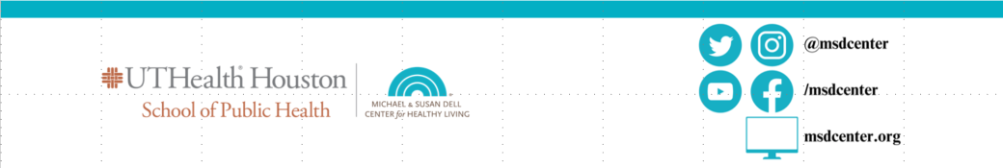
Implementing weighted interval censoring survival analysis on tobacco regulatory science
Adriana Pérez, Sarah Valencia, Pushan P. Jani, Melissa B. Harrell
Department of Biostatistics and Data Science
The University of Texas Health Science Center at Houston, School of Public Health, Austin, TX, USA
Email: adriana.perez@uth.tmc.edu
Presented at Portland, OR, JSM 2024, Monday, August 5/2024 at 2 pm
,

Slide 2

Disclaimer: Funding Acknowledgements: Research reported in this publication was supported to Dr. Pérez by grant number R21HL165401 from the National Heart, Lung, And Blood Institute (NHLBI) and the Food and Drug Administration (FDA) Center for Tobacco Products (CTP).
The content is solely the responsibility of the authors and does not necessarily represent the official views of the National Institutes of Health (NIH) or FDA.
NIH and FDA was not involved in the design and conduct of this study; collection, management, analysis, and interpretation of the data; preparation, review, or approval of the manuscript.
Thank you to the PATH Study, Lucas Smith, and Luis Mijares for their help with figures an summary statistics on the prevalence of Hookah use in the PATH Study.

Slide 3


The Population Assessment of Tobacco and Health (PATH) Study and prevalence of hookah USA
The PATH Study is a nationally representative longitudinal study of tobacco use, its determinants, and its impacts. Congress gave FDA authority to regulate tobacco products.
Annual waves(1-4) were collected in 2013-2017 and biannually(5-8) in 2018- 2024. Youth (12-17 years old) and Adults were invited to participate.
Hookah synonyms are waterpipe tobacco, narghile, sisha, maassel, argileh or hubble bubble. Use of hookah can cause lung, gastro-intestinal, and bladder malignancies, and pulmonary, cardiovascular, and hematological impairments
In 2013-2016 the incidence of hookah use among youth, young adults (18-25), and adults were 8.9%, 14.1%, and 1.4%, respectively. Among adults aged 18+ in 2019, the prevalence of past 30-day use of hookah was 1.0%.
Hookah smoke inhaled after 1-hour hookah session is 100-200 times the amount of a single cigarette, 9 times of carbon monoxide, and 1.7 times the amount of nicotine of a single cigarette.

Slide 4
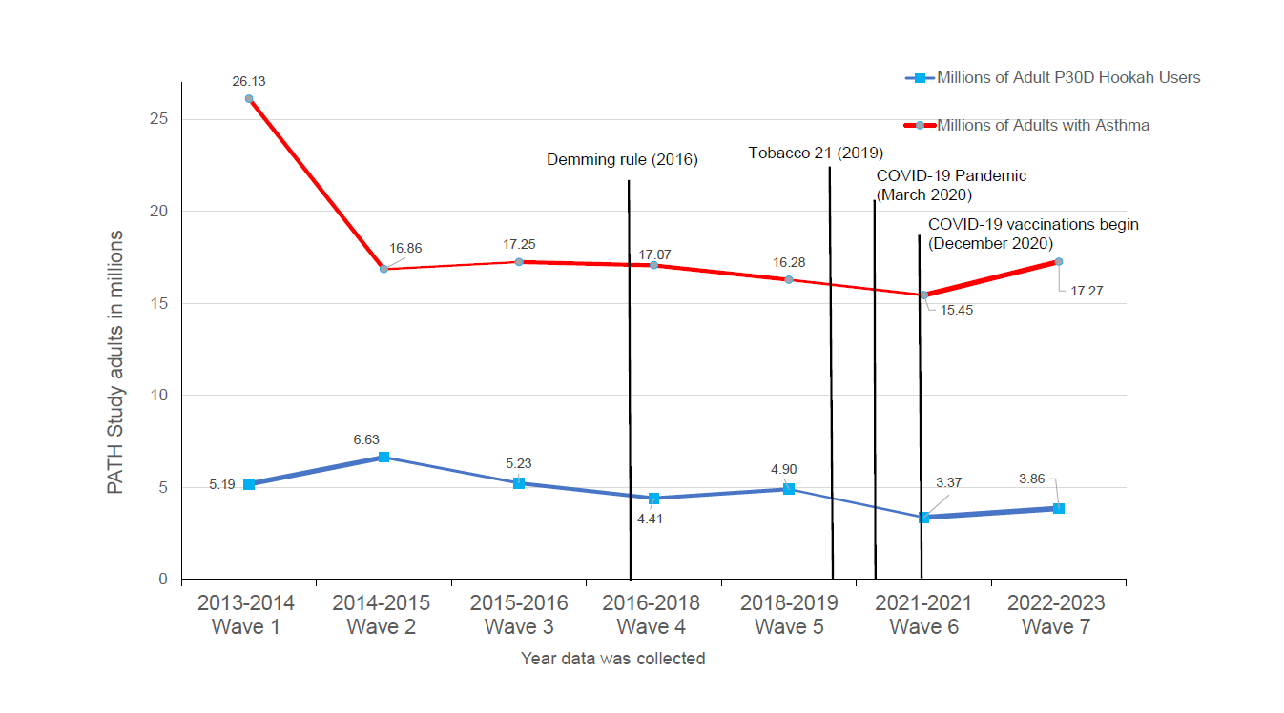
Prevalence of P30D Hookah use & Asthma Prevalence among Adults in the PATH Study (2013-2023)

Slide 5
Public Health Significance and Objectives
Estimating the effect of hookah use among never-cigarette users on the age of asthma onset is paramount to protect public health, educate the public, and provide evidence to the Food Drug Administration(FDA) and tobacco regulatory science.
Aim:
To explore the association between the average length of hookah sessions and the age of asthma onset after controlling for other risk factors.

Slide 6
Methods
The PATH Study uses a complex design that requires base and 100 balance repeated replicate weights to obtain variance estimates.
Adults (>18 years) participants who were never users of cigarettes, any type of cigars, electronic cigarettes, smokeless tobacco, and asthma-free upon entry were included.
The PATH Study does not disclose the DOB of participants.
The lower age bound estimated the age at the last wave where participants did not report asthma. The upper age bound estimated the age at the wave that participants reported asthma incidence.
The effect of the average length of hookah session on the age of asthma onset was estimated using weighted interval-censoring-Cox regression with cubic splines (3 knots) as the baseline hazard function.
Sampling weights of the first wave of PATH participation were used.

Slide 7
Variance estimation for complex surveys
Techniques available for this estimation within complex surveys include: Replicated Sampling, Balanced Repeated Replication, Jackknife Repeated Replication, the Taylor Series Method
To facilitate the variance calculation TWO UNITS are selected as a set of replicated subsamples (paired selection design) from each stratum from where the design was made.
The variance between two units is one-half of the squared difference between them. The sample is made into random groups to form replicates (pseudo-replication).
Using Fay’s method one-half of the samples will be weighted down by a factor 𝜖=0.3 and the other-half is weighted up by a compensating factor 2 − 𝜖.

Slide 8
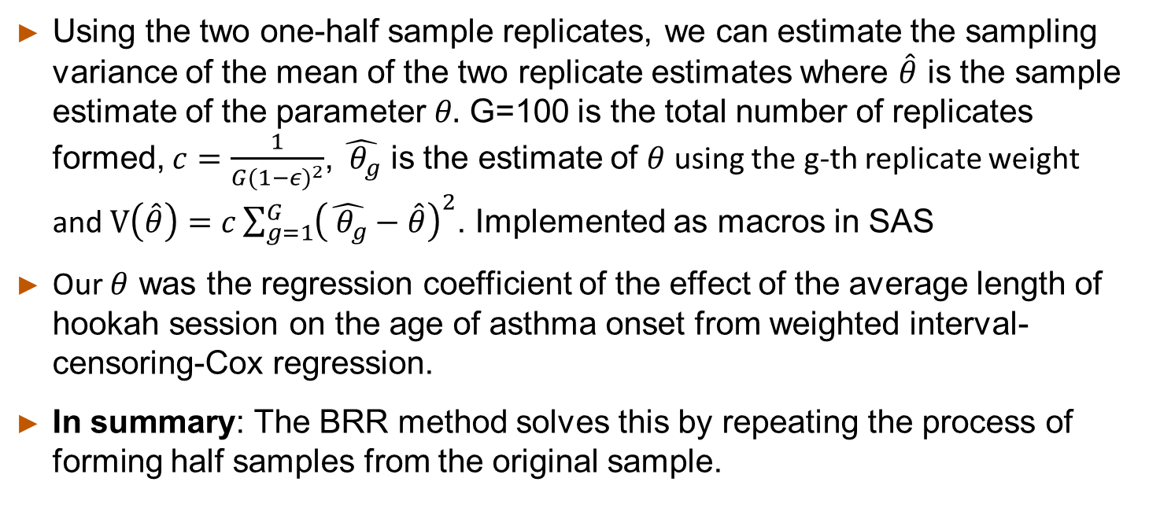
Balanced Repeated Replication (BRR) (Cont.)
Using the two one-half sample replicates, we can estimate the sampling variance of the mean of the two replicate estimates where $\hat{θ}$ is the sample estimate of the parameter $θ.$ G=100 is the total number of replicates formed, $c=\frac{1}{G{(1−ε)}^{2}}$, $\hat{{ θ}_{g}}$ is the estimate of $θ$ using the g-th replicate weight and $V\left(\hat{θ}\right)=c\sum_{g=1}^{G}{{\left(\hat{{ θ}_{g}}−\hat{θ}\right)}^{2}}$. Implemented as macros in SAS
Our $θ$ was the regression coefficient of the effect of the average length of hookah session on the age of asthma onset from weighted interval-censoring-Cox regression.
In summary: The BRR method solves this by repeating the process of forming half samples from the original sample.

Slide 9
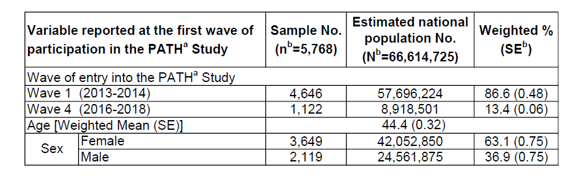
Results Table 1: Demographic characteristics of adults who were asthma-free, never used: cigarettes, cigars, ENDS, or smokeless tobacco at the first wave of participation in the PATHª Study
a. The restricted file received disclosure to publish: 12/06/2023-01/18/2024. United States Department of Health and Human Services. National Institutes of Health. National Institute on Drug Abuse, and United States Department of Health and Human Services. Food and Drug Administration. Center for Tobacco Products. Population Assessment of Tobacco and Health (PATH) Study [United States] Restricted-Use Files. Inter-university Consortium for Political and Social Research [distributor], 2023-05-19. https://doi.org/10.3886/ICPSR36231.v36.
b. Other included non-Hispanic Asian, multiracial, and any other race or ethnicity not otherwise specified.

Slide 10
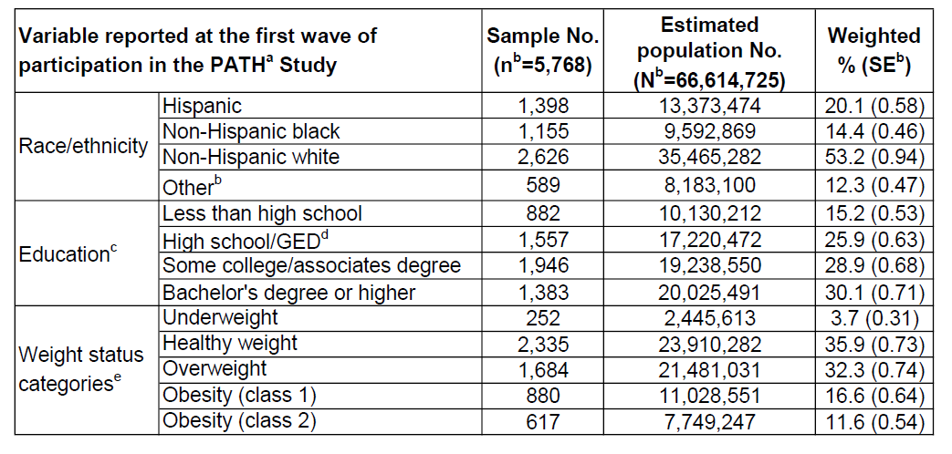
Table 2: Race, Education & Weight Categories among adults who were asthma-free, never used: cigarettes, cigars, ENDS, or smokeless tobacco at the first wave of participation in the PATHª Study
a. The restricted file received disclosure to publish: 12/06/2023-01/18/2024. United States Department of Health and Human Services. National Institutes of Health. National Institute on Drug Abuse, and United States Department of Health and Human Services. Food and Drug Administration. Center for Tobacco Products. Population Assessment of Tobacco and Health (PATH) Study [United States] Restricted-Use Files. Inter-university Consortium for Political and Social Research [distributor], 2023-05-19. https://doi.org/10.3886/ICPSR36231.v36.
b. Other included Non-Hispanic Asian, multiracial, and any other race or ethnicity not otherwise specified.
c. Highest level of education attained by participants.
d. GED: General Educational Development Test.
e. Adult body mass index (BMI) was calculated as weight in kilograms divided by height in meters squared. Adults with a BMI score less than 18.5 were classified as underweight, 18.5 to 25 as healthy weight, 25 to 30 as overweight, 30 to 35 as obesity class 1, and greater than 35 as obesity class 2.

Slide 11
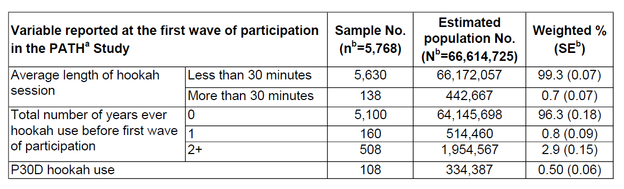
Table 3: Hookah session among adults who were asthma-free, never used: cigarettes, cigars, ENDS, or smokeless tobacco at the first wave of participation in the PATHª Study
a. The restricted file received disclosure to publish: 12/06/2023-01/18/2024. United States Department of Health and Human Services. National Institutes of Health. National Institute on Drug Abuse, and United States Department of Health and Human Services. Food and Drug Administration. Center for Tobacco Products. Population Assessment of Tobacco and Health (PATH) Study [United States] Restricted-Use Files. Inter-university Consortium for Political and Social Research [distributor], 2023-05-19. https://doi.org/10.3886/ICPSR36231.v36.
b. Other included non-Hispanic Asian, multiracial, and any other race or ethnicity not otherwise specified.

Slide 12
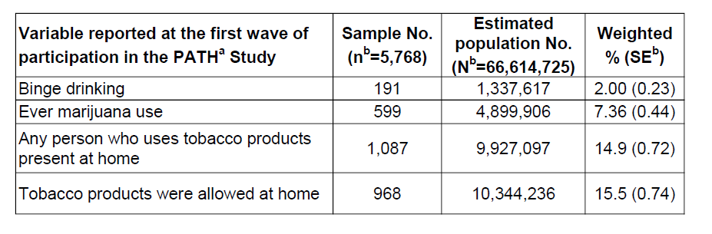
Table 5: Rules at home, Used Hookah in the P30D, Binge Drinking, Marijuana, among adults who were asthma-free, never used: cigarettes, cigars, ENDS, or smokeless tobacco at the first wave of participation in the PATHª Study
a. The restricted file received disclosure to publish: 12/06/2023-01/18/2024. United States Department of Health and Human Services. National Institutes of Health. National Institute on Drug Abuse, and United States Department of Health and Human Services. Food and Drug Administration. Center for Tobacco Products. Population Assessment of Tobacco and Health (PATH) Study [United States] Restricted-Use Files. Inter-university Consortium for Political and Social Research [distributor], 2023-05-19. https://doi.org/10.3886/ICPSR36231.v36.
b. Other included non-Hispanic Asian, multiracial, and any other race or ethnicity not otherwise specified.

Slide 13
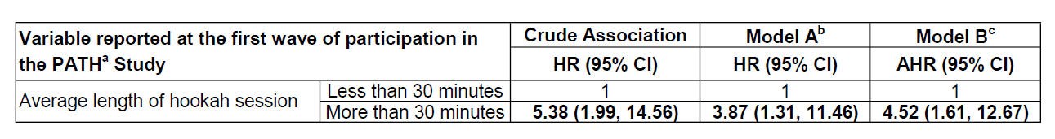
Table 5: Association of average length of hookah session with the age of asthma onset among adults who were asthma-free, never used: cigarettes, cigars, ENDS, or smokeless tobacco at the first wave of participation in the PATHª Study (2013-2021)
Adults (>18 years old) who reported an average length of hookah session of more than 30 minutes had a 352% increase risk in the onset of asthma at earlier ages in comparison to adults who do not use hookah or the average of hookah sessions is <30 minutes (HR: 4.52, 95%CI: 1.61-12.67).
The restricted file received disclosure to publish: 12/07/2023-12/13/2023. United States Department of Health and Human Services. National Institutes of Health. National Institute on Drug Abuse, and United States Department of Health and Human Services. Food and Drug Administration. Center for Tobacco Products. Population Assessment of Tobacco and Health (PATH) Study [United States] Restricted-Use Files. Inter-university Consortium for Political and Social Research [distributor], 2023-05-19. https://doi.org/10.3886/ICPSR36231.v36.
Model A controls for: sex, race/ethnicity, education, weight status categories, binge drinking, ever marijuana use, other household members reported tobacco product use, and rules at home about tobacco products.
Model B controls for sex, race/ethnicity, education, weight status categories, and ever marijuana use

Slide 14
Conclusions
Implementing interval-censoring Cox regression models with balance repeated replicate weights was feasible.
Although, adult (>18 years) participants who were asthma-free and who never used: cigarettes, any type of cigar, ENDS, and smokeless tobacco, were around 66.6 million, the majority (99.5%) did not report past 30-day hookah use at the first weight of participation, 3.7% reported more than 1 year of hookah use before the first wave of participation, and over 440k adults reported the average of hookah session before asthma onset to be more than 30 minutes.
The association between 30 minutes and more as the average length of hookah sessions and the age of asthma onset remained significant after controlling for risk factors.
Knowing the potential risk of earlier asthma onset due to the average length of hookah sessions may prevent people from initiating use or motivate users to quit.

Slide 15
References
Centers for Disease Control and Prevention, Smoking and Tobacco Use. Hookahs. 2021; https://www.cdc.gov/tobacco/data_statistics/fact_sheets/tobacco_industry/hookahs/index.htm. Accessed 08/01/2024.
Cornelius ME, Wang TW, Jamal A, Loretan CG, LJ. N. Tobacco Product Use Among Adults – United States, 2019. MMWR Morbidity and Mortality Weekly Report. 2020;69:1736-1742.
Stanton CA, Sharma E, Seaman EL, et al. Initiation of any tobacco and five tobacco products across 3 years among youth, young adults and adults in the USA: findings from the PATH Study Waves 1-3 (2013-2016). Tobacco control. 2020;29(Suppl 3):s178-s190.
The restricted file received disclosure to publish: 12/07/2023-07/31/2024.United States Department of Health and Human Services. National Institutes of Health. National Institute on Drug Abuse, and United States Department of Health and Human Services. Food and Drug Administration. Center for Tobacco Products. Population Assessment of Tobacco and Health (PATH) Study [United States] Restricted-Use Files. Inter-university Consortium for Political and Social Research [distributor], 2023-05-19. https://doi.org/10.3886/ICPSR36231.v36.

